Slide 1
Education Handbook

Slide 2
TODAY’s Objectives
Understand your roles and responsibilities
Learn procedures, policies and tools
Discover ways to produce quality education events
Access the Chapter Leader Resources Page
Notes:
Today, we’re going to go over your role and responsibility as VP of Education as well as how the following areas may affect your chapter work over the next 18 months:
Chapter demographics
Using survey data and needs assessments
Your 12-month calendar and educational strategy
Event policies
Educational formats
Audiovisual tips
Site selection
Speaker selection
Event marketing

Slide 3
Role & Responsibilities
Maintain and update your Chapters’ 18- to 24-month calendar of activities that includes a minimum of 6 educational opportunities
Design, secure speakers and manage program registration and other logistics
Take the lead on special educational projects (e.g., regional events, CMP Prep courses, GMID)
Be fiscally responsible
Help plan the board’s 3-year strategic vision
Pass on your knowledge and mentor others
Notes:
As a VP of Education, this is what MPI expects of you:
You will maintain and update an 24-month calendar of activities that includes a minimum of six educational opportunities
You will design the educational programs, secure the speakers and manage the program logistics, including registration and site selection
When there are special educational projects, for example CMP prep courses or Global Meetings Industry Day, you will take the educational lead. Depending on your chapter structure, you may partner with Special Events to produce these.
Be fiscally responsible to work within your chapter’s budget to produce these educational programs
Help plan the chapter board’s three-year strategic vision
Pass on your knowledge to others and help mentor and develop your chapter’s next generation of leaders.

Slide 4
Event Policies: What’s Required
Talk to your chapter president or administrator to secure a copy of your chapter policy manual
Understand who is responsible for signing contracts and managing the process of clock-hour filing (if it’s in the budget and what is required for metrics)
Identify who’s managing sponsorships for events and tracking fulfillment
Notes:
Talk to your chapter president or administrator to secure a copy of your chapter policy manual that is supposed to incorporate global minimums
Also in your local chapter policy manual should be information about responsibilities. Make sure you understand who is responsible for signing contracts, managing the EIC clock-hour filing (and that it’s in the budget), managing sponsorships for events.
Global has specific education policies
Nonmember event attendance policy (can attend no more than 2 events without joining MPI)
Minimum 6 education events
Event attendance pricing policy

Slide 5
Chapter Demographics
Who are your chapter members?
Where are they geographically concentrated?
What is your planner to supplier ratio?
What industries do they represent?
How many are novice vs. managerial vs. executive level?
What are they interested in?
What keeps them up at night?
Why do they choose to come to your events or stay home?
What do they want out of MPI membership?
Notes:
Demographics tell the story of your chapter members and are an essential tool you can use to create the most relevant and engaging educational programs possible.
Here are some questions you can ask the VP of Membership or your chapter administrator that will help you understand your audience:
Who are your chapter members?
Where are they geographically concentrated
What is your planner to supplier ratio?
What industries do they represent?
How many are students or novice versus managerial versus operating at the executive level?
What are they interested in learning?
What keeps them up at night?
Why do they choose to come to your events or stay home?
What do they want out of their MPI Membership?
If you want people to come to your educational events, you have to deliver relevant, engaging content in a place and at a time that works for them. Honing in on the demographics of your group will give you a good place to start from. But you may need additional data from surveys and conducting a needs assessment of your membership to get the fullest picture of what your audience enjoys, what it wants and needs, and how you can deliver on that promise with your educational programming.

Slide 6
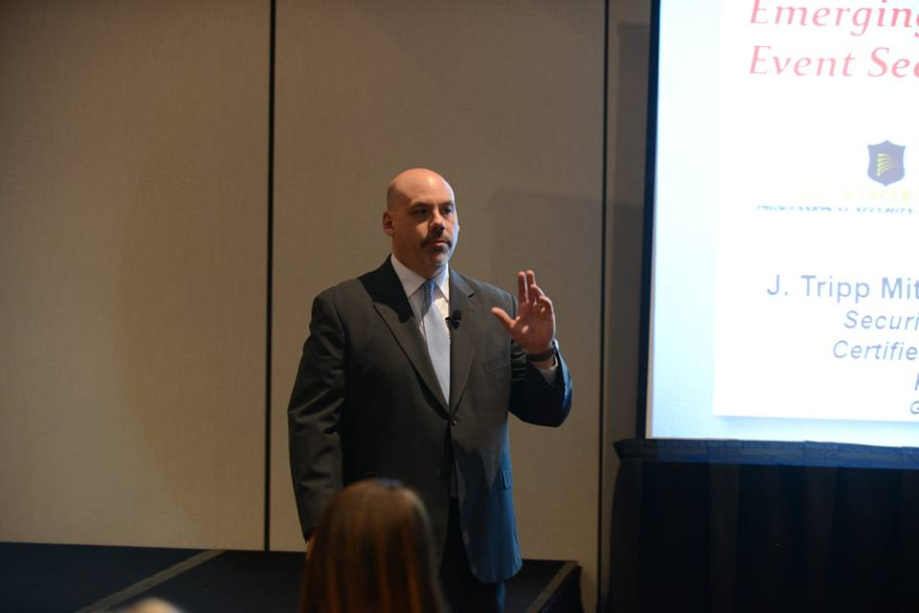
Look at Historical Data & headlines
Ask yourself:
What do my members like/avoid?
What do they need to know in today’s economy?
How can I help them future-proof their careers?
What would appeal to people who have been in the industry for more than 10 years?
Example: A chapter enjoyed Tripp Mitchell’s presentation on Emergency Preparedness so much, he came back to do a series of workshops the following year
Notes:
The secret to happy, engaged audiences is knowing what they want and giving them more of it. If there is a topic or speaker that was popular in the past, consider bringing them back and either putting a new spin on the educational experience or digging deeper into the topic.
For example, a popular lecture last year, might be a good topic to tackle as a hands-on workshop or solutions room session this year. Or a popular speaker may come back as a facilitator or to teach about a different topic this year.

Slide 7
Gain credit for your content
Get content approved:
By the EIC for the CMP Preferred Provider Program: http://www.eventscouncil.org/
You want to have certification available for at least 50% of your educational events. And virtual events can count, too!
Notes:
You want to have clock hours available for at least 50% of your educational events. And virtual events can count, too!

Slide 8
Strike a balance
Look for programs that meet both member groups’ needs
Appeal to seasoned members as mentors, forum facilitators, panel members and “featured experts”
Don’t underestimate the value of peer-to-peer problem-solving & idea exchanges
Notes:
One of the biggest challenges is striking a balance between planners needs and suppliers needs from an educational perspective.
If you don’t want to have to program two concurrents every educational event, think about forums or workshops or other peer-to-peer opportunities you can create where they can learn from each other, discuss hot-button issues and work on improving the planner-supplier relationship.
Another challenge is keeping your senior executive-level members engaged. One way to keep them connected is to engage them to act as mentors and educational leaders. If they’re not great facilitators or educators, then maybe they would be good on a panel or as a featured expert. Peer-to-peer educational formats or topics that will help them adapt to new trends also appeal to more advanced-level learners. And if you program for advanced level learners, you will also attract more novice individuals who want to learn from them.

Slide 9
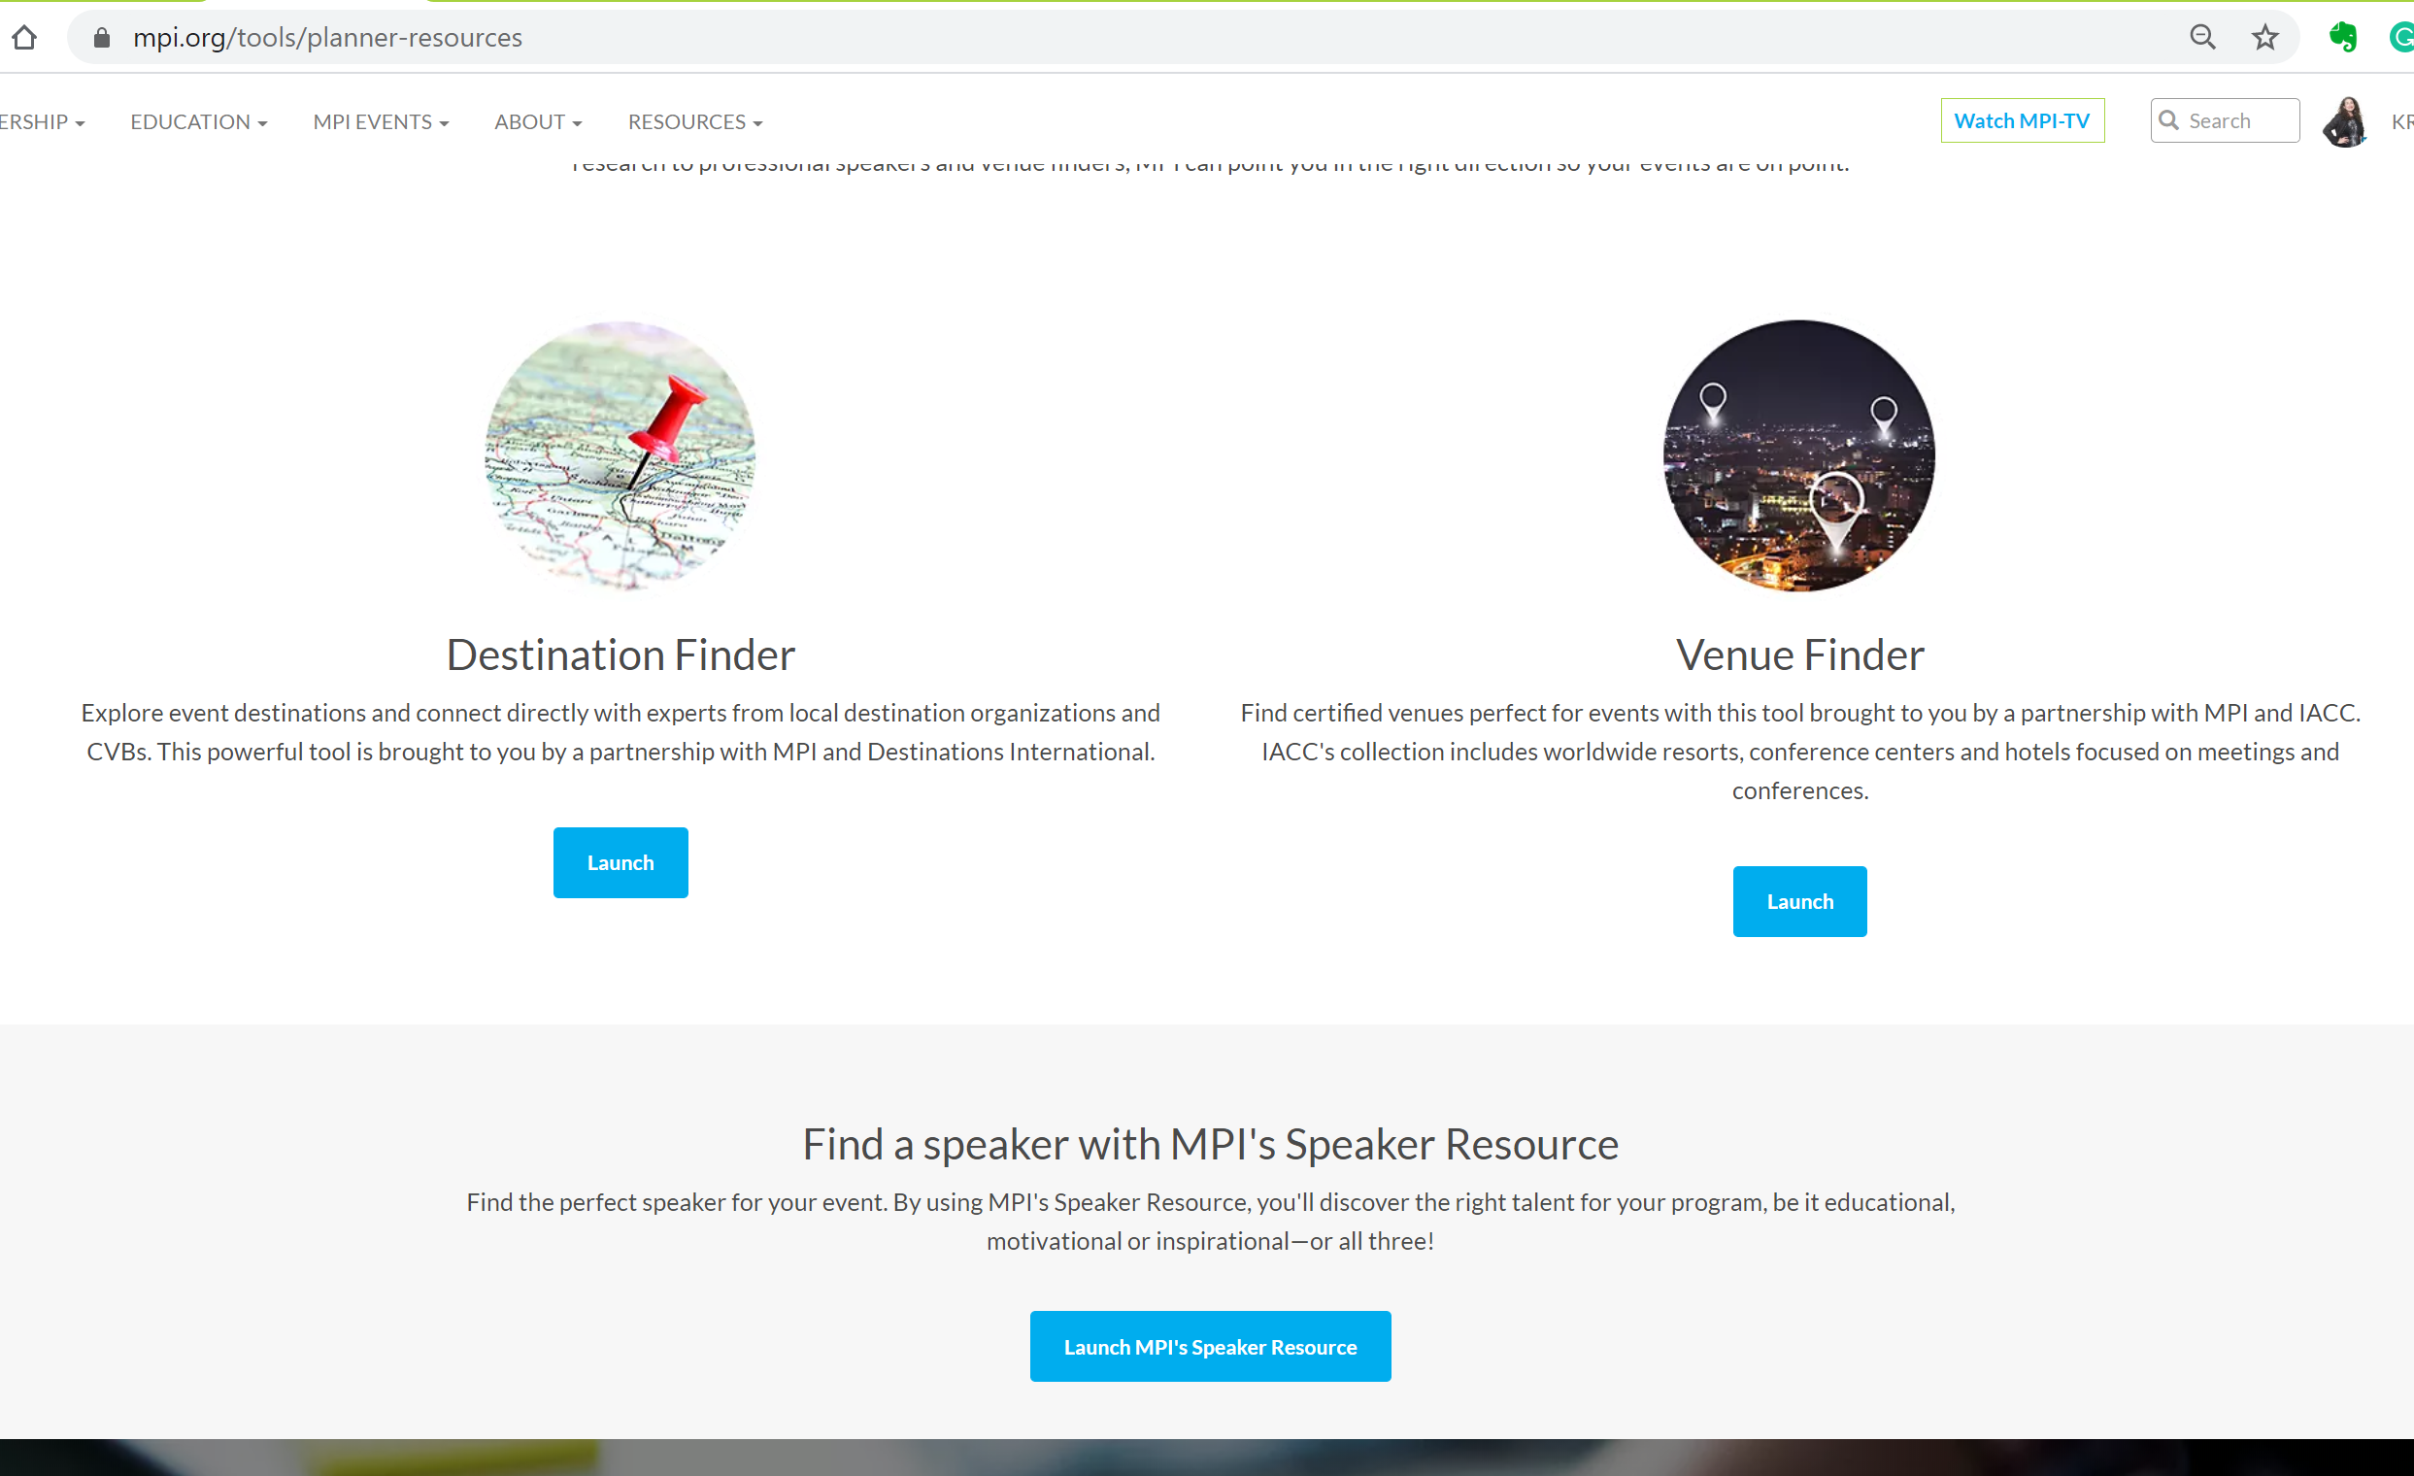
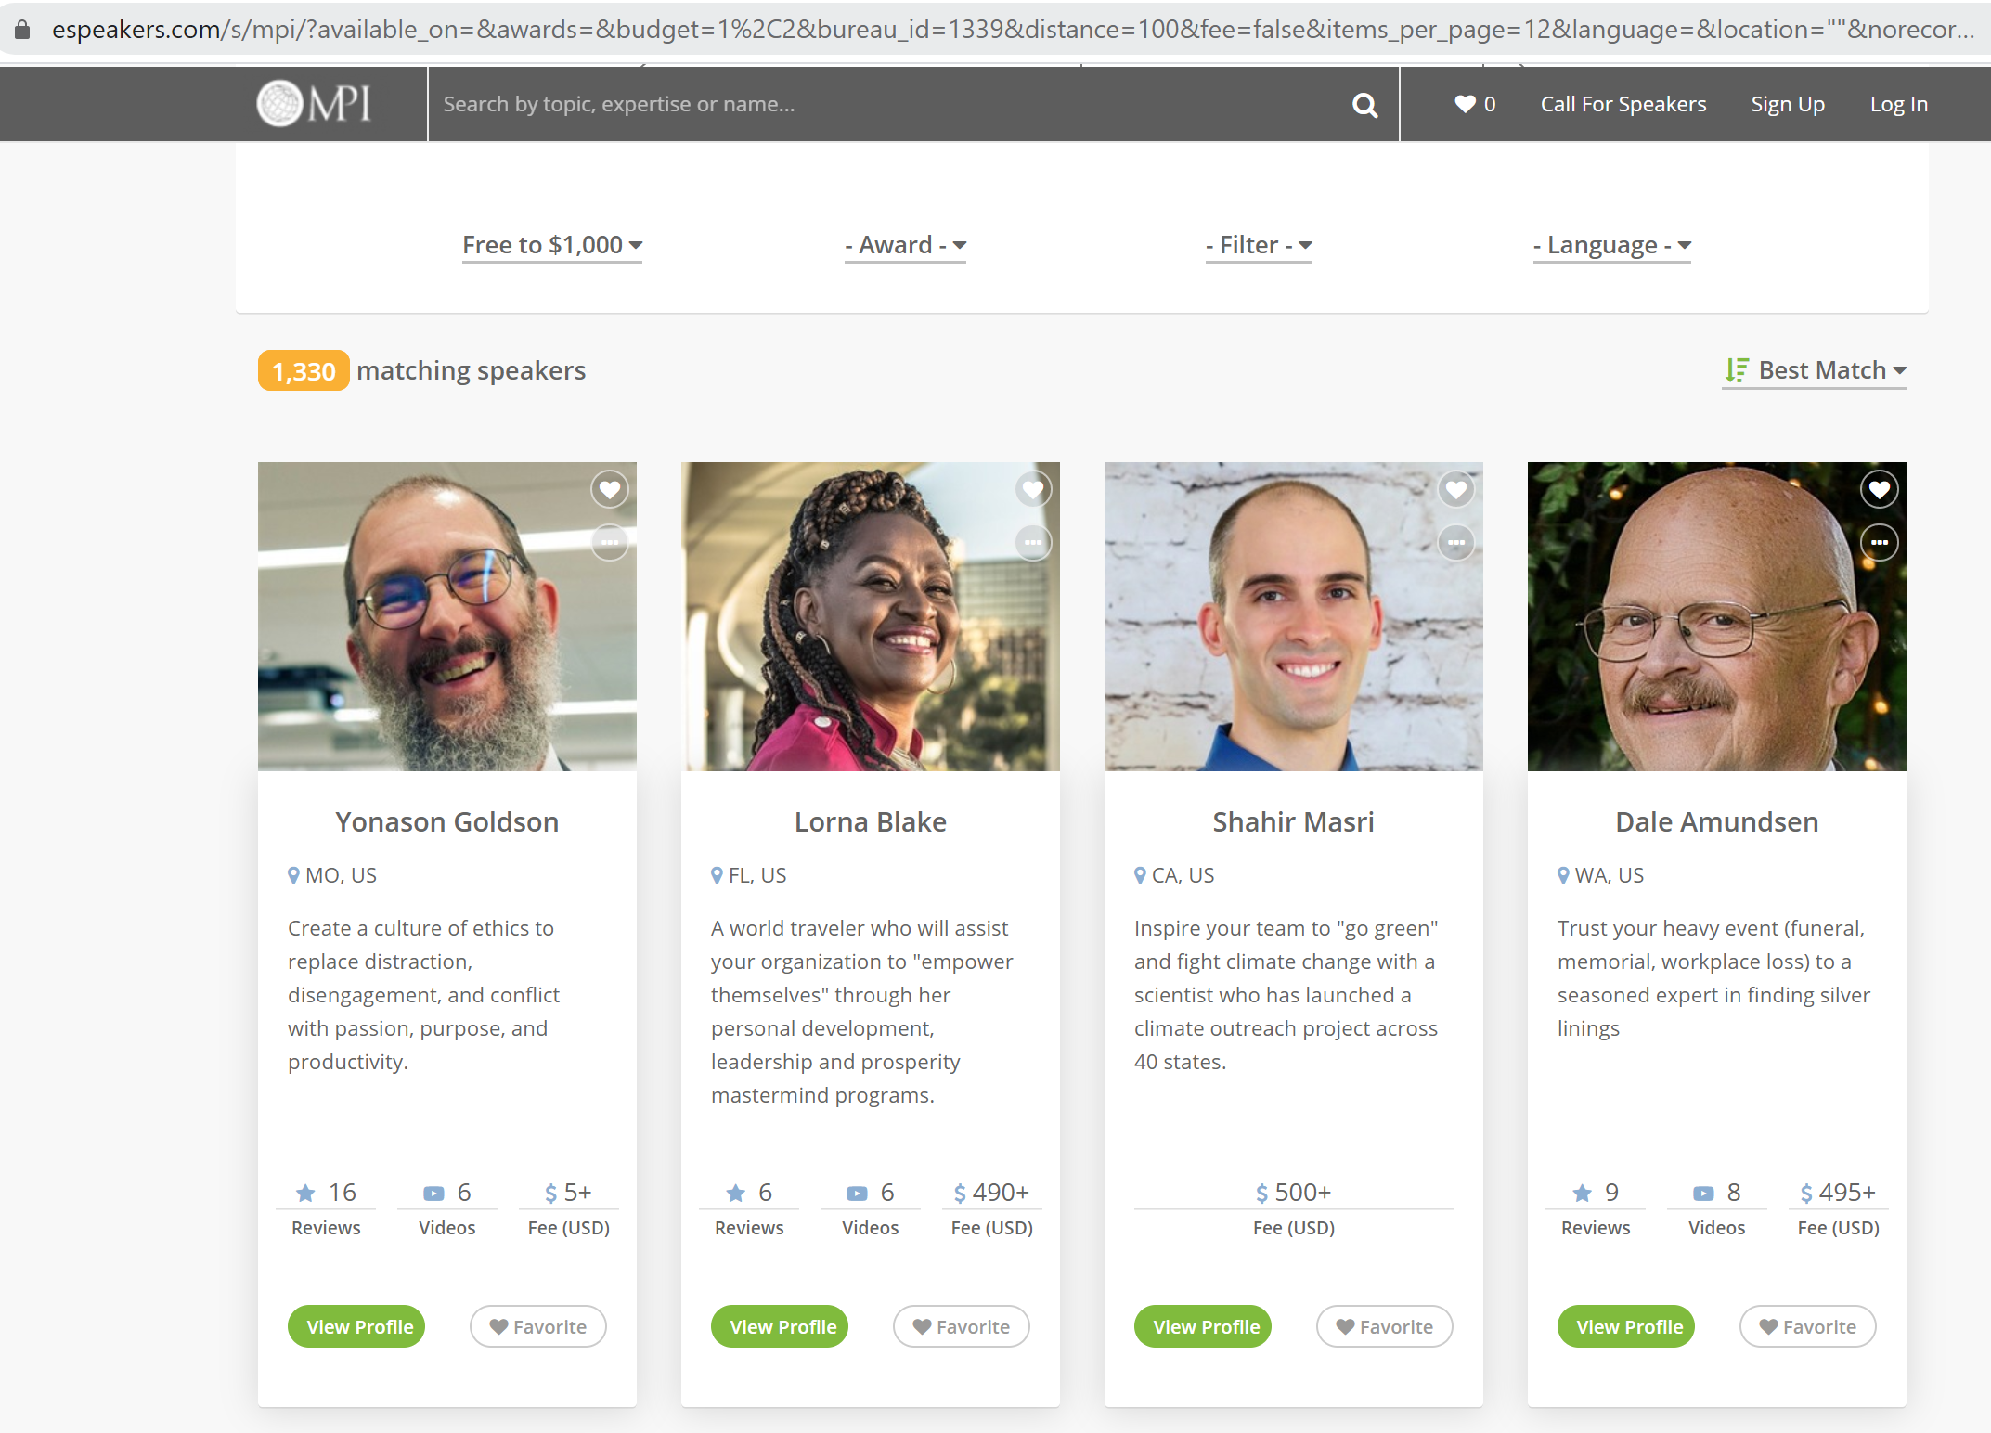
ESPEAKERS
Notes:
Espeakers is a great resource to find speakers

Slide 10
Speaker Selection Tips
Survey your membership about what they want to learn and who they’d like to see
Ask other VPs of Education about programs their membership loved
Ask MPI Academy about top-ranked WEC, EMEC and IMEX speakers & topics
Use survey and demographic data to create your call for proposals and ask members to distribute as well as post on your website
See who’s in your backyard
Look at other industry events
Use MPI’s speaker resources
Notes:
Here are some speaker selection tips:
Survey your membership about what they want to learn and who they’d like to see
Ask other VPs of Education about programs their membership loved
Ask MPI Academy about top-ranked WEC, EMEC and IMEX speakers & topics
Use survey and demographic data to create your call for proposals and ask members to distribute as well as post on your website
See who’s in your backyard
Look at other industry events
Use MPI’s Speaker Resource: https://www.espeakers.com/s/mpi/v3#/search

Slide 11
Planner AND Supplier Discussions
Venue booking best practices
What are planners looking for from their partners and vice versa. (Do they use CVBs, Do they use Cvent, how are they sourcing?)
Determining DMC financial stability as a partner.
Costs to meeting planners due to COVID (hotel rates, fees)
With significantly reduced financial resources at the DMO level, how will planners re-act to limited resources for financial assistance from their DMO partners?
How have venues changed post pandemic (studios, procedures, options)
Notes:
Work with your VP of Communications to create 6-8 week marketing plans for each event. Look at every communication you can leverage.
Ask speakers to contribute blogs, post on social media channels and do video promos and 2-minute recaps that you can use before, during and after the event to engage your audience.
Make sure you have an event hashtag and links to your social channels prominently displayed on your website, email invitations and other event collateral.

Slide 12
Unique Session Formats
Knowledge share
Fishbowl
Pods
Problem solving sessions
Mock trials
Competitions
Live games
Networking lounge
Game show with panel of experts
Ask the expert
Speed networking
Fireside chats
Ted Talks
Spectrogram used for panelists
Pecha kucha/Ignite
Behind the scenes of the hybrid option
Walking tour
Notes:
Work with your VP of Communications to create 6-8 week marketing plans for each event. Look at every communication you can leverage.
Ask speakers to contribute blogs, post on social media channels and do video promos and 2-minute recaps that you can use before, during and after the event to engage your audience.
Make sure you have an event hashtag and links to your social channels prominently displayed on your website, email invitations and other event collateral.

Slide 13
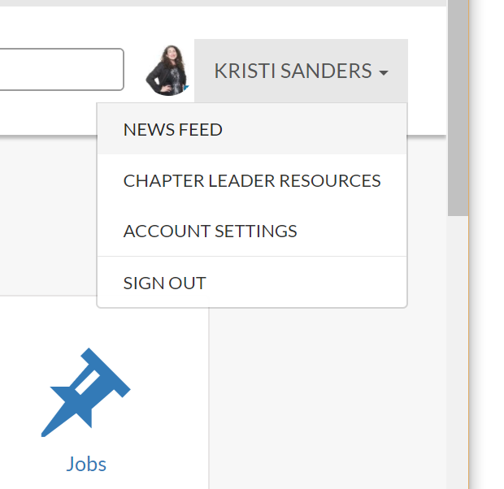
Chapter Leaders Resource Page (CLRP)
Go to mpiweb.org and log in.
Go to the drop-down menu by your name and select “Chapter Leader Resources”
Select “Education”
Download what you need
Plus: Read your monthly Chapter Leaders Newsletter & tune into VP of Education calls!
Notes:
The CLRP (Chapter Leaders Resource Page is a library or useful resources. Check it out!

Slide 14
Education Handbook

