Slide 1

FINANCE & CHAPTER ADMINISTRATOR HANDBOOK

Slide 2

There’s a LOT to Know…
Finance Roles & Responsibilities
Sponsorship Roles & Responsibilities
Understand Accounting Platform
Review Cash Analysis Tool
Budgeting and Forecasting
Working with the Chapter Administrator
Transfer/Assign Account Signatures
Accounts and Signature Cards
Comprehend Insurance Requirements and Policies
Review Taxes/CPA/Timely Filings
Evaluate Sponsorship Prospectus
Sponsorship Fulfillment
Contract Review and Approvals
Signing checks
Deadlines required
Financial Policies and Reporting
Audits and Annual Reviews
Protecting your Chapter’s assets
Financial Reporting Tools
Fiduciary responsibilities
Fundraising and Silent Auctions
Special Events
Committee Engagement and Management
Chapter Best Practices
CLRP & LMS
2

Slide 3


But there also are a LOT of Resources and Support available to you
Office of the President
Three fellow board members who have “Been There” and “Done That” when it comes to
managing the chapter’s financial resources. Lean
on them for guidance and support
Chapter Administrator
Paid staff who has access to historical financial records and supports the OOP and VP of Finance as needed
3
MPI Global
Your Regional Council, Regional Operations Manager and Chapter Facilitator can also provide additional resources and share best practices

Slide 4


CHAPTER FINANCE 101
Purpose, Roles & Responsibilities
Leadership Transition
Chapter Financial Platform
Required Financial Reporting
Cash versus Accrual Accounting
Understanding Financial Statements
Cash Flow and Reserves
4

Slide 5
Role of VP & Director of Finance
The VP of Finance responsibilities include the following:
The Director of Finance responsibilities include the following:
Management | Leadership Skills
Strategic Planning: work with the board to create and execute a 3-Year Strategic Plan and Annual Business Plan Advise, support and develop board of directors in executing initiatives Assist in chapter budget development and fiscal planning Target future leaders within existing board, committees and membership Schedule transition time with incoming VP’s | Facilitation Collaboration Delegation Mentoring Coaching Teaching Financial Motivational Conflict/Resolution ⁵ Execution
Processes | Leadership Skills
Execute strategies to support the chapter’s business plan Contribute to a marketing plan Set goals and objectives for the team Develop team budget based on line items in overall chapter budget Educate team members regarding Committee Chair Responsibilities Target future leadership within committee Schedule transition time with incoming Committee Chair | Collaboration Delegation Managerial Financial Coaching Teaching Execution

Slide 6
Finance Roles & Responsibilities
Meet/exceed all budgetary financial expectations
Prepare annual operating budget and ensure compliance once approved by the Board
Manage/supervise chapter financial efforts
Review the Chapter Policy Manual
Maintain proper accounting procedures for receipt and handling of funds, financial records, and paying authorized invoices
Prepare annual operating budget
Ensure chapter is incorporated according to chapter minimum bylaws
Ensure safekeeping of chapter funds in such banks, trust companies, and/or investments as approved by the BOD
Comply with all governmental tax regulations
6
Present up-to-date financial statements at each Board of Directors’ meeting
Renew all permits and authorized post office boxes, if any

Slide 7

Leadership
Responsibilities
Term:
All VP & Director roles are one year terms as defined by the Chapter Bylaws.
On-Boarding Responsibilities
Attend role transition without going board members/meetings etc.
Complete Your Board Service Training
Role Specific Training for Finance
Review all bylaws and polies, make note of any associated to your role specifically
Your chapters annual review is conducted within 60 days of the c⁷lose of the previous year, if this is available review it to make note of any key items.
Ensure the proper and complete transition of files and records, including the
permanent records from the outgoing VP Finance. Ask about any missing records immediately.
Work with the outgoing VP Finance to secure the signatures of new officers authorized
to sign checks, and filing the signature cards with the bank.

Slide 8



Finance Leadership Transition
Preparing for Success
ALIGNMENT WITH THE CHAPTER
CULTIVATE CHAPTER CULTURE
STRENGTHEN MEMBER TIES

Slide 9
Finance Leadership Transition
Preparing for Success
SAMPLE VP Finance Transition Document
Incoming VP Finance |  | Phone |  | Email
Current VP Finance |  | Phone |  | Email
Review of role, responsibilities and leadership attributes.
Strategic Goals and Objectives of this position and the supporting committees:
Successful Processes which should be continued:
Challenges Faced by the VP Finance and Executive Committee:
Action Items/Pending Issues:
Recommendations of ways to support or streamline current challenges and pending issues:
Predecessor to provide the following supporting documents:
Support Committee chairs list with contact information
Description of all programs/initiatives that were planned by the reporting committees including any vendors/sponsors that were used
Copies of all meeting notices or marketing materials
Any other materials that you feel would be helpful to the new board position

Slide 10

Chapter Financial Platform
QuickBooks
10

Slide 11
Questions & Answers
What are the goals of the chapter accounting platform?
  Provide chapters (and administrators) with best-in-class platform
  Enable chapter leaders to focus on creating exceptional experiences
at the chapter level.
  Ensure transparency and accuracy of financial accounting across the MPI enterprise
  Create and implement accounting standards & best practices
Are chapters required to utilize the accounting platform and associated guidelines/policies?
Yes, all chapters are required to participate in the platform and adhere to the guidelines and policies that will be provided. The platform is designed to support and protect chapters with their daily financial management and operations, ensuring strong governance and consistency with all chapter’s financial management.
Will chapters be required to use the MPI Chapter Chart of Accounts
provided with the migration?
Yes, the most current Common Chart of Accounts can always be found under the Finance section
on the Chapter Leader Resource Page. Global will maintain
the Common Chart of Accounts and collaborate with Chapters based
on new needs, updating as necessary.
What is a chart of accounts?
A chart of accounts (COA) is a financial, organizational tool that provides a complete listing of every account in an accounting system. An account is a unique record for each type of asset, liability, equity, revenue and expense.
Are all chapters required to meet the monthly close date of the 15th?
Yes, all chapters need to adhere to the same close date to ensure monthly reports
are processed in a timely fashion.
Will MPI Global be involved in any of my monthly financial processing or budgeting?
No, all chapters are responsible for the financial management of their chapter. MPI Global is only providing a safe and consistent platform and processes to ensure
strong financial oversight and operations at the chapter level. Chapters should
continue to practice fiduciary responsibility and management over all aspects of
their day-to-day chapter accounting.

Slide 12

FINANCIAL REPORTING
Monthly Written Report
Prepare and present a financial report every month, this may be done by your administrator but should be reviewed by you prior to release.
Submit copies to the President and Chapter Admin. Retain a copy for your records.
Normally this is done with your monthly board packet. If your board does bi-monthly board meetings a monthly closing P&L and
other associated financial report should be completed.
Annual Financial Review
It is recommended that the accounts of MPI chapters be reviewed or audited annually by a certified public accountant who shall be approved by the Board of Directors, and who shall provide a report for the Board of Directors as directed by the Board of Directors. A committee not associated with the normal finance activities may provide the review, however, MPI recommends a Certified Public Accountant.
Materials to Submit to Reviewer (Check with your accountant for a specific list)
A copy of the last financial review report, if available
Checkbook and canceled checks
Bank statements and deposit receipts
VP Finance book or ledger
The annual financial summary
Itemized statements and receipts of bills paid
Check requests
12
Copies of chapter minutes that would include an adopted budget, as well as any approved amendments
Current bylaws
Financial Review Procedures
Start the financial review with the records posted after the last review.
Check to see if the amount shown on the bank statement corresponds to the starting balance recorded in the checkbook and ledger.
Complete a sample test of transactions. The size of this sample should be based on the size of the chapter. (If mistakes are found, the
sample should be broadened to take in more transactions. It may be deemed necessary to review all the transactions of the chapter).
The chapter should consider retaining the services of an external auditor if nearly all of the transactions are reviewed due to errors or concerns regarding accuracy.

Slide 13

CASH VS. ACCRUAL ACCOUNTING
Cash Basis Accounting
Records income when cash is received and expenses when cash is paid out
Cash Basis – June Revenue: Registration Fees
$50.00 x 25 = $ 1,250.00
Expenses: Food and Beverage
$30.00 x 85 = $ 0.00
Net Profit $ 1,250.00
If you are unsure of your cash/accrual basis, ask your Chapter Administrator.
Accrual Basis Accounting
Records revenue when it is earned and expenses when they are owed
Accrual Basis – June
Revenue
Registration Fees
$40 x 50=
$50 x 25 =
$ 2,000.00
$ 1,250.00
Accounts Receivable $ 500.00 Total Revenue $ 3,750.00
Expenses
Food and Beverage
$30.00 x 85
$ 2,550.00
Net Profit
$ 1,200.00

Slide 14




UNDERSTANDING FINANCIAL STATEMENTS
BALANCE SHEET
Statement of Financial Position
PROFIT & LOSS
Statement of Activities
BUDGET vs. ACTUAL
Identifying Trends
14
CASH FLOW
Cash Flow Analysis Tool
CASH RESERVES
Presentations are tools that can be used as lectures, and more.

Slide 15
STATEMENT OF FINANCIAL POSITION
Assets
Liabilities and Equity
Current Assets Checking/Savings Accounts Certificates of Deposit Other Liquid Assets
Current Liabilities Other Liabilities Unearned Income Taxes Payable
Accounts Receivable
Equity
Other Current Assets Prepaid Expenses
Total Liabilities and Equity
Total Assets
The Statement of Financial Position is a ‘snapshot of the financial position of the chapter at a specified time, such a quarterly, semi-annually, or annually. At that specific time period, it shows total assets, liabilities, and Equities.

Slide 16
STATEMENT OF ACTIVITIES
What is a Profit and Loss Statement?
“A profit and loss statement (P&L) is a financial statement that summarizes the revenues, costs and expenses incurred during a specific period of time, usually a fiscal quarter or year”
Source: https://www.investopedia.com/terms/p/plstatement.asp
“A chart of accounts (COA) is a listing of each account a company owns, along with the account type and account b₁a₆ lance, shown in the order the accounts appear in the company’s financial statements. “Chart of accounts” is the official accounting term for the display of this information, which includes both balance- sheet accounts and income-statement accounts.”
Source: https://www.investopedia.com/terms/c/chart-accounts.asp

Slide 17
PROFIT AND LOSS STATEMENT
Revenue
Chapter Dues
Education Events Special Events Silent Auction
Co-Located Events (i.e. GMID) Advertising Revenue
Expenses
Administrative Expenses Committee Expenses
Subaccounts for each
Committee Events Expenses
Subaccounts for each
Event
Total Revenue – Total Expenses = Net Profit

Slide 18

CASH FLOW STATEMENT
The cash flow statement (CFS) measures how well the Chapter manages its cash position, meaning how well it generates cash to pay its debt obligations and fund its operating expenses.
18

Slide 19

CASH RESERVES
Retained Earnings are a part of Chapter’s net income and are appropriated for a specific purpose.
According to the Chapter Policy Manual Article VI, Section 3.1 defines Reserves as “funds set aside to be used in emergency cases.”

Slide 20
CASH ANALYSIS TOOL EXAMPLE
Chapter Cash Flow Analysis
Operating Cash from Last Statement 3/31/20
$ 18,853.43 Does not include seed money and profits from GMID and Jingle/Mingle. There are also GMID registrations that need to be refunded or otherwise dealt with
$ 134,551.78
Reserves from Last Statement
Forecast/Actual April Operating Revenue
May
June
July
August
September
October
November
December
Operating Expenses Profit/Loss
$20,948.11
$3,807.41
$17,140.70
$2,997.37
$15,143.38
-$12,146.01
$0.00
$4,580.00
-$4,580.00
$0.00
$6,168.00
-$6,168.00
$0.00
$3,768.00
-$3,768.00
$0.00
$4,308.00
-$4,308.00
$0.00
$4,858.00
-$4,858.00
$0.00
$3,958.00
-$3,958.00
$0.00
$3,958.00
-$3,958.00
Rebates on 120 day freeze from May
Plans are for rebates to begin again in August
Cash Flow $43,211.45
Transfers from Reserves
Change in Reserves $7,217.32
New Reserves $141,769.10
$39,540.67
$44,960.67
$38,792.67
$35,024.67
$40,716.67
$35,858.67
$31,900.67
$37,942.67
$8,475.23
$10,000.00
$10,000.00
$10,000.00
$0.00
$0.00
$0.00
$0.00
$0.00
$0.00
$0.00
$150,244.33
$140,244.33
$140,244.33
$140,244.33
$130,244.33
$130,244.33
$130,244.33
$120,244.33
Cash Flow
$50,000.00
$45,000. 00
$40,000. 00
$35,000.00
$30,000. 00
$25,000. 00
$20,000.00
$15,000. 00
$10,000. 00
$5,000.00
$43,211.45
$44,960.67
$40,716.67
$39,540.67
$38,792.67
$35,024.67
$35,858.67
$37,942.67
$31,900.67
20
$0.00
1
2
3
4
5
6
7
8
9
Instructions:
The operating account cash number (highlighted in green) can be pulled from Quickbooks after reconciling with your bank statement. Be sure to pull your report is on a "cash basis."
The opening Reserves number (also highlighted in green) should match the closing balance on your March bank statement.
Forecast your revenue and expenses through December (line by line) taking into consideration anticipated lost revenue and cost saving measures. Enter the totals by month in the yellow highlighted area. The profit/loss line and cash flow line will automatically populate. The cash flow chart will begin to take shape.
The Draw from Reserves line (highlighted in blue) allows you to forecast cash draws from reserves and pinpoints the timing when reserves are needed. If your operating account starts to go cash negative, enter the amount you want to draw from reserves inside that month.
You can forecast your draw from reserves slowly and over multiple months. For example: you can draw from reserves in April and again in July.
When you see cash starting to build in your operating account, you can restore funds back into reserves by entering a negative number (example: -$5,000.)
New Reserves (line 16) keeps a running reserve balance as you draw and restore the reserve fund.

Slide 21
CHAPTER $$$$
Budgeting and Forecasting (WHY) Banking and Investments (HOW) Protecting Your Chapter’s Assets Compliance and Security Information Taxes and Annual Review
21

Slide 22
Budgeting and Forecasting (WHY)
Budgeting has three major aspects:
1. Forecasts income and expenses (predicts profitability
22
Acts as a decision-making tool
Serves to monitor chapter performance

Slide 23
Chapter Budgets
Developing & Approving the Budget
Effective budgeting includes consideration of the Chapter's stated goals and planned activities, as well as the financial needs to achieve
these. The budget should show the allocated expenditures for the year’s activities, as well as the funds on hand and the anticipated receipts. Expenditures should equal receipts.
Review the previous year’s budget and VP Finance reports to determine how well that budget met the Chapter’s needs.
Determine the projected financial requirements, taking into consideration the funds needed for the approved programs, projects and any leadership development.
Determine the sources of funds to meet these requirements.
Work with your Chapter Administrator and President to prepare a draft budget that reflects the above needs and the history of the chapter.
A monthly budget format is recommended.
Budget should be presented to the various VPs for input for their areas and needs. Then adjustments made as deemed appropriate.
Budget is typically reviewed by the incoming Board to ensure there is buy in and agreement. Current year Board will vote on the budget
prior to new term year.
Budget should be submitted to MPI Global by December 1 annually.
Amending the Budget
Since the budget is only an estimate of the planned expenditures for the year, it may be necessary to amend it. The budget may be amended by a vote of the Chapter Board.
Approval of Expenditures
If needs arise for funds that are not allocated in the budget during the year, a proposal from the requesting department needs to be submitted to the Board for consideration. The proposal should include a description of the project and needs associated. Amount of
funds requested; any details associated with the project that will assist the Board in making a decision. The submitting VP is responsible to
provide all necessary details to consider the proposal.

Slide 24
Banking and Investments (HOW)
Banking
What does your Policy Manual say about banking?
It is the Chapter’s responsibility to select its financial institutions
28
Ensure signature cards on chapter accounts are changed. There should ALWAYS be at least two
(2) signatures on ALL Chapter checks.
Investment accounts should not be solely under your Administrator’s name and should also require two (2) signatures for change.

Slide 25
Banking
Bank Accounts
All MPI Chapters must establish a bank account.
Opening a bank account requires the Chapter provide the bank with an IRS Employer Identification Number (EIN).
  Each domestic chapter is issued an EIN when it is created.
  Do not use an individual’s Social Security number to open an account.
All Chapters should have polices related to banking procedures
Who is authorized to change accounts
Who has access and can sign, how many signatures, etc.
Bank accounts are managed by the chapters and not MPI Global. It is the chapters responsibility to ensure secure management of all finances.
Savings Accounts
In planning the budget, it is not uncommon for chapters to have contingency savings accounts or other interest-bearing accounts for the following reasons:
Efficient management of funds (funds earn interest until the²⁹y are expended)
Reserves to be used as an emergency fund
Monies to finance unexpected (but approved) projects or programs
Reserve Fund
MPI chapters will maintain a minimum reserve of 6 – 8 months operating funds. Operating funds will be defined as annual fixed expenses plus 20%. This timeframe is to be a minimum as it is recognized that external events in the industry, significant downturn in the economy
or stock market could make a longer commitment necessary.

Slide 26
Banking – continued
Federal and State Requirements
501(c)(3)
All domestic MPI chapters are classified as tax-exempt 501(c)(3) under the
Internal Revenue Code. This means that chapters are able to accept contributions and provide donors with tax receipts. From time to time, MPI US chapters may be asked to provide proof of its 501c3 non-profit status. A copy of the letter can be provided by contacting your Regional Operations
Manager. They will work with the MPI Global team to provide documentation.
Form W-9
Chapters use this form to provide their tax identification number to entities that will pay them income during the tax year.
Annual 990 Income Tax Filing
On an annual basis, each MPI US chapter is required to file their 990 Income Tax
reports for the previous financial year.
Access to Reserves
The access of the “reserve” shall first be referred to
the Finance Committee for consideration. Final approval by a majority vote of the MPI Chapter Board of Directors is required.
Online Banking - Recommended Account Controls
There should be no more than two individuals as administrators of the account (typically the VP Finance and Chapter President).
Set user access levels by roles and responsibility.
Review user access regularly.
Remove user IDs as soon as a person resigns their position.
Set up alerts to notify persons of account activity.
Allow read-only access to individuals who should
be monitoring the bank account.

Slide 27
Credit Cards and Debit Cards
If your Chapter has a credit card and ATM/debit cards issued in the Chapter name, there must be strong internal controls in place to mitigate possible risks while also maintaining accurate record-keeping.
Best Practices
Have a credit card policy and/or procedures in place. These policies and/or procedures will vary by state regarding by whom and for what the credit card can be used, as well as cardholder responsibilities.
Do not apply for Chapter credit cards using an individual's Social Security number. Instead, use your Chapter's employer identification
number (EIN).
If a Chapter is unable to have a credit card issued under its EIN, then a Chapter member may use their own credit card to pay for a pre- approved chapter expense, and they should submit receipts via an expense report through the Chapter to receive reimbursement.
Under no circumstance should a Chapter directly pay a personal credit card bill that is registered to an individual member.
Get a credit card that will allow limits by user. Limits should be set by the Board.
Set up an approval process to make sure all credit card receipts are received and all charges have been approved.
Make sure that all expense reports are signed and dated by the cardholder as well as the designated approver.
Make sure there is a process in place to destroy or deactivate cards of volunteers who leave the Board.
Assign a person who does not have access to the MPI Chapter card to review receipts and reconcile them to the credit card/bank statements.

Slide 28
Protecting Your
Chapter’s Assets
What is PCI Compliance and why should I care? The Payment Card Industry Data Security Standard (PCI DSS) applies to companies of any size that accept
credit card payments. If your company intends to accept card payment, and store, process and transmit cardholder data, you need to host your data secu³r² ely with a PCI compliant hosting provider.
What is CEO Fraud and what steps to I need to take to guard against it?
CEO Fraud happens when cybercriminals impersonate
executives and trick other employees into executing unauthorized wire transfers or sending tax information.

Slide 29
COMPLIANCE AND SECURITY INFORMATION
About the PCI Data Security Standard
https://www.globalpaymentsinc.com/en-us/customer-center/customer-support/pci- data-security-standard
PCI Compliance Guide
https://www.pcicomplianceguide.org/faq/
CEO Fraud, aka Business Email Compromise
https://www.fbi.gov/news/stories/business-e-mail-compromise-on-the-rise

Slide 30



1
TAXES/ANNUAL REVIEW
Primary responsibility rests with the VP Finance; the Board of Directors is ultimately responsible
2
3
Office of the President responsibility is to ensure timely and accurate submissions
Where financially feasible, al3w4 ays use the services of a certified public accountant to prepare taxes. Benefits of using a CPA include their defense of any potential objection by the taxing agency in your country.

Slide 31
CHAPTER PARTNERSHIPS
Strategic Partnership Activation & Fulfillment Chapter Partnership Best Practices
35

Slide 32



Strategic Partnership Activation & Fulfillment
Building Growth and Success
ALIGNMENT WITH THE CHAPTER
Each Chapter is responsible for creating its own partnership strategies, including:
UTILIZE GLOBAL RESOURCES
Chapter Leader Resource Page (CLRP):
Access your Chapter Demographic Report which provides date on membership, demographics, and overall buying power
BUILDING MPI/PARTNER BRAND AWARENESS
Marketing strategies to build engagement and support thorough chapter communications
Research current funding, partnership, and investment trends and topics pertinent to the chapter
Chapter Website
Social Media Channels
Event Sponsorship
Chapter Newsletters
Chapter Email Communications
MPI Foundation:
Maintain up-to-date information on Chapter Grants available through MPI Global and its Foundation
Managing/updating Chapter partnership documents for fulfillment, RFP processes, and in-kind value and tracking

Slide 33
Sponsorship
Chapter Web Revenue Share Program
Chapter Sponsorship Sales Consultation
MPI Global Sales Resources for Chapters

Slide 34
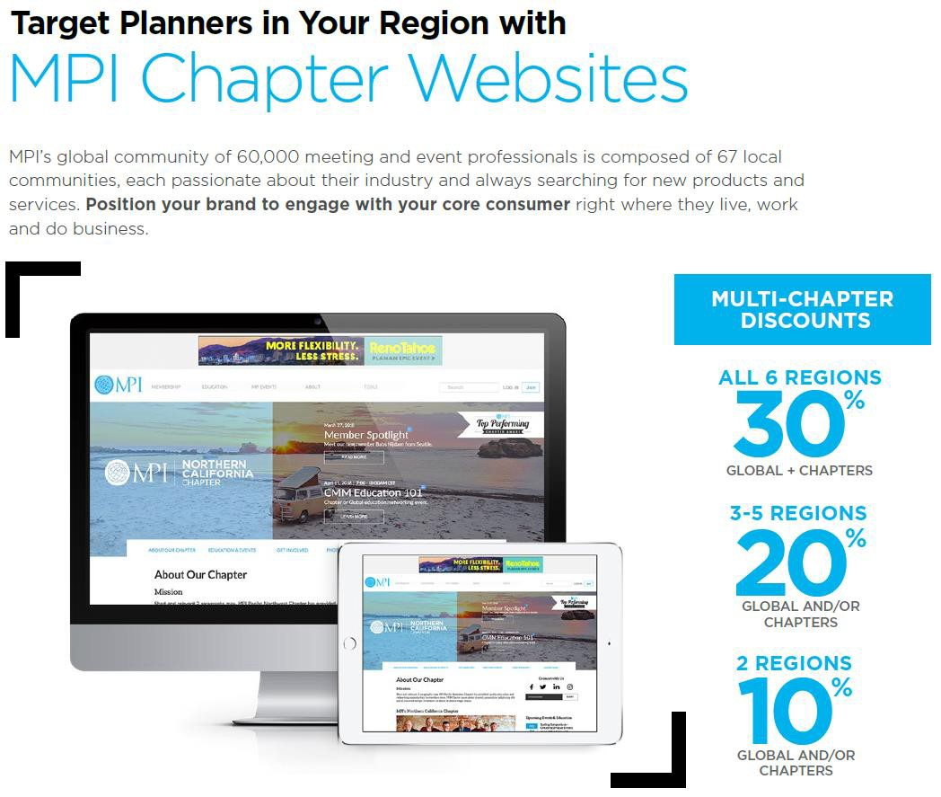
Chapter Web Sponsorships

Slide 35
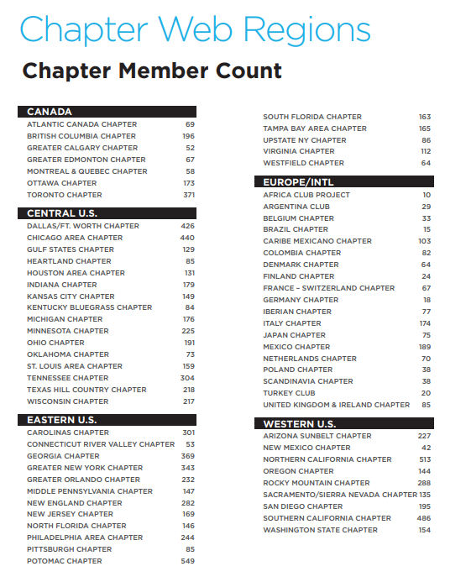

Slide 36
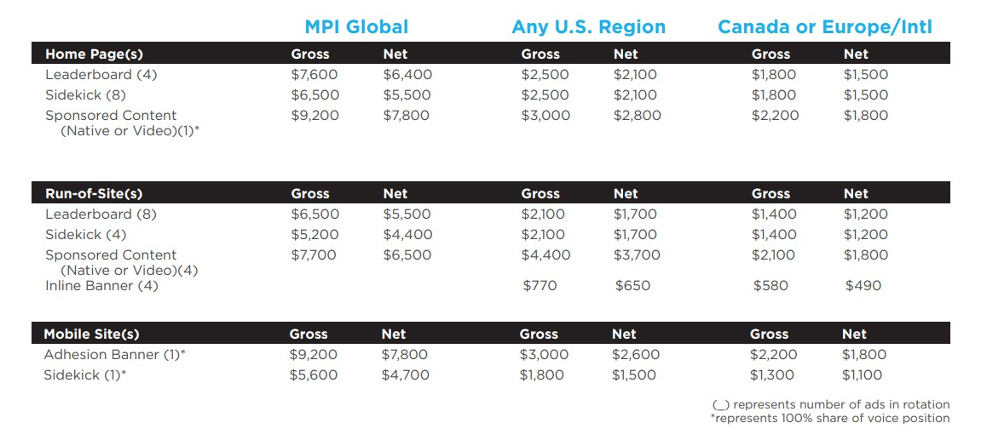

Slide 37
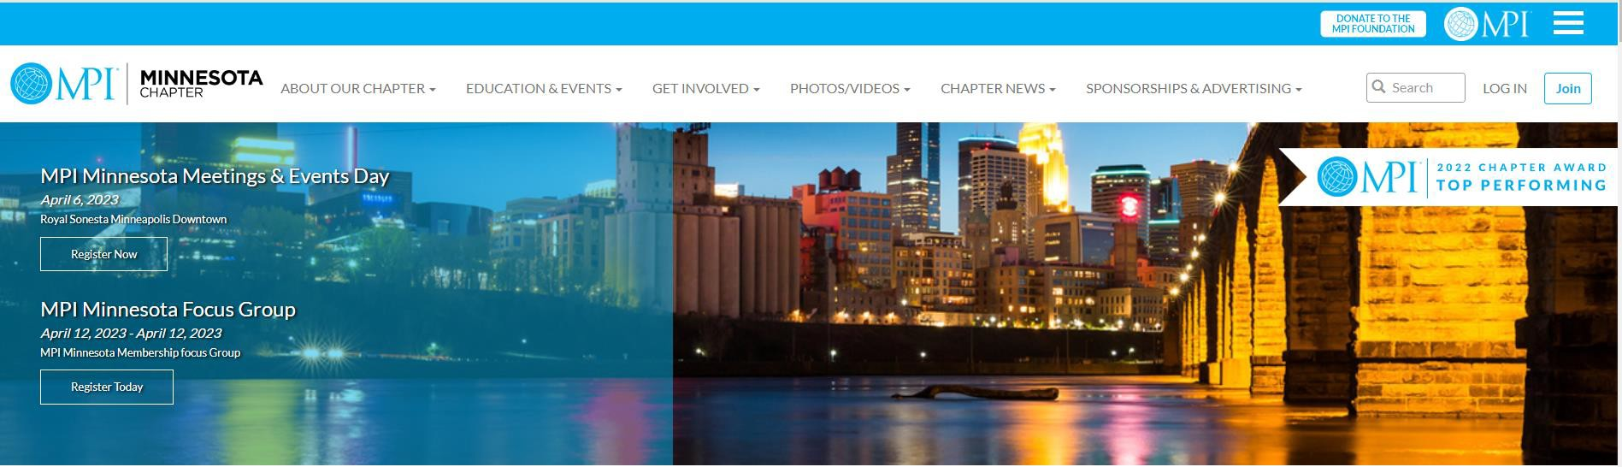
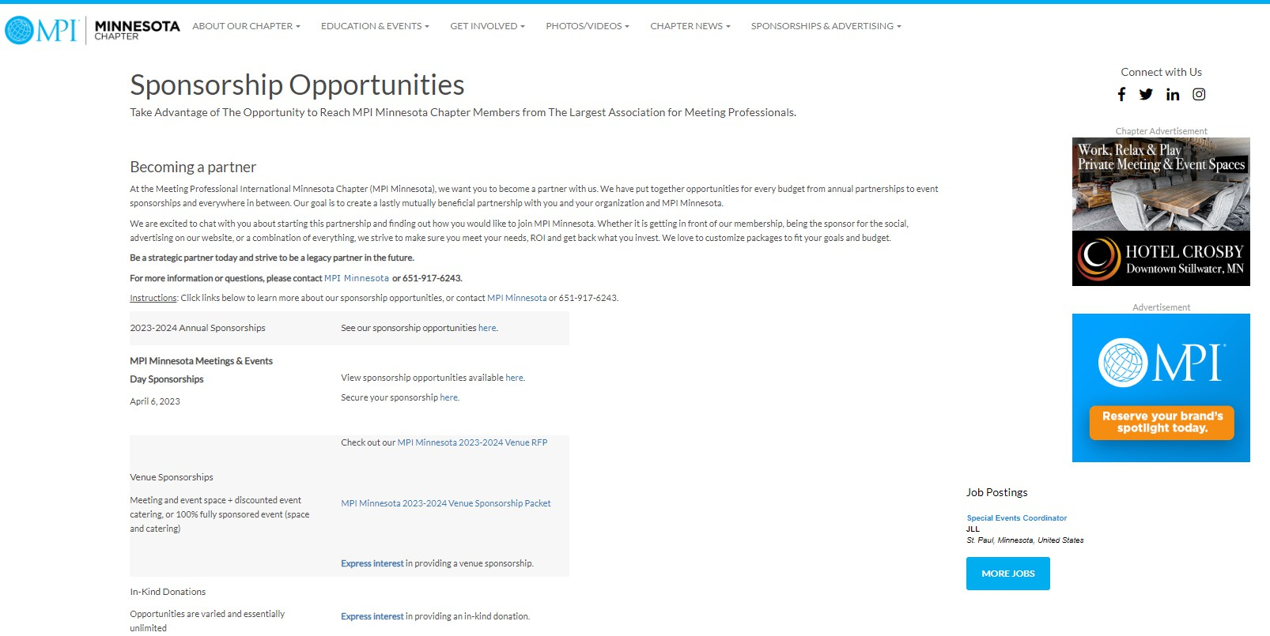

Slide 38
Chapter Partnership Best Practices
Lots of great ideas and approaches among Chapters. Here’s some of our favorites:
Partnership RFPs
MPI DFW Cash Sponsorship Form
MPI DFW In-Kind Sponsorship Form
MPI San Diego Sponsorship Opportunities
MPI Southern California Sponsorship Opportunities
MPI New Jersey MEETS Conference Sponsorship Kit
MPI Greater Orlando Sponsor Prospectus
MPI Orange County Partnership Prospectus
RISE Awards
Marketplace Achievement – MPI Southern California Online Ad Portal
Marketplace Achievement – MPI Mexico Planner Sponsored Tables
Marketplace Achievement – MPI Dallas/Fort Worth Sales Blitz
New Approaches
Affiliate Memberships: Bundles with other Chapters, targeted on geographic destination clusters, i.e. North Texas, Florida

Slide 39
SUPPORT & RESOURCES
Working with Your Chapter Administrator
Chapter Leaders Resource Page (CLRP) Chapter Support Framework
MPI Global Compliance Timelines Compliance and Security Information
43

Slide 40
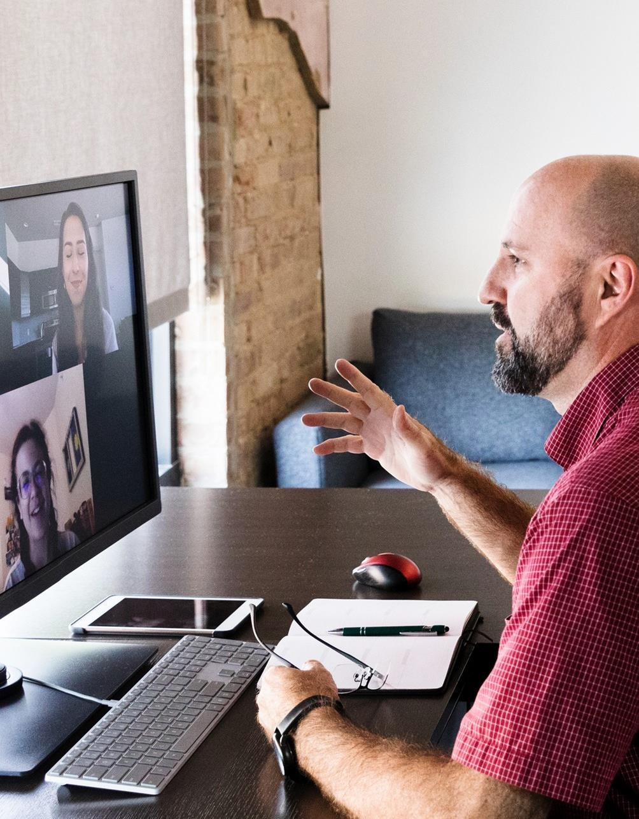
Working with your Chapter Administrator
The Chapter Administrator may be a paid vendor contracted by the chapter Board of Directors
Scope of Services – know your needs
Instruct Board on who does what (Chapter vs. Administrator)
Compensation determined and approved by Board
Annual Performance Review with Office of the President
Your Chapter Administrator is an important resource
and partner!

Slide 41
CHAPTER ADMINISTRATOR
Policies & Guidelines
01
Administrator is Managed by the Office of the President
02
Policies & Guidelines
Contracts include required langu₄a₅ ge provided
Business license and insurance

Slide 42


CHAPTER LEADERS RESOURCES
46

Slide 43
















CHAPTER SUPPORT FRAMEWORK
Programs
Platforms & Services
MPI Verified Facilitator Program
Chapter Leadership Summit
Websites
Accounting
Registration
Volunteer
Training
Chapter Shared Services
Regional Operations Managers
MPI Cares
Standards
Chapter Bylaws & Policies
Global Branding
Performance Metrics

Slide 44
FINANCE & CHAPTER ADMINISTRATOR HANDBOOK

