Slide 1

FINANCE & CHAPTER ADMINISTRATOR HANDBOOK

Slide 2

THERE’S A LOT TO KNOW…
Finance Roles & Responsibilities
Sponsorship Roles & Responsibilities
Understand Accounting Platform
Review Cash Analysis Tool
Budgeting and Forecasting
Working with the Chapter Administrator
Bank Accounts and Signature Cards
Review Taxes/CPA/Timely Filings
Contract Review and Approvals
Signing cheques
Financial Policies and Reporting
Audits and Annual Reviews
Protecting your Chapter’s assets
Financial Reporting Tools
Fiduciary responsibilities
Fundraising and Silent Auctions
Special Events
Chapter Best Practices
2

Slide 3


CHAPTER FINANCE 101
Purpose, Roles &Responsibilities
Leadership Transition
Chapter Financial Platform
Required Financial Reporting
Cash versus Accrual Accounting
Understanding Financial Statements
Cash Flow and Reserves
4

Slide 4
ROLE OF VP & DIRECTOR OF FINANCE
The VP of Finance responsibilities include the following:
The Director of Finance responsibilities include the following:
Management | Leadership Skills
Strategic Planning: work with the board to create and execute a 3-Year Strategic Plan and Annual Business Plan Advise, support and develop board of directors in executing initiatives Assist in Chapter budget development and fiscal planning Target future leaders within existing board, committees and membership Schedule transition time with incoming VP’s | Facilitation Collaboration Delegation Mentoring Coaching Teaching Financial Motivational Conflict/Resolution Execution
Processes | Leadership Skills
Execute strategies to support the Chapter’s business plan Contribute to a marketing plan Set goals and objectives for the team Develop team budget based on line items in overall Chapter budget Educate team members regarding Committee Chair responsibilities Target future leadership within committee Schedule transition time with incoming Committee Chair | Collaboration Delegation Managerial Financial Coaching Teaching Execution

Slide 5
FINANCE ROLES & RESPONSIBILITIES
Meet/exceed all budgetary financial expectations
Prepare annual operating budget and ensure compliance once approved by the Board
Manage/supervise Chapter financial efforts
Review the MPI Chapter Policy Manual
Maintain proper accounting procedures for receipt and handling of funds, financial records, and paying authorized invoices
Prepare annual operating budget
Ensure Chapter is incorporated according to MPI Chapter Bylaws
Ensure safekeeping of Chapter funds in such banks, trust companies, and/or investments as approved by the BOD
Comply with all governmental tax regulations
Present up-to-date financial statements at each Board of Directors’ meeting
Renew all permits and authorized post office boxes, if any

Slide 6

LEADERSHIP RESPONSIBILITIES
Term:
All VP & Director roles are one-year terms as defined by the MPI Chapter Bylaws
On-Boarding Responsibilities:
Attend board transition/onboarding meetings with outgoing board members
Complete Your Board Service Training
Role Specific Training for Finance

Slide 7
LEADERSHIP RESPONSIBILITIES (Cont.)
Review all bylaws and policies, make note of any specifically associated to your role
Your Chapter's annual review is conducted within 60 days (or according to local guidelines) of the close of the previous year. If this is available, review it to make note of any key items
Ensure the proper and complete transition of files and records, including the permanent records from the outgoing VP Finance. Ask about any missing records immediately
Work with the outgoing VP Finance to secure the signatures of new officers authorized to sign checks and file the signature cards with the bank

Slide 8



FINANCE LEADERSHIP TRANSITION
Preparing for Success
ALIGNMENT WITH THE CHAPTER
CULTIVATE CHAPTER CULTURE
STRENGTHEN MEMBER TIES

Slide 9
FINANCE LEADERSHIP TRANSITION
Preparing for Success
SAMPLE VP Finance Transition Document
Incoming VP Finance: |  | Phone: |  | Email:
Current VP Finance: |  | Phone: |  | Email:
Review of role, responsibilities and leadership attributes:
Strategic Goals and Objectives of this position and the supporting committees:
Successful Processes which should be continued:
Challenges Faced by the VP Finance and Executive Committee:
Action Items/Pending Issues:
Recommendations of ways to support or streamline current challenges and pending issues:
Predecessor to provide the following supporting documents:
Support Committee chairs list with contact information
Description of all programs/initiatives that were planned by the reporting committees including any vendors/sponsors that were used
Copies of all meeting notices or marketing materials
Any other materials that you feel would be helpful to the new board position

Slide 10

CHAPTER FINANCIAL PLATFORM
QUICKBOOKS ONLINE
10

Slide 11
FREQUENTLY ASKED QUESTIONS
What are the goals of the Chapter accounting platform, QuickBooks Online?
Provide Chapters (and administrators) with a best-in-class platform.
Enable Chapter leaders to focus on creating exceptional experiences at the Chapter level.
Ensure transparency and accuracy of financial accounting across the MPI enterprise.
Create and implement accounting standards and best practices.
Are Chapters required to utilize the accounting platform and associated policies/guidelines?
Yes, all Chapters are required to participate in the platform and adhere to the guidelines and policies that will be provided. The platform is designed to support and protect Chapters with their daily financial management and operations, ensuring strong governance and consistency with all Chapter’s financial management.
Are Chapters required to use the provided MPI Chapter Chart of Account?
Yes, the most current Common Chart of Accounts can always be found under the Finance section on the Chapter Leader Resource Page. MPI will maintain the Common Chart of Accounts and collaborate with Chapters based on new needs, updating, as necessary.

Slide 12
FREQUENTLY ASKED QUESTIONS (Cont.)
What is a Chart of Accounts?
A Chart of Accounts (COA) is a financial, organizational tool that provides a complete listing of every account in an accounting system. An account is a unique record for each type of asset, liability, equity, revenue and expense.
Are all Chapters required to meet the monthly close date of the 15th?
Yes, all Chapters need to adhere to the same close date to ensure monthly reports are processed in a timely fashion.
Will MPI be involved in any of my monthly financial processing or budgeting?
No, all Chapters are responsible for the financial management of their Chapter. MPI is only providing a safe and consistent platform and processes to ensure strong financial oversight and operations at the Chapter level. Chapters should continue to practice fiduciary responsibility and management over all aspects of their day-to-day chapter accounting.

Slide 13
FINANCIAL REPORTING
Monthly Written Report
Prepare and present a financial report every month, this may be done by your administrator but should be reviewed by you prior to release.
Submit copies to the President and Chapter Administrator and retain a copy for your records.
Normally this is done with your monthly board packet. If your board does bi-monthly board meetings a monthly closing P&L and other associated financial report should be completed.
Annual Financial Review
It is recommended that the accounts of MPI Chapters be reviewed or audited annually by a certified public accountant who shall be approved by the Board of Directors, and who shall provide a report for the Board of Directors as directed by the Board of Directors. A committee not associated with the normal finance activities may provide the review, however, MPI recommends a Certified Public Accountant.
12

Slide 14
FINANCIAL REPORTING (Cont.)
Materials to Submit to Reviewer (Check with your accountant for a specific list)
A copy of the last financial review report, if available
Checkbook and canceled checks
Bank statements and deposit receipts
VP Finance book or ledger
The annual financial summary
Itemized statements and receipts of bills paid
Check requests
Copies of Chapter minutes that would include an adopted budget, as well as any approved amendments
Current bylaws
Financial Review Procedures
Start the financial review with the records posted after the last review.
Check to see if the amount shown on the bank statement corresponds to the starting balance recorded in the checkbook and ledger.
Complete a sample test of transactions. The size of this sample should be based on the size of the Chapter. (If mistakes are found, the sample should be broadened to take in more transactions. It may be deemed necessary to review all the transactions).
The Chapter should consider retaining the services of an external auditor if nearly all the reviewed transactions have errors or there are concerns regarding accuracy.
12

Slide 15

CASH VS. ACCRUAL ACCOUNTING
Cash Basis Accounting
Records income when cash is received and expenses when cash is paid out
Cash Basis – June Revenue: Registration Fees
$50.00 x 25 = $ 1,250.00
Expenses: Food and Beverage
$30.00 x 85 = $ 0.00
Net Profit $ 1,250.00
If you are unsure of your cash/accrual basis, ask your Chapter Administrator.
Please note that MPI does not dictate which accounting model Chapters should use.
Accrual Basis Accounting
Records revenue when it is earned and expenses when they are owed
Accrual Basis – June
Revenue
Registration Fees
$40 x 50=
$50 x 25 =
$ 2,000.00
$ 1,250.00
Accounts Receivable $ 500.00 Total Revenue $ 3,750.00
Expenses
Food and Beverage
$30.00 x 85
$ 2,550.00
Net Profit
$ 1,200.00
Notes:
If you are unsure of your cash/accrual basis, ask your ROM or your Chapter Administrator. Also, the top left of your financial statements should reflect the basis for your accounting.

Slide 16




UNDERSTANDING FINANCIAL STATEMENTS
BALANCE SHEET
Statement of Financial Position
BUDGET vs. ACTUAL
Identifying Trends
PROFIT & LOSS
Statement of Activities
CASH FLOW
Cash Flow Analysis Tool
CASH RESERVES
Funds for emergency situations.
Notes:
MPI and the Chapters operates on a calendar year. A calendar year runs January through December, while a fiscal year runs for 12 months consistent with what is good for the business entity.

Slide 17
STATEMENT OF FINANCIAL POSITION
Assets
Liabilities and Equity
Current Assets Checking/Savings Accounts Certificates of Deposit Other Liquid Assets
Current Liabilities Other Liabilities Unearned Income Taxes Payable
Accounts Receivable
Equity
Other Current Assets Prepaid Expenses
Total Liabilities and Equity
Total Assets
The Statement of Financial Position is a snapshot of the financial position of the Chapter at a specified time, such as quarterly, semi-annually, or annually. At that specific point in time, it shows total assets, liabilities, and equities.

Slide 18
STATEMENT OF ACTIVITIES
What is a Profit and Loss Statement?
“A profit and loss statement (P&L) is a financial statement that summarizes the revenues, costs and expenses incurred during a specific period of time, usually a fiscal quarter or year”
Source: https://www.investopedia.com/terms/p/plstatement.asp
“A chart of accounts (COA) is a listing of each account a company owns, along with the account type and account b₁a₆ lance, shown in the order the accounts appear in the company’s financial statements. “Chart of accounts” is the official accounting term for the display of this information, which includes both balance- sheet accounts and income-statement accounts.”
Source: https://www.investopedia.com/terms/c/chart-accounts.asp

Slide 19

PROFIT AND LOSS STATEMENT
Revenue
Chapter Rebates/Dues
Education Events Special Events Fundraising Auction
Co-located Events (i.e. GMID) Advertising Revenue
Expenses
Administrative Expenses Committee Expenses
Sub-accounts for each Committee Events Expenses
Sub-accounts for each Event
Total Revenue – Total Expenses = Net Profit
Notes:
This slide shows a very simple list of possible items appearing on Chapter financial statements. Revenue less Expenses yields net profit (or loss) for whatever period the statement covers.

Slide 20

CASH FLOW STATEMENT
The cash flow statement (CFS) measures how well the Chapter manages its cash position, meaning how well it generates cash to pay its debt obligations and fund its operating expenses.
Notes:
The cash flow statement measures how well a company manages its cash position, meaning how well the company generates cash to pay its debt obligations and fund its operating expenses

Slide 21

CASH RESERVES
Retained Earnings are a part of Chapter’s net income and are appropriated for a specific purpose.
According to the MPI Chapter Policy Manual, Article VI Finance, Section 3 Reserve Fund, Item 3.1 Terms: the term Reserves for financial purposes will be defined as funds set aside to be used in emergency cases.
Notes:
The reason for a company to hold cash reserves is to have the necessary liquidity to meet the cost of all expected and unexpected costs in the short-run and to have cash on hand for potential investments.
Cash Reserves or Retained Earnings are a part of Chapter’s net income and are appropriated for a specific purpose.
The MPI Chapter Policy Manual, defines reserves as funds set aside to be used in emergency cases.

Slide 22
CASH ANALYSIS TOOL EXAMPLE
Chapter Cash Flow Analysis
Operating Cash from Last Statement 3/31/20
$ 18,853.43 Does not include seed money and profits from GMID and Jingle/Mingle. There are also GMID registrations that need to be refunded or otherwise dealt with
$ 134,551.78
Reserves from Last Statement
Forecast/Actual April Operating Revenue
May
June
July
August
September
October
November
December
Operating Expenses Profit/Loss
$20,948.11
$3,807.41
$17,140.70
$2,997.37
$15,143.38
-$12,146.01
$0.00
$4,580.00
-$4,580.00
$0.00
$6,168.00
-$6,168.00
$0.00
$3,768.00
-$3,768.00
$0.00
$4,308.00
-$4,308.00
$0.00
$4,858.00
-$4,858.00
$0.00
$3,958.00
-$3,958.00
$0.00
$3,958.00
-$3,958.00
Rebates on 120 day freeze from May
Plans are for rebates to begin again in August
Cash Flow $43,211.45
Transfers from Reserves
Change in Reserves $7,217.32
New Reserves $141,769.10
$39,540.67
$44,960.67
$38,792.67
$35,024.67
$40,716.67
$35,858.67
$31,900.67
$37,942.67
$8,475.23
$10,000.00
$10,000.00
$10,000.00
$0.00
$0.00
$0.00
$0.00
$0.00
$0.00
$0.00
$150,244.33
$140,244.33
$140,244.33
$140,244.33
$130,244.33
$130,244.33
$130,244.33
$120,244.33
Cash Flow
$50,000.00
$45,000. 00
$40,000. 00
$35,000.00
$30,000. 00
$25,000. 00
$20,000.00
$15,000. 00
$10,000. 00
$5,000.00
$43,211.45
$44,960.67
$40,716.67
$39,540.67
$38,792.67
$35,024.67
$35,858.67
$37,942.67
$31,900.67
20
$0.00
1
2
3
4
5
6
7
8
9
Instructions:
The operating account cash number (highlighted in green) can be pulled from Quickbooks after reconciling with your bank statement. Be sure to pull your report is on a "cash basis."
The opening Reserves number (also highlighted in green) should match the closing balance on your March bank statement.
Forecast your revenue and expenses through December (line by line) taking into consideration anticipated lost revenue and cost saving measures. Enter the totals by month in the yellow highlighted area. The profit/loss line and cash flow line will automatically populate. The cash flow chart will begin to take shape.
The Draw from Reserves line (highlighted in blue) allows you to forecast cash draws from reserves and pinpoints the timing when reserves are needed. If your operating account starts to go cash negative, enter the amount you want to draw from reserves inside that month.
You can forecast your draw from reserves slowly and over multiple months. For example: you can draw from reserves in April and again in July.
When you see cash starting to build in your operating account, you can restore funds back into reserves by entering a negative number (example: -$5,000.)
New Reserves (line 16) keeps a running reserve balance as you draw and restore the reserve fund.

Slide 23
CHAPTER $$$$
Budgeting and Forecasting (WHY)
Banking and Investments (HOW)
Protecting Your Chapter’s Assets
Compliance and Security
Information Taxes and Annual Review

Slide 24
BUDGETING AND FORECASTING (WHY)
Budgeting has three major aspects:
1. Forecasts income and expenses (predicts profitability)
Acts as a decision-making tool
Serves to monitor Chapter performance
Notes:
Budgets are excellent tools for not only allocating where revenue is anticipated but also what expenses are predicted. A budget is nothing more than an educated guess as to how the Chapter will perform during a given year. A rule of thumb is to budget revenue conservatively and expenses high. The reason for projecting expenses higher is so that any potential increases in rates or fees, i.e. postal mailing rate increases, printing increases and other factors that could influence a rate hike in normal expenses is anticipated. For example, if fuel costs increases, companies whose businesses are to delivery goods will either raise their rates or add a temporary fuel surcharge to their rates so that the end user is paying for the spike in fuel prices.

Slide 25
CHAPTER BUDGETS
Developing & Approving the Budget
Effective budgeting includes consideration of the Chapter's stated goals and planned activities, as well as the financial needs to achieve these. The budget should show the allocated expenditures for the year’s activities, as well as the funds on hand and the anticipated receipts. Expenditures should equal receipts.
Review the previous year’s budget and VP Finance reports to determine how well that budget met the Chapter’s needs.
Determine the projected financial requirements, taking into consideration the funds needed for the approved programs, projects and any leadership development.
Determine the sources of funds to meet these requirements.
Work with your Chapter Administrator and President to prepare a draft budget that reflects the above needs and the history of the Chapter.
A monthly budget format is recommended.
Budget should be presented to the various VPs for input for their areas and needs with adjustments made as deemed appropriate.
Budget is typically reviewed by the incoming Board to ensure there is buy-in and agreement. Current year Board will vote on the budget prior to new term year.
Budget should be submitted annually to MPI by December 1.

Slide 26

CHAPTER BUDGETS (Cont.)
Amending the Budget
Since the budget is only an estimate of the planned expenditures for the year, it may be necessary to amend it. The budget may be amended by a vote of the Chapter Board of Directors.
Approval of Expenditures
If needs arise for funds that are not allocated in the budget during the year, a proposal from the requesting department needs to be submitted to the Board for consideration. The proposal should include a description of the project and needs associated. The amount of funds requested, and any details associated with the project, will assist the Board in making a decision. The submitting VP is responsible for providing all necessary details for the proposal to be considered.

Slide 27
BANKING AND INVESTMENTS (HOW)
Banking
What does your MPI Chapter Policy Manual say about banking?
It is the Chapter’s responsibility to select its financial institutions.
Ensure signature cards on Chapter accounts are changed. There should ALWAYS be at least two (2) signatures on ALL Chapter checks.
Investment accounts should not be solely under your Administrator’s name and should also require two (2) signatures for change.
Notes:
A determination made by directors and/or management as to how, when, where and how much capital will be spent on investment opportunities. The decision often follows research to determine costs and returns for each option.

Slide 28
BANKING
Bank Accounts
All Chapters must establish a bank account.
Opening a bank account requires the US Chapters provide the bank with an IRS Employer Identification Number (EIN).
  Each domestic Chapter is issued an EIN when it is created.
  Do not use an individual’s Social Security number to open an account.
  International Chapters must follow local guidelines for non-profit organizations to open/manage bank accounts.
All Chapters should have polices related to banking procedures.
Who is authorized to change accounts.
Who has access and can sign, how many signatures, etc.
Bank accounts are managed by the Chapters and not MPI, and it is the Chapters' responsibility to ensure secure management of all finances.

Slide 29
BANKING (Cont.)
Savings Accounts
In planning the budget, it is not uncommon for Chapters to have contingency savings accounts or other interest-bearing accounts for the following reasons:
Efficient management of funds (funds earn interest until the are expended).
Reserves to be used as an emergency fund.
Monies to finance unexpected (but approved) projects or programs.
Reserve Fund
As per the MPI Chapter Policy Manual, Article VI Finance, Section 3 Reserve Fund, Item 3.2 Reserve Target: the reserve target shall be defined as a minimum of 25% of annual fixed expenses. This should not include any event-related expenses, only expenses needed to keep the Chapter operational. Best practice is to maintain 50-100% of annual fixed expenses.

Slide 30
BANKING (Cont.)
Access to Reserves
The access of the reserve shall first be referred to the VP of Finance for consideration. Final approval by a majority vote of the Board of Directors is required.
A resolution process must be followed to access the reserves as outlined in the CLRP > Finances > Budgeting.
Online Banking - Recommended Account Controls
There should be no more than two individuals as administrators of the account (typically the VP Finance and Chapter President).
Set user access levels by roles and responsibilities.
Review user access regularly.
Remove user IDs as soon as a person resigns from their position.
Set up alerts to notify persons of account activity.
Allow read-only access to individuals who should be monitoring the bank account.

Slide 31
BANKING (Cont.)
Federal and State Requirements
(for US Chapters only)
501(c)(3)
All US Chapters are classified as tax-exempt 501(c)(3) under the Internal Revenue Code. This means that Chapters are able to accept contributions and provide donors with tax receipts. From time to time, US Chapters may be asked to provide proof of its 501(c)(3) non-profit status. A copy of the Letter of Determination can be provided by contacting your Regional Operations Manager. They will work with the MPI team to provide the required documentation.
Form W-9
US Chapters use this form to provide their tax identification number to entities that will pay them income during the tax year.
Annual 990 Income Tax Filing
On an annual basis, each US Chapter is required to file their 990 Income Tax reports for the previous financial year.

Slide 32
CREDIT CARDS AND DEBIT CARDS
If your Chapter has a credit card and ATM/debit cards issued in the Chapter name, there must be strong internal controls in place to mitigate possible risks while also maintaining accurate record-keeping.
Best Practices
Have a credit card policy in place. These policies will vary by state regarding by whom and for what the credit card can be used, as well as cardholder responsibilities.
Do not apply for Chapter credit cards using an individual's Social Security number. Instead, use your Chapter's employer identification number (EIN). International Chapters must follow local guidelines for obtaining credit and/or debit cards.
If a Chapter is unable to have a credit card issued under its EIN, then a Chapter board member may use their own credit card to pay for a pre- approved Chapter expense, and they should submit receipts via an expense report through the Chapter to receive reimbursement.
Under no circumstance should a Chapter directly pay a personal credit card bill that is registered to an individual board member.

Slide 33

CREDIT CARDS AND DEBIT CARDS (Cont.)
Get a credit card that will allow limits by user. Limits should be set by the Board of Directors.
Set up an approval process to make sure all credit card receipts are received and all charges have been approved.
Make sure that all expense reports are signed and dated by the cardholder as well as the designated approver.
Make sure there is a process in place to destroy or deactivate cards of volunteers who leave the Board.
Assign a person who does not have access to the Chapter card to review receipts and reconcile them to the credit card/bank statements.

Slide 34
PROTECTING YOUR CHAPTER’S ASSETS
What is PCI Compliance and why should I care?
The Payment Card Industry Data Security Standard (PCI DSS) applies to companies of any size that accept
credit card payments. If your Chapter intends to accept card payment, and store, process and transmit cardholder data, you need to host your data secu³r² ely with a PCI compliant hosting provider.
What is CEO Fraud and what steps to I need to take to guard against it?
CEO Fraud happens when cybercriminals impersonate
executives and trick other employees into executing unauthorized wire transfers or sending tax information.
Notes:
The Payment Card Industry is an international organization that regulates billions of transactions daily and provides security guidelines to protect personally identifiable information (PII). These security controls provide a baseline and prevent low-level hackers from causing a data breach.
If you use an online credit card processor, you must ensure that your website and/or the one where the transactions occur is PCI compliant. Consult your Finance Resources for additional, detailed information on PCI Compliance.
Cyber-Enabled Financial Fraud is on the Rise Globally. Your Finance Resources contains an FBI guideline on how to deal with CEO Fraud. CEO Fraud is also known as Business Email Compromise.
What is PCI Compliance and why should I care?
In the USA, the Payment Card Industry Data Security Standard (PCI DSS) applies to companies of any size that accept credit card payments. If your company intends to accept card payment, and store, process and transmit cardholder data, you need to host your data securely with a PCI compliant hosting provider.
What is CEO Fraud and what steps to I need to take to guard against it?
CEO Fraud happens when cybercriminals impersonate executives and trick other employees into executing unauthorized wire transfers or sending tax information.

Slide 35
COMPLIANCE AND SECURITY INFORMATION
About the PCI Data Security Standard
https://www.globalpaymentsinc.com/en-us/customer-center/customer-support/pci- data-security-standard
PCI Compliance Guide
https://www.pcicomplianceguide.org/faq/
CEO Fraud, aka Business Email Compromise
https://www.fbi.gov/news/stories/business-e-mail-compromise-on-the-rise

Slide 36
TAXES AND ANNUAL REVIEW
Primary responsibility rests with the VP of Finance, however the Board of Directors is ultimately responsible.
Office of the President responsibility is to ensure timely and accurate submissions.
Where financially feasible, always use the services of a certified public accountant to prepare taxes. Benefits of using a CPA include their defense of any potential objection by the taxing agency in your country.

Slide 37
SENDING FUNDS TO MPI GLOBAL
If your Chapter is submitting payment to MPI Global for membership related fees (example, Chapter scholarship is granted) through an ACH/Wire payment, include the name and membership number of the individual who is being granted the scholarship.
If the member is new, include the full name as it will be listed on their membership application.
This will aid MPI’s finance team in matching the payment with the membership application/renewal.

Slide 38
CHAPTER PARTNERSHIPS
Strategic Partnership
Activation & Fulfillment
Chapter Partnership Best Practices
35

Slide 39



STRATEGIC PARTNERSHIP ACTIVATION & FULFILLMENT
Building Growth and Success
UTILIZE MPI RESOURCES
Chapter Leader Resource Page (CLRP):
Access your Chapter Demographic Report which provides data on membership, demographics, and overall buying power
ALIGNMENT WITH THE CHAPTER
Each Chapter is responsible for creating its own partnership strategies, including:
BUILDING MPI/PARTNER BRAND AWARENESS
Marketing strategies to build engagement and support thorough Chapter communications
MPI Foundation:
Maintain up-to-date information on Chapter grants available through the MPI Foundation
Research current funding, partnership, and investment trends and topics pertinent to the Chapter
Chapter Website
Social Media Channels
Event Sponsorship
Chapter Newsletters
Chapter Email Communications
Managing/updating Chapter partnership documents for fulfillment, RFP processes, and in-kind value and tracking

Slide 40

SPONSORSHIP
Chapter Web Revenue Share Program
Chapter Sponsorship Sales Consultation
MPI Sales Resources for Chapters

Slide 41

CHAPTER WEB SPONSORSHIPS

Slide 42



BUT THERE ALSO ARE A LOT OF RESOURCES AND SUPPORT AVAILABLE TO YOU
Office of the President
Three fellow board members who have “Been There” and “Done That” when it comes to managing the Chapter’s financial resources. Lean on them for guidance and support
Chapter Administrator
Paid staff who has access to historical financial records and supports the OOP and VP of Finance as needed
3
MPI
Your Regional Council, Regional Operations Manager and Chapter Facilitator can also provide additional resources and share best practices

Slide 43
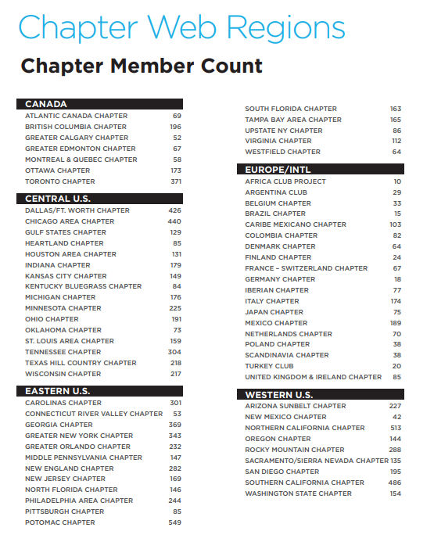

Slide 44
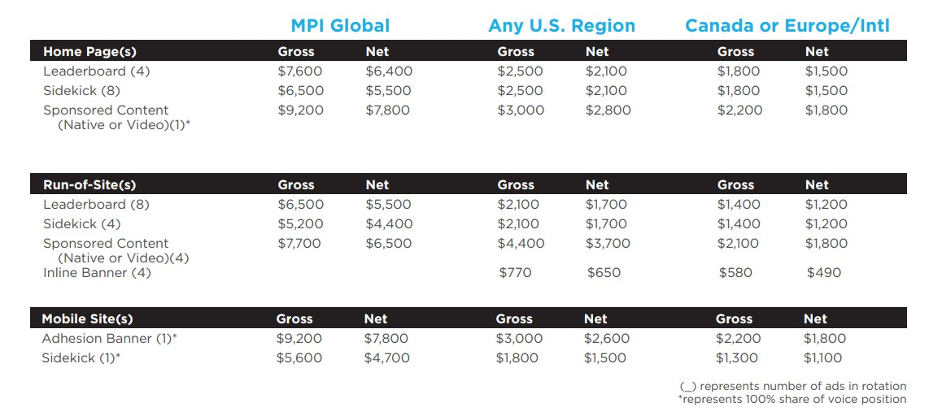

Slide 45
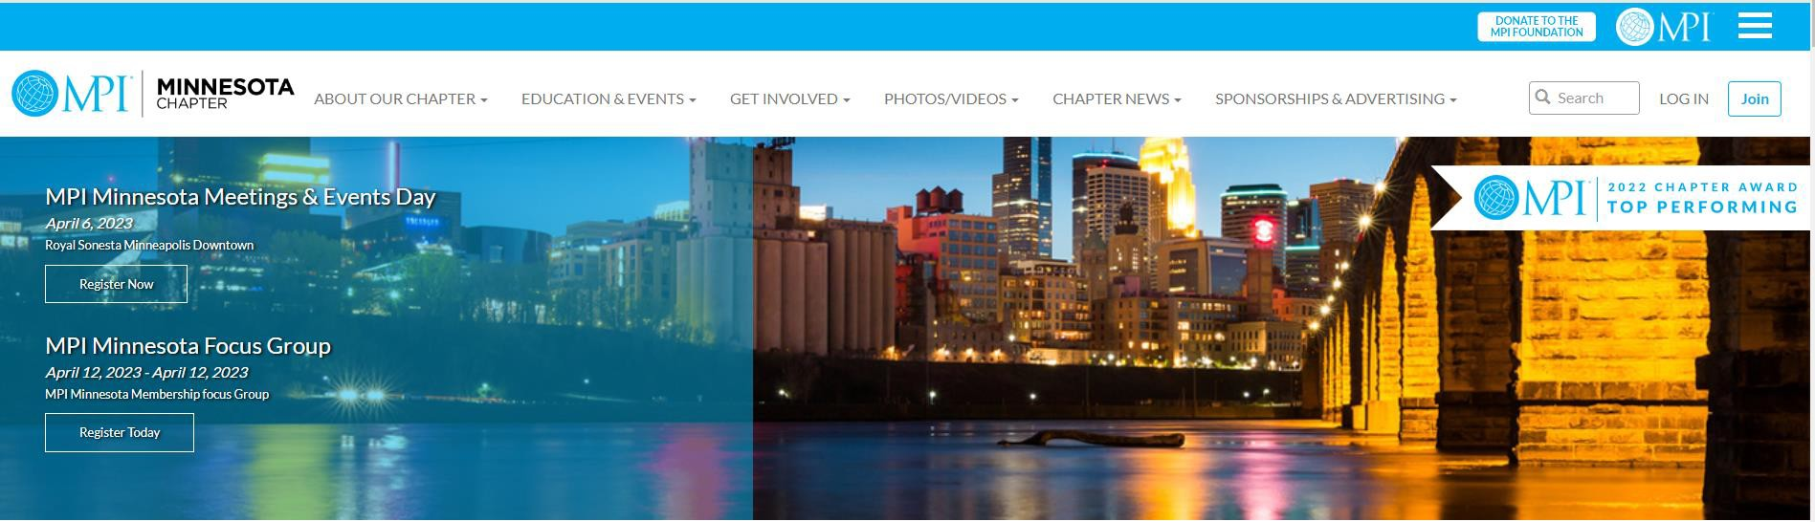
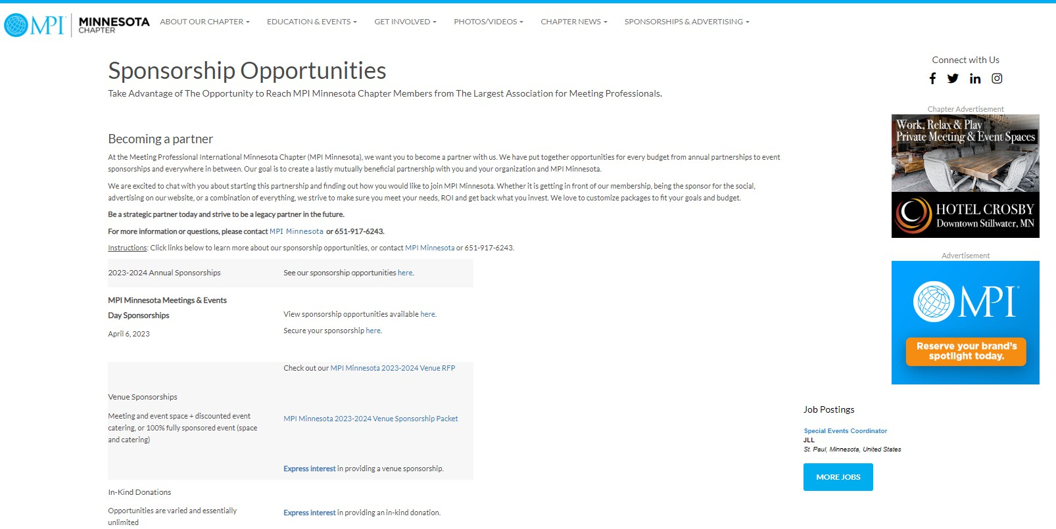

Slide 46
SPONSORSHIP – THE MONEY
When invoicing sponsors, include your Chapter mailing/remittance information boldly and clearly on the invoice.
Include your Chapter W-9 (or other required documentation)to ensure the correct entity is paid.
If the payment is accidently submitted to MPI Global’s post office box, it will be automatically deposited and must be refunded to the payee. MPI Global cannot forward funds to the Chapter in this scenario.
It is most efficient to ensure the correct entity is paid the first time.

Slide 47
SUPPORT & RESOURCES
Chapter Leaders Resource Page (CLRP)
Chapter Support Framework
MPI Compliance Timelines
Compliance and Security Information

Slide 48

WORKING WITH YOUR CHAPTER ADMINISTRATOR
The Chapter Administrator may be a paid vendor contracted by the Chapter’s Board of Directors
Scope of Services – know your needs
Instruct Board on who does what (Chapter vs. Administrator)
Compensation determined and approved by Board of Directors
Annual Performance Review with Office of the President
Your Chapter Administrator is an important resource
and partner!
Notes:
The Payment Card Industry is an international organization that regulates billions of transactions daily and provides security guidelines to protect personally identifiable information (PII). These security controls provide a baseline and prevent low-level hackers from causing a data breach.
If you use an online credit card processor, you must ensure that your website and/or the one where the transactions occur is PCI compliant. Consult your Finance Resources for additional, detailed information on PCI Compliance.
Cyber-Enabled Financial Fraud is on the Rise Globally. Your Finance Resources contains an FBI guideline on how to deal with CEO Fraud. CEO Fraud is also known as Business Email Compromise.
What is PCI Compliance and why should I care?
In the USA, the Payment Card Industry Data Security Standard (PCI DSS) applies to companies of any size that accept credit card payments. If your company intends to accept card payment, and store, process and transmit cardholder data, you need to host your data securely with a PCI compliant hosting provider.
What is CEO Fraud and what steps to I need to take to guard against it?
CEO Fraud happens when cybercriminals impersonate executives and trick other employees into executing unauthorized wire transfers or sending tax information.

Slide 49
CHAPTER ADMINISTRATOR
POLICIES & GUIDELINES
01
Administrator is Managed by the Office of the President
02
Policies & Guidelines
Contracts include required langu₄a₅ ge provided
Business license and insurance
Notes:
Developed to provide best-in-class support for Chapter Administrators & their chapters.

Slide 50


CHAPTER LEADERS RESOURCES PAGE
Notes:
Remember you also have a resource area to support you. During your trainings we have provided many of the documents you need or that we have already referenced but on the mpi.org site you have access to the CLRP - both the Chapter Leader Training and Finances Tabs are the place to find resources and support tools. If it is not here, contact your Regional Operations Manager for Assistance.

Slide 51






CHAPTER SUPPORT FRAMEWORK
Programs
Platforms & Services
MPI Verified Facilitator Program
Chapter Leadership Summit
Websites
Accounting
Registration
Volunteer
Training
MPI Cares
Chapter Shared Services
Chapter Operations Team
Standards
Chapter Bylaws & Policies
Global Branding
Performance Metrics

Slide 52
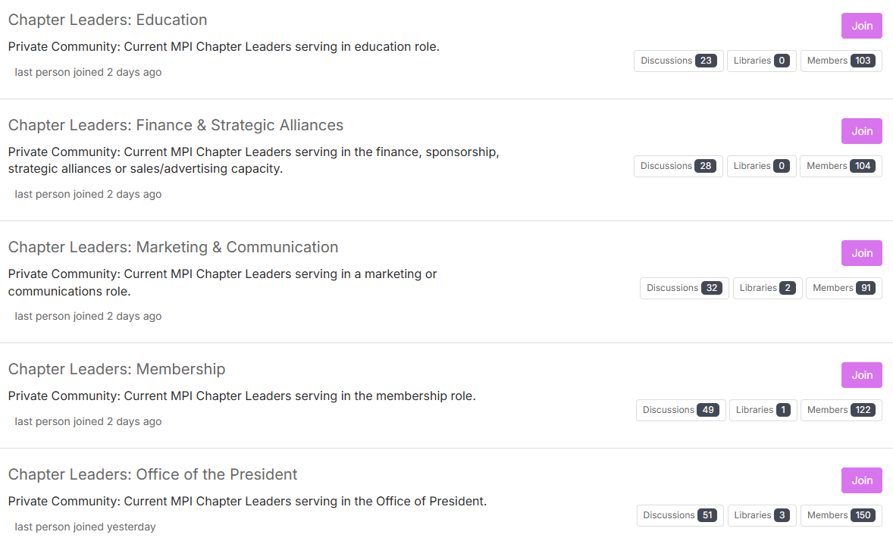
MPI COMMUNITY FORUM: BY DEPARTMENT
Notes:
All MPI Volunteer Chapter Leaders have access to ask questions, seek advice or share ideas.

Slide 53
CHAPTER PARTNERSHIP BEST PRACTICES
Lots of great ideas and approaches among Chapters. Here’s some of our favorites:
Partnership RFPs
MPI DFW Cash Sponsorship Form
MPI DFW In-Kind Sponsorship Form
MPI San Diego Sponsorship Opportunities
MPI Southern California Sponsorship Opportunities
MPI New Jersey MEETS Conference Sponsorship Kit
MPI Greater Orlando Sponsor Prospectus
MPI Orange County Partnership Prospectus
RISE Awards
Marketplace Achievement – MPI Southern California Online Ad Portal
Marketplace Achievement – MPI Mexico Planner Sponsored Tables
Marketplace Achievement – MPI Dallas/Fort Worth Sales Blitz
New Approaches
Affiliate Memberships: Bundles with other Chapters, targeted on geographic destination clusters, i.e. North Texas, Florida

Slide 54
FINANCE & CHAPTER ADMINISTRATOR HANDBOOK

