Slide 1
MARKETING AND COMMUNICAITONS HANDBOOK

Slide 2
GOALS & OBJECTIVES
MPI, Your Chapter’s,
and How They Intersect

Slide 3
VISION
Lead and empower the meeting and event community to change the world.
MISSION
Connect the global meeting and event community to learn, innovate, collaborate and advocate.

Slide 4
MPI’s Pillars of Value Delivery to its Community
ACTIONABLE EDUCATION
Where other education providers offer up DIY lessons, MPI provides a career path. More than clock hours and credits, MPI delivers advancement and action, jobs and profits, corporate improvement and sustainable, positive change.
A CAREER HOME
MPI delivers value at every stage of our members’ careers. Once someone joins, they often remain involved and highly active with MPI for decades.

Slide 5
MPI’s Pillars of Value Delivery to its Community
THOUGHT LEADERSHIP
MPI is the global meeting and event thought leader, empowering the world’s best and brightest individuals to become agents of change, reinventing the world through the events they plan.
INDUSTRY ADVOCACY
When MPI speaks, the industry takes notice. MPI is the voice of meeting and event professionals around the world, advocating for the industry and its significant economic impact.

Slide 6
MPI’s Pillars of Value Delivery to its Community
RETURN ON INVESTMENT
No professional investment delivers more value than an MPI membership. MPI provides an unparalleled level of growth and advancement, both personally and professionally. And the people you meet could be lifelong friends.

Slide 7
All MPI chapters are not created equal.
Notes:
Today, we’re going to go over your role and responsibility as VP of Communications as well as how the following areas may affect your chapter work over the next 18 months:
About Meeting Professionals International
Your role
Brand guidelines: Global and Chapter
Additional Resources

Slide 8
However, MPI Chapters are the first and most important touchpoint in the MPI member experience. How you activate this experience is key.
How you retain members is key.
Notes:
Today, we’re going to go over your role and responsibility as VP of Communications as well as how the following areas may affect your chapter work over the next 18 months:
About Meeting Professionals International
Your role
Brand guidelines: Global and Chapter
Additional Resources

Slide 9
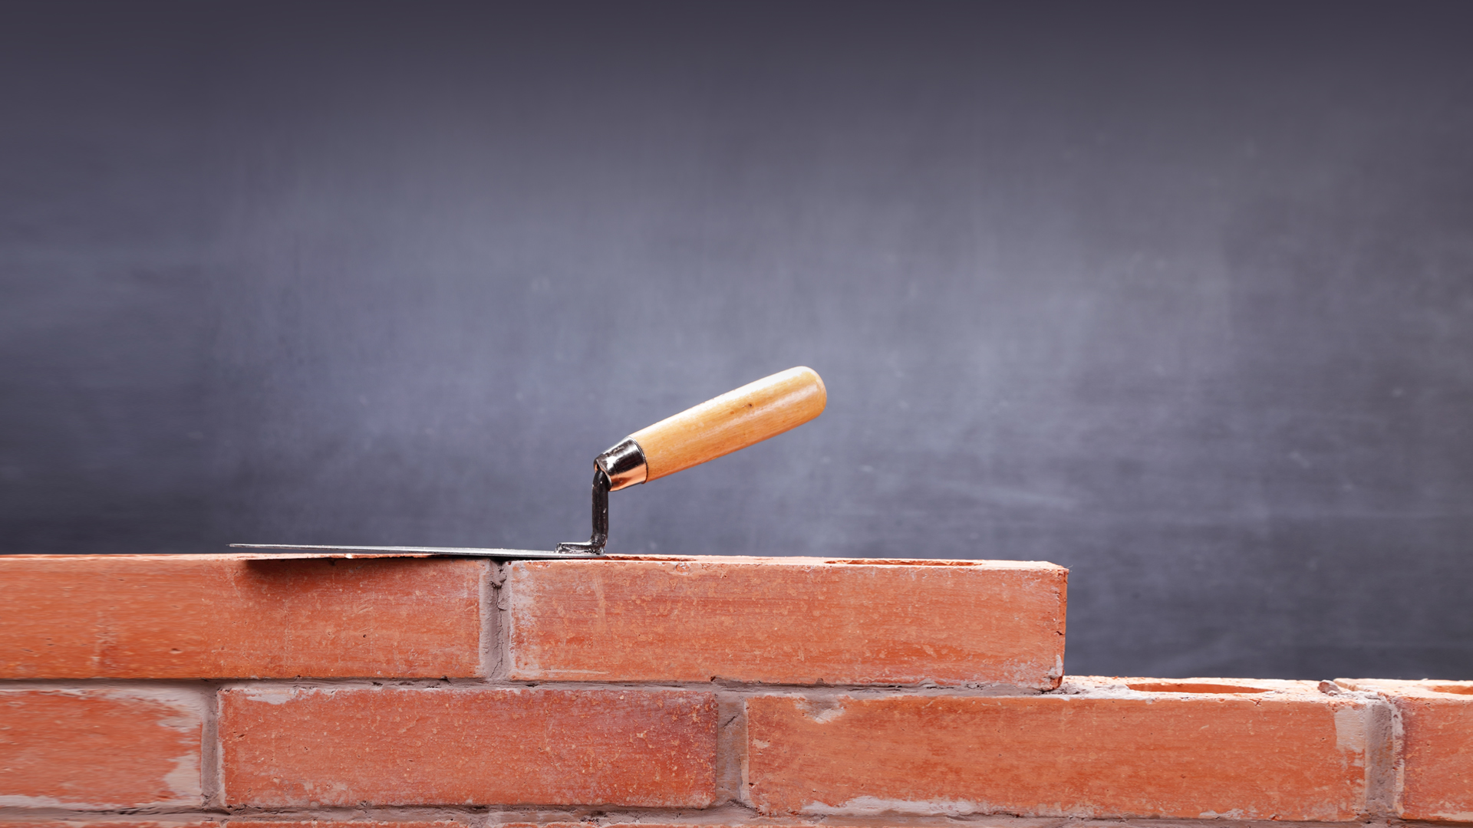
Today is all about creating a foundation
for you to build upon, customizing your marketing plan for your chapter.
Notes:
Today, we’re going to go over your role and responsibility as VP of Communications as well as how the following areas may affect your chapter work over the next 18 months:
About Meeting Professionals International
Your role
Brand guidelines: Global and Chapter
Additional Resources

Slide 10
A Day in the Life
Preparing for Your New Role

Slide 11
What are YOUR goals?

Slide 12
Best Practices,
Challenges and Wins

Slide 13
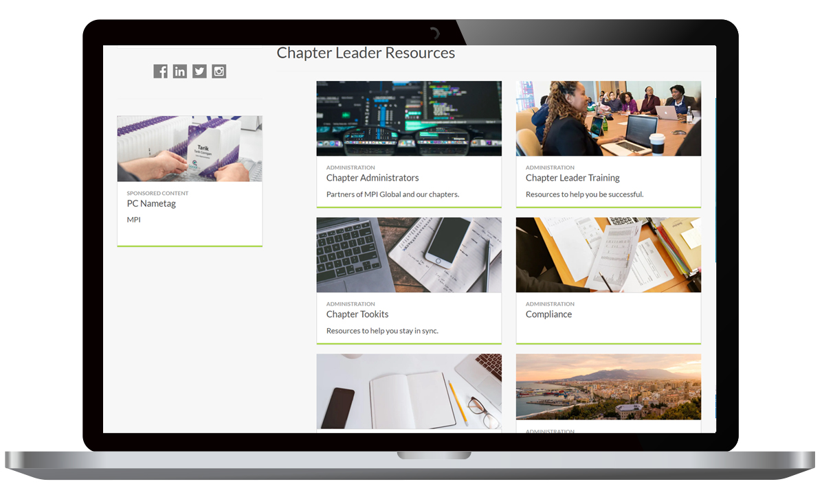
RESOURCES
Chapter Leader Resource Page
• Marketing Toolkits
• Logos
• Promotional Assets

Slide 14
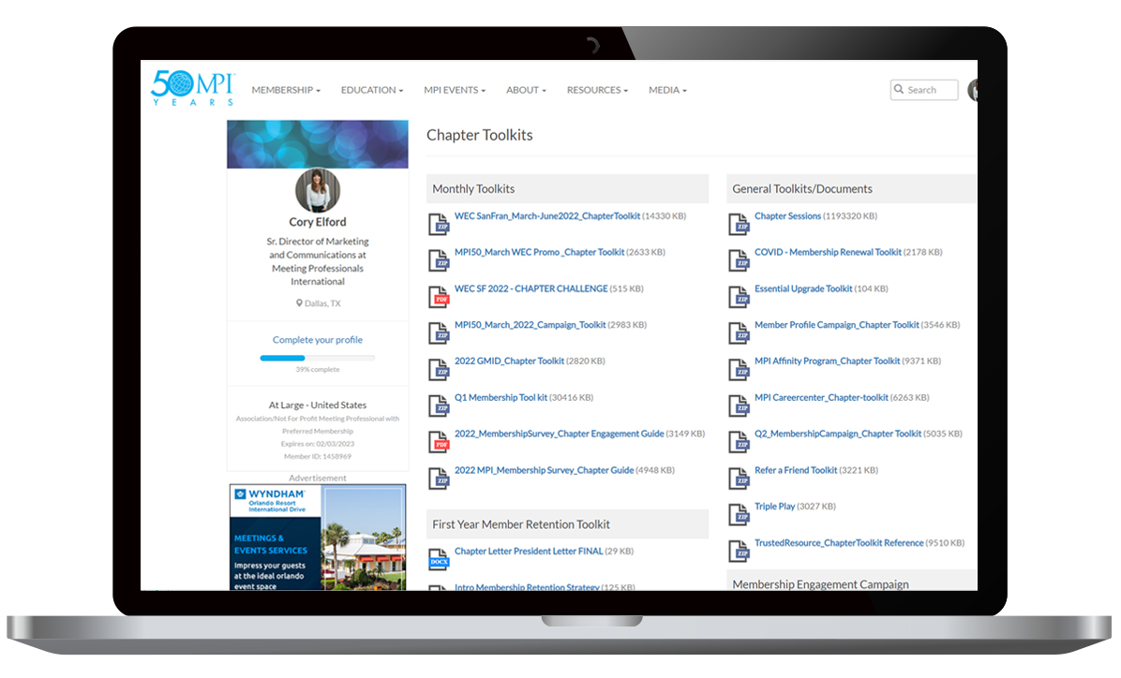
RESOURCES
Chapter Leader Resource Page
• Marketing Toolkits
• Logos
• Promotional Assets

Slide 15
RESOURCES
Chapter Leader Resource Page
Log in at mpi.org.
Go to the drop-down menu by
your name and select “Chapter
Leader Resources”
Download what you need

Slide 16
RESOURCES
MPI Chapter Websites
Designed to deliver a consistent MPI brand experience across all chapters
Ready to customize with your chapter’s content
MPI gives you widgets and tools to facilitate what you need

Slide 17
RESOURCES
MPI Chapter Websites
You’re not on your own!
Deep knowledge base and effective support ticket system to help you
Jay Hough, Director of Technology Services, MPI - jhough@mpi.org

Slide 18
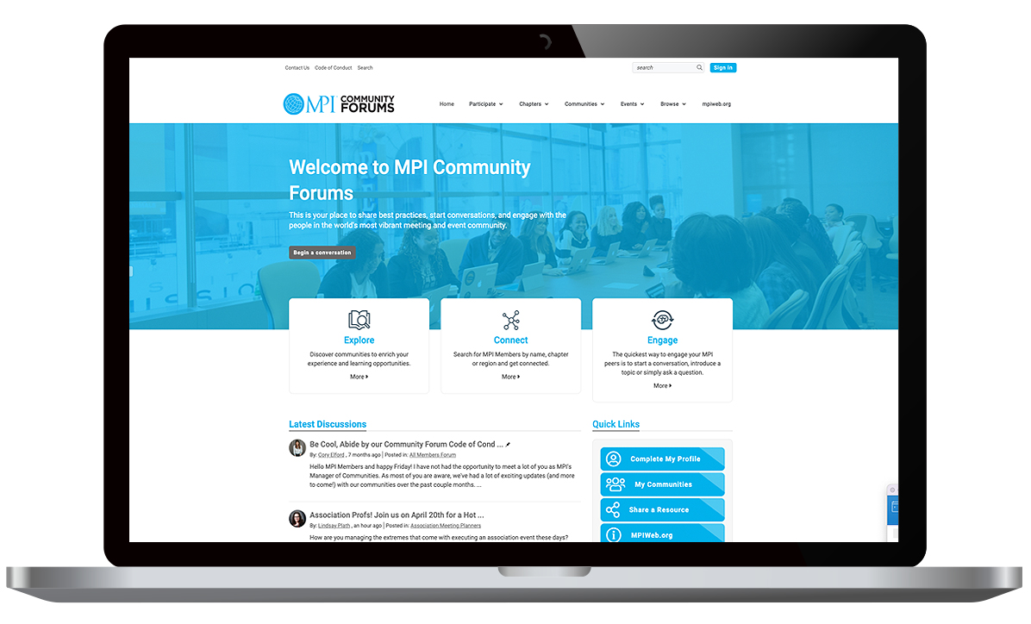
RESOURCES
Content, real-time feedback and houses a library of assets tailored to specific social interests and professions
Stay engaged 24/7 and to provide even more value through digital connections
Opportunity for chapters to host their own community events (MPI Women, LGBTQ, Black Meeting Professionals, Association Professionals, etc)
MPI Community Forums

Slide 19
RESOURCES
MPI Brand Guide

Slide 20
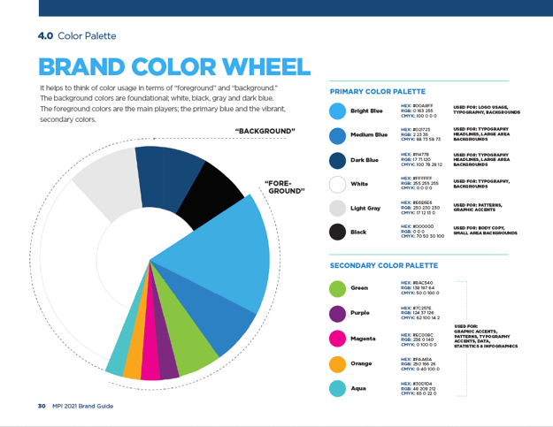
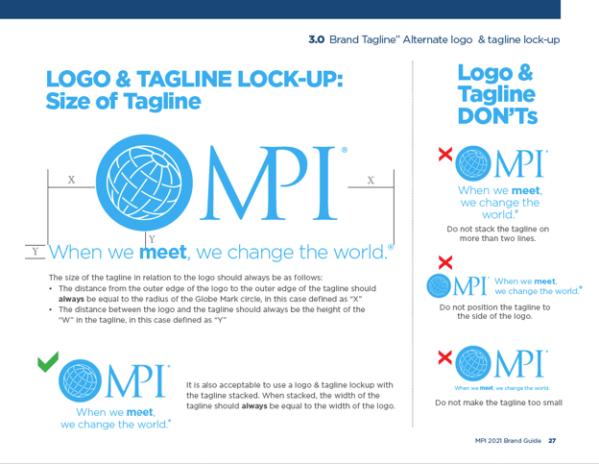
RESOURCES
MPI Brand Guide
MPI visual and language style guide
MPI Brand character
Design guidelines
Chapter logo use standards

Slide 21
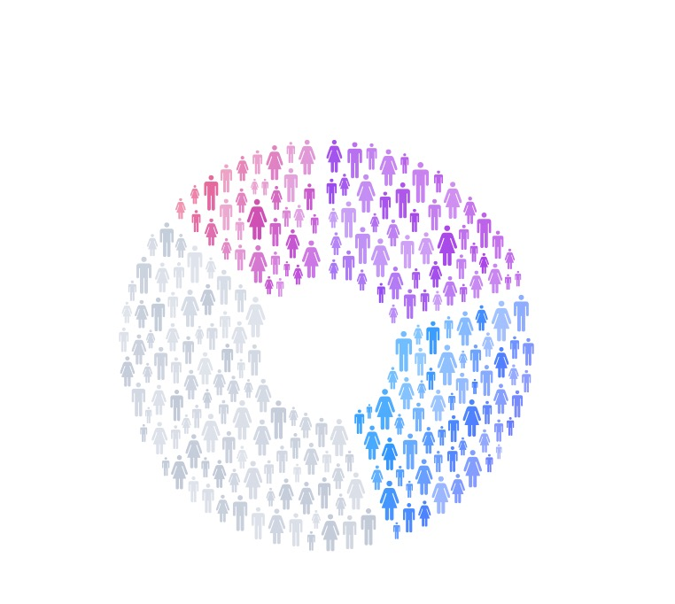
Who is your
chapter audience?
Who are you speaking
to demographically, geographically & valuegraphically?

Slide 22
Always promote the importance of fully completed Member Profiles!

Slide 23
SOCIAL MEDIA
• MPI always provides social media examples in our toolkits
• Use different platforms for different things
• Don't overwhelm yourself with every platform. Stick to where your audience is.
• This is your opportunity to really develop your "chapter tone" within the MPI brand guidelines

Slide 24
MARKETING AND COMMUNICAITONS HANDBOOK

