Slide 1

MARKETING AND COMMUNICATIONS HANDBOOK

Slide 2
GOALS & OBJECTIVES
MPI, Your Chapters, and How They Intersect

Slide 3

VISION
Lead the business events community in changing the world.rld.
MISSION
Be the premiere, inclusive business events association for professional development.

Slide 4
MPI’s Pillars of Value
Delivery to its Community
ACTIONABLE EDUCATION
Where other education providers offer up DIY (discover your pupose) lessons, MPI provides a career path.
More than clock hours and credits, MPI delivers advancement and action, jobs and profits, corporate improvement and sustainable, positive change.
A CAREER HOME
MPI delivers value at every stage of our members’ careers. Once someone joins, they often remain involved and highly active with MPI for decades.

Slide 5
MPI’s Pillars of Value
Delivery to its Community
THOUGHT LEADERSHIP
MPI is the global meeting and event thought leader, empowering the world’s best and brightest individuals to become agents of change, reinventing the world through the events they plan.
INDUSTRY ADVOCACY
When MPI speaks, the industry takes notice. MPI is the voice of meeting and event professionals around the world, advocating for the industry and its significant economic impact.

Slide 6
MPI’s Pillars of Value
Delivery to its Community
RETURN ON INVESTMENT
No professional investment delivers more value than an MPI membership. MPI provides an unparalleled level of growth and advancement, both personally and professionally. And the people you meet could be lifelong friends.

Slide 7

All MPI Chapters are not created equal.

Slide 8
MPI MEMBER EXPERIENCE
However, MPI Chapters are the first and most important
touchpoint in the MPI member experience.
How you activate this experience is key.
How you retain members is key.

Slide 9

Today is all about creating a foundation
for you to build upon, customizing your marketing plan for your Chapter.

Slide 10
A DAY IN THE LIFE
Preparing for Your New Role

Slide 11
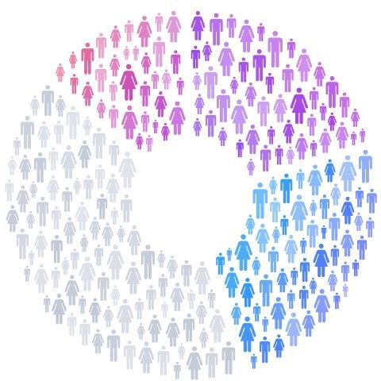
WHAT ARE YOUR GOALS?
Who is your Chapter audience
Who are you speaking to demographically, geographically & value graphically?

Slide 12
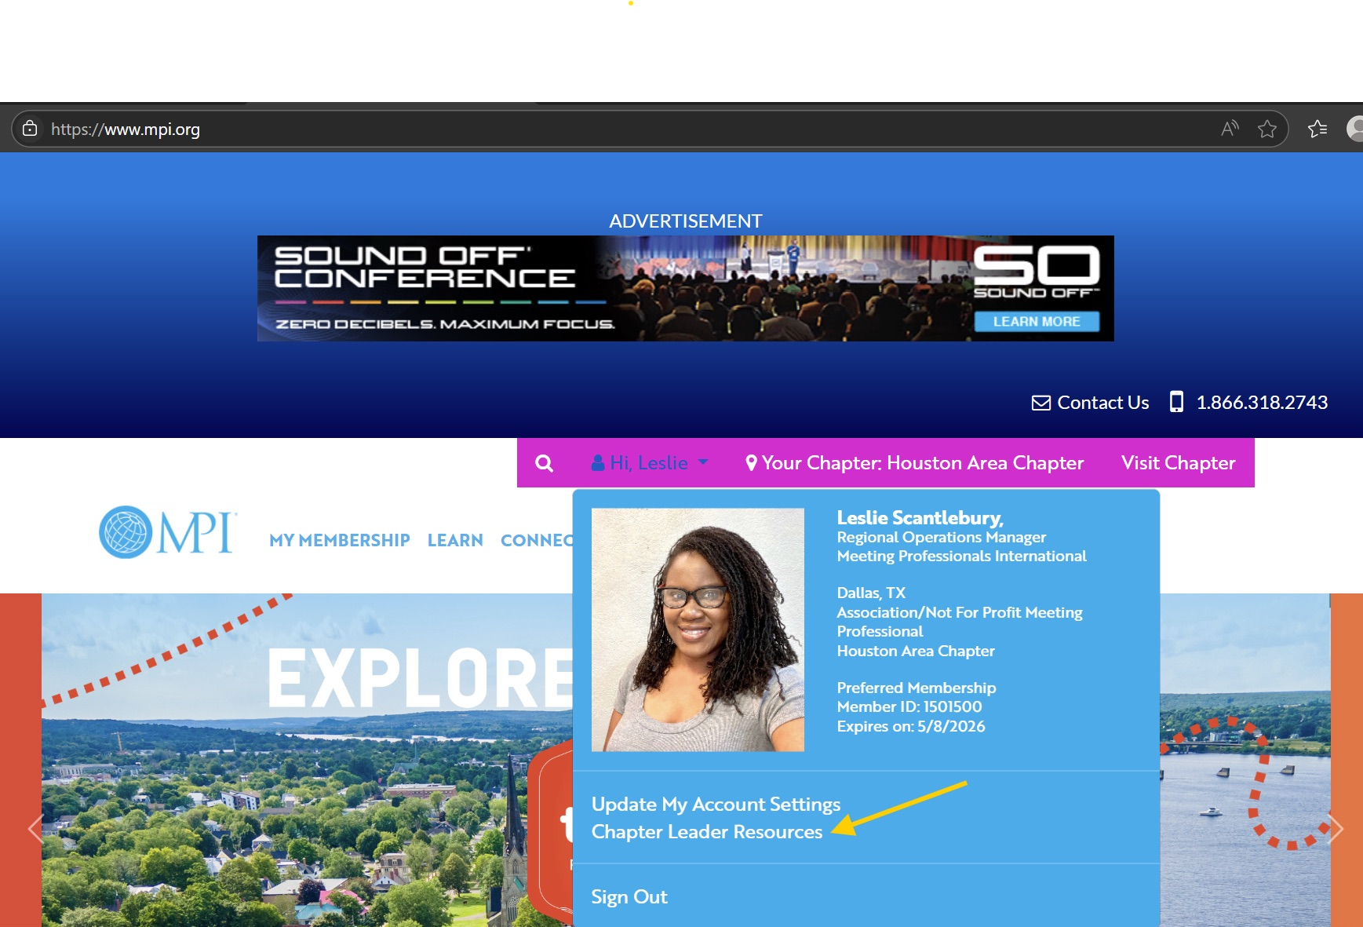
RESOURCES
Chapter Leader Resource Page
Log in at mpi.org
Go to the drop-down menu by your name and select: “Chapter Leader Resources”
Download what you need

Slide 13
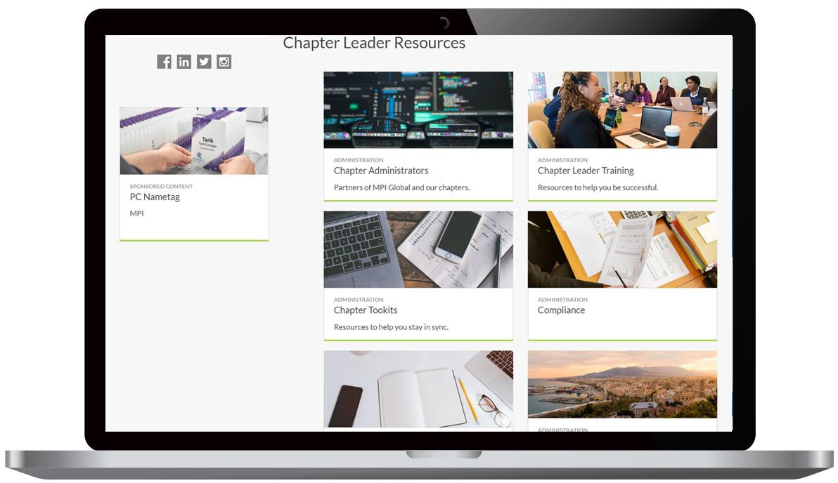
RESOURCES
Chapter Leader Resource Page
Chapter Administrators
Chapter Leader Training
Chapter Toolkits
Compliance
Education
Facilitator Program
Finances
Marketing & Communication
Membership
Office of the President
RISE Awards & RISE Up

Slide 14
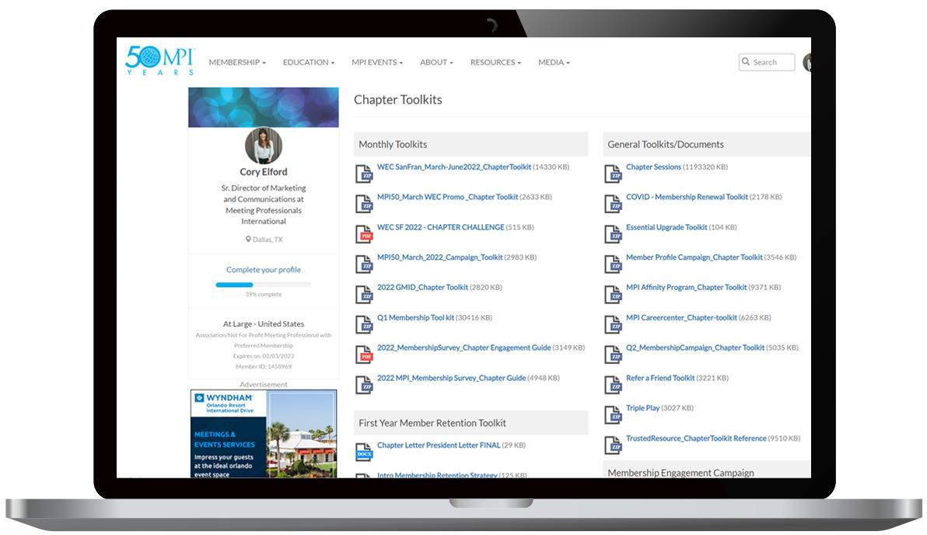
RESOURCES
Chapter Leader Resource Page
Marketing Toolkits
Logos
Promotional Assets

Slide 15
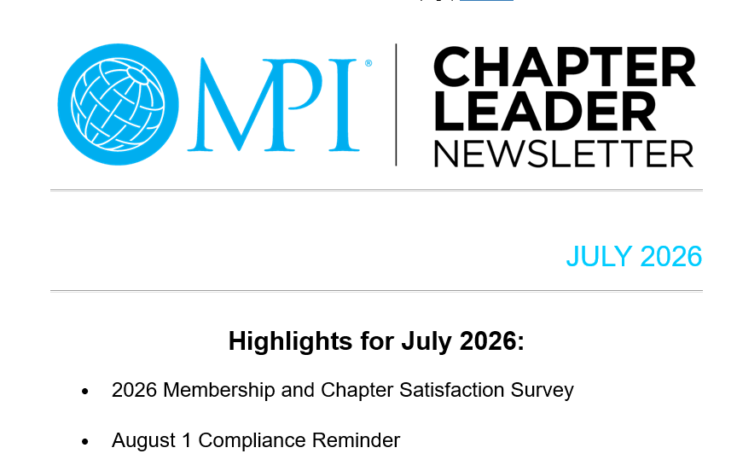
RESOURCES
Monthly dedicated Chapter Leaders newsletter sent the Thursday of the month!

Slide 16
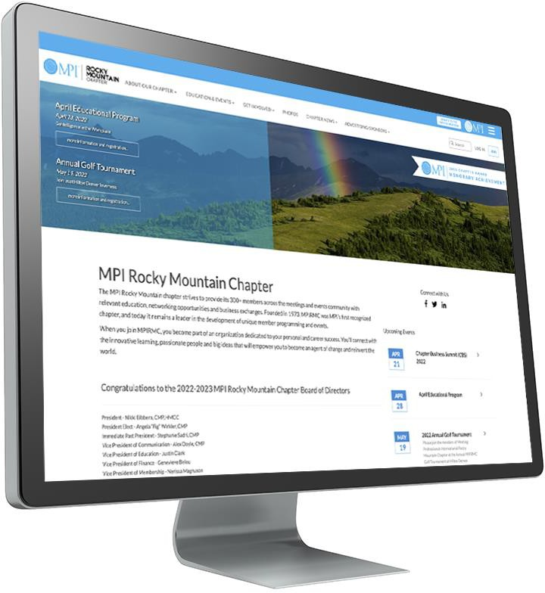
MPI CHAPTER WEBSITE
Designed to deliver a consistent MPI brand experience across all Chapters
Ready to customize with your Chapter’s content
MPI gives you widgets and tools to facilitate what you need

Slide 17
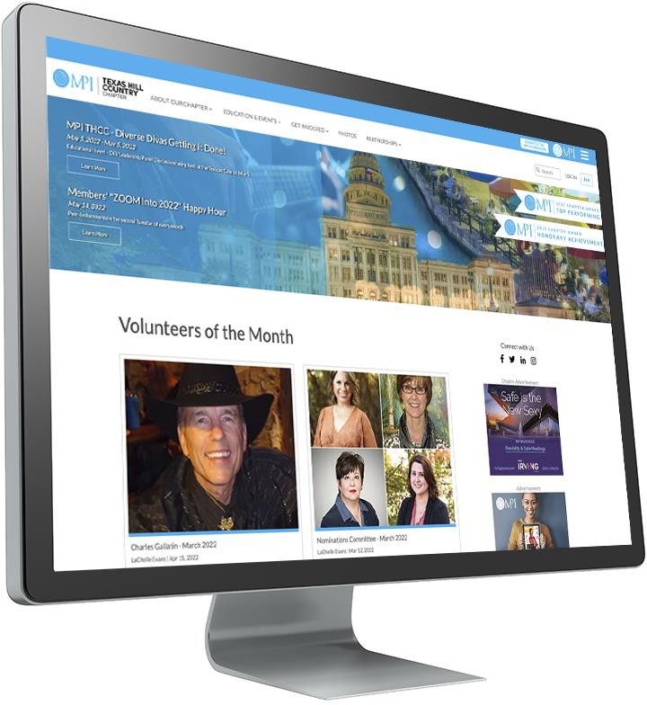
MPI CHAPTER WEBSITE
You’re not on your own!
Deep knowledge base and effective support ticket system to help you
For website support contact: support@mpi.org or review training here https://support.mpiweb.org/portal/en/home
Important you have a Chapter process in place for Username and Password for any role change to continue access website

Slide 18
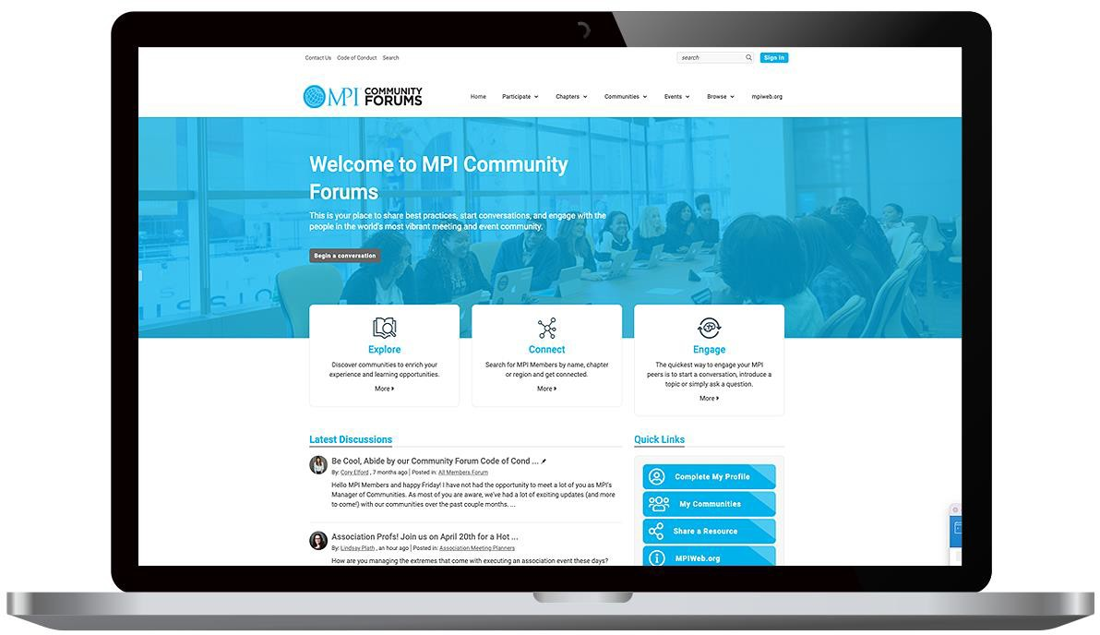
MPI COMMUNITY FORUMS
Content, real-time feedback and houses a library of assets tailored to specific social interests and professions
Stay engaged 24/7 and to provide even more value through digital connections
Opportunity for Chapters to host their own community events (MPI Women, LGBTQ, Black Meeting Professionals, Association Professionals, etc.)

Slide 19

MPI BRAND GUIDE

Slide 20

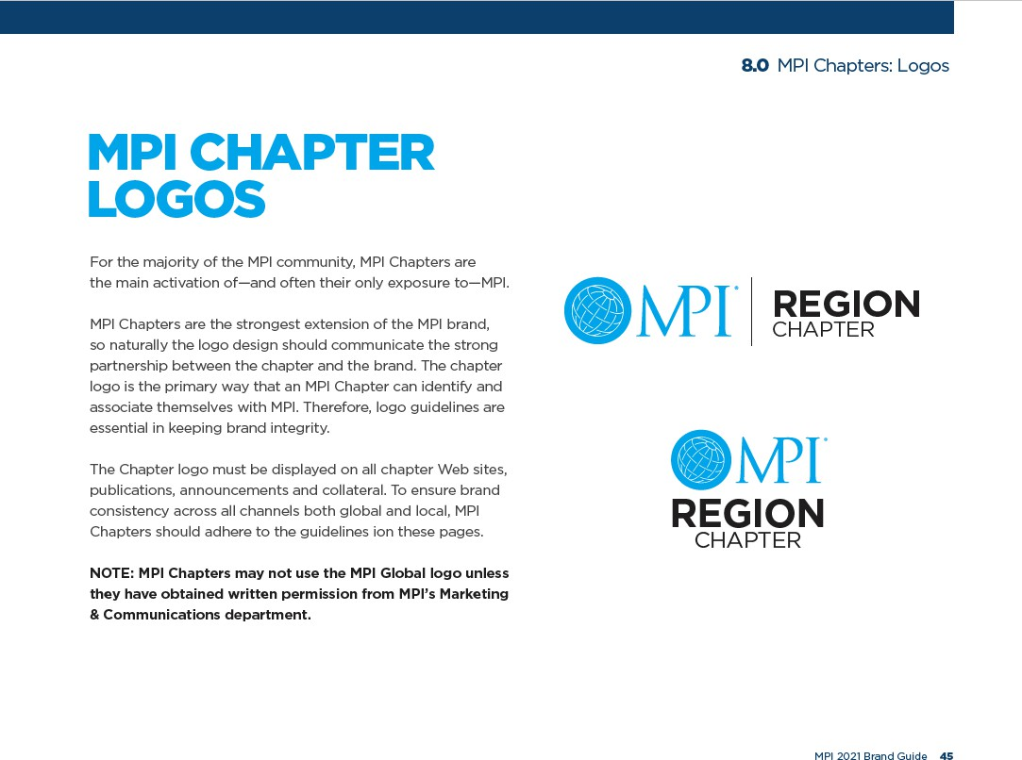
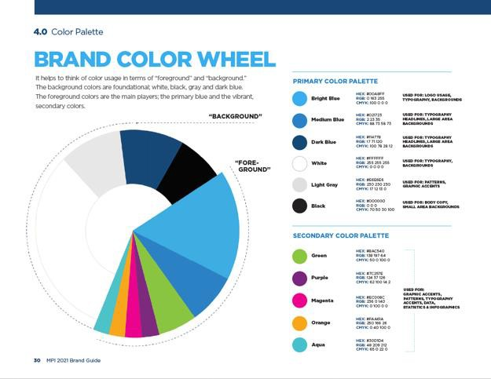
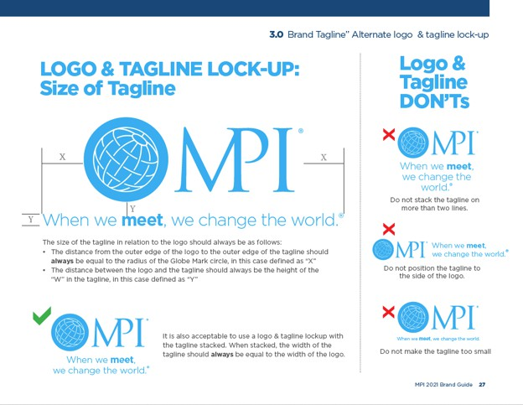
MPI BRAND GUIDE
MPI visual and language style guide
MPI Brand character
Design guidelines
Chapter logo use standards

Slide 21

Always promote the importance of fully completed Member Profiles!
This helps your Chapter demographic report
MEMBER PROFILES

Slide 22
SOCIAL MEDIA
MPI always provides social media examples in our toolkits
Use Social Media takeover option to showcase your Chapter events!
Adjust content and tone so it aligns and is relevant to the platform it will be posted on
Don't overwhelm yourself with every platform. Stick to where
your audience is
Check out your Chapter’s demographics and develop a marketing persona, then write your content to appeal to that persona

Slide 23
BEST PRACTICES, CHALLENEGES AND WINS
Session part 2 and discover your Marketing Community!
Notes:
For best practices log on the CLR and check the Marketing TAB – Also engage at the Community level thru the dedicated VP Marketing Community – There will be a session on Best practices at CLS

Slide 24
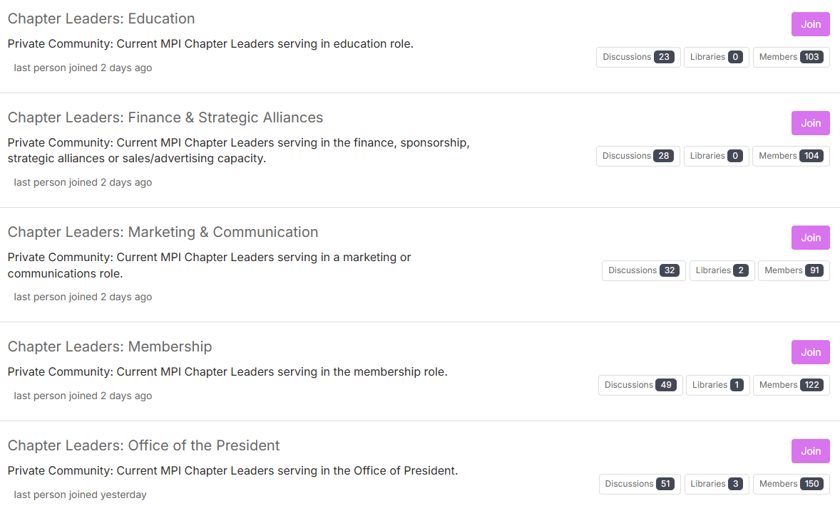
MPI COMMUNITY FORUM: By Department
Notes:
All MPI Volunteer Chapter Leaders have access to ask questions, seek advice or share ideas.

Slide 25
MARKETING AND COMMUNICAITONS HANDBOOK

