Slide 1
MEMBERSHIP HANDBOOK

Slide 2
MPI Global
Membership Team Overview

Slide 3
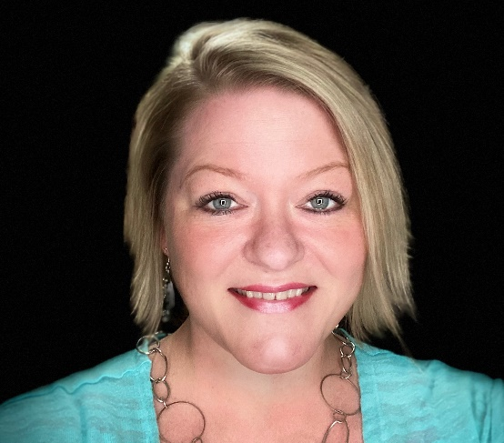
MPI Global TEAM OVERVIEW
MPI MEMBER
ENGAGEMENT TEAM
Manager of Membership Development
Victoria Schaefer
Member Engagement Representative
Jazzlynn Garrett
Member Engagement Representative
Marlene Jackson
Member Engagement Representative
Mark Kilgore
Member Engagement Representative
Teresa Sauceda

Slide 4
MPI MEMBERSHIP VALUE PROPOSITION
Through innovative solutions for members and chapters across the globe, MPI advances the meetings and events industry and provides personal and career growth to the professionals in it. MPI is the premier association that educates, supports and connects the connectors—the people who are passionate about bringing people together to change the world.

Slide 5
Regional Focus: Territories divided up globally.
New Membership: Follow-up with any potential new members that you have already reached out to.​
Membership Upgrades: Follow-up with any Essential members that are in your chapter area to upgrade to the Preferred or Premier categories. ​
Profile Updates: If members provide you with new contact information, please ask them to access their online account profile.
Membership Renewals: This includes current members and those in the grace period.​
Other: Installment plans, membership transfers, unemployed members, Student in Transition, retired and lifetime memberships.
MEMBER ENGAGEMENT REPS: THE FRONT LINE

Slide 6
Levels of Membership
Essential Member | Preferred Level | Premier Level​
Member with MPI Global, but not affiliated with a home chapter | Essential Membership Benefits PLUS: | All Preferred membership benefits PLUS: ​
Could be the Best Option if There is Not a Local Chapter in Member's Area | Local Chapter Affiliation & Discounted Rate to All Chapter Events​ | VIP Access at MPI Signature Events
Receive Communications from MPI Global; The Meeting Professional, Industry Research, Weekly Newsletters, etc | Opportunity to Expand Your Leadership Skills by Becoming a Committee Member or Board Member​ | Advanced Copy of Meetings Outlook & Job Board Notice
Member Directory Listing and Access | Eligibility for the Chapter Annual Awards at annual recognition event​ | 10% discount on WEC Registration & Academy Programs (CMP, CMM, etc)
Business & Affiliate Memberships

Slide 7
Affiliate Memberships
Business Memberships
Opportunity to “affiliate” with other Chapters
100% of Dues go Directly to the Home Chapter!
Chapter Sets Their Own Rate
Cross-sell Affiliate Memberships
Organizations with multiple MPI members
Organizations Qualify with 5+ Members
Reduced Membership Rates
Single Invoicing for the Organization
Organizations hold the membership
Notes:
VS

Slide 8
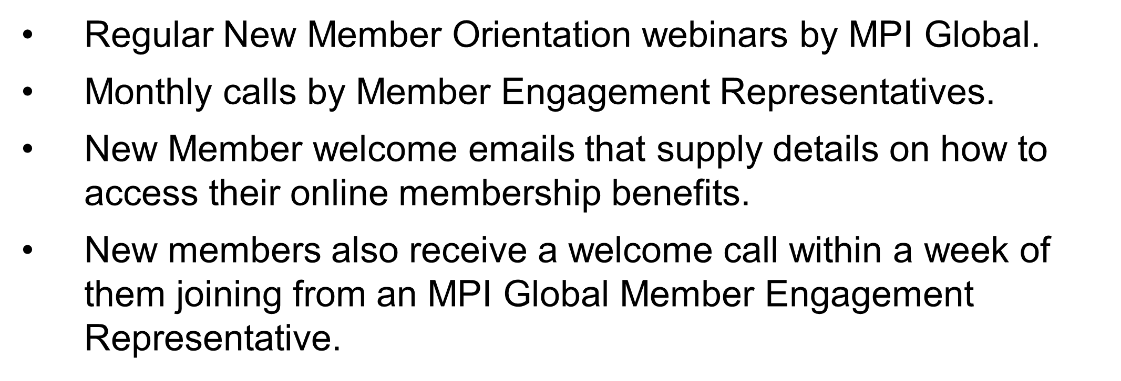
GLOBAL NEW MEMBER ENGAGEMENT

Slide 9
Annual Chapter Promotion
MPI offers chapters a promotion annually, valid for 20% off NEW MPI memberships.
Campaign can run for 30 days, surrounding an event
Contact feedback@mpi.org to request the tailored discount code to offer prospects.

Slide 10
MPI Chapter
Leadership Page (CLRP) Overview

Slide 11
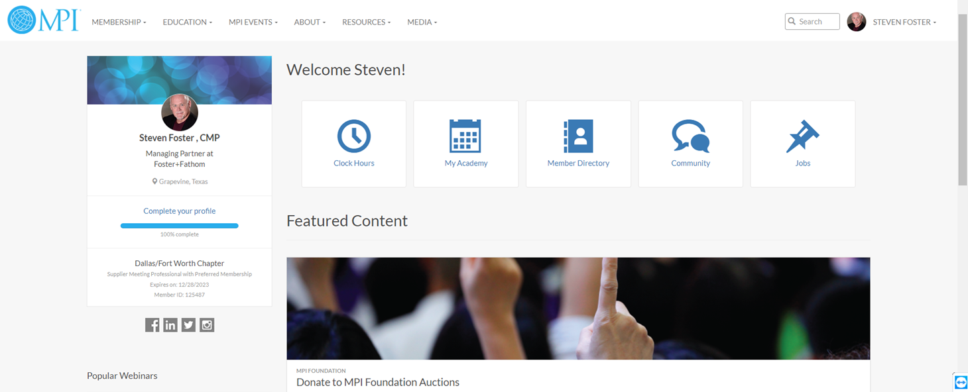
Chapter Leader
Resource Page (CLRP)
The Chapter Leader Resource Page (CLRP) is located within MPIweb.org and is only accessible to current chapter board
members.
Here you will find resources, requirements and templates for the various roles within your board as well as important updates from MPI Global for our chapter leaders.

Slide 12
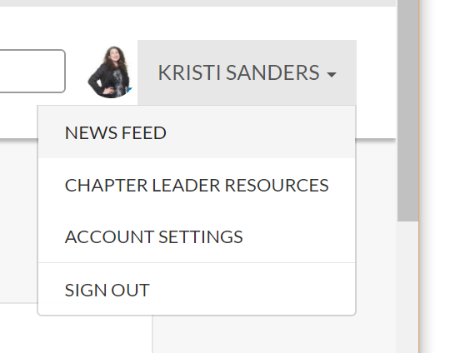
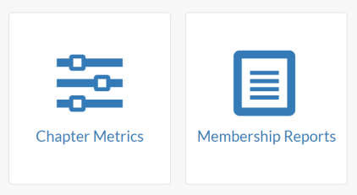
CHAPTER LEADER RESOURCE PAGE (CLRP)
Go to mpi.org and log in.
Go to the drop-down menu by your name and select “Chapter Leader Resources”
Buttons to run Membership and Chapter
Metrics (Dashboard) Reports are at the top
(only let your Administrator or one designated leader enter dashboard data)
Role-Specific content areas are below so you can select the library and download what you need

Slide 13
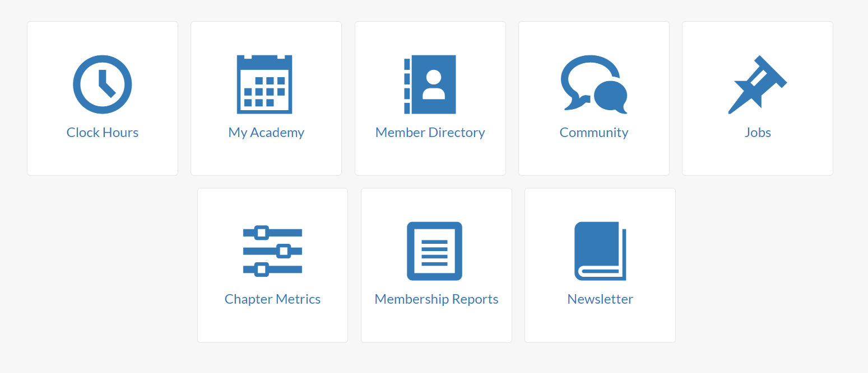
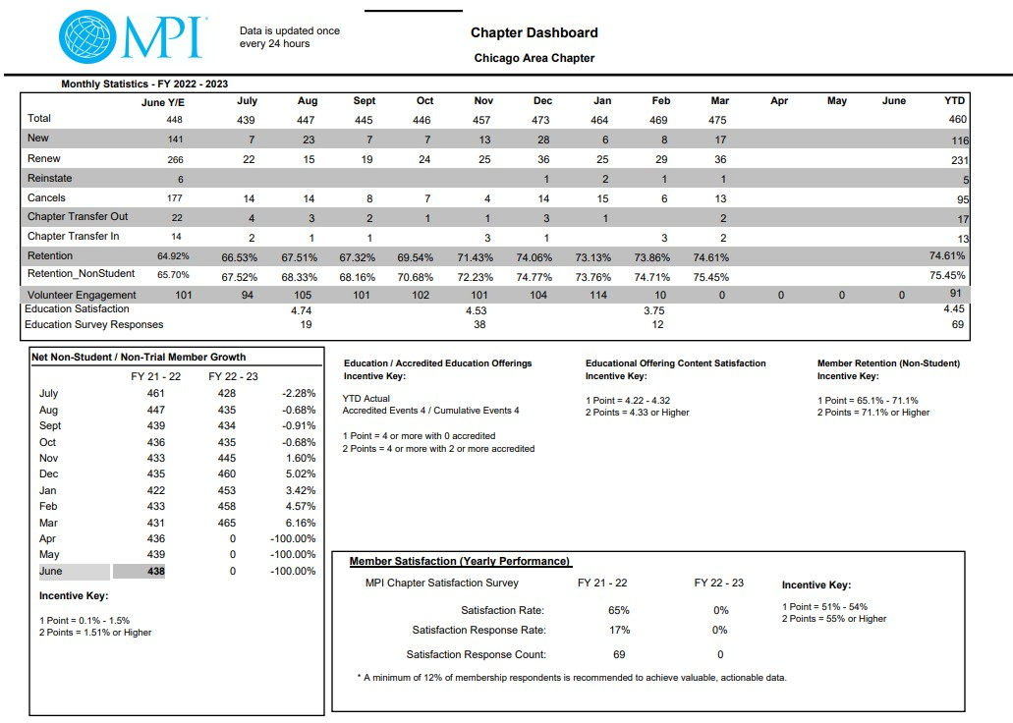
CHAPTER DASHBOARD
Log into mpi.org -> “Chapter Leader Resources”

Slide 14
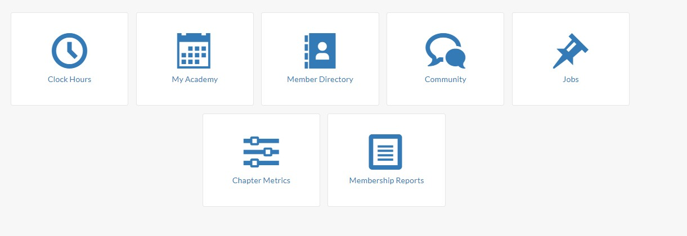
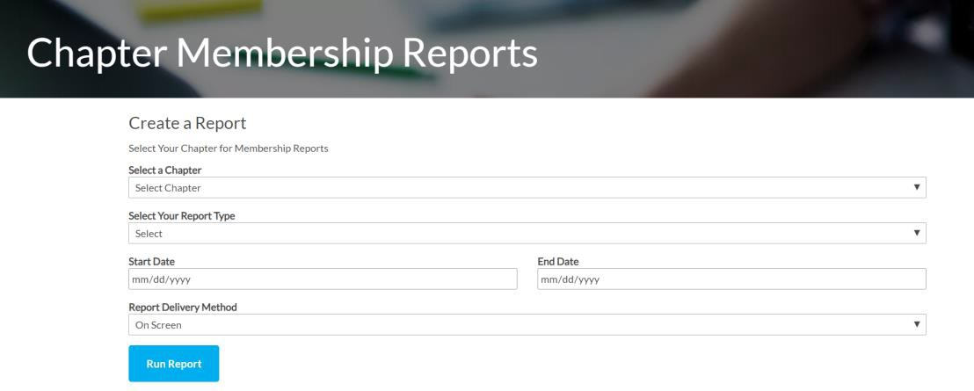
MEMBERSHIP REPORTS
Log into mpi.org -> “Chapter Leader Resources”

Slide 15
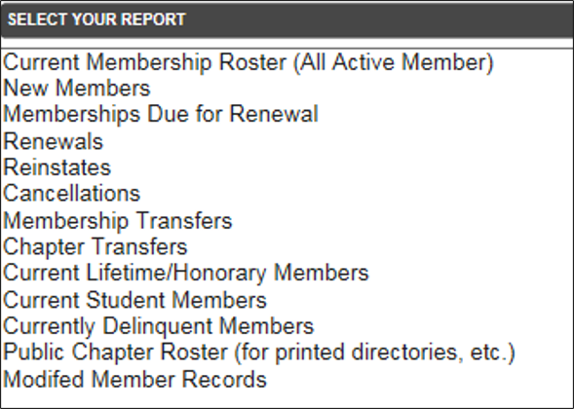
MEMBERSHIP REPORTS
CLRP MEMBERSHIP REPORTS ARE UPDATED EVERY
24 HOURS
Notes:
Chapter reports are found on the Chapter Leader Resource Page (CLRP). The reports should be pulled monthly and reviewed during the board meetings. The membership reports should be pulled to contact members who are close to expiration or have already expired to renew/reinstate their membership. -

Slide 16
VP of Membership
The chapter Vice President of Membership shall oversee new member recruitment and orientation, member recognition programs, scholarships and retention. The Vice President of Membership will have access to all membership reports, including new and renewing members, directly from the MPI database.
Membership Roles & Responsibilities
Chapter Membership Team
Support the VP of Membership

Slide 17
MEANINGFUL MEMBERSHIP PRACTICES

Slide 18
ENGAGEMENT BEST PRACTICES
Form a New Member Committee in charge of welcoming, onboarding and engaging new members
Create an Ambassador or Buddy System
Send a handwritten welcome note to new members from the president/board
Offer a new member orientation or social gathering at each event
Connect with new members by phone or email to understand why they joined MPI and what they hope to get out of membership
Check in on a quarterly and 6-month basis to see how they’re doing

Slide 19
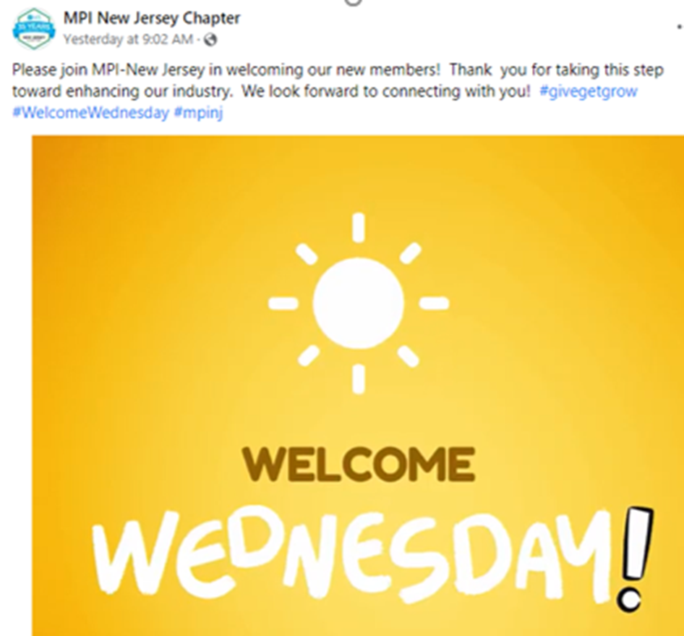
ENGAGEMENT BEST PRACTICES
Assign board/committee members and new members to each table.
Showcase volunteer opportunities
Reward & recognize members who have recruited the most members.
Recognize new members during event & in post-event recap.
Send handwritten thank-you notes to newbies for attending.
Feature new members in newsletter, social media &/or website

Slide 20
MEMBER RECRUITMENT
MORE MEMBERS = MORE REBATES = MORE $ FOR YOUR CHAPTER
WAYS TO ATTRACT NEW MEMBERS –
Encourage members to bring guests
Social media marketing
Offer corporate memberships for 5+ members
Reinstate cancelled members
Leverage new member campaigns from MPI Global
Promote MPI Foundation scholarships
Use your resources from Global –
CLRP member section
Refer-a-Friend
Justification Letter to Boss

Slide 21
WHAT IS MEMBERSHIP RETENTION?
Of the total members who existed on a specific date 12 months ago, the percentage of those exact people who are still members on the same date 12 months later
Member retention = Total Current Members/Total Previous Members
(Ex: chapter has 120 members on March 31 last year;
Of those, 95 are still members on March 31 this year;
Retention = 95/120 = 85%

Slide 22
HOW CHAPTERS CAN ASSIST WITH RENEWALS
Engage your members throughout the year
Share chapter accomplishments from the past year
Highlight benefits for Preferred & Premier levels
Call & email members on the renewal list
Know the at-risk members
Use the Chapter Leadership Resource to know who is being contacted based on the renewal schedule: ​
Click on “Membership Reports” ​
Choose “Memberships Due for Renewal”

Slide 23
MPI Membership
Performance Standards

Slide 24
MEMBERSHIP IS A
SHARED RESPONSIBILITY
CHAPTER PERFORMANCE STANDARDS
MEMBERSHIP ENGAGEMENT
MEMBERSHIP
RECOGNITION
MEMBERSHIP PROFESSIONAL DEVELOPMENT
MEMBERSHIP
SATISFACTION
MEMBERSHIP GROWTH
& RETENTION

Slide 25
2023-24 PERFORMANCE STANDARD & METRIC GOALS
Membership Satisfaction
Administration & Financial
Education Events
Membership Satisfaction 61% – 70% Sustaining 71% > High Performing
Net Profit
0% - 1% Sustaining 1.1% > High Performing
Clock Hour Accreditation 4 > Events = Sustaining
4 > Events/2 > accredited = High
Performing
* Retention w/o Students 68.1% - 73% Sustaining 73.1% > High Performing
Reserves
25.1 – 75% Sustaining 75.1% > High Performing
Education Content Satisfaction
4.22 – 4.32% Sustaining 4.33% > High Performing
Net Member Growth 0.1% – 3% Sustaining 3 % > High Performing

Slide 26
Building a Dynamic Chapter Membership Team
At your Chapter Retreat
Set SMART goals aligned with MPI Metrics
Start to build your Committee
Collaborate on Event & Marcom Strategies
During Your Term
Schedule regular meetings​
​Keep chapter metrics dashboard updated​
Regularly check in on the CLRP
Engage WITH your members
#tellyourmpistory
Just because you’ve always done it “that way”
begs the question, how’s “that” working for you?

Slide 27
CHAPTER MEMBER ENGAGEMENT – A Personalized Approach
NEW MEMBER EMAIL CAMPAIGN MEMBER NAME, on behalf of the Board of Directors, it is my pleasure to welcome you to the MPI CHAPTER NAME. As BOARD TITLE, I want to personally invite you to attend our next event, DAY, DATE at LOCATION TBD.
One of the most productive ways to maximize your MPI membership is participating in our education and networking events and finding a place to get involved. I’ll follow up this email with a call next week, and perhaps we can find time to meet for coffee or connect on a ZOOM call.
To get the conversation started, I have a few "getting to know you" questions:
1. What inspired you to join the chapter?
2. What has been a professional accomplishment that you like to rave about?
3. What are three career goals that we can help you achieve?
Thanks for taking time to respond. I look forward to personally helping grow your career and connect with industry colleagues at MPI CHAPTER NAME
Sincerely,
SIGNATURE EMAIL FROM BOARD MEMBER
Note: The goal is to build a stronger volunteers base. Members are invited to join specific committees where a need is present. No more committee lists to select from. The board “places” them in an area just to get them involved immediately. This now becomes part of each schedule board meeting. Update the list and contact new members, evaluate previous calls and gauge where members are involved.

Slide 28
MEMBERSHIP RECOGNITION
EVERY
Notes:
Welcome New Members
Celebrate Milestones & Anniversaries
Feature Partner Organizations
Showcase Legacy Leaders
Build and Promote Communities and Committees

Slide 29
MEMBERSHIP HANDBOOK

