Slide 1

MEMBERSHIP HANDBOOK

Slide 2
MPI Global
Membership Team Overview

Slide 3
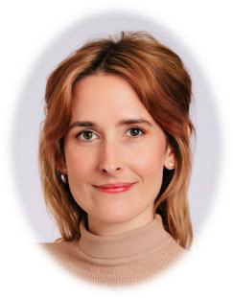

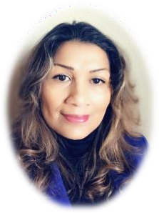
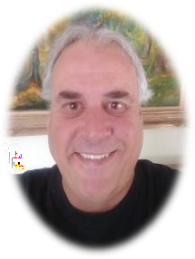
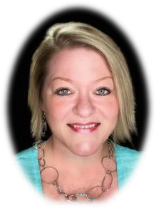
MPI GLOBAL MEMBERSHIP TEAM OVERVIEW
Christine Richards
Manager, Membership Development
Member Engagement Representatives
Jazzlynn Garrett
Pacific US, Midwest US
Marlene Jackson
Northeast US, LATAM
Mark Killgore
Southwest US, Southeast US
Teresa Sauceda
Canada, EMEA & APAC
feedback@mpi.org

Slide 4
Regional Focus: Territories divided up globally.
New Membership: Follow-up with any potential new members that you have already reached out to.
Membership Upgrades: Follow-up with any Essential members that are in your Chapter's area to upgrade to the Preferred or Premier categories.
Profile Updates: If members provide you with new contact information, please ask them to enter the information in their online account profile.
Membership Renewals: This includes current members and those in the grace period.
Other: Installment plans, membership transfers, unemployed members, Student in Transition, retired and lifetime memberships.

Slide 5

68 Chapters & Clubs
Europe 9:
Belgium Luxembourg
France-Switzerland
Iberian
Italia
Netherlands
Poland
Scandinavia
Turkey
United Kingdom/Ireland
North America 49:
USA (42)
Canada (7)
Asian-Pacific 1:
Japan
Mexico 3:
Bajio Mexicano
Caribe Mexicano
Mexico
South America 6:
Colombia
Argentina Club)
Brazil (Club)
Ecuador (Club)
Central America (Club)
Peru

Slide 6
MPI MEMBERSHIP VALUE PROPOSITION
Through innovative solutions for members and Chapters across the globe, MPI advances the meetings and events industry and provides personal and career growth to the professionals in it.
MPI is the premier association that educates, supports and connects the connectors—the people who are passionate
about bringing people together to change the world.

Slide 7
MPI MEMBERSHIP LEVELS
Essential
Member with MPI, but not affiliated with a home chapter
Potentially the best option if there is not a local Chapter in
the member's area
Includes subscription to MPI Global communications like
The Meeting Professional,
industry research, weekly newsletters, and more
Member Directory listing and access
Preferred
Essential level benefits PLUS:
Local Chapter affiliation & discounted rate to all MPI and Chapter events
Opportunity to expand
leadership skills through Committee or Board service
Eligibility for the Chapter Annual Awards at annual recognition event
Premier
Preferred level benefits PLUS:
VIP access at MPI Signature Events
10% discount on registration
for MPI Global Signature Events like World Education Congress (WEC), theEVENT and EMEC
10% discount on MPI Academy
programs (CMP, CMM, and more)
Business & Affiliate Memberships

Slide 8
MPI MEMBERSHIP
If you are an MPI member Preferred or Premier level, you can add these two options:
Affiliate Membership
Opportunity to “affiliate” with other Chapters
100% of dues go directly to the home Chapter!
Chapter sets their own rate
Cross-sell Affiliate Memberships
Business Membership
Organizations qualify with 5+ Members
Reduced membership rates
Single invoicing for the organization
Organizations own the membership, not the individual member

Slide 9
NEW MEMBER ENGAGEMENT FROM MPI GLOBAL
Regular New Member Orientation webinars
Monthly calls from the Member Engagement Team
Welcome emails from Global and the Member Engagement Team including details about orientation and how to access benefits

Slide 10
ANNUAL CHAPTER / CLUB MEMBERSHIP PROMOTION
Each Chapter/Club may request a one- time annual promotion, valid for 20% off NEW MPI memberships.
Promotion can run for up to 30 days, surrounding an event.
Contact the Member Engagement Team at feedback@mpi.org to request the tailored discount code to offer prospects.

Slide 11
Chapter Leaders Resource Page (CLRP) Overview

Slide 12
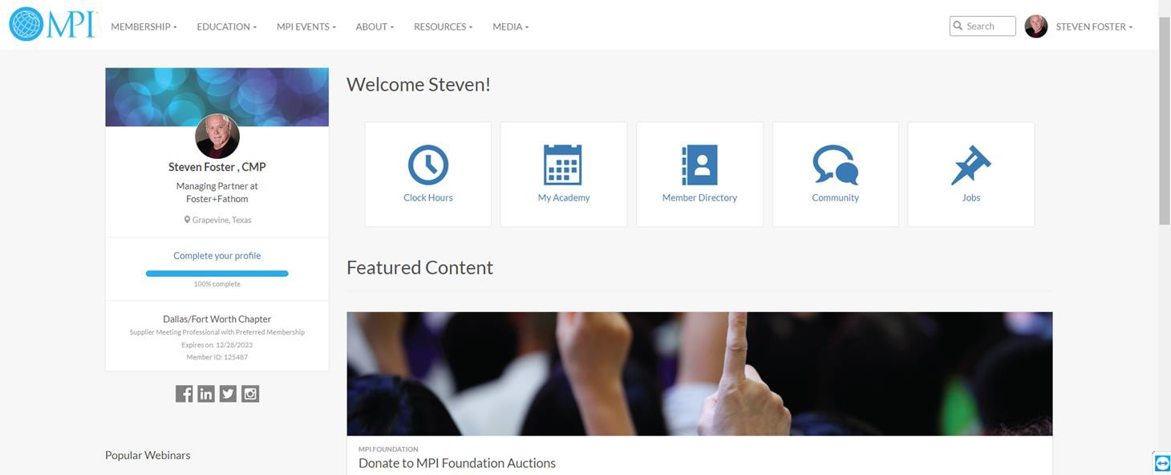
CHAPTER LEADER RESOURCE PAGE (CLRP)
The Chapter Leader Resource Page (CLRP) is located within MPI.org and is only accessible by current Chapter/Club board members.
Here you will find resources, requirements, and templates for the various roles within your board as well as important updates from MPI Global.

Slide 13
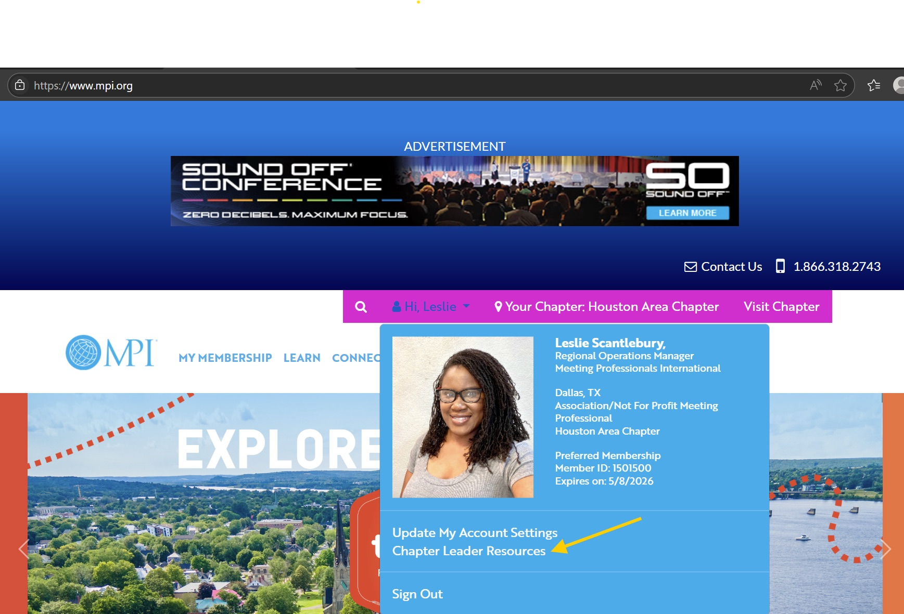
CHAPTER LEADER RESOURCE PAGE (CLRP)
Go to mpi.org and log in.
Click your name at the top right, and select “Chapter Leader Resources”.
Scroll down for buttons to run "Membership" and "Chapter Metrics".
Membership TAB and content areas are below. Select a library and download what you need.

Slide 14
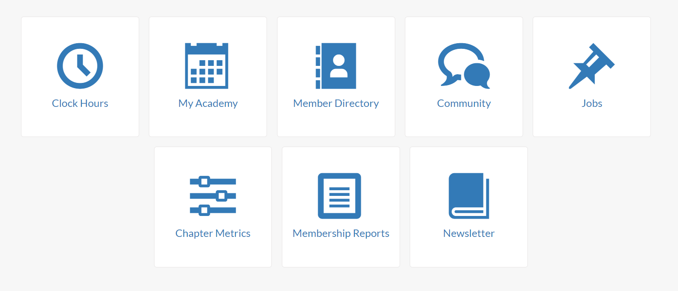
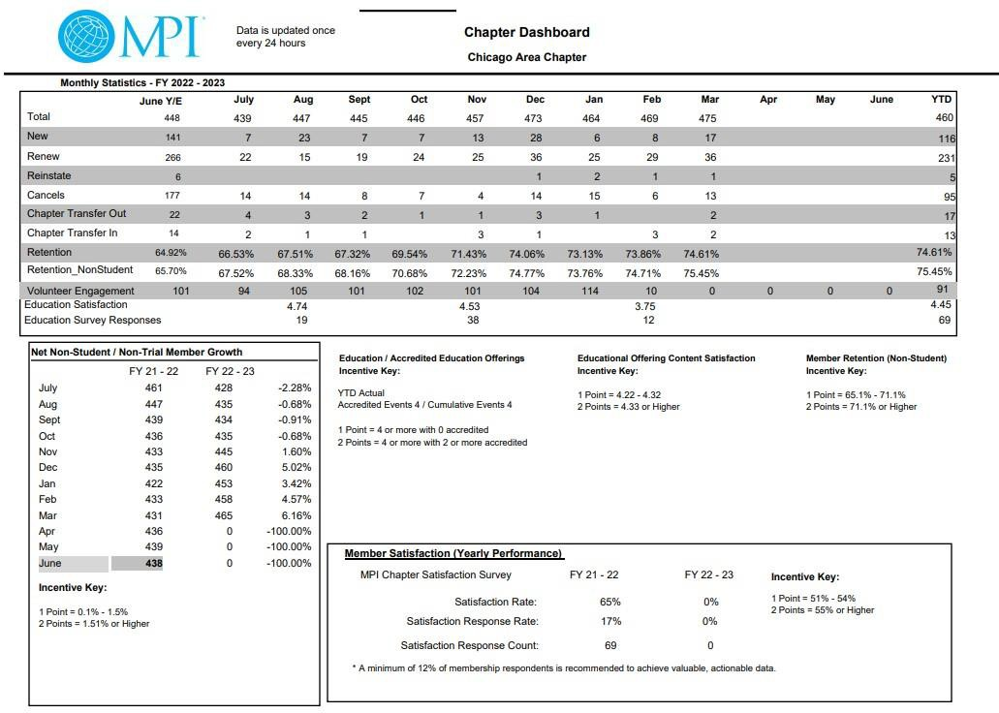


CHAPTER DASHBOARD

Slide 15
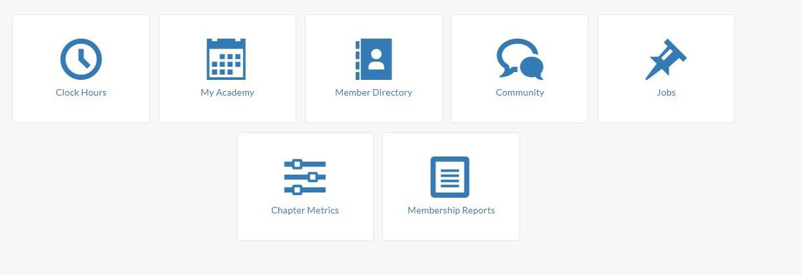
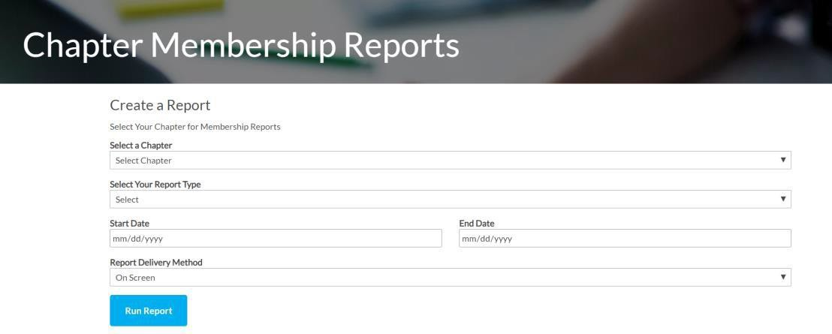


MEMBERSHIP REPORTS

Slide 16
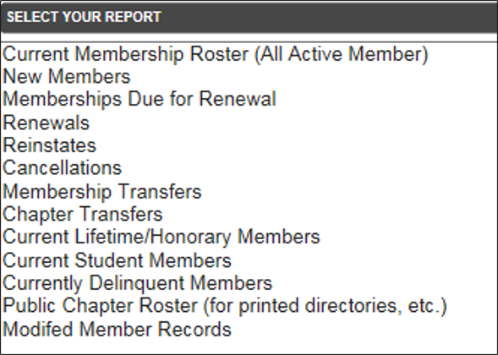
MEMBERSHIP REPORTS
CLRP MEMBERSHIP REPORTS ARE UPDATED EVERY 24 HOURS

Slide 17


MEMBERSHIP REPORTS
VP of Membership
The Chapter Vice President of Membership shall oversee new member recruitment and orientation, member recognition programs, scholarships, and retention. The Vice President of Membership will have access to all membership reports, including new and renewing members, directly from the MPI database.
Chapter Membership Team
Director and Team Supports the VP of Membership (Recruiting new members and connecting with actual members)
Membership Roles & Responsibilities

Slide 18

WHAT IS MEMBERSHIP RETENTION?
Of the total members who existed on a specific date 12 months ago, the percentage of those exact people who are still members on the same date 12 months later
Member retention = Total Current Members / Total Previous Members (Example: A Chapter had 120 members on March 31 last year;
Of those, 95 are still members on March 31 this year; Retention = 95 / 120 = 85%

Slide 19
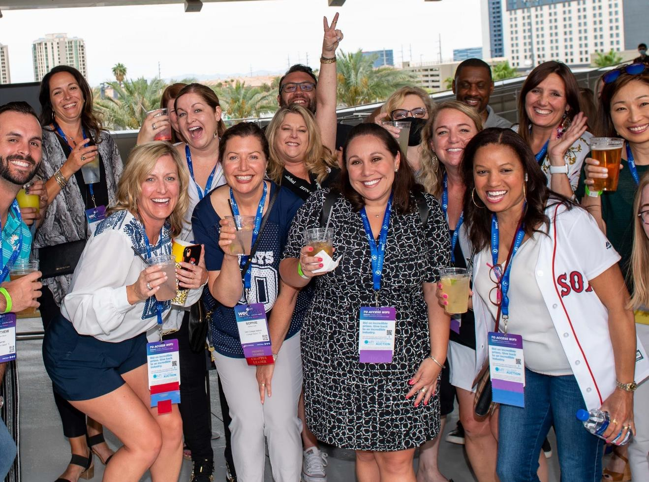
HOW CAN CHAPTERS ASSIST WITH RENEWALS?
Engage your members throughout the year.
Share Chapter accomplishments from the past year.
Highlight benefits for Preferred & Premier levels.
Call & email members on the renewal list.
Know and connect with at-risk members.
Use the Chapter Leader Resources Page (CLRP) to know who is being contacted based on the renewal schedule:
  Click on “Membership Reports”
  Choose “Memberships Due for Renewal”

Slide 20
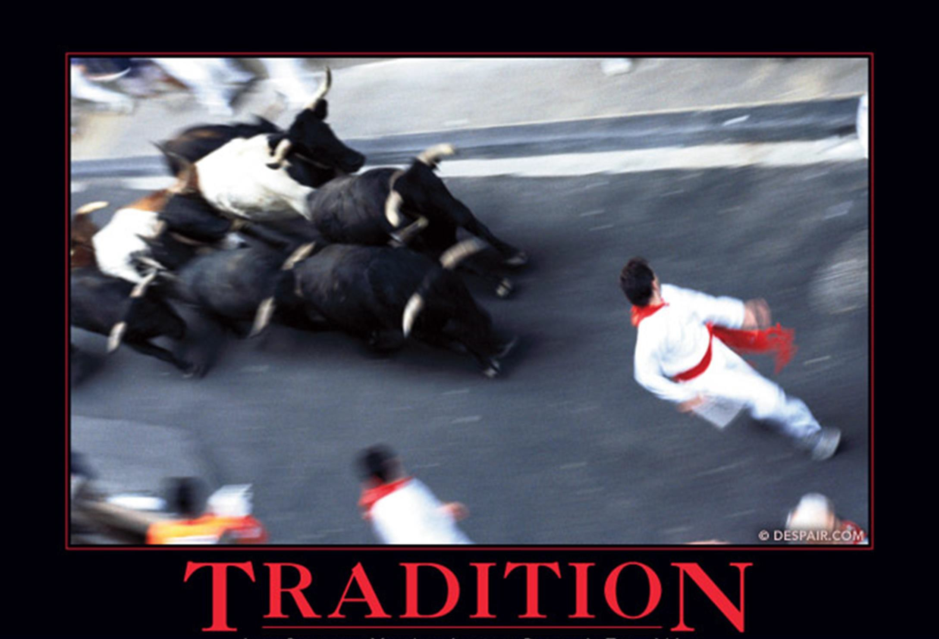
BUILD A DYNAMIC CHAPTER MEMBERSHIP TEAM
At your Chapter Retreat
Set SMART goals aligned with MPI Metrics
Start to build your Committee
Collaborate on Event & Marketing / Communication Strategies
During Your Term
Schedule regular meetings
Keep Chapter metrics dashboard updated
Regularly check the CLRP
Engage with your members
#tellyourMPIstory
Just because you’ve always done it “that way”
raises the question, how’s “that” working for you?

Slide 21
CHAPTER MEMBER ENGAGEMENT
A PERSONALIZED APPROACH
NEW MEMBER EMAIL CAMPAIGN MEMBER NAME, on behalf of the Board of Directors, it is my pleasure to welcome you to the
MPI
CHAPTER NAME. As BOARD TITLE, I want to personally invite you to attend our next event, DAY, DATE at LOCATION TBD.
One of the most productive ways to maximize your MPI membership is by participating in our education and networking events and finding a place to get involved. I’ll follow up this email with a call next week, and perhaps we can find time to meet for coffee or connect on a ZOOM call.
To get the conversation started, I have a few "getting to know you" questions:
What inspired you to join our Chapter?
What has been a professional accomplishment that you like to rave about?
What are three career goals that we can help you achieve?
Thanks for taking time to respond. I look forward to personally helping grow your career and connect with industry colleagues at
MPI
CHAPTER NAME
Sincerely,
SIGNATURE EMAIL FROM BOARD MEMBER
Note: The goal is to build a stronger volunteers base. Members are invited to join specific committees where a need is present. No more committee lists to select from. The board “places” them in an area just to get them involved immediately. This now becomes part of each schedule board meeting. Update the list and contact new members, evaluate previous calls and gauge where members are involved.

Slide 22

MEMBERSHIP RECOGNITION
EVERY

Slide 23
MPI Membership Performance Standards

Slide 24
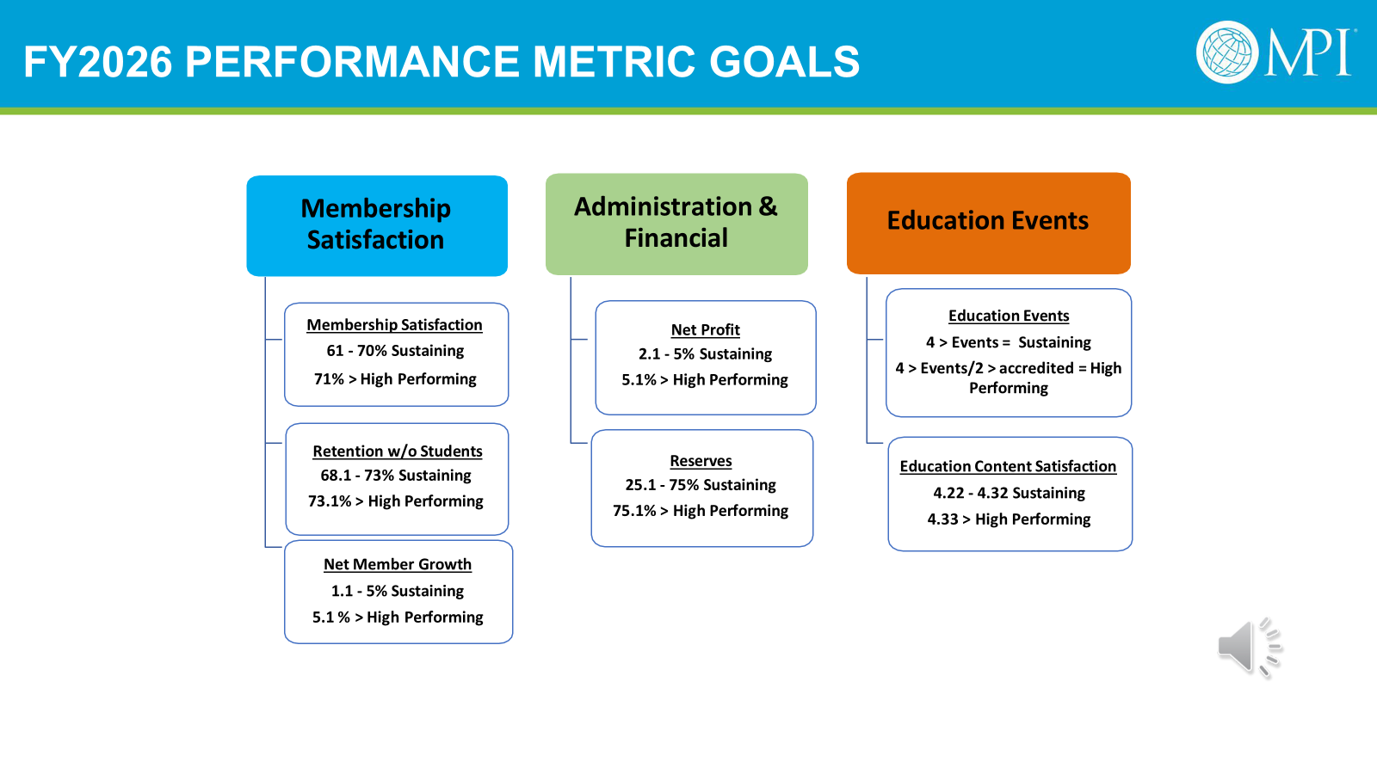
2026 PERFORMANCE STANDARD & METRIC GOALS
Membership Satisfaction
Administration & Financial
Education Events
Membership Satisfaction 61% – 70% Sustaining 71% > High Performing
Clock Hour Accreditation 4 > Events = Sustaining
4 > Events / 2 > accredited =
High Performing
Net Profit 2.1% - 5% Sustaining
5.1% > High Performing
* Retention w/o Students 68.1% - 73% Sustaining 73.1% > High Performing
Reserves
25.1 – 75% Sustaining 75.1% > High Performing
Education Content Satisfaction
4.22 – 4.32% Sustaining 4.33% > High Performing
Net Member Growth 1.1% – 5% Sustaining 5.1% > High Performing

Slide 25
MEANINGFUL MEMBERSHIP PRACTICES

Slide 26
ENGAGEMENT BEST PRACTICES
Form a New Member Committee in charge of welcoming, onboarding, and engaging new members.
Create an Ambassador or Buddy System.
Send a handwritten welcome note to new members from the President or the Board of Directors.
Offer a new member orientation or social gathering at each
event.
Connect with new members by phone or email to understand why they joined MPI and what they hope to get out of membership.
Check in on a quarterly or 6-month basis to see how new members are doing.

Slide 27
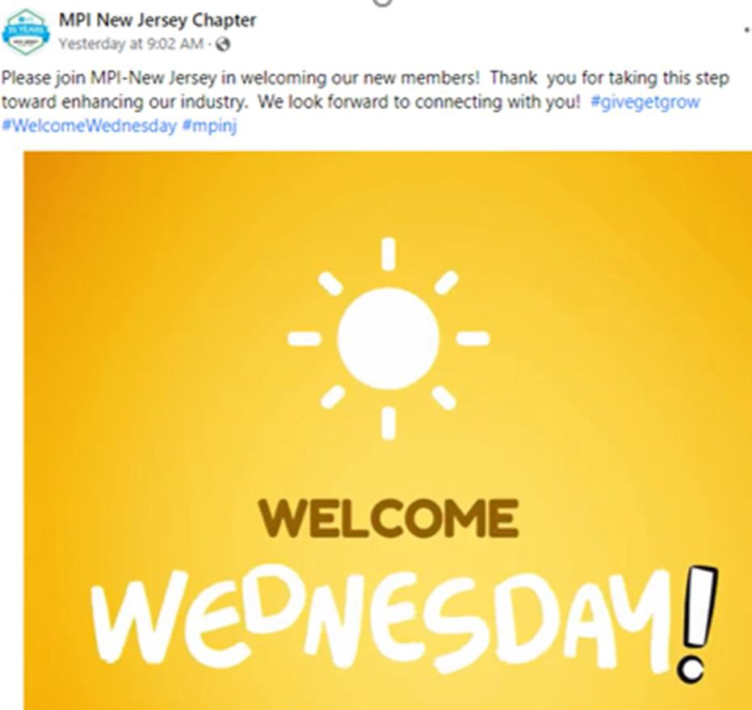
ENGAGEMENT BEST PRACTICES
At your events, assign board/committee members and new members to each table.
Showcase volunteer opportunities.
Reward & recognize members who recruit the most members.
Recognize new members during events & in post-event recaps.
Send handwritten thank-you notes to new members for attending events.
Feature new members in newsletters, social media, &/or your Chapter website.

Slide 28

RECRUITMENT BEST PRACTICES
MORE MEMBERS = MORE REBATES = MORE $ FOR YOUR CHAPTER
WAYS TO ATTRACT NEW MEMBERS
Encourage members to bring guests to events.
Use social media to promote your Chapter and membership.
Promote Business Membership for organizations with 5+ members.
Connect with cancelled members to get them
Reinstated.
Leverage new member campaigns from MPI Global.
Promote MPI Foundation scholarships.
Use your resources from MPI Global –
  CLRP Membership section
  Refer-a-Friend Toolkit
  Justification Letter to Boss
  Top 5 Reasons to Join

Slide 29






MEMBERSHIP IS A SHARED RESPONSIBILITY
CHAPTER PERFORMANCE STANDARDS
MEMBERSHIP ENGAGEMENT
MEMBERSHIP RECOGNITION
MEMBERSHIP PROFESSIONAL DEVELOPMENT
MEMBERSHIP SATISFACTION
MEMBERSHIP GROWTH & RETENTION

Slide 30
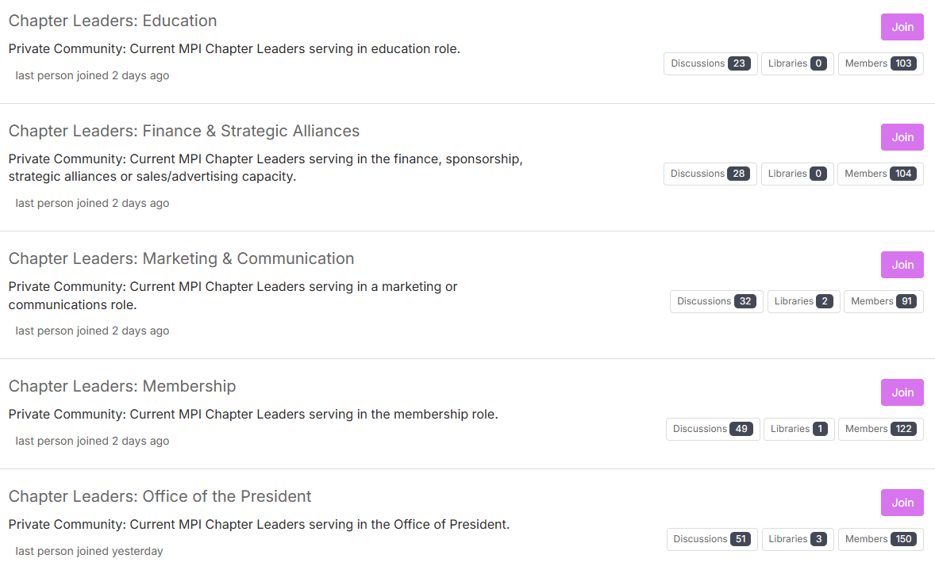
MPI COMMUNITY FORUM: By Department
Notes:
All MPI Volunteer Chapter Leaders have access to ask questions, seek advice or share ideas.

Slide 31
MEMBERSHIP HANDBOOK

