Slide 1


OFFICE OF THE PRESIDENT HANDBOOK

Slide 2
OFFICE OF THE PRESIDENT ROLES OVERVIEW
President
  Face of the Chapter; listen to Chapter members; lead strategy; manage the Board of Directors
Immediate Past President
  Nominations & Governance Chair; advisor and mentor to President
President-Elect
  Very involved in leadership development, attends committee meetings, assist current Chapter President

Slide 3

LEADERSHIP RESPONSIBILITIES
Full Value Concept
Servant leadership
“Freedom within a framework”
Psychological safety
Accountability
Clear direction
Professional growth
Activity alignment
Clear vision
High morale

Slide 4

LAYING THE FOUNDATION
Ensure your team knows the following before your year begins – these are best communicated through a board orientation and at Chapter retreats:
Requirements
Expectations
Accountability
Role Descriptions
Role Readiness
Financial Acumen
Governance Documents

Slide 5
SHARED RESPONSIBILITIES OF THE OOP
W RI TE YO U R SU BT IT LE HERE
CHAPTER PERFORMANCE STANDARDS
PERFORMANCE STANDARDS
NON-PERFORMANCE STANDARDS
MEMBERSHIP SATISFACTION & GROWTH
COMMUNICATION & BRAND
ADMINISTRATION & FINANCE
LEADERSHIP & ENGAGEMENT
EDUCATIONAL OFFERINGS

Slide 6
BYLAW SIMPLIFICATION CHANGES
Requirements
BEFORE
AFTER
Chapter member minimum: Club member minimum:
50 (standard rebate)
30 (reduced bylaws/policies; start-up rebate & $1K funding)
40 (standard rebate)
20 (reduced bylaws/policies; start-up rebate & $1K funding)
7 Minimum Officers: OOP, VP Finance, VP Membership, VP Marketing, VP Education
5 Minimum Officers: OOP, VP Finance, VP Membership Roles only: VP Marketing, VP Education
Board Officers Minimum
Board Officers Maximum
25
20
Board Meetings Minimum
6
4
Education Events Minimum
6 (pre-pandemic)
4
Performance Reviews
2X (mid-year and annual)
1X(annual)
Annual Retreats
2X (annual plus mid-year)
1X (annual with mid-year being optional)
Financial Audit Review
Required
Discretionary/Optional
Board Meeting Absences
Two back-to-back deemed BOD resignation
Flexibility in attendance of board meetings
Global and Chapter Standards
Integrated bylaws and policies
Separated bylaws and policies; Appendix added

Slide 7
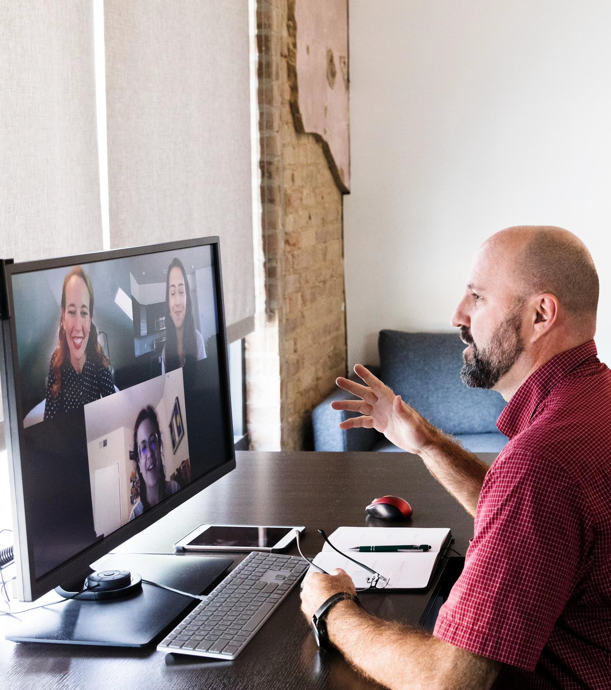
CHAPTER ADMINISTRATION
Paid vendor contracted by the Chapter's BOD
Scope of Services – know your needs
Clear division of labor (who does what)
Compensation determined and approved by BOD
Annual performance review with OOP
Your Chapter Administrator is an important resource and partner!

Slide 8
CHAPTER ADMINISTRATOR
Policies & Guidelines
01
Contract language includes terms from the MPI Chapter Policy Manual found on the CLRP
02
Must provide proof of business license and general liability insurance

Slide 9
THE REGIONAL OPERATIONS MANAGER IS YOUR MPI PARTNER
ROM Responsibilities
Chapter Leader Training
Facilitator Program & Training
Chapter Administrator Training
Chapter Leader Resources & Templates
Evaluating the Effectiveness of Performance Standards & Metrics
Communicating Your Concerns and Ideas Back to MPI Global
Communicating MPI Updates & Important News
Your ROM does not act as your administrator nor does your work for you

Slide 10


























CHAPTER SUPPORT FRAMEWORK
Programs
Platforms & Services
Administrator MPI
Onboarding
Chapter Leadership Summit
Website Management Platform
Accounting Platform
MPI-verified Facilitator
Registration
()
Volunteer Training
MPI HEARS
Regional Operations Managers
Standards
Chapter Bylaws
& Policy Manual
MPI Branding
Performance Metric Goals

Slide 11
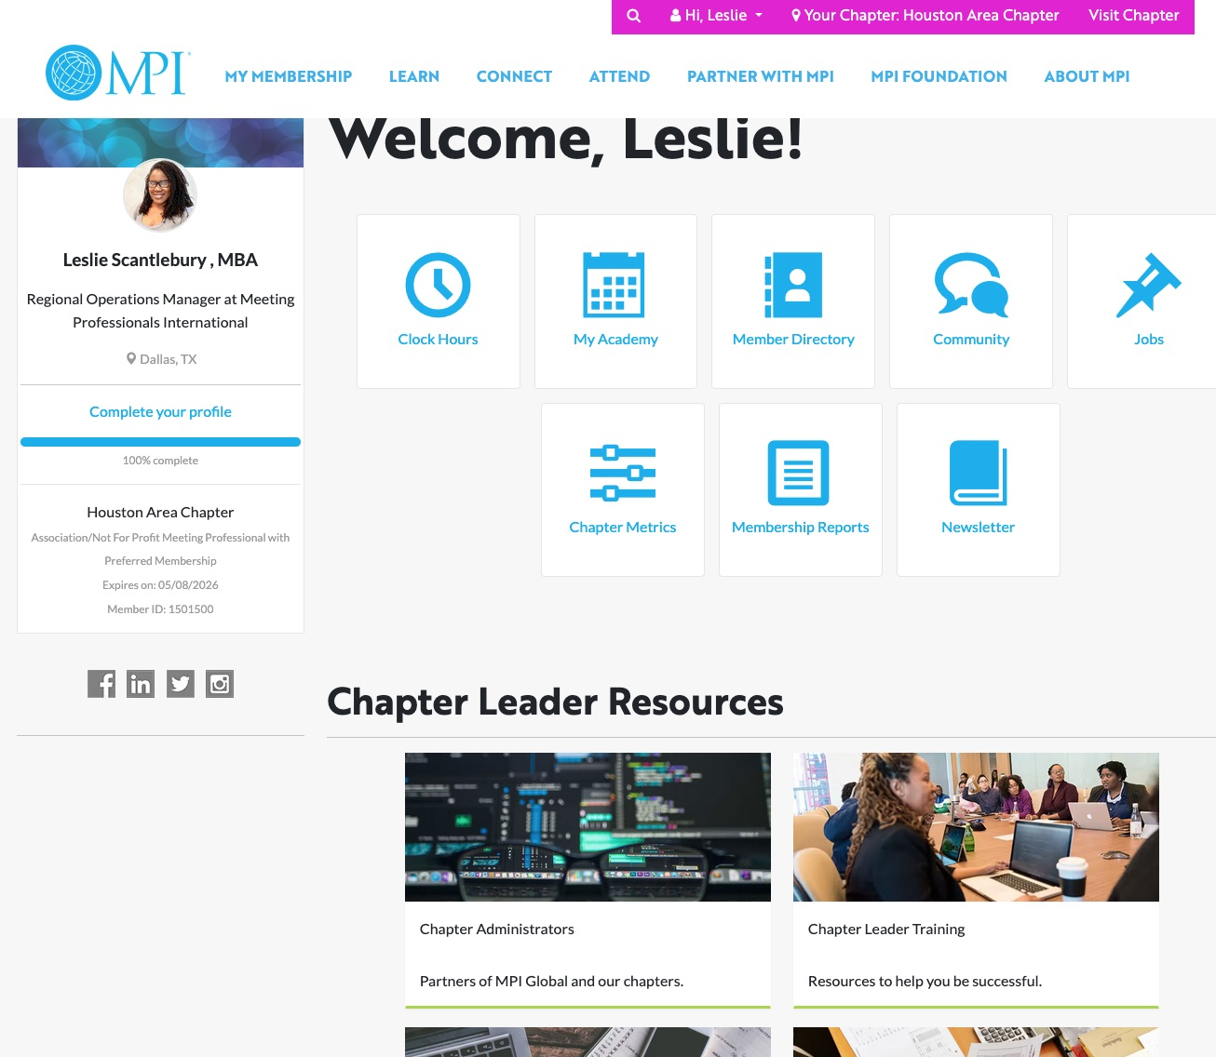
CHAPTER LEADERS RESOURCE PAGE (CLRP)

Slide 12
FINANCIAL OVERSIGHT
Though the VP of Finance actively manages the budget, the OOP is ultimately responsible for financial oversight
The OOP should work with the VP of Finance to plan for/address any revenue shortfalls or unanticipated expenses
If possible, reserves should be replenished to help provide a financial safety net for future boards
Financial controls should be communicated to all board members.
i.e. Who can sign contracts? Who can sign checks? How to apply for reimbursements? Etc.

Slide 13


TAXES/ANNUAL REVIEW
1
2
3
Led by the VP Finance, though responsibility for filing falls to the entire BOD
As OOP, responsibility is to ensure timely and accurate submissions
Where financially feasible, always use the services of a certified public accountant to prepare and file taxes
Benefits of using a CPA include their defense of any potential objection by the taxing agency in your country

Slide 14


Slide 15
MEDIA & OPTICS
Local Chapter press releases are allowed for local events
Run any media requests by MPI to ensure you know the essential talking points and can represent the brand
Comply with 501(c)3 status rules or legal requirements set by your country/region
Contact MPI to get the latest resources and talking points on hot-button issues

Slide 16

OFFICE OF THE PRESIDENT HANDBOOK

