Slide 1


OFFICE OF THE PRESIDENT HANDBOOK

Slide 2
OFFICE OF THE PRESIDENT ROLES OVERVIEW
President
  Strategic oversight - face of the Chapter, listen to Chapter members, manage the Board of Directors, mentor to President Elect
Immediate Past President
  Mentor - Governance & Nominations Committee Chair; advisor and mentor to President
President-Elect
  Learn - very involved in leadership development, attends committee meetings, shadow and assist Chapter President

Slide 3
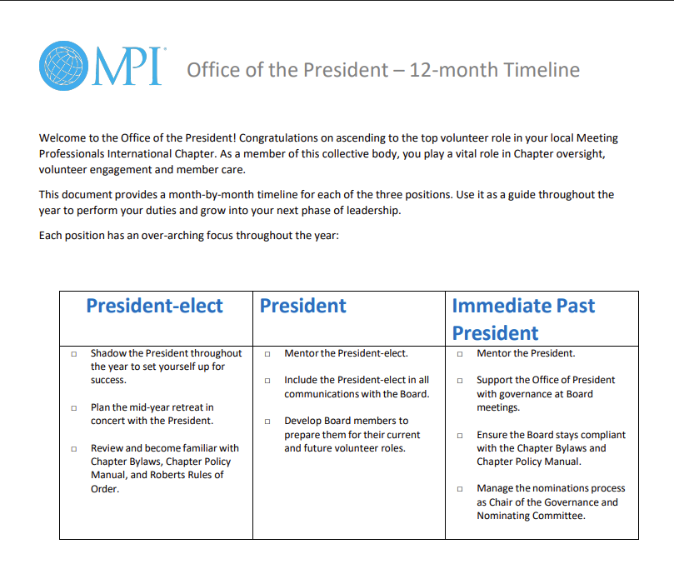
OFFICE OF THE PRESIDENT ROLES
To guide you through the coming term, review the Office of the President 12-month Timeline here: CLRP/Office of the President/Office of President Roles.
This document outlines a monthly focus for each member of the OTP throughout the coming term.
Notes:
The President’s role is to ensure that the board is successfully managing the plans set forth as a whole. It is not his/her job to do the tactical work; his/her responsibility is to define strategy, track progress, and provide general oversight. ​
​
The President Elect’s main job is to learn. This is typically done through interacting with board committees and providing leadership development to board members. ​
​
The Immediate Past President should be mentoring the President and leading the Governance & Nominations committee. Succession planning is EVERYONE’S job but is a particular focus for both the IPP (as chair of the committee) and the PE (who is a non-voting member of the Governance & Nominations Committee). ​
​
Job descriptions or roadmaps are key to understanding your specific responsibilities outside of overall board management and oversight.​
​
Don’t assume that board members automatically understand the division of labor in the OTP. Be prepared to explain who does what, where duties may overlap, and who receives varied communications.​
​
Requirements: Board attendance for ALL board meetings and retreats (in person or virtually is up to you). Timely submission of board reports.​
​
Expectations: Have expectation conversations with each department – what do you expect from them and what can they expect from you?​
​
Accountability: What qualifies as an excused absence? How do board members prefer to receive feedback when they are not meeting expectations? What derelictions of duty might necessitate removal? Have clear ground rules in place prior to needing to deal with a situation.​
​
Role Descriptions: Do they have their job descriptions and understand their role and responsibilities? Did they take their assigned trainings? Have they asked clarifying questions, when necessary?​
​
Role Readiness: Did they participate in transition meetings for their new role? Do they understanding how to ensure business continuity and how to implement new initiatives?​
​
Financial Acumen: Do they know how to read financial statements and manage the budget? What training is needed to assist them in understanding the numbers?​
​
Governance Documents: Did they receive and read a copy of both the MPI and MPI Chapter bylaws and policy manual? Did they submit their conflict of interest form? Do they understand the significance of these documents?​

Slide 4
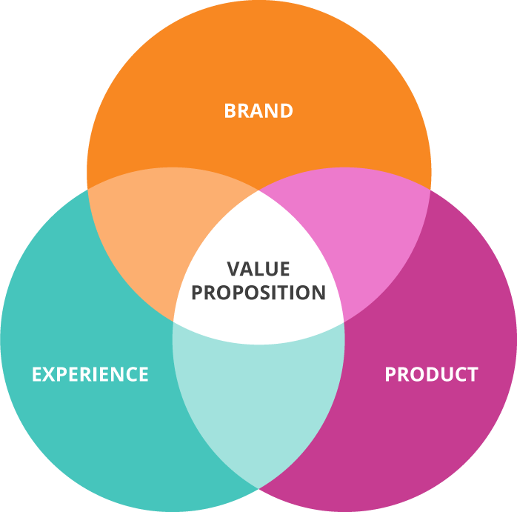
LEADERSHIP RESPONSIBILITIES
Full Value Concept
Servant leadership
“Freedom within a framework”
Psychological safety
Accountability
Clear direction
Professional growth
Activity alignment
Clear vision
High morale
Notes:
What does board leadership look like?​
​
-- It’s about remembering whom are you serving. As a board, you are serving your membership, and as a member of the OTP, you are also serving your board. This is the definition of Servant Leadership. ​
​
- The board is looking to you to give them “freedom within a framework” – i.e. you set the vision and parameters but support each board member’s personal style for getting the work done. It’s not about you. Tap into your team, understand their leadership skills and how they operate….lead to their strengths, not yours​.
​
- Establish “psychological safety”. This means to cultivate an environment where creative abrasion is encouraged in a respectful manner. These safe conversations are often where growth can be achieved! Be willing to address conflict in a fair and equitable manner. Uphold the principles of professionalism. ​
​
Hold board members accountable to their commitments and lead by example. Be on time, be prepared, show up, and be available. That way you can expect the same from the board members. If you are too busy with work and life, they will be too. Don’t ask them to do something that you would not be willing to do. ​
​
Provide and reiterate a clear mission and vision. Define what success looks like – “you need to name it to claim it”. ​
​
- Provide regular feedback and remember that chapter leaders often volunteer for professional growth opportunities – help them learn the ropes and improve personal and team performance. ​
​
- Ensure board members are aligned in their efforts. Working in silos results in duplicative work, inefficiencies, and confusion.​
​
Set the tone for positive board morale. There is a saying that “Culture eats strategy for breakfast.” You can teach strategy, but it can take years to fix a toxic culture. Be supportive, acknowledge contributions, celebrate small wins. Help make the experience fun!​
​
​

Slide 5

LAYING THE FOUNDATION
Ensure your team knows the following before your year begins – these are best communicated through a board orientation and at Chapter Retreats:
Requirements
Expectations
Accountability
Role Descriptions
Role Readiness
Financial Acumen
Governance Documents
Notes:
The President’s role is to ensure that the board is successfully managing the plans set forth as a whole. It is not his/her job to do the tactical work; his/her responsibility is to define strategy, track progress, and provide general oversight. ​
​
The President Elect’s main job is to learn. This is typically done through interacting with board committees and providing leadership development to board members. ​
​
The Immediate Past President should be mentoring the President and leading the Governance & Nominations committee. Succession planning is EVERYONE’S job but is a particular focus for both the IPP (as chair of the committee) and the PE (who is a non-voting member of the Governance & Nominations Committee). ​
​
Job descriptions or roadmaps are key to understanding your specific responsibilities outside of overall board management and oversight.​
​
Don’t assume that board members automatically understand the division of labor in the OTP. Be prepared to explain who does what, where duties may overlap, and who receives varied communications.​
​
Requirements: Board attendance for ALL board meetings and retreats (in person or virtually is up to you). Timely submission of board reports.​
​
Expectations: Have expectation conversations with each department – what do you expect from them and what can they expect from you?​
​
Accountability: What qualifies as an excused absence? How do board members prefer to receive feedback when they are not meeting expectations? What derelictions of duty might necessitate removal? Have clear ground rules in place prior to needing to deal with a situation.​
​
Role Descriptions: Do they have their job descriptions and understand their role and responsibilities? Did they take their assigned trainings? Have they asked clarifying questions, when necessary?​
​
Role Readiness: Did they participate in transition meetings for their new role? Do they understanding how to ensure business continuity and how to implement new initiatives?​
​
Financial Acumen: Do they know how to read financial statements and manage the budget? What training is needed to assist them in understanding the numbers?​
​
Governance Documents: Did they receive and read a copy of both the MPI and MPI Chapter bylaws and policy manual? Did they submit their conflict of interest form? Do they understand the significance of these documents?​

Slide 6
SHARED RESPONSIBILITIES OF THE OTP
METIC GOALS
PERFORMANCE STANDARDS
NON-PERFORMANCE STANDARDS
MEMBERSHIP SATISFACTION & GROWTH
COMMUNICATION & BRAND
FINANCE
LEADERSHIP & ENGAGEMENT
EDUCATIONAL EVENTS
Notes:
Membership Retention & Growth, Finance & Educational Events are all scored and Communication & Brand and Leadership & Engagement are not scored/incentivized.​
​
Annual Performance Standards are part of your partnership with MPI.​
​
There are three areas that are scored metrics and impact how the chapter is incentivized​
Membership Satisfaction & Growth- Membership Satisfaction, Retention, Net Member Growth year over year​
Financial – Net Profit, reserves as measured against the annual fixed expenses​
Education – 4 education offerings and content satisfaction​
​
Then there are two more that we collectively monitor, yet aren’t officially scored or incentivized​
Leadership – Succession, Volunteer Ratio and attending global trainings​
Communications – Brand standards and web/social media outlets​
​
In your role, you are responsible for ensuring that the board understands 1) what these standards are, 2) what it takes to be considered “sustaining” for these standards, and 3) how to manage the business to target these key areas. Your Regional Operations Manager will review where your chapter currently sits as a year-end assessment. It is key that you meet with each of your various board departments to review their areas, the needs associated, and any concerns for performing against these targets.​
​
​

Slide 7
BYLAW SIMPLIFICATION CHANGES
Requirements
BEFORE
AFTER
Chapter member minimum: Club member minimum:
50 (standard rebate)
30 (reduced bylaws/policies; start-up rebate & $1K funding)
40 (standard rebate)
20 (reduced bylaws/policies; start-up rebate & $1K funding)
7 Minimum Officers: OOP, VP Finance, VP Membership, VP Marketing, VP Education
5 Minimum Officers: OOP, VP Finance, VP Membership Roles only: VP Marketing, VP Education
Board Officers Minimum
Board Officers Maximum
25
20
Board Meetings Minimum
6
4
Education Events Minimum
6 (pre-pandemic)
4
Performance Reviews
2X (mid-year and annual)
1X(annual)
Retreats
2X (annual plus mid-year)
1X (annual with mid-year being optional but recommended)
Financial Audit Review
Required
Discretionary/Optional
Board Meeting Absences
Two back-to-back deemed BOD resignation
Flexibility in attendance of board meetings
Global and Chapter Standards
Integrated bylaws and policies
Separated bylaws and policies; Appendix added
Notes:
Our MPI Chapter Simplification Process was introduced a few years back.
​
It’s important to reinforce that these changes were intended to simplify the leadership experience by reducing required minimums.​
​
These minimums will help our Chapter network grow and remain sustainable. While they are, indeed, minimums, it is up to your Board of Directors to evaluate the level of offerings that is most beneficial to your membership which may exceed the minimum standards. ​
​
On the left, you see the previous Chapter Requirements; on the right are the current Chapter requirements.
​
Some areas that I want to highlight:​
Creating a new chapter has become easier – we now only require 40 members to start a chapter and 20 to start a club.
The minimum number of Board Officers is seven, however, every chapter must have five Board Officers minimum. ​
Minimum required Board meetings were reduced to four, however, the number of Board Meetings annually above the minimum is set by the President. ​
Each Chapter must host a minimum of four education events annually. That is the required minimum, however, not necessarily what is in the best interest of your membership.
A Mid-Year Retreat is now optional, however, it is recommended. This is at the discretion of the President.
Annual financial audit reviews are optional, however, they remain a best practice.
​
I want to reinforce again that these adjustments are setting minimum requirements for Chapter governance. This is very important to understand.​
​

Slide 8

CHAPTER ADMINISTRATION
Paid vendor contracted by the Chapter's BOD
Scope of services
Clear division of labor
Compensation determined and approved by BOD
Annual performance review with OTP
Your Chapter Administrator is an important resource and partner!
Notes:
If your chapter works with an administrator or association management company, you want to ensure you have some practices in place to support the overall management of these roles and services.​
​
- Sourcing and Contracting: Administrative support is sourced and contracted at the chapter level, so the chapter is responsible for the administrator’s contract. Typically, this administrator is managed and reviewed by the Office of the President. Does your chapter have a policy that states who reviews the contract, determines price increases, etc.? The board has the authority unless otherwise stated. ​
​
- Scope of Services: All chapters vary in their defined scope of services; it is up to the board as to what responsibilities to assign to the administrator. Common responsibilities include bookkeeping, marketing communications, event registration, etc. However, this is completely up to you to determine.​
​
- Clear Division of Labor: Each board member should be given a copy of the scope of services and understand what is their responsibility versus the administrator’s. Often, there is a lot of crossover and confusion and this is where you risk the ball being dropped because each are not clear on who is responsible for what. It is wise to review your scope of services annually to see if any updates or changes need to be made. Partnership with your administrator is key, they can help you understand in what areas changes may be helpful based on the experience they have from year over year. ​
​
- Compensation: The fees associated with the contracts are also determined at the chapter level and are defined by the scope of service. Fees can vary from region to region and/or based on how extensive the scope of services is. Comparing prices from West Coast to Mid West, for example, might not be comparable due to cost-of-living differences.​
​
- Annual Performance Review: All chapters must provide an annual review of services for the administrator. This should be a conversation - they review their partnership with you and you with them. It’s important to remember these are vendors you have contracted for specific services, not full-time employees. You should be reviewing performance of the scope of services, not the person. While it can be awkward to review someone perceived as a loyal friend, remember that it is your fiduciary responsibility. If you keep the conversation centered on the work and not the person, those conversations should be easier. The Performance Review should be shared with the board and agreed upon in advance of delivery.​
​
- Valuable Partner: If you are not partnering with your administrator to support your overall efforts, you missing out on a great resource! They can be a valuable guide in helping you achieve your goals, membership growth, operational excellence, and succession planning. Depend on them specifically to help you stay on track with governance, MPI global requirements, and timelines.​
​

Slide 9
CHAPTER ADMINISTRATOR
Policies & Guidelines
01
Contract language includes terms from the MPI Chapter Policy Manual found on the CLRP
02
Must provide proof of general liability insurance
Notes:
When you are formalizing a Chapter Administrator contract, keep these things in mind:
The contract should include the entire scope of services in writing.
Contract language provided in the MPI Chapter Policy Manual must be included as provided. This protects the Chapter.
The contract (like all other Chapter contracts) must be signed by both the President and VP of Finance.
​A copy of the contract must be submitted to your Chapter Operations Team member.
Chapter Administrators must provide MPI the following when initially contracted: Copy of Business License, Chapter Operations Form, Complimentary Membership Form
Chapter Administrators must provide MPI the following annually (as part of the compliance process): Proof of general liability insurance.
​
​

Slide 10
THE CHAPTER OPERATIONS TEAM IS YOUR MPI GLOBAL PARTNER
Chapter Operations Team Responsibilities
Chapter Leader Training
Chapter Administrator Onboarding
Chapter Leader Resources
Help Chapters create strategies to successfully achieve metric goals.
Communicating Your Concerns and Ideas Back to MPI Global
Communicating MPI Updates & Important News
The Team does not act as your administrator nor does your work for you
Notes:
Your Regional Operations Manager (COM) is here to support you in your work. They are a guide to ensure you stay on track and hit all your key targets. They are also a resource for support in the leadership areas you will face. Keep them in the loop, have regular calls with them, and include them in the planning process - they are a valuable asset for success!​
​
ROMs can offer guidance on things such as:​
Volunteer Management​
Execution of Business Plan & Budget​
Healthy Financial Performance​
Achieving Performance Standards​
Brand Integrity​
Identifying Talent/Succession Planning​
Global Best Practices​
Chapter Recognition Programs & Awards​

Slide 11
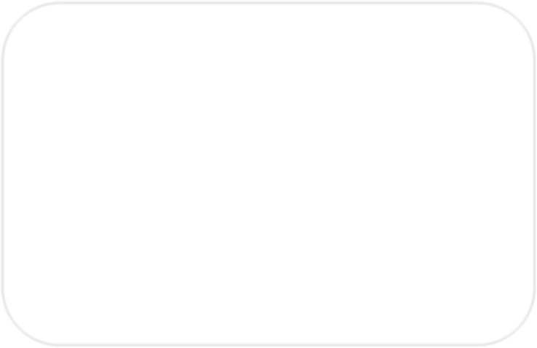
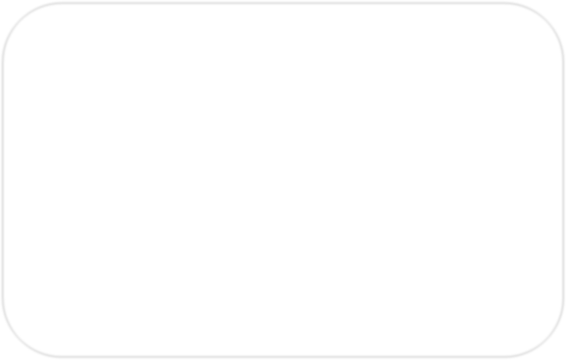
























CHAPTER SUPPORT FRAMEWORK
Programs
Platforms & Services
Administrator MPI
Onboarding
Chapter Leadership Summit
Website Management Platform
Accounting Platform
MPI-verified Facilitator
Registration
Volunteer Training
MPI HEARS
Global Chapter Operations Team
Standards
Chapter Bylaws
& Policy Manual
MPI Branding
Performance Metric Goals

Slide 12
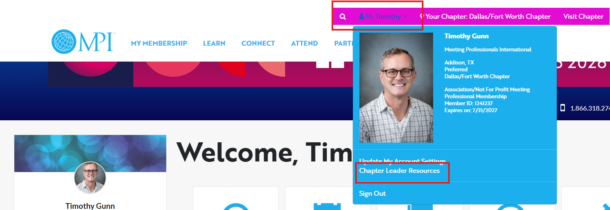
CHAPTER LEADERS RESOURCE PAGE (CLRP)

Slide 13
FINANCIAL OVERSIGHT
Though the VP of Finance actively manages the budget, the OTP is ultimately responsible for financial oversight
The OTP should work with the VP of Finance to plan for/address any revenue shortfalls or unanticipated expenses
If possible, reserves should be replenished if needed to help provide a financial safety net for future boards
Financial controls should be communicated to all board members.
i.e. Who can sign contracts? Who can sign checks? How to apply for reimbursements? Etc.
Notes:
The OTP is responsible for the financial stability of the chapter and to ensure business continuity. If finances become precarious, don’t wait to talk to your ROM! They can help you determine measures to help keep your chapter afloat.​

Slide 14


TAXES/ANNUAL REVIEW
1
2
3
Led by the VP Finance, though responsibility for filing falls to the entire BOD
As OTP, responsibility is to ensure timely and accurate submissions
Where financially feasible, always use the services of a certified public
accountant to prepare and file taxes. Benefits of using a CPA include
their defense of any potential objection by the taxing agency in your
Country.
Notes:
For domestic chapters.​
​
International chapters and clubs should follow their local laws accordingly.​

Slide 15
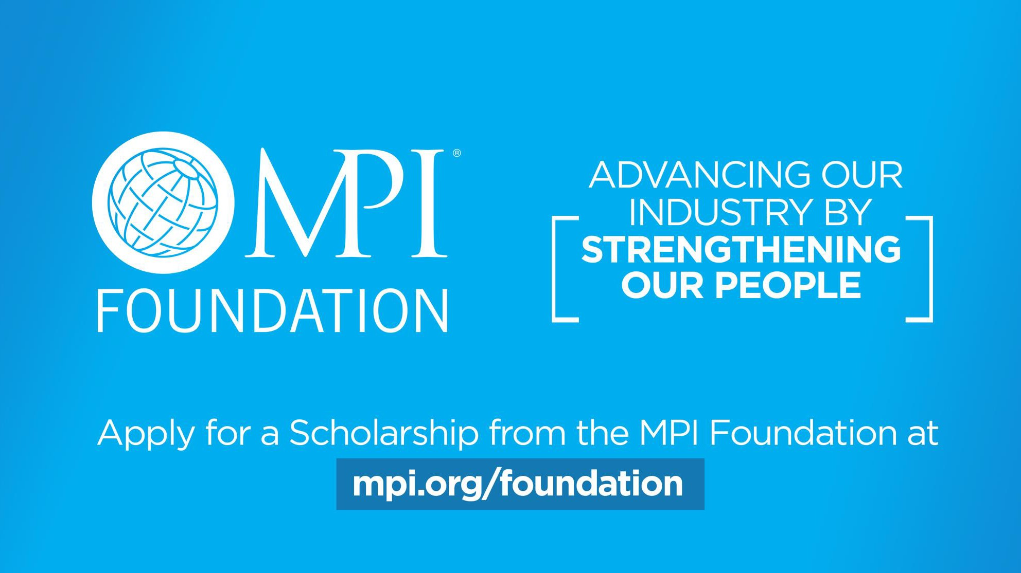

Slide 16
MEDIA & OPTICS
Local Chapter press releases are permitted for local events.
Run any media requests by MPI to ensure you know the essential talking points and can represent the brand.
Comply with 501(c)(3) status rules or legal requirements set by your country/region.
Contact MPI to get the latest resources and talking points on hot-button issues.
Notes:
MEDIA​
Chapters may have a need to create local press releases for events and those are encouraged. You do, however, need to include MPI Global in any formal media address that you may engage in as it relates to MPI’s position on any topic or issue. Because you are a representation of the overall brand, you must be careful when talking to the media about any political issues concerning our industry and our position on them. You should work with MPI Global prior to any statements or articles to ensure that the media team has reviewed them for proper positioning. Because of the 501c3 status in the United States, we have rules to follow as it relates to lobbying and political activities, and the MPI Global staff can guide you on that. In most cases, we can provide a statement that can be used should something arise.​
​
Local chapter press releases are permitted for local events​
Ensure you establish and maintain good relationships with local reporters/newspapers​
Run any media requests by MPI Global to ensure you know the essential talking points and can represent the brand​
Comply with the 501(c)3 Status or legal requirements set by your country/region ​
Signing a letter or attending a protest can be “advocacy” or “politics” and optics matter – if in doubt, ask your ROM​
Contact MPI Global to get the latest resources and talking points on hot-button issues – this includes for social media!​
​

Slide 17

OFFICE OF THE PRESIDENT HANDBOOK

Slide 18
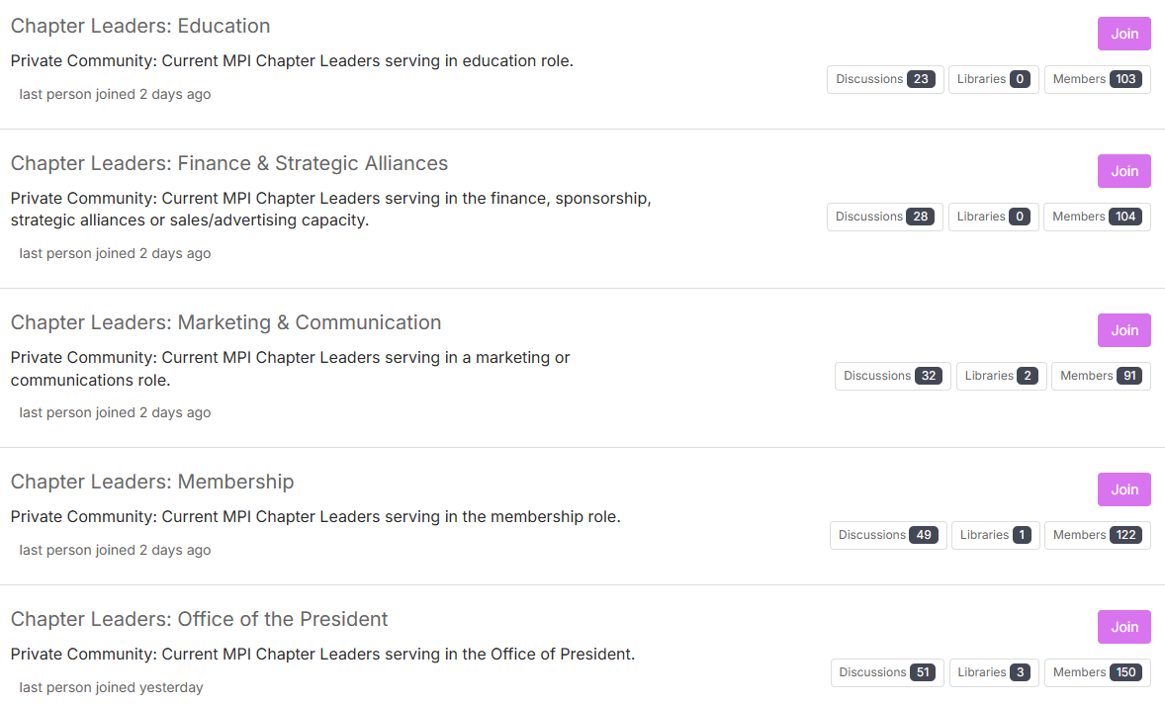
MPI COMMUNITY FORUM: By Department
Notes:
All MPI Volunteer Chapter Leaders have access to ask questions, seek advice or share ideas.

Slide 19
OFFICE OF THE PRESIDENT BEST PRACTICES

Slide 20
PRESIDENT
This is a year of strategic oversight. Dive into Chapter documentation including
  Governance documents (MPI Bylaws and Policy Manual AND MPI Chapter Bylaws and Policy Manual)
  Robert’s Rules of Order
  Chapter administrator contract and scope of services
Governance & Nominations Committee
  Appoint this committee in January after taking office
  No additional involvement in the Nominations process
Replace “I” with “We” in terminology as you oversee Chapter operations

Slide 21
PRESIDENT
Board Meetings
  Review the CLRP for information on what types of decisions require Board motions.
  Ensure Board reports are submitted in a timely fashion.
  Set deadlines and expectations for Board reports with enough time for review before being compiled into the Board Meeting packet. Review to ensure all necessary back-up information is included so Board members can make informed decisions during meetings.

Slide 22
PRESIDENT
Board Meetings (continued)
  Encourage conversation between Board meetings. Not all conversations need to take place around the Board table.
  Ensure Board meeting packet is distributed with enough time for review before the meeting.
  Ensure there is a clear understanding of what constitutes an excused absence from a Board meeting. See Chapter governance documents for more information.
  Monitor Board member attendance at meetings and address if concerns arise.

Slide 23
PRESIDENT ELECT
This is a year of learning. Dive into Chapter documentation including
  Governance documents (MPI Bylaws and Policy Manual AND MPI Chapter Bylaws and Policy Manual)
  Robert’s Rules of Order
  Chapter administrator contract and scope of services
Shadow the President – ask questions
Governance & Nominations Committee
  Non-voting member
  Provide feedback to the committee and information on your upcoming priorities
  Do not attempt to dictate Board selection
  Remember this isn’t “my” Board – it is the Chapter’s Board

Slide 24
IMMEDIATE PAST PRESIDENT
This is a year of mentoring.
  Aid the Chapter President by mentoring them and assisting when requested.
  Avoid attempting to retain control of the Chapter and/or Board. That is no longer your role.
  Avoid the “this is how we’ve always done it” response to new ideas and processes.
Governance & Nominations Committee
  Chair the committee that has been appointed by the President.
  Lead the board slating process (including review of current organizational chart with the sitting Board).
  Once the board slating process is complete, the work continues to grow the volunteer pipeline.

Slide 25
IMMEDIATE PAST PRESIDENT
Governance & Nominations Committee (continued)
  Throughout the year, serve as a governance resource to the Board of Directors.
  Ensure Chapter policies and procedure documents are current. Revise if necessary – working through the Governance and Nominations Committee and then voted on by the sitting Board.

Slide 26
OFFICE OF THE PRESIDENT BEST PRACTICES

