Slide 1
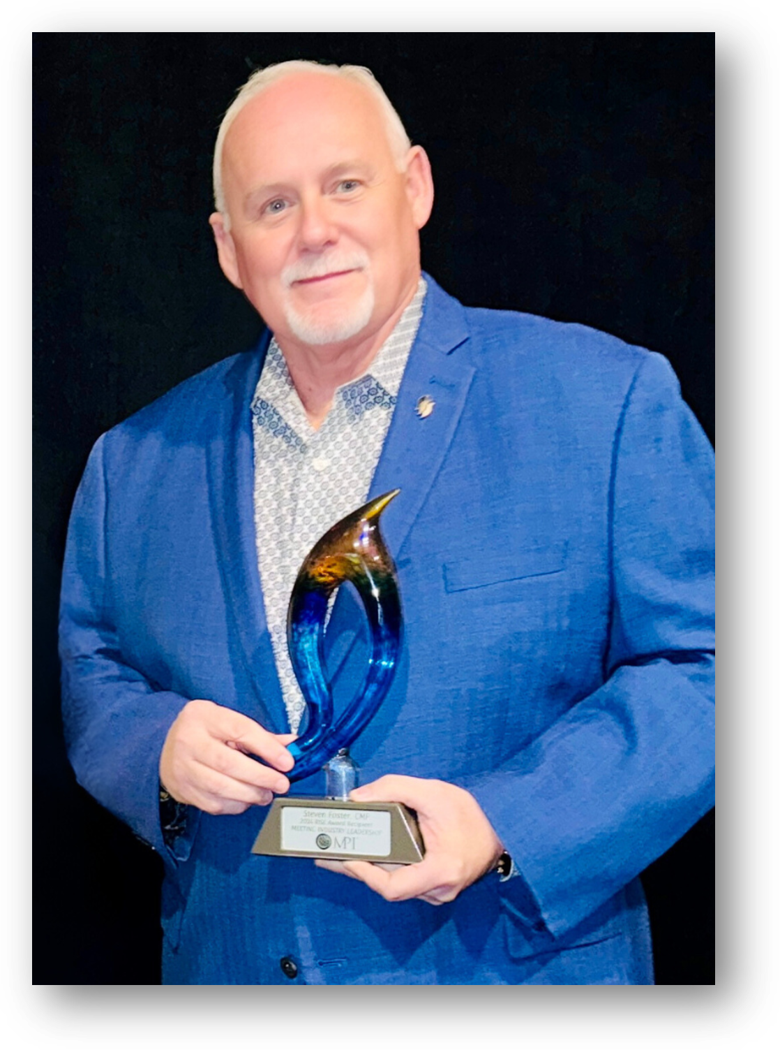
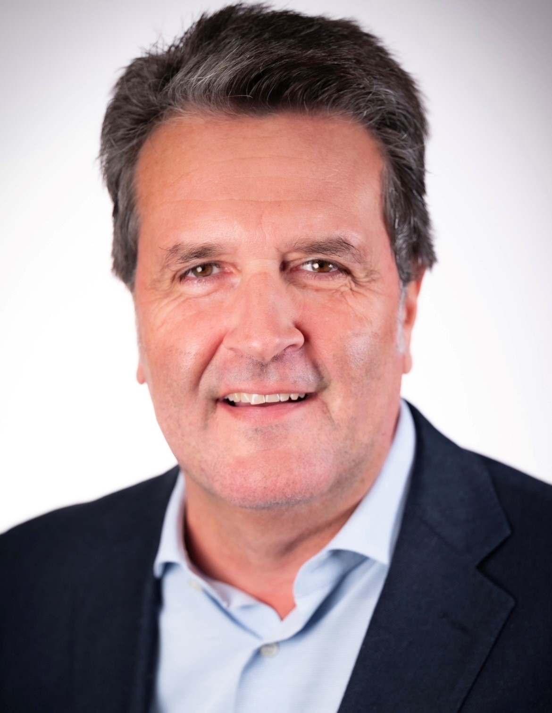


CHAPTER LEADERS' SOLUTION ROOM finance-sponsorship BREAKOUT session
Thursday, May 8, 2025
Steven G. Foster, CMP
Managing Partner
Foster+Fathom
MPI SW Region US Council Chair
Federico Toja
Director Chapter Operations Europe
Meeting Professionals International
This breakout session will be recorded so that it can be shared with any board members not currently on the call today. Please keep microphone muted & use the chat for questions

Slide 2

TOPICS FOR CONVERSATION
MPI QuickBooks Training (CLRP)
  Chapter Leader Resource Page
RISE Award Finance Submissions (CLRP)
  MPI SOCAL Online Advertising Portal
  MPI Mexico Planner Sponsored Tables
  MPI Wisconsin Chapter Marketplace Excellence
Regional Council Support
  FY2025 Goals

Slide 3
QUICKBOOKS TRAININGS
Online Training #1 – Completed 3/4/2025
Online Training #2 - July 31, 2025
Recording posted on CLRP

Slide 4
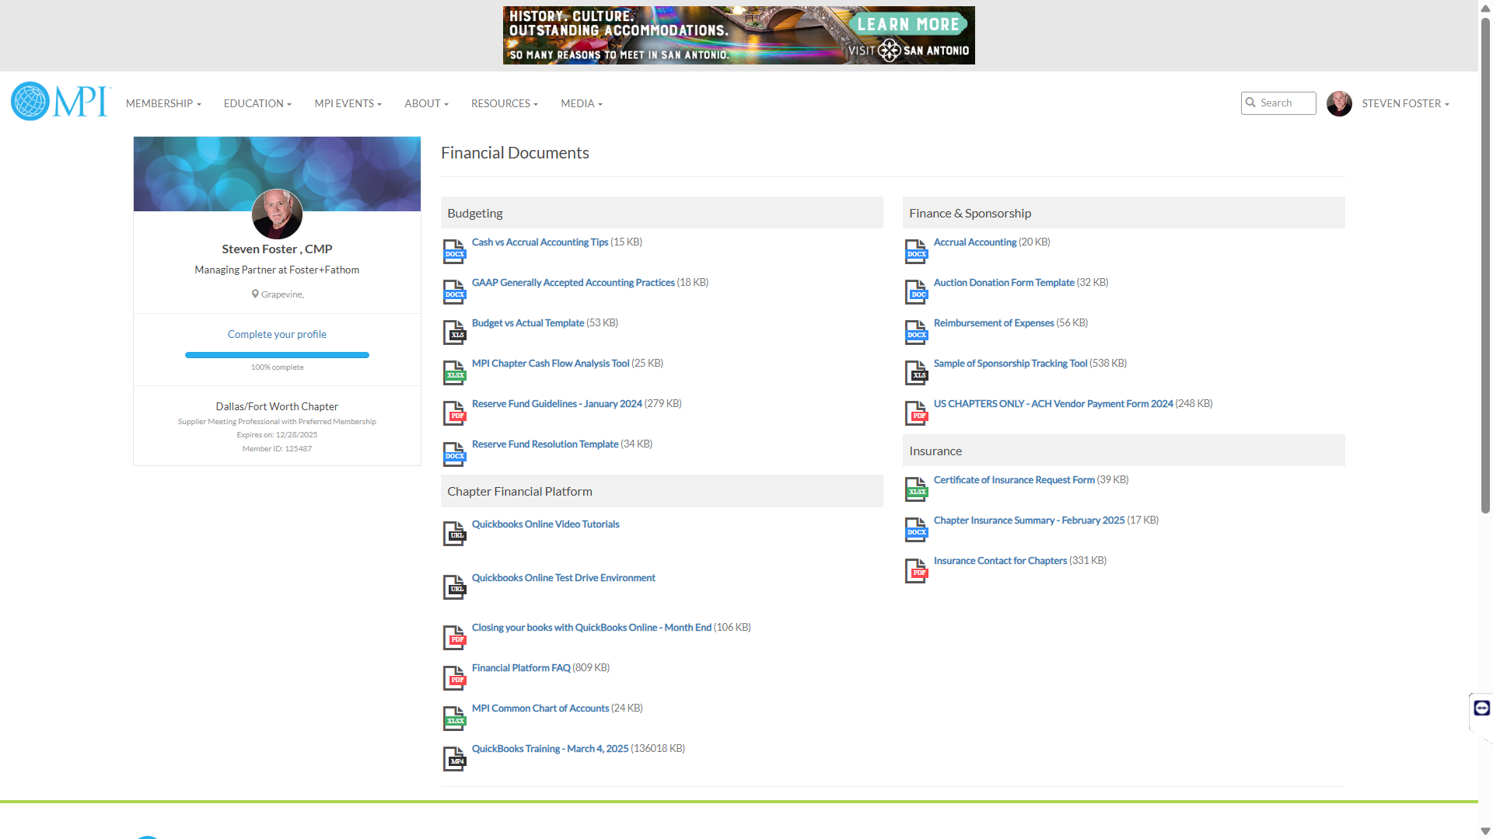





Slide 5

Chapter SPONSORSHIP Best Practices
1. Research and Understand Potential Sponsors
  Tailor the Ask - (don't use a one-size-fits-all approach)
2. Develop a Compelling Sponsorship Proposal
  Identify your goals - (increased membership, funding, awareness)
  Highlight unique opportunities – (showcase value-added benefits)
  Customized sponsorship package – (tiered levels of investment ROI)
3. Leverage Relationships
  Treat and promote sponsors like partners, not just donors.
  Track the impact of the sponsorship and measure success against goals
  Provide value to sponsors and actively promote them
Chapter Partnerships

Slide 6
MPI Regional Council SUPPORT
2025 Council of Regional Chairs
Charles Bello, Board Liaison
Nicole Newman, Board Liaison
Timothy Gunn, Staff Management Liaison
MaryAnne Bobrow – Pacific US
Steven Foster – Southwest US
Shannon Jones – Southeast US
Pamela Kammerer – Northeast US
William Kubiak – Midwest US
Ricardo Magana – LATAM
Suzanne Medcalf Mulligan - EMEA & APAC
Helene Moberg - Canada
The Council of Regional Chairs will be responsible for fostering collaboration, excellence, and continuous improvement across the established MPI regions, providing strategic direction, benchmarking, best practices and mentorship. They will create a cohesive and effective regional council that will support and empower their respective regions, while providing mentorship and support to Chapter leaders.
The Regional Chairs will enhance their leadership skills, share knowledge and work with their regions to implement best practices. The goal is to provide strategic leadership and promote consistency, innovation and the highest standards of performance across all regions.

Slide 7
Q & A

Slide 8
THANK YOU!

