Slide 1
THE SOLUTION ROOM
May 8, 2025
Notes:
Welcome to The Solution Room Winter 2025
Chat box
MPI Chapter
Chapter Leader Title

Slide 2


WELCOME!
Break out rooms will open shortly
Office of the President
Marketing & Communications
Finance & Sponsorship
Education
Membership
Chapter Administrators
Each breakout room session will be recorded and shared on the Chapter Leader Resource Page under the Chapter Leader Training Section.
Notes:
Here is a list of the breakout rooms for today’s Solution Room. We will jump into the rooms shortly so hang tight.

Slide 3
Today’s agenda
Resources to Assist You
Upcoming Trainings
WEC 2025
Breakout Sessions by Departments
This call will be recorded so that it can be shared with any board members not currently on the call today. Please keep microphone muted & use the chat for questions
Notes:
Before we open our breakout rooms, I am going to take a few minutes to share some updates on projects and programs designed to support you and your teams.

Slide 4
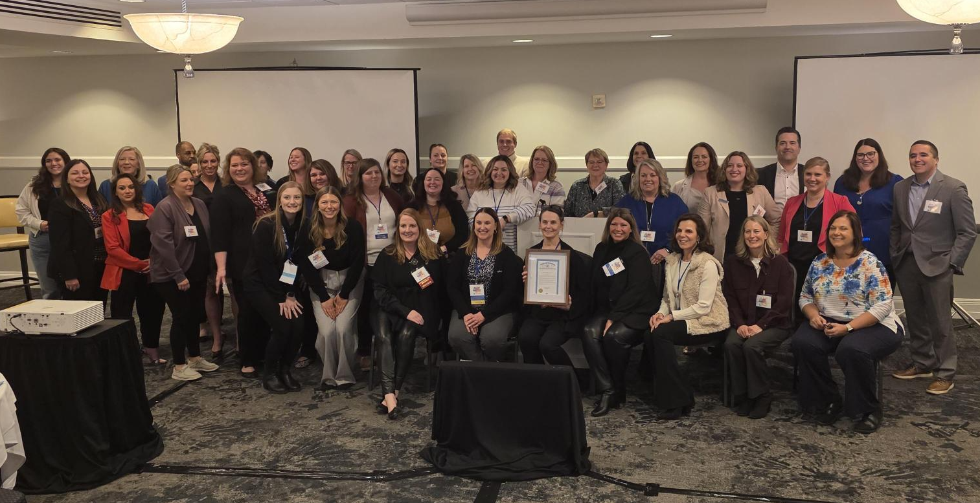
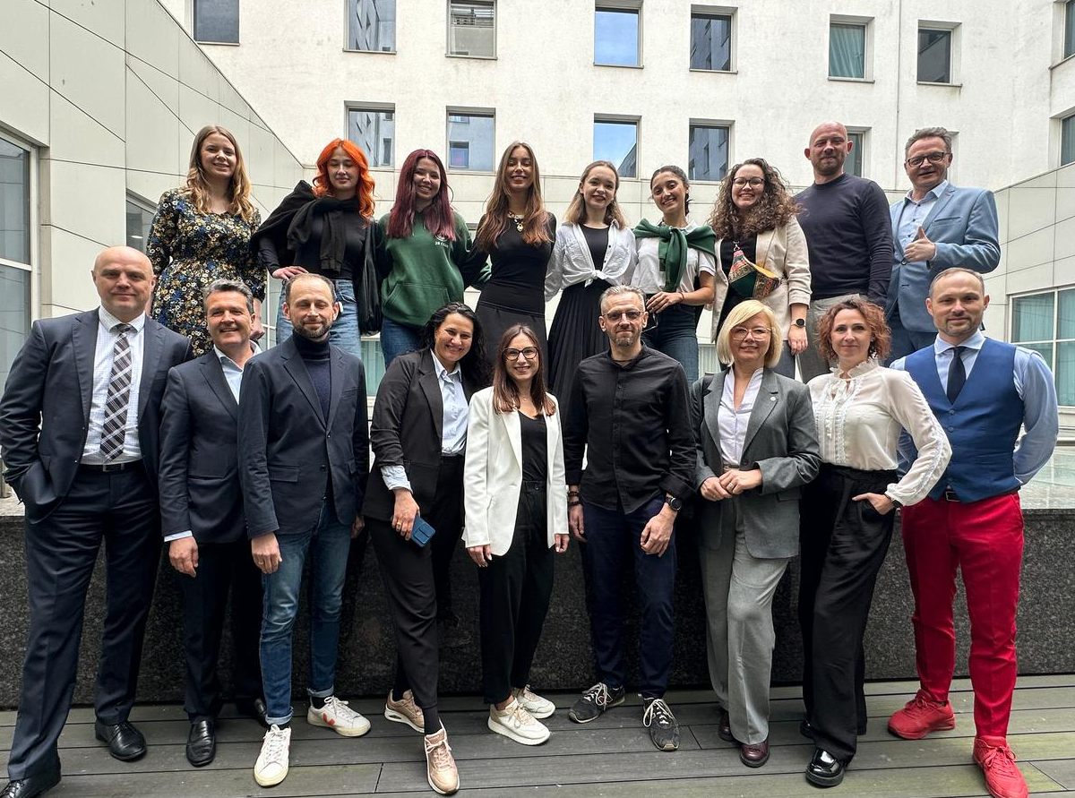
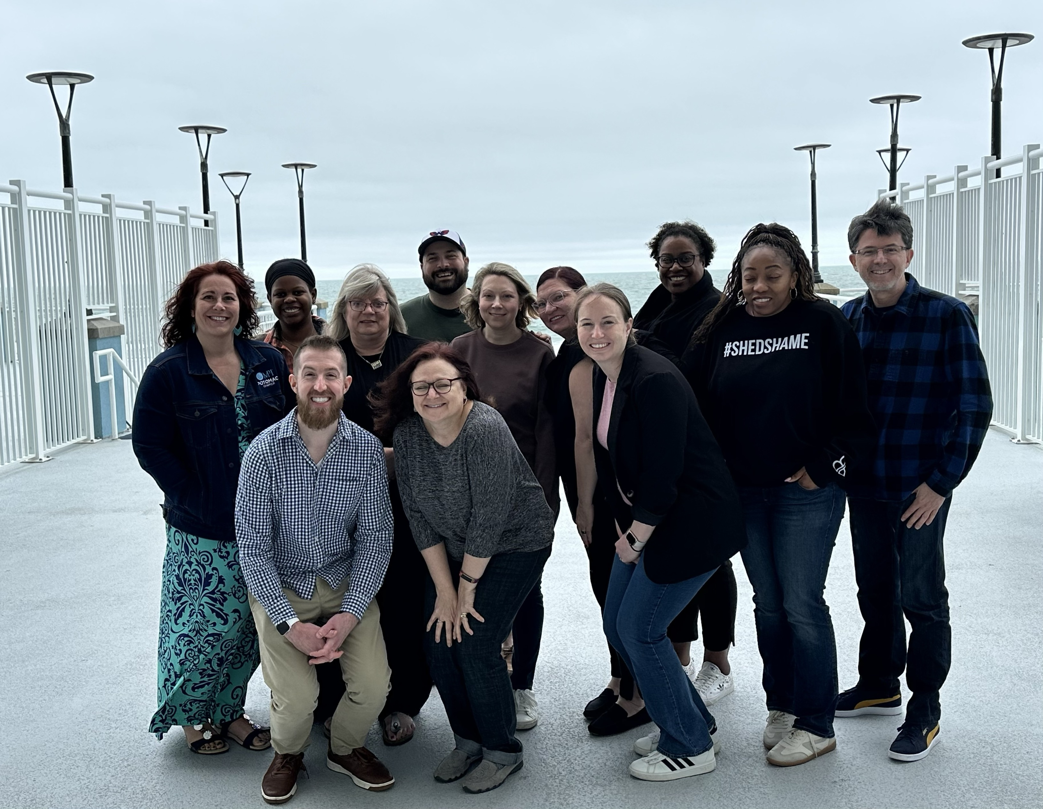
Midyear Retreats

Slide 5
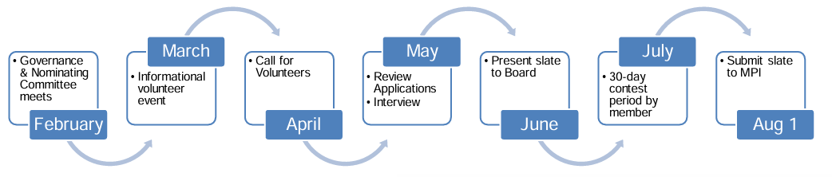
FY2026 Nomination Process

Slide 6
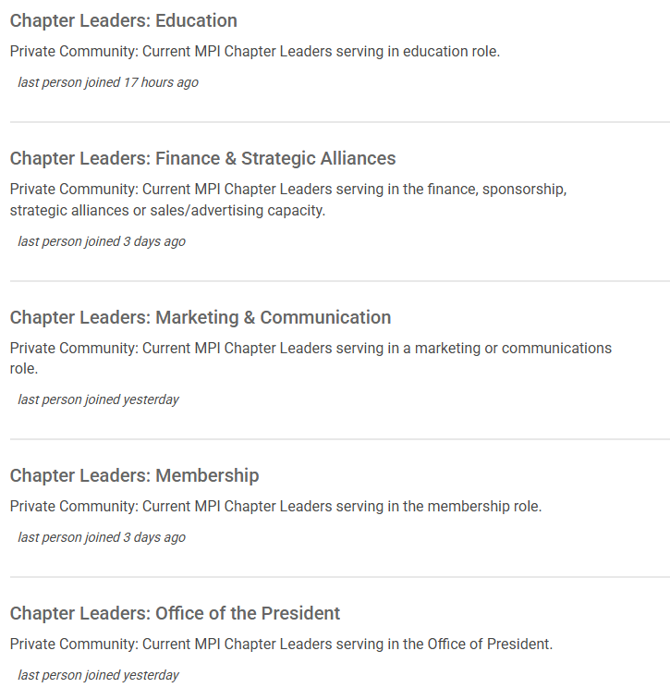
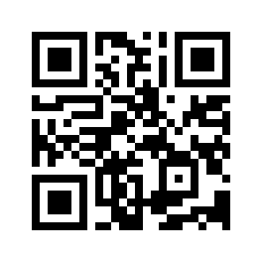
MPI Communities by department
Available to all FY2025 Volunteer Chapter Leaders
Ask questions or seek guidance from other leaders
Notes:
AL:
Since our last update, we have officially launched the long-anticipated Volunteer Chapter Leader Communities on MPI.org. Each leadership domain has a community for current Volunteer Chapter Leaders to interact, ask questions and share best practices to make our MPI ecosystem stronger! If you are new to MPI Communities, be sure to log in and set your communication preferences. Join the conversation today!
Now, over to Leslie.

Slide 7
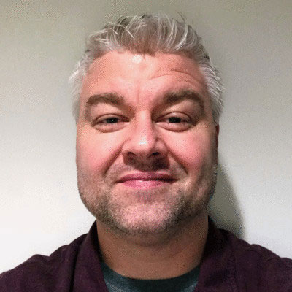
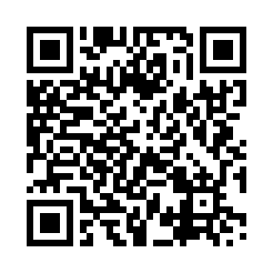
Sitefinity Training
June 26
10:00 – 11:00 AM CDT
Learn how to update the chapter website.
Bring questions or issues.
Register Online!
Jay Hough
Director of Technology

Slide 8
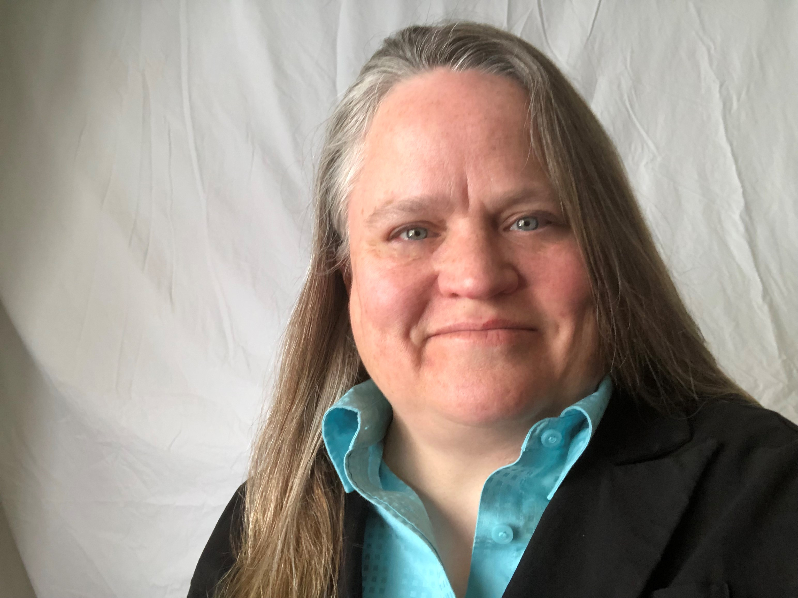
Quickbooks Training
July 31
10:00 – 11:00 AM CDT
Anyone can attend.
Bring questions or issues.
Register Online!
Jean Esch
MPI AP/AR Coordinator

Slide 9

Chapter Leader Discount
For all 2025 Board Members and Chapter Admins.​
To register, use the link on the Chapter Leader Newsletter webpage.​
Chapter Leaders must use the dedicated URL when registering.
No registration deadline!
Notes:
Add WEC to your chapter website.
Send this information to your current Board Members

Slide 10
Chapter Leader Lounge
Wednesday
Volunteer Chapter Leader Reception
Thursday
Navigating the Volunteer Lifecyle: From Enthusiasm to Fatigue and Back Again
Stronger Together: Unlocking the Power of Regional Collaboration
Friday
From Conflict to Clarity - Fostering a Culture of Collaboration and Mutual Respect
Do I Need a Motion for That?
Notes:
Add WEC to your chapter website.
Send this information to your current Board Members

Slide 11
Chapter Challenge
It only take one ticket to win!
Chapters in the Challenge:
MPI Aloha Chapter
MPI Arizona Sunbelt Chapter
MPI Gulf States Chapter
MPI Heartland Chapter
MPI Indiana Chapter
MPI Kansas City Chapter
MPI Michigan Chapter
MPI North Florida Chapter
MPI Northern California Chapter
MPI Potomac Chapter
MPI St. Louis Area Chapter
MPI United Kingdom & Ireland Chapter
MPI Wisconsin Chapter
Notes:
Add WEC to your chapter website.
Send this information to your current Board Members

Slide 12
BREAKOUTS
Office of the President – Tara Liaschenko, Facilitator, Steven Foster, Facilitator, & Angela Layton, MPI Regional Operations Manager
Marketing & Communications – Nicole Coon, Facilitator & Mark Kilgore, MPI Membership Engagement Representative
Finance & Sponsorships – Federico Toja, MPI Director of Chapter Operations – EMEA & LATAM
Membership – Christine Richards, MPI Manager Membership Development
Education – Mark Bice, Facilitator, & Tim Luepke, Director MPI Academy
Chapter Administrators – Leslie Scantlebury, MPI Regional Operations Manager
Your room end early? Join us in another room.
Notes:
TIM:
Now its time for our breakout sessions. We have a team of subject matter experts waiting for you to join them. They will facilitate our 5 breakout sessions. Pick your breakout from the buttons your Zoom navigation bar. We will end the breakout rooms in approximately 30 minutes. Have fun and see you back here at the end of today’s Solution Room.

Slide 13
Q&A

