Slide 1
FOUNDATION
SECURING TOMORROW BY
STRENGTHENING TODAY

Slide 2


Welcome
Kevin Kirby
IBOD, Chapter Liaison

Slide 3

Why contribute to The MPI Foundation?
The MPI Foundation fuels the growth and advancement of MPI Members by providing them professional development and career opportunities through grants and scholarships. The MPI
Foundation also propels the meetings and events industry by funding innovative research and pan industry initiatives that support the strategic plan of MPI.
When you give to the MPI Foundation, you are actively growing the knowledge base of the MPI global community. By creating bedrock of smart and talented MPI members, you are nurturing the people that move your industry forward. It’s an investment in the strength of the MPI global community, and in securing the future success of the industry. Proceeds from the event will go directly back into the meeting and events industry to help fund the MPI Foundation.

Slide 5
Christine Roberts
Foundation Director

Slide 6
Thank You!

Slide 7
Foundation Revenue Sources
Foundation Funds
Global Events
31.1%
New Sources
Corporate Giving
50.2%
Chapter Giving
2.9%
Individual Giving
.5%

Slide 8
Upcoming Events for Foundation
IMEX Frankfurt: Auction, Cim-Clubbing @Gibson Club
WEC
  MPI Hub Central – Text 2 Give
  Rendezvous WEC – June 4
MPI Foundation Cocktails for Charity @ The Meetings Show UK– June 27
Rendezvous@ Destinations International, Anaheim– July 10
Rendezvous @ibtm Americas, Mexico City – September 5
Rendezvous @IMEX America, Las Vegas – October 17
Thought Leaders Summit November 4 – 8 – UNICO, Riviera Maya, Cancun

Slide 10
Foundation Distribution
Foundation Funds
Global Research
Endowment
Major Grants
Chapter Grants
Member Scholarships
Designing Inclusive Experiences
Research Project
WEC Scholarships
CMM/CMP, EMEC, Experiential
Events, IMEX America
Helps us prepare for the future, fund operations expenses from interest to maximize $ distributed to community
Opportunities for education, developed
Content programs, speaker education, from
Education Fund, or branded corporate
Sponsors – like American Airlines Women in
Leadership; FMAV #Event Design; MCI (in
Development), others
* Connections to Career: C2C, with
Sunshine Education Summit –
4 Florida chapter Regional conference
* the EVENT Conf. Ottawa – 3 chapter
Regional conference.

Slide 11
WEC Scholarships and Grants
WEC - $61,317 in Annual Education Fund Scholarships
WEC - $24,000 in Branded Scholarships – Algonquin College, Wyndham, and The International Centre
$35,000 EMEA, Japan and Brazil – WEC scholarships for PE
Grant – Connections to Career: C2C

Slide 12
Tools

Slide 13
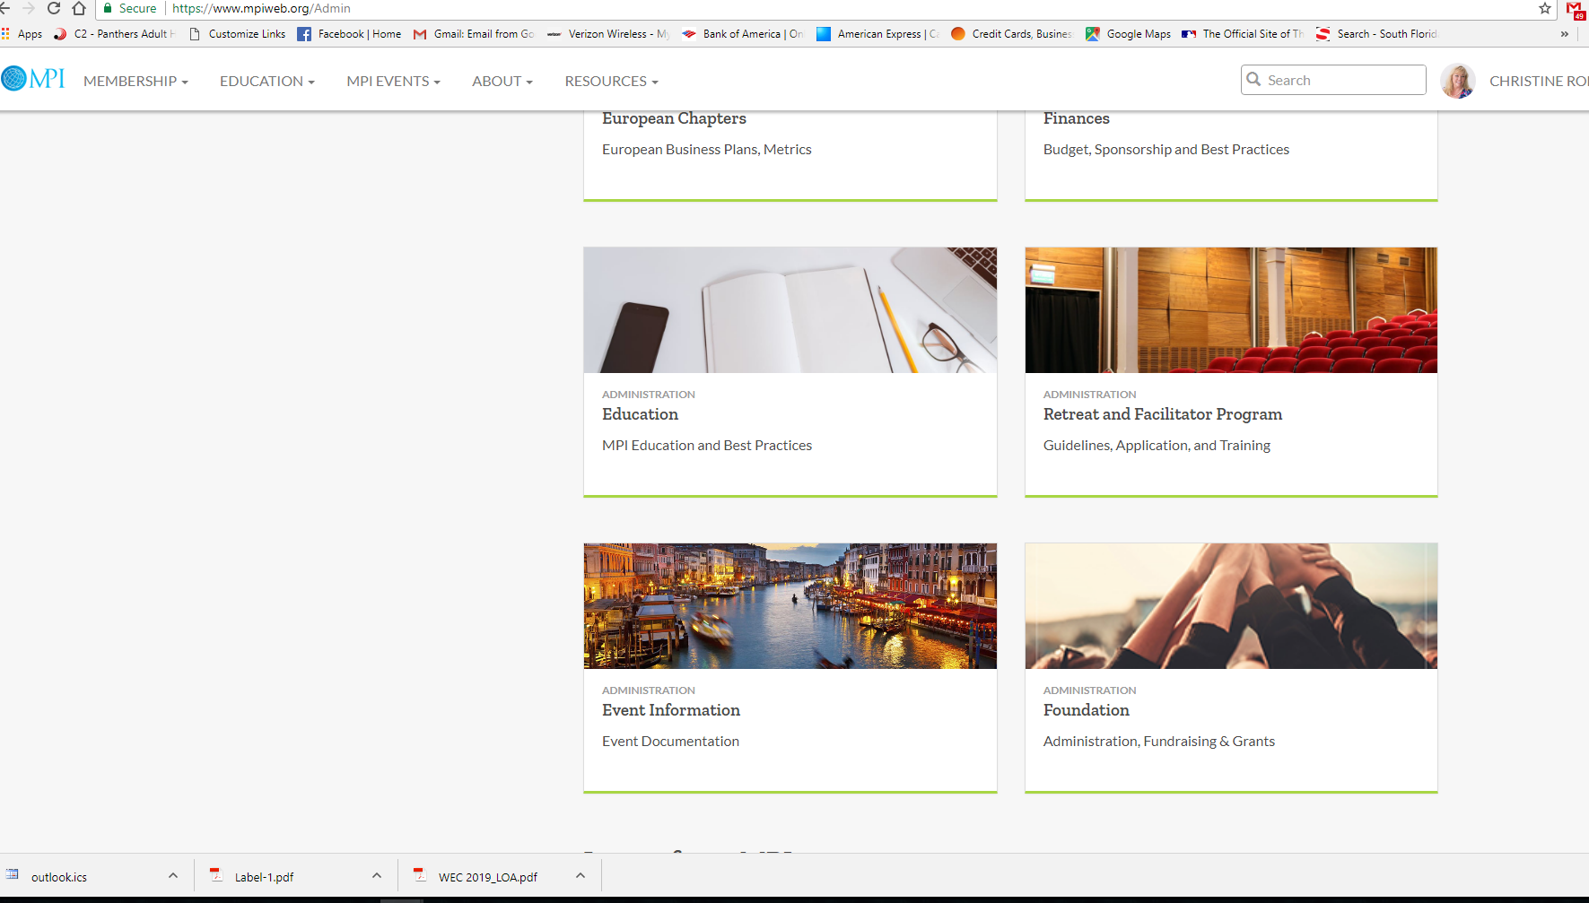
New Foundation Area – Chapter Leaders Resource Page
Grant Details – Overview and timeline
Links to Grant applications to be completed by Chapter leaders
Resources – video, information about the Foundation, powerpoint
Chapter Programs (ideas for your chapter / best practices)

Slide 14
Best Practices
Host a Wellness Event – charge a donation amount for a session preceding another educational session or conference
Host a Cocktails for Charity – Mix n’ Mingle where cash donations, raffle sales or tickets go to the Foundation from the Chapter
Use the Web or Text 2 Give campaigns during a chapter event
Establish a pledge amount with your board – and campaign to raise funds towards that amount
Do an annual Raffle
Send one email to members with a contest to raise funds
Establish a small percentage from an annual event (auction) to donate 10% to the Foundation
Ask for voluntary donations from registrations for events

Slide 15
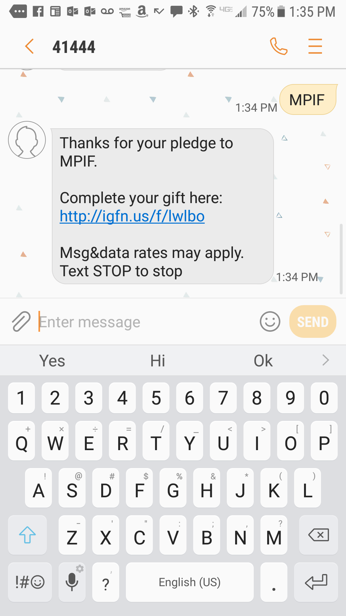
TEXT To Give
TEXT the word MPIF
To 41444 Receive text
message to complete gift
OR
www.mpifoundation.org/donate
Please provide member number and Chapter Affiliation to be credited to Chapter for annual tracking.

Slide 16
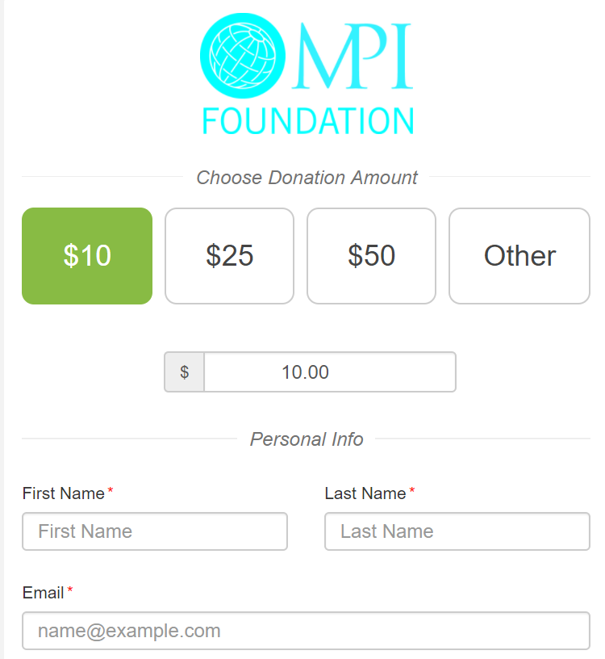
WEB To Give
Safedonate.us/mpif
OR VISIT
www.mpifoundation.org/donate
Please provide member number and Chapter Affiliation to be credited to Chapter for annual tracking.
Complete credit card information in form

Slide 17
Chapter Leaders Reception @ CBS – 5:00 pm
Sponsored by MPI Foundation

Slide 18
Thank You!

