Slide 1
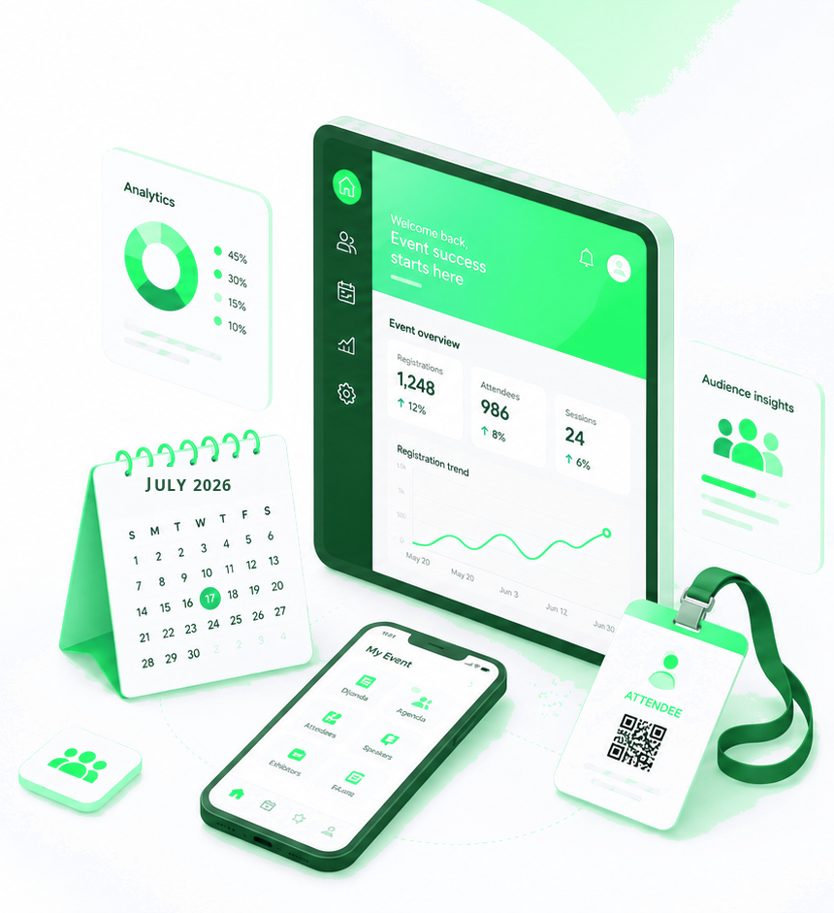

Cvent Monthly Product News
August 2026

Slide 2

About the newsletter
The August updates span two release windows (August 19 and September 2) and are grouped into six product neighborhoods to make it easier to review what changed, why it matters, and where each update fits across the Cvent platform.
Plan & Promote
Exchange Solutions
Event Insights (Cvent Assistant), Auto-Enabled Waiting Room (Queue-it), Data Privacy Templates
Verify RFP Contact Emails, Sharing Interactive Floor Plans, Booking Insights with Emburse
Attendee Engagement
Spend & Workflow
Attendee Assistant (Open Beta), Event Approval, Manual Participation Tracking
Auto Event Creation in Workflows, Workflow Execution History, Reposite,
Vendors in Budget
Actionable Insights
Trade Show Solutions
LinkedIn Event Sync (Beta), HubSpot Expanded Mappable Fields, Publishing Insights to Access Portal
Request a Jifflenow Meeting, Daily Lead Action Report, Location Assignment

Slide 3
August at a glance: features by neighborhood
40
feature releases
Note: Several Plan & Promote items (e.g., Event Insights, Publishing Insights to Access Portal, REST API endpoints, LinkedIn Event Sync, and HubSpot mappings) also appear under Actionable Insights & Integrations.

Slide 4
Additional resources
Helpful links for product news, roadmap visibility, and subscription management.
Announcements
Subscribe to Product News
Browse all Event Marketing & Management product news on the Cvent Product News home page.
Get an email whenever a new product news update is published.
Roadmap
Manage Subscription
See what is currently planned on the Cvent release roadmap.
From the Product News home page, choose “Manage Subscription” to tailor which product interest areas you receive.
Open Forum
Ask questions about rolled-out updates in the Cvent Community.

Slide 5
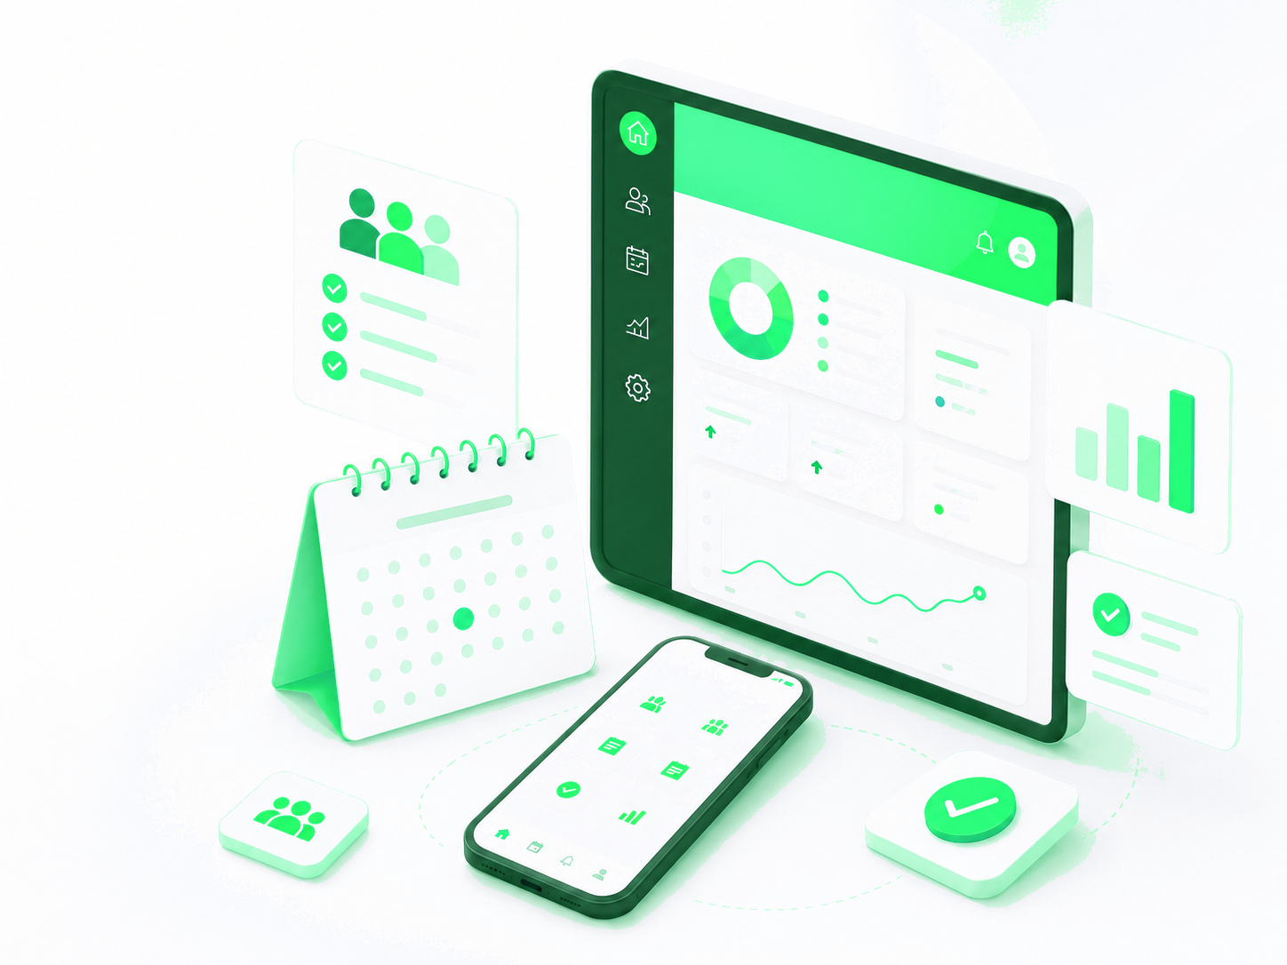
Plan & Promote
Registration, Payments, Integrations

Slide 6
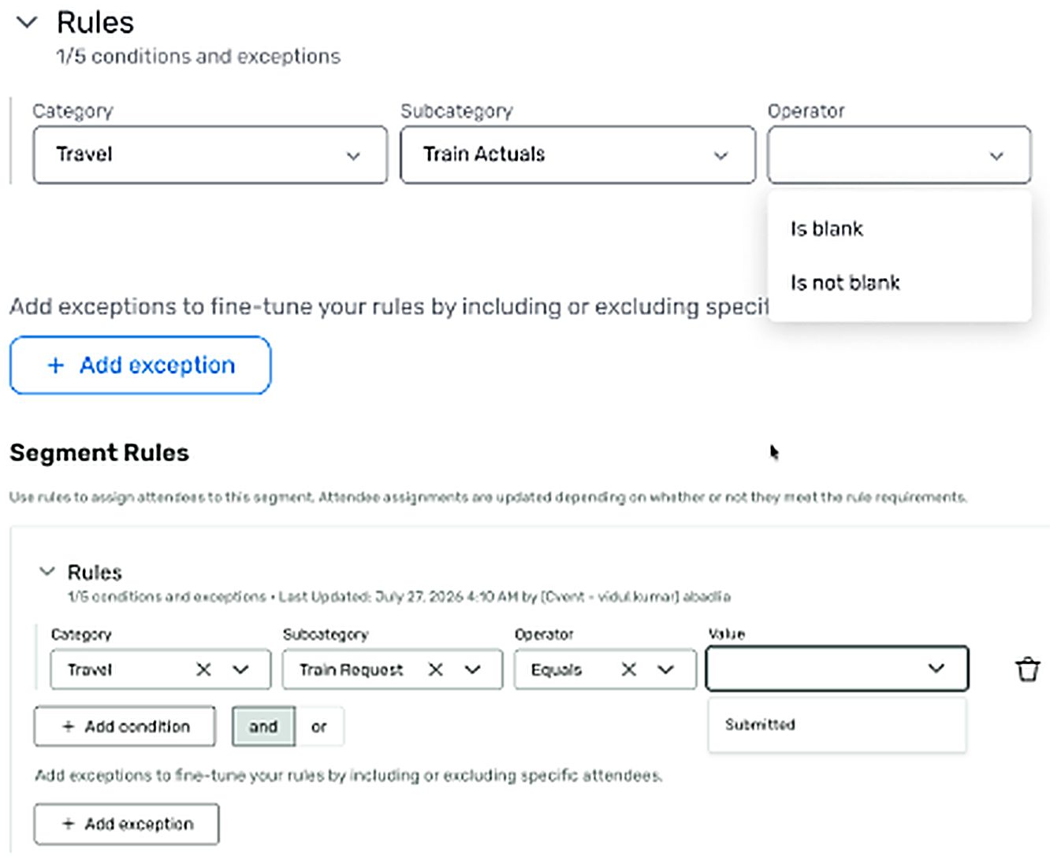
REGISTRATION (ALSO ATTENDEE ENGAGEMENT)
Train Travel in Dynamic Audience Segments
What changed: Planners can now build rule-based Dynamic Segments using Train Request and Train Actual data on events where Train Travel is enabled.
Why it matters: Replaces the manual export-and-filter workflow for identifying and communicating with train travelers.
Use case: Build a targeted list of invitees who submitted a Train Request for pre-event logistics briefings.

Slide 7
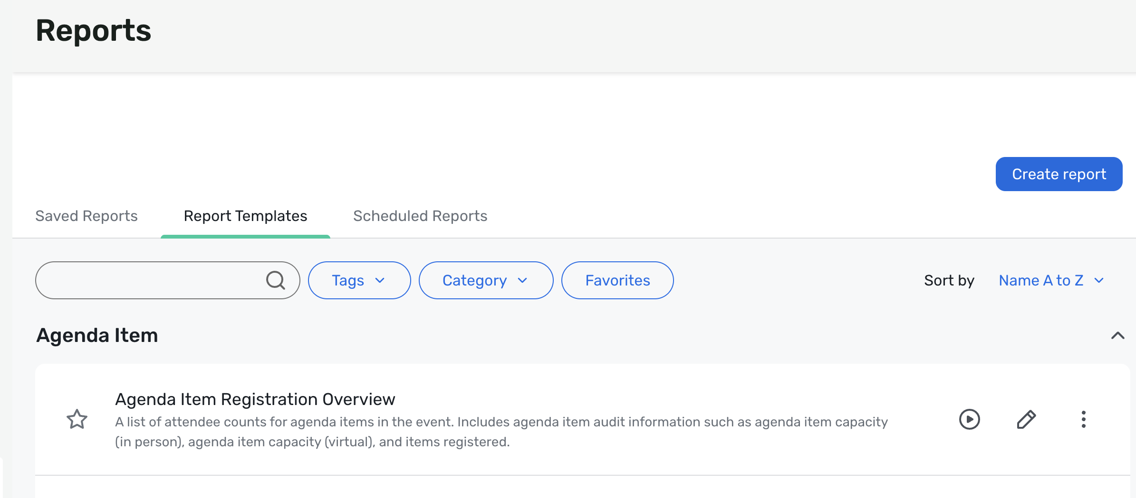
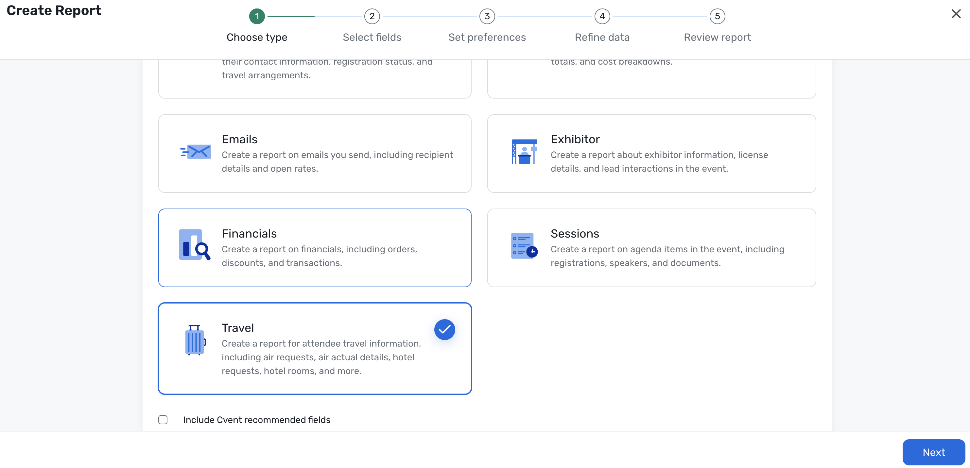
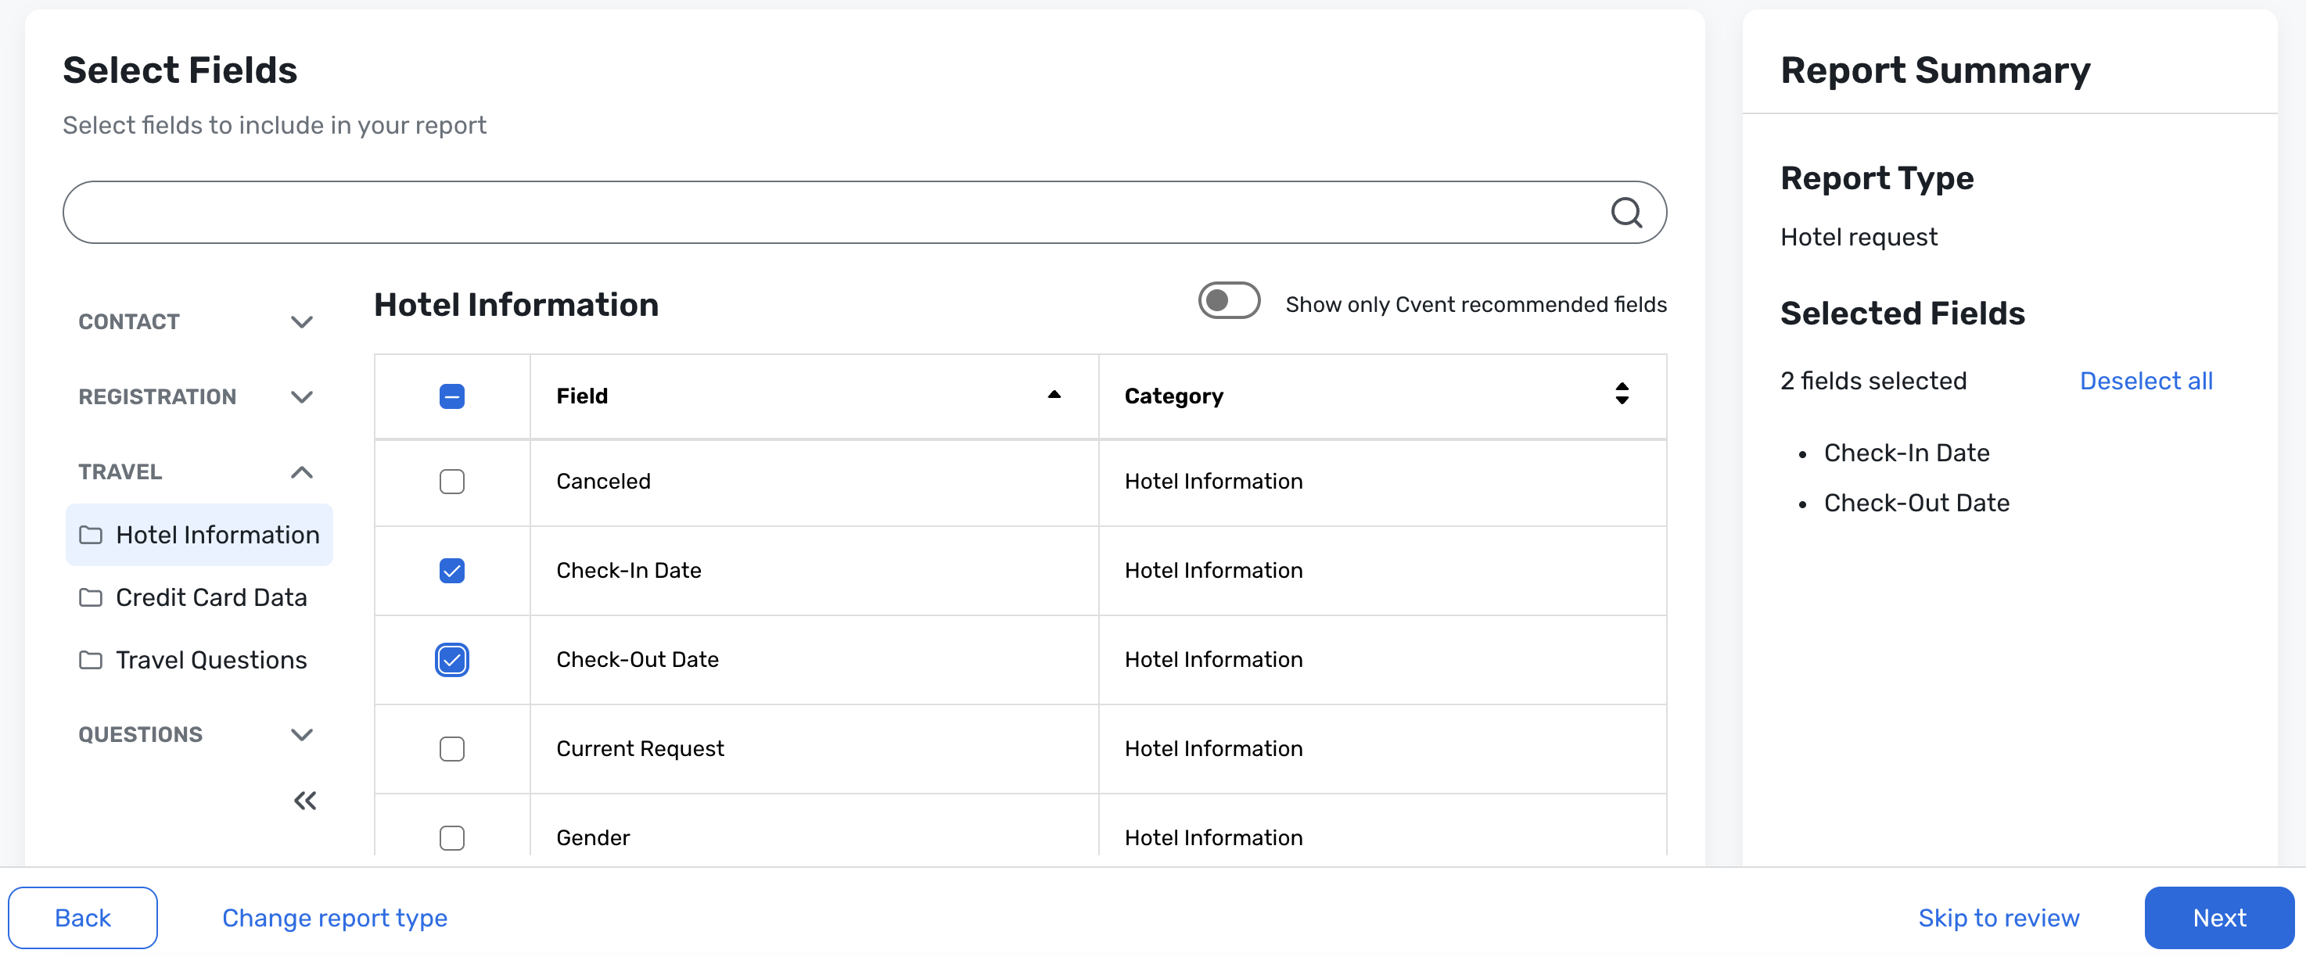
REGISTRATION
Build Your Own Reports: Hotel Request Report
What changed: The Hotel Request report is now available in Build Your Own Reports (BYOR), so planners can pick fields, apply filters, and save configurations.
Why it matters: Lets teams tailor hotel request reporting to their needs without the limits of a templated structure.
Use case: Create a shared rooming report grouped by hotel, room type, or check-in date for housing and onsite staff.

Slide 8
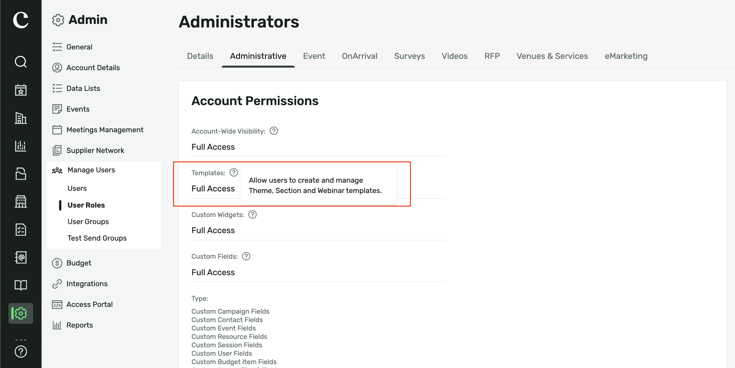
REGISTRATION
Section Templates User Permissions
What changed: Section Templates now follow the admin-level Templates permission, controlling who can save, rename, or delete shared section content.
Why it matters: Reduces accidental deletions and helps large teams govern reusable sections consistently.
Use case: Give admins full access to manage the section library while other users can still apply existing sections.

Slide 9
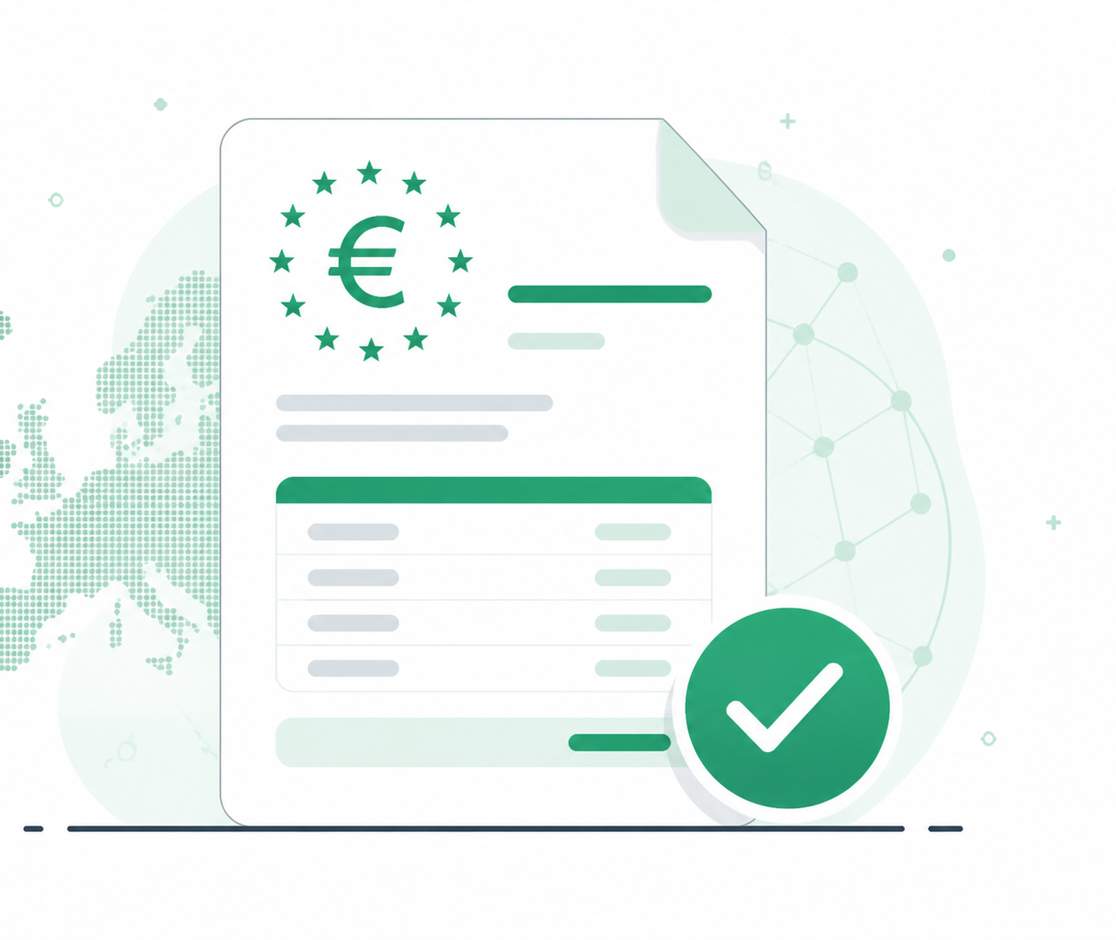
REGISTRATION / PAYMENTS
EU E-Invoicing for All Supported Countries
What changed: Registration now supports webhook-based delivery of the data needed to generate EN 16931-compliant XML e-invoices for all EU countries that require them, not just Belgium.
Why it matters: Automates invoice-data delivery to your Access Point Provider and retires the manual download step.
Use case: Configure a webhook so invoice data is sent automatically whenever an order is created or canceled.

Slide 10
REGISTRATION
Auto-Enabled Waiting Room for High-Demand Registrations, Powered by Queue-it
What changed: Registration automatically creates a Queue-it waiting room when an event sees a sudden traffic surge (e.g., 600 visitors in 1 minute or 1,000 in 3 minutes).
Why it matters: Keeps high-demand events stable and fair by holding net-new visitors in a queue and releasing them in a controlled flow.
Use case: Protect a registration launch driven by a social post or public ticket drop without manual setup.

Slide 11
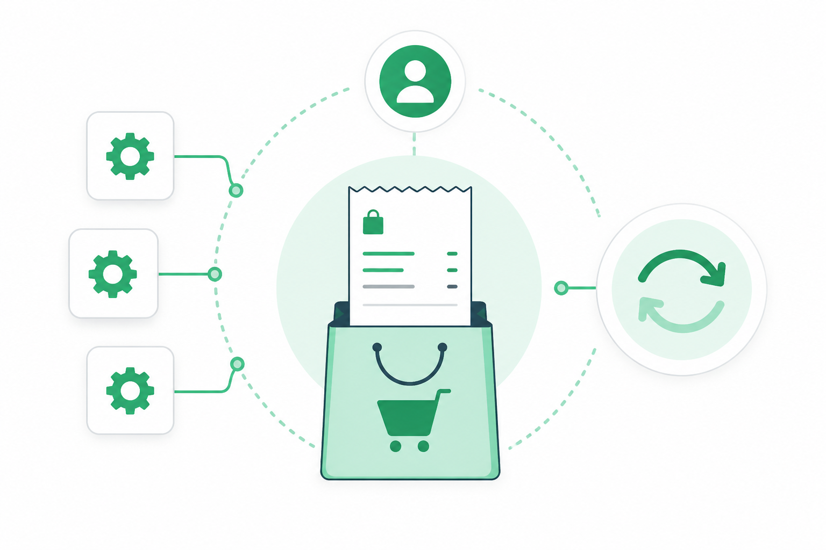
REGISTRATION
REST API Account-Level Endpoints: Orders and Transactions
What changed: New account-level REST endpoints retrieve orders and transactions across an entire account in a single paginated call, without iterating event by event.
Why it matters: Makes daily, weekly, or monthly financial syncs to data warehouses and CRMs practical at scale.
Use case: Run a nightly delta query to reconcile all account orders and transactions into a data warehouse.

Slide 12
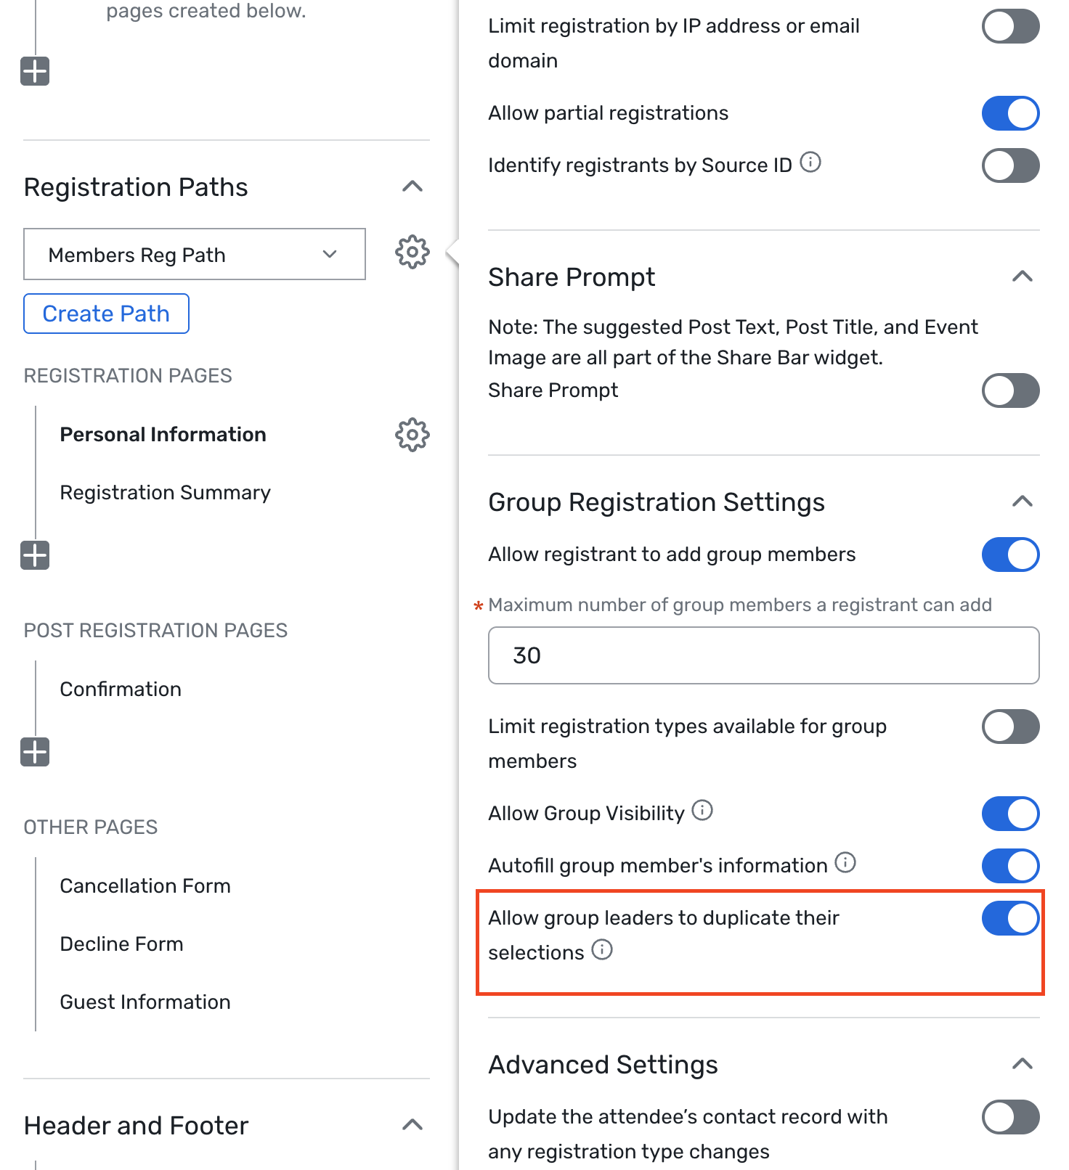
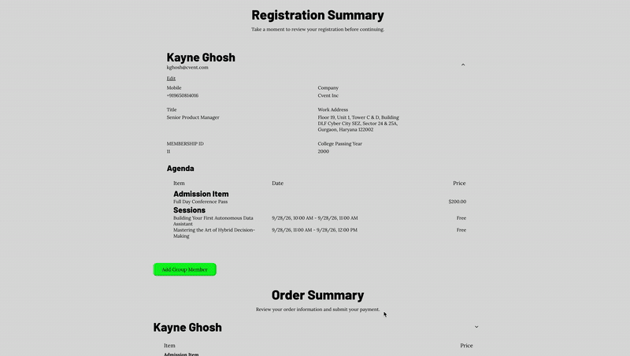
REGISTRATION
Allow Group Leaders to Duplicate their Selections
What changed: Group leaders can auto-fill eligible shared contact fields from their own registration when adding group members, during and after initial registration.
Why it matters: Speeds up team registration with less manual entry and fewer data-entry errors.
Use case: A travel coordinator registering a sales team can carry shared company details across each member.

Slide 13
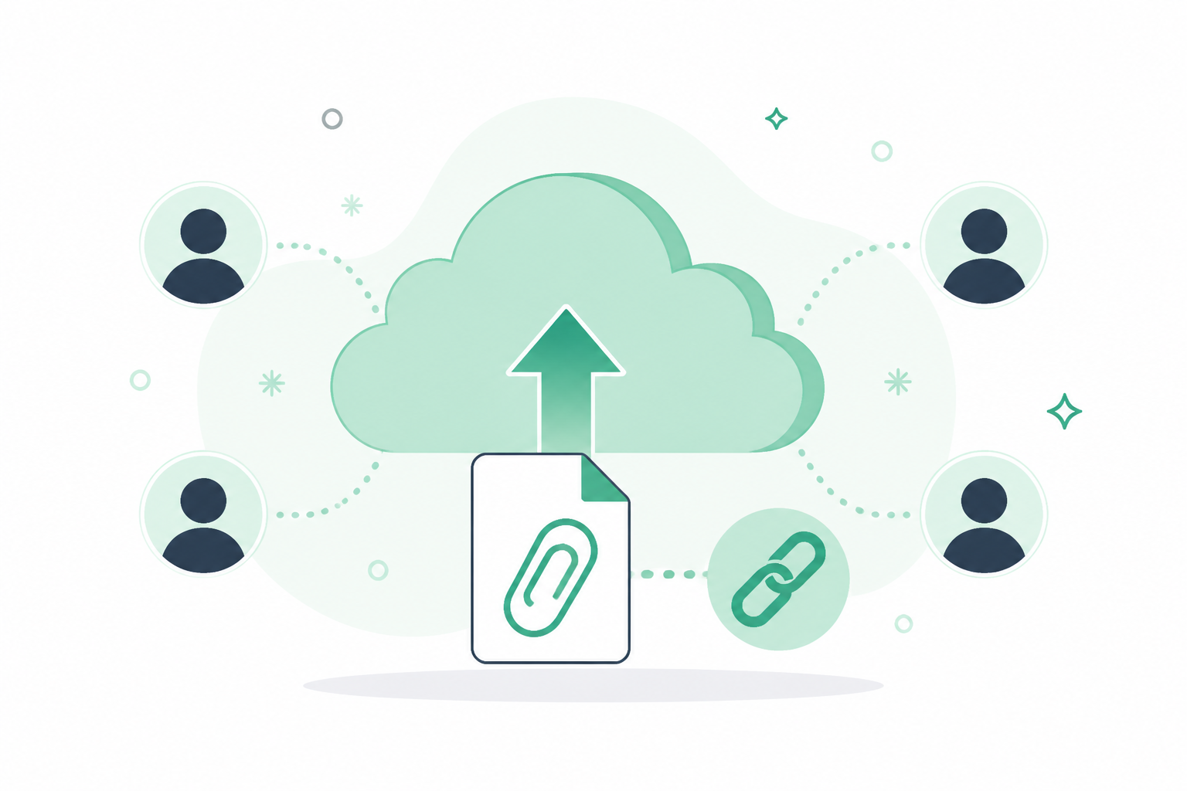
REGISTRATION
REST API: File Upload Link in Attendee Endpoints
What changed: Attendee API responses now include a direct download link for any file an attendee uploaded, alongside the filename.
Why it matters: Makes it easy to review, store, or process attendee-submitted files in downstream workflows.
Use case: Pull uploaded documents directly from the API response instead of tracking them down manually.

Slide 14
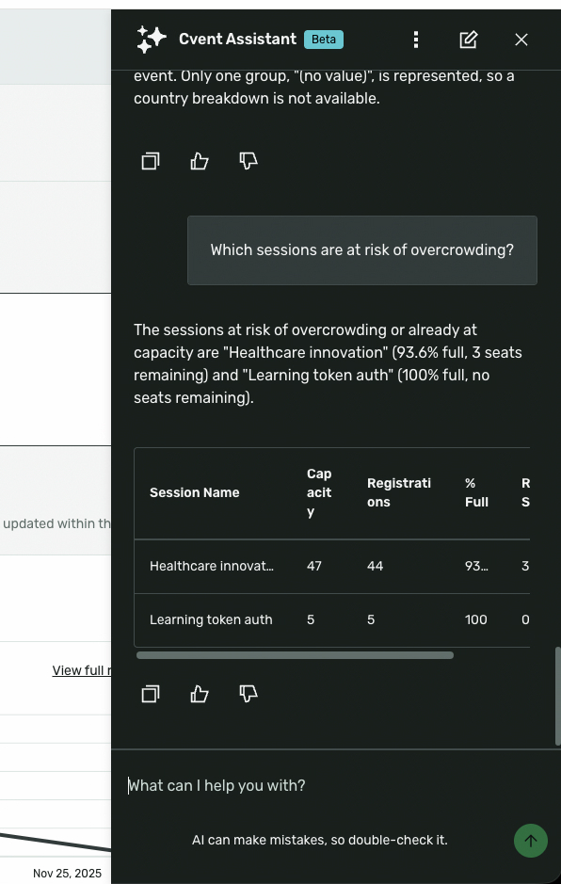
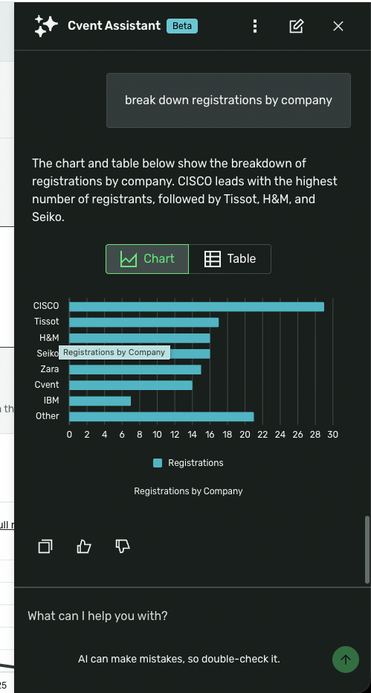
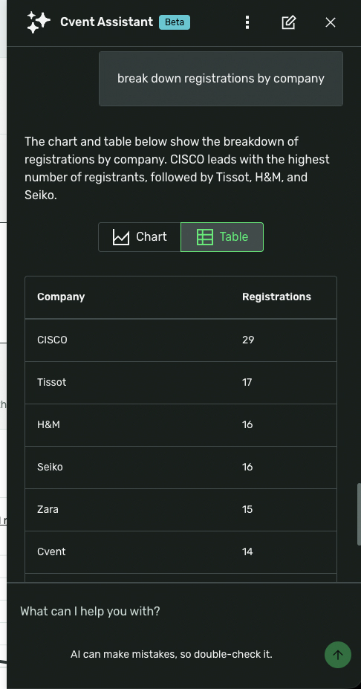
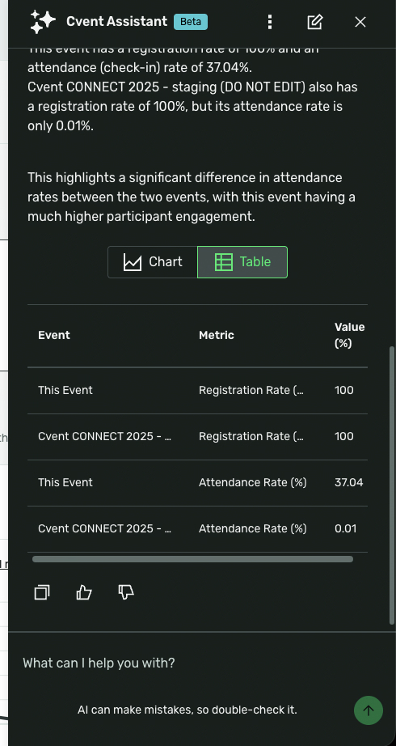
REGISTRATION
Event Insights Capability - Cvent Assistant
What changed: The Cvent Assistant now answers plain-language questions about event data - registration pace, session attendance, revenue, check-in trends - with text, tables, and auto-rendered charts.
Why it matters: Get trusted, permission-aware answers in seconds without running reports or exporting to Excel.
Use case: Ask "How is registration trending this week?" or compare attendance to a prior event and get an instant answer.

Slide 15
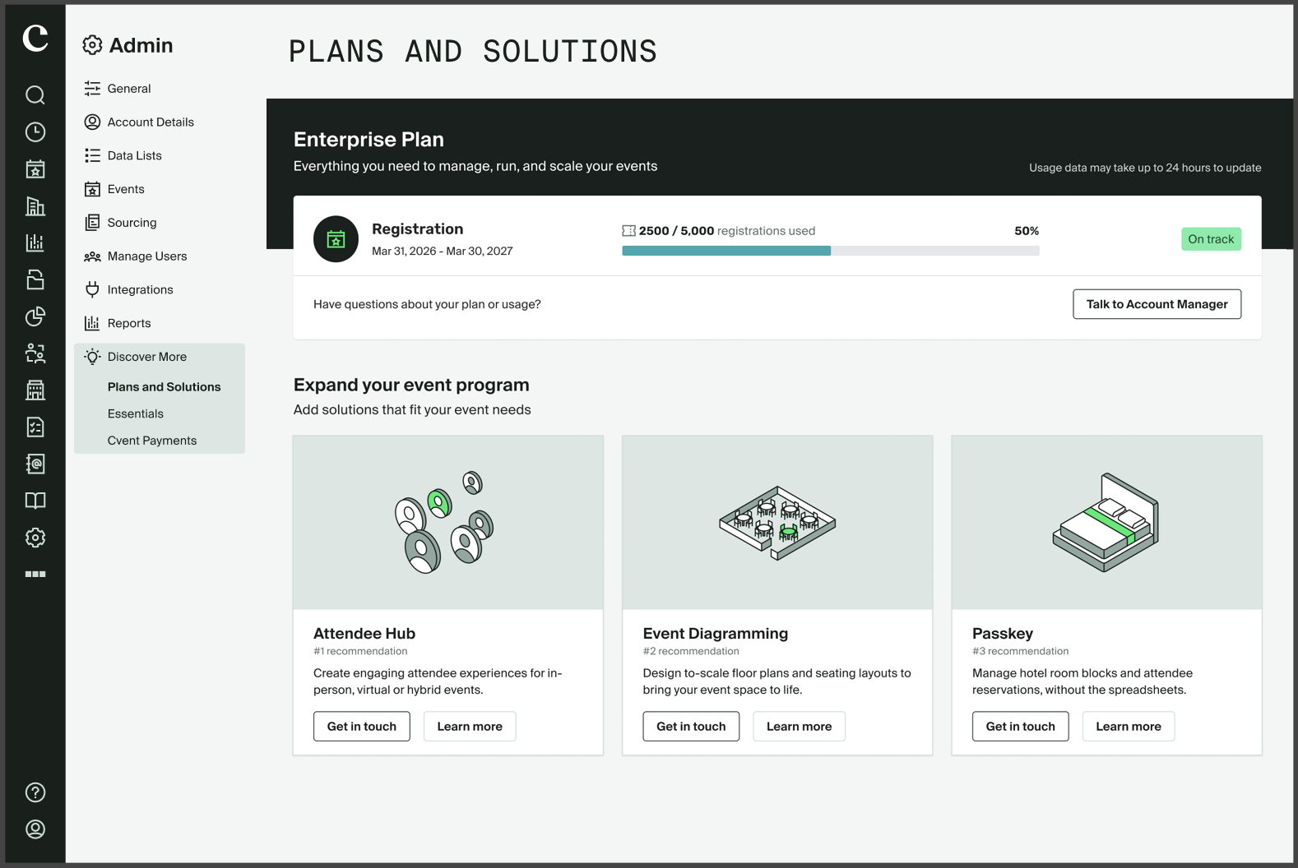
REGISTRATION
Personalized Discover Hub
What changed: A new in-app hub shows each account its plan usage against contracted entitlements and surfaces dynamically tailored product recommendations.
Why it matters: Helps accounts see where they stand and discover the Cvent products most relevant to them.
Use case: Review how many contracted registrations you've used and explore recommended add-ons with a Talk to Account Manager option.

Slide 16
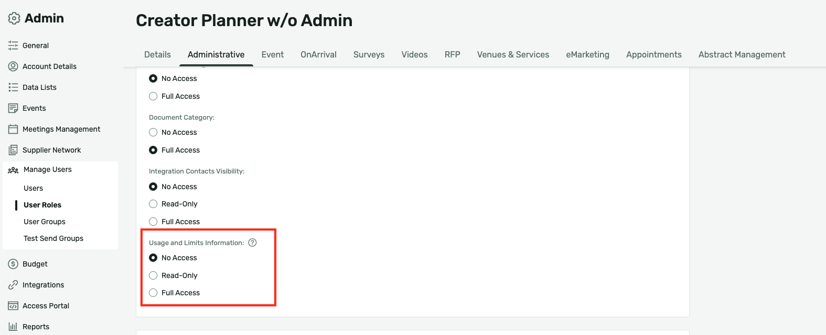
REGISTRATION
Usage and Limits Information Permission
What changed: A new Usage and Limits Information permission in user role management lets admins set No Access, Read-Only, or Full Access to contract and usage data.
Why it matters: Ensures sensitive usage and consumption data is visible only to the right people.
Use case: Grant Full Access to admins while non-admin custom roles default to No Access.

Slide 17
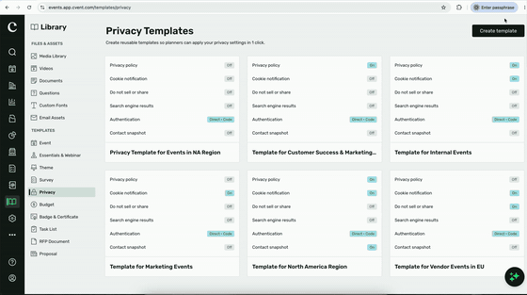
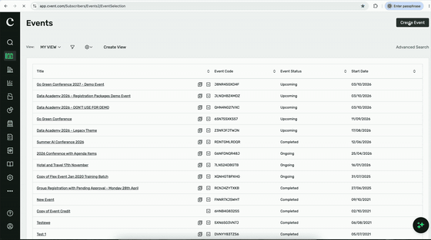
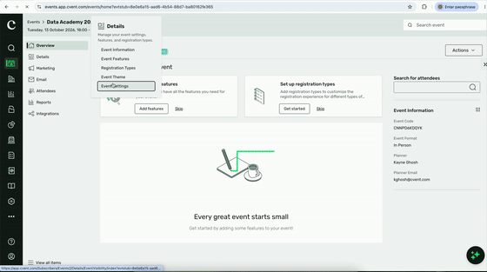
REGISTRATION
Data Privacy Templates
What changed: Account admins can define approved privacy and security settings once and have them applied automatically to eligible Standard Events at creation.
Why it matters: Standardizes privacy across a portfolio while keeping authorized admins able to override when needed.
Use case: Apply a consistent privacy policy, cookie notice, and analytics settings across all new events from Library > Templates > Privacy.

Slide 18
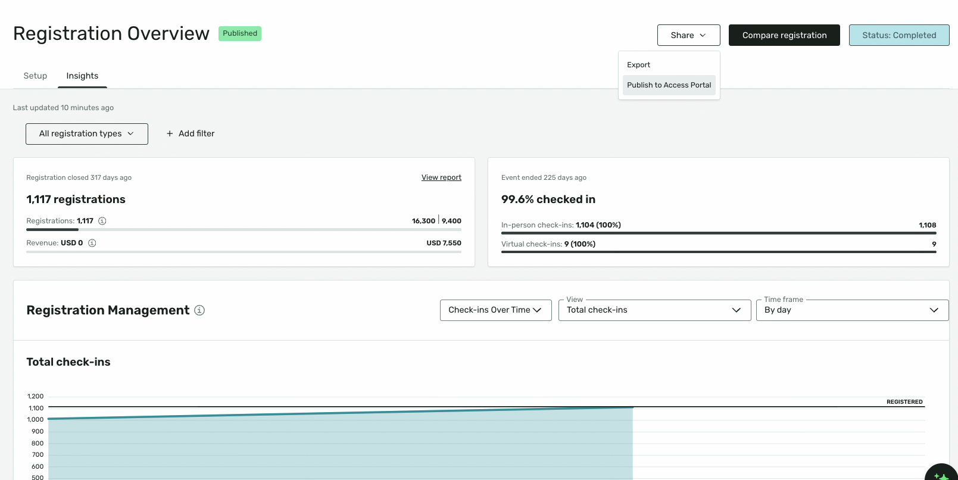
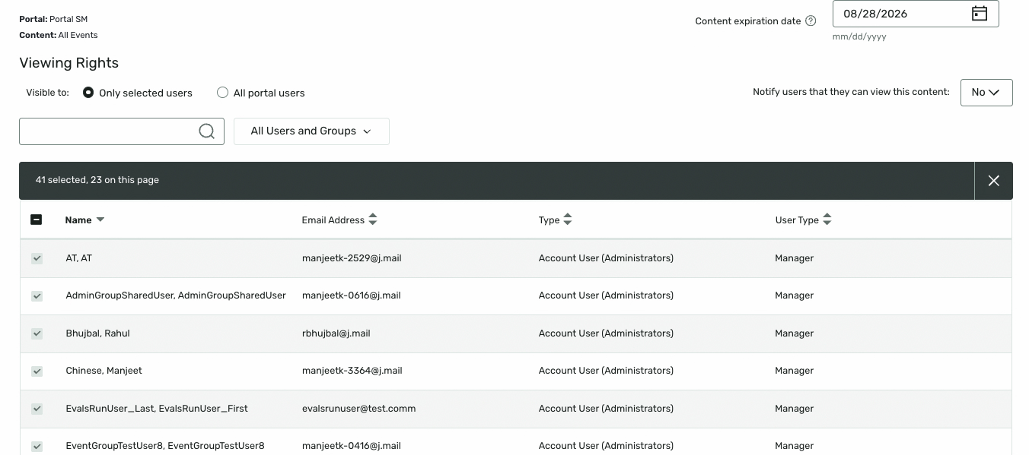
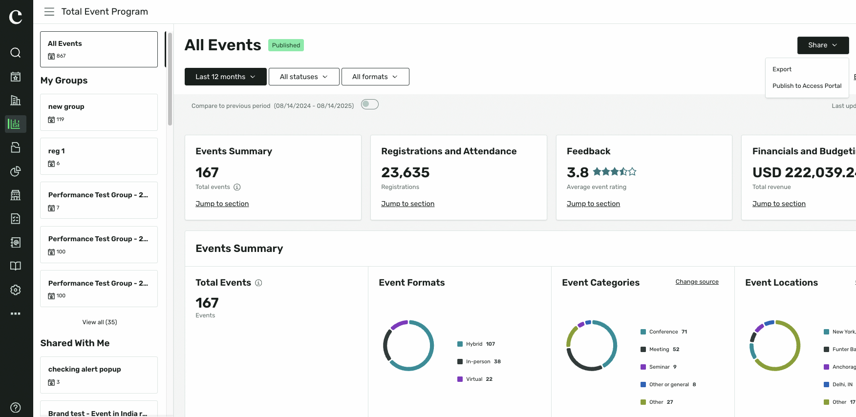
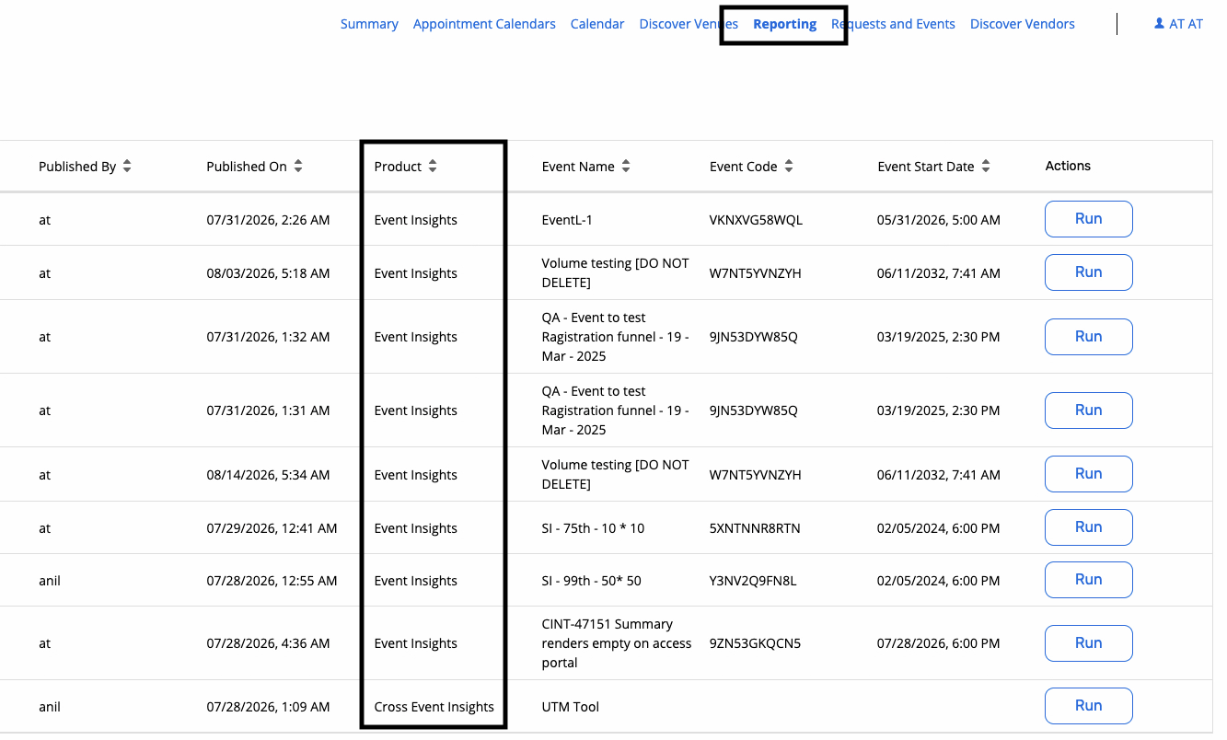
REGISTRATION
Publishing Insights to Access Portal
What changed: Organizers can publish Registration Overview, Session Overview, and Cross Event Insights directly to the Access Portal with permission-based visibility.
Why it matters: Surfaces key event data in context for portal users instead of keeping it siloed in planner tools.
Use case: Give account users self-service visibility into registration and session data without exporting reports.

Slide 19
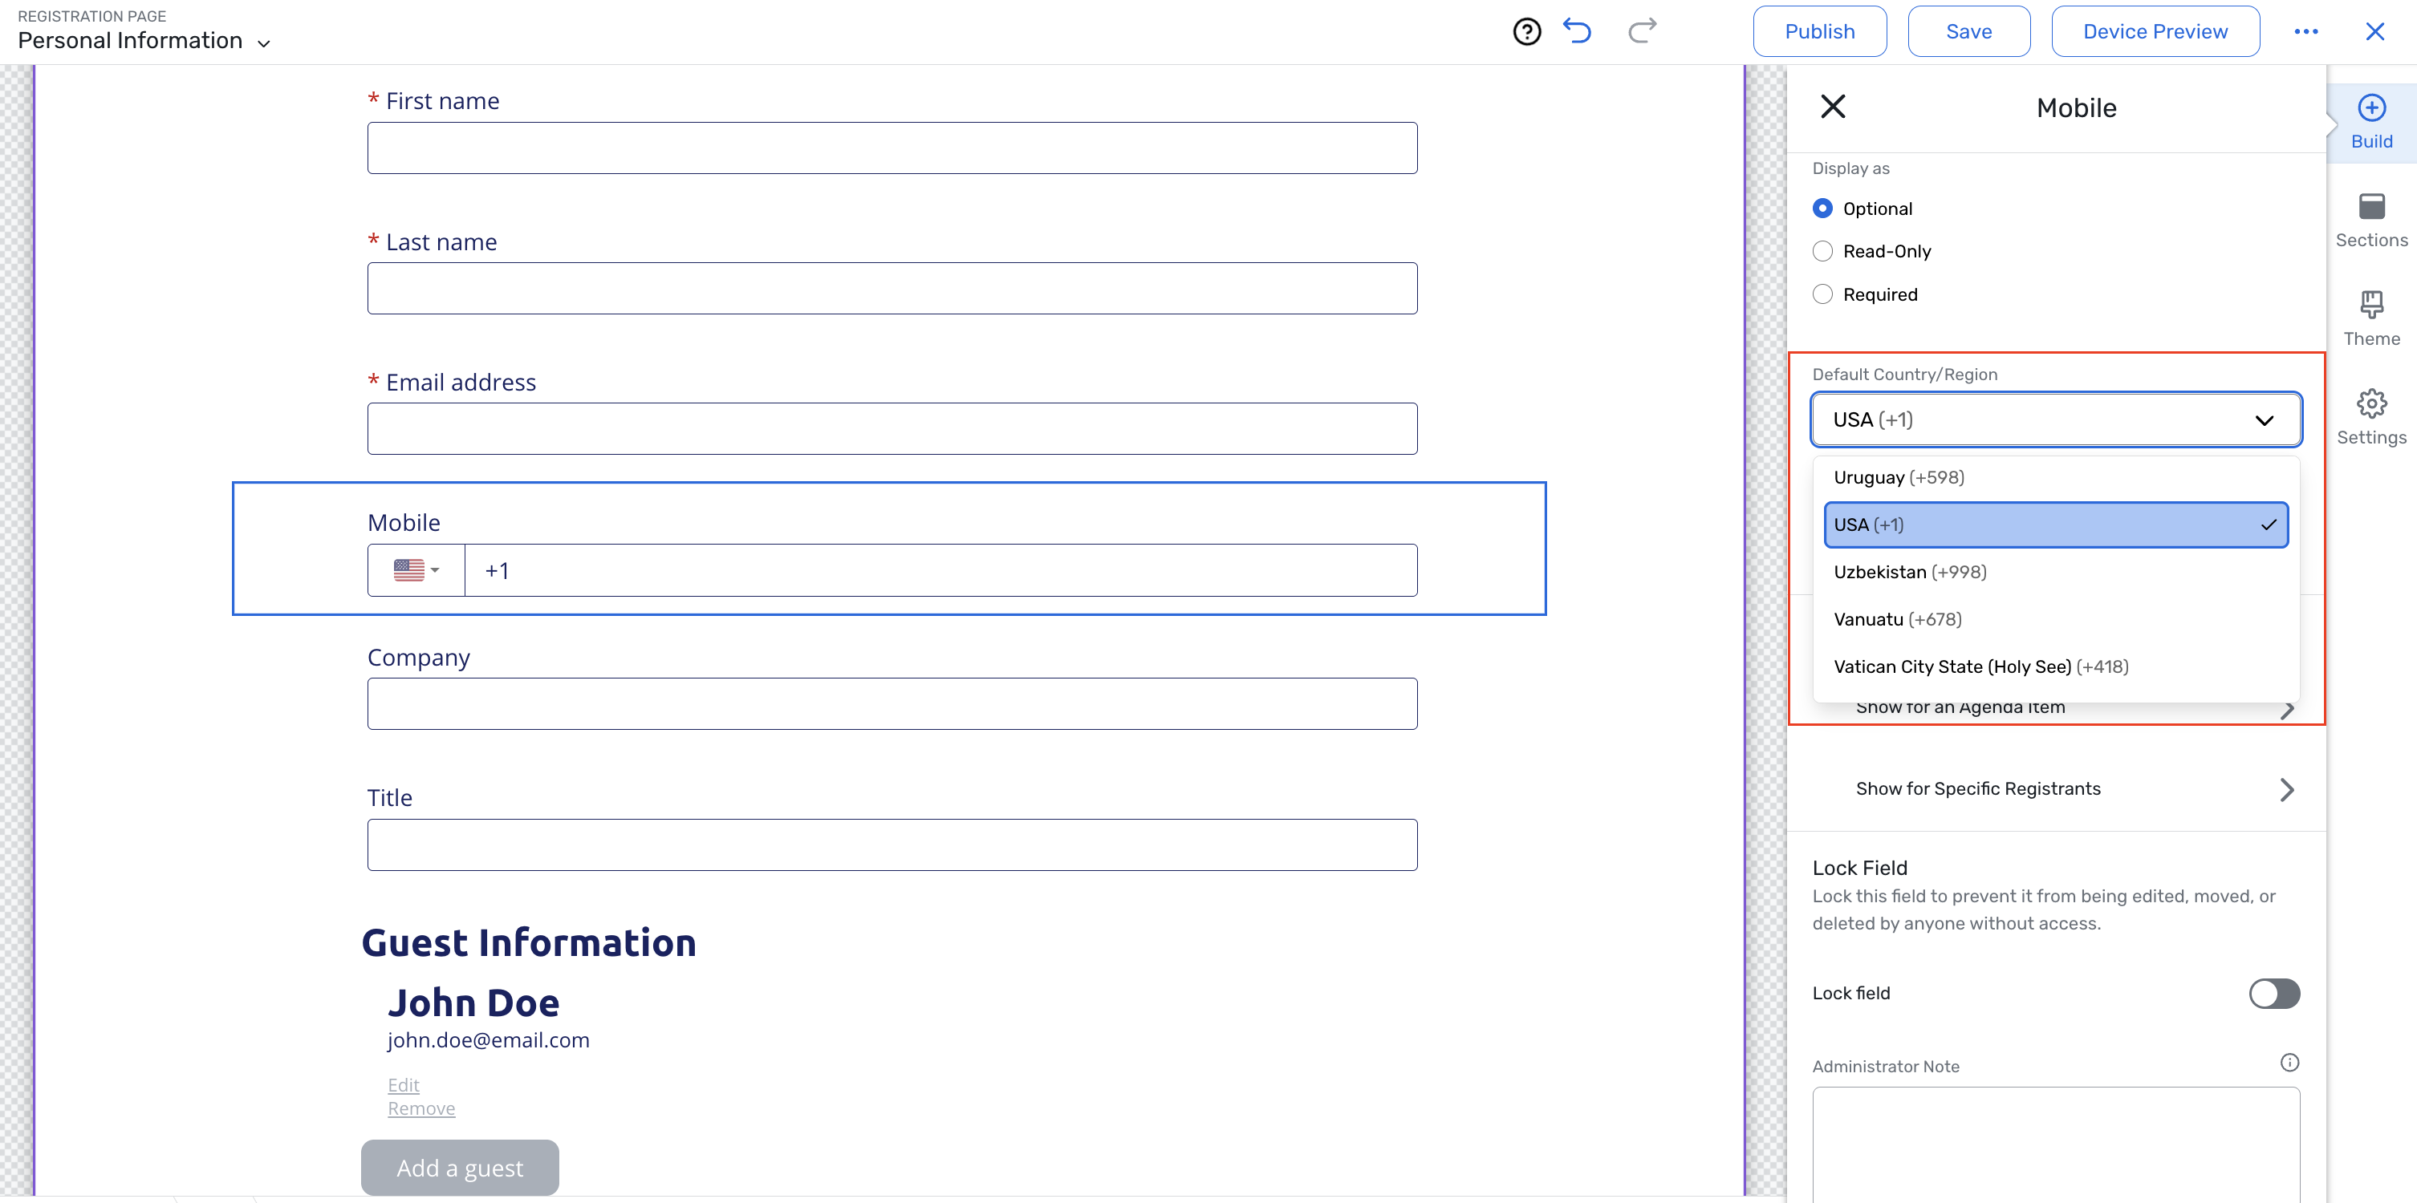
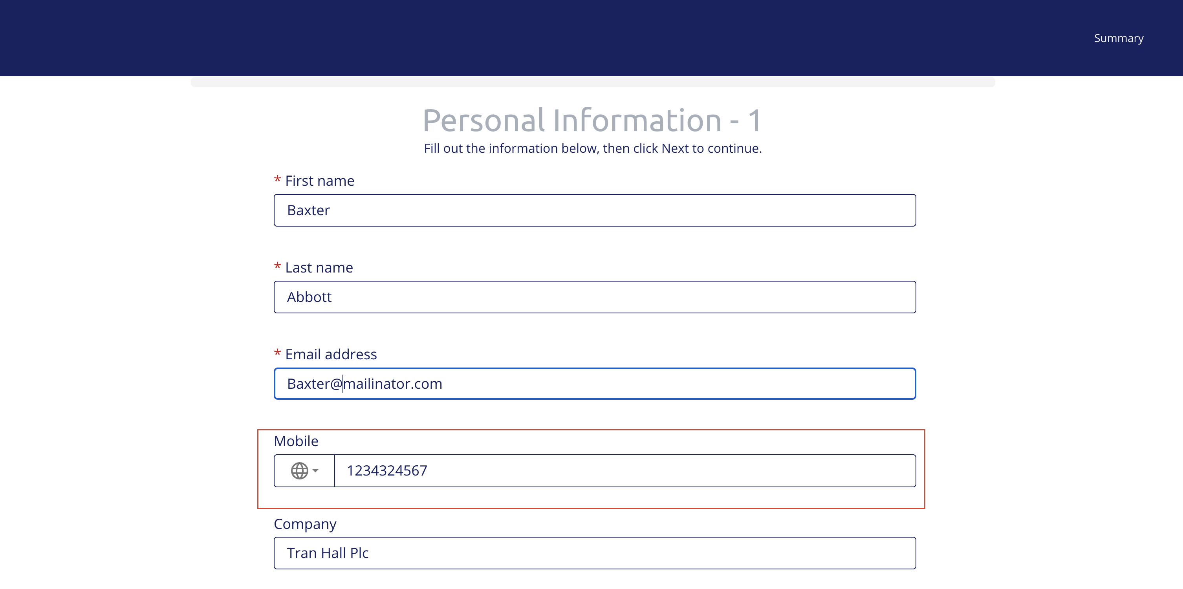
REGISTRATION
Mobile Number Country Code Enhancements
What changed: You can now set a default country for the standard mobile number field, use event locale as a fallback, or choose "No country code."
Why it matters: Gives attendees a more relevant starting point and supports accurate international contact details.
Use case: Default a global event's mobile field to the audience's most common country instead of the event locale.

Slide 20
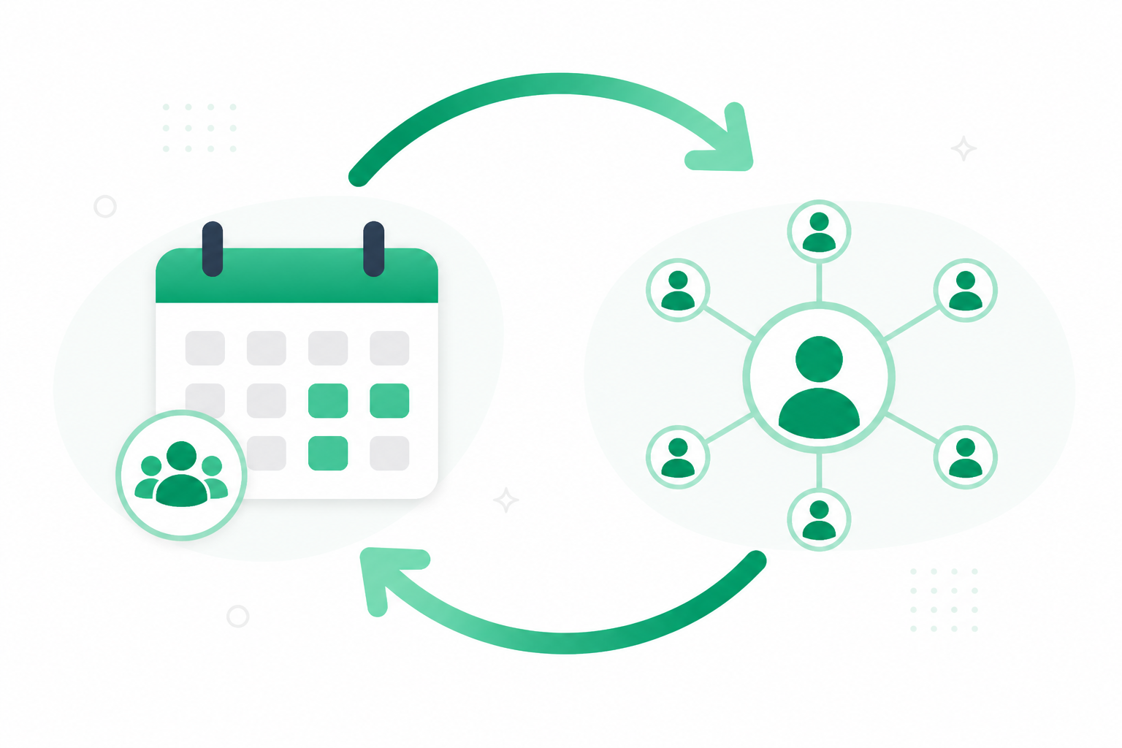
INTEGRATIONS
Event Sync and Registrant Capture for LinkedIn (Beta)
What changed: Create and maintain a LinkedIn Event directly from Cvent, and for Webinar and Essentials events, sync LinkedIn registrations back into Cvent automatically.
Why it matters: Promote events on LinkedIn without duplicating work, keeping attendee data centralized for follow-up and attribution.
Use case: Publish once in Cvent, promote on LinkedIn, and watch registrations flow back tagged for attribution.

Slide 21
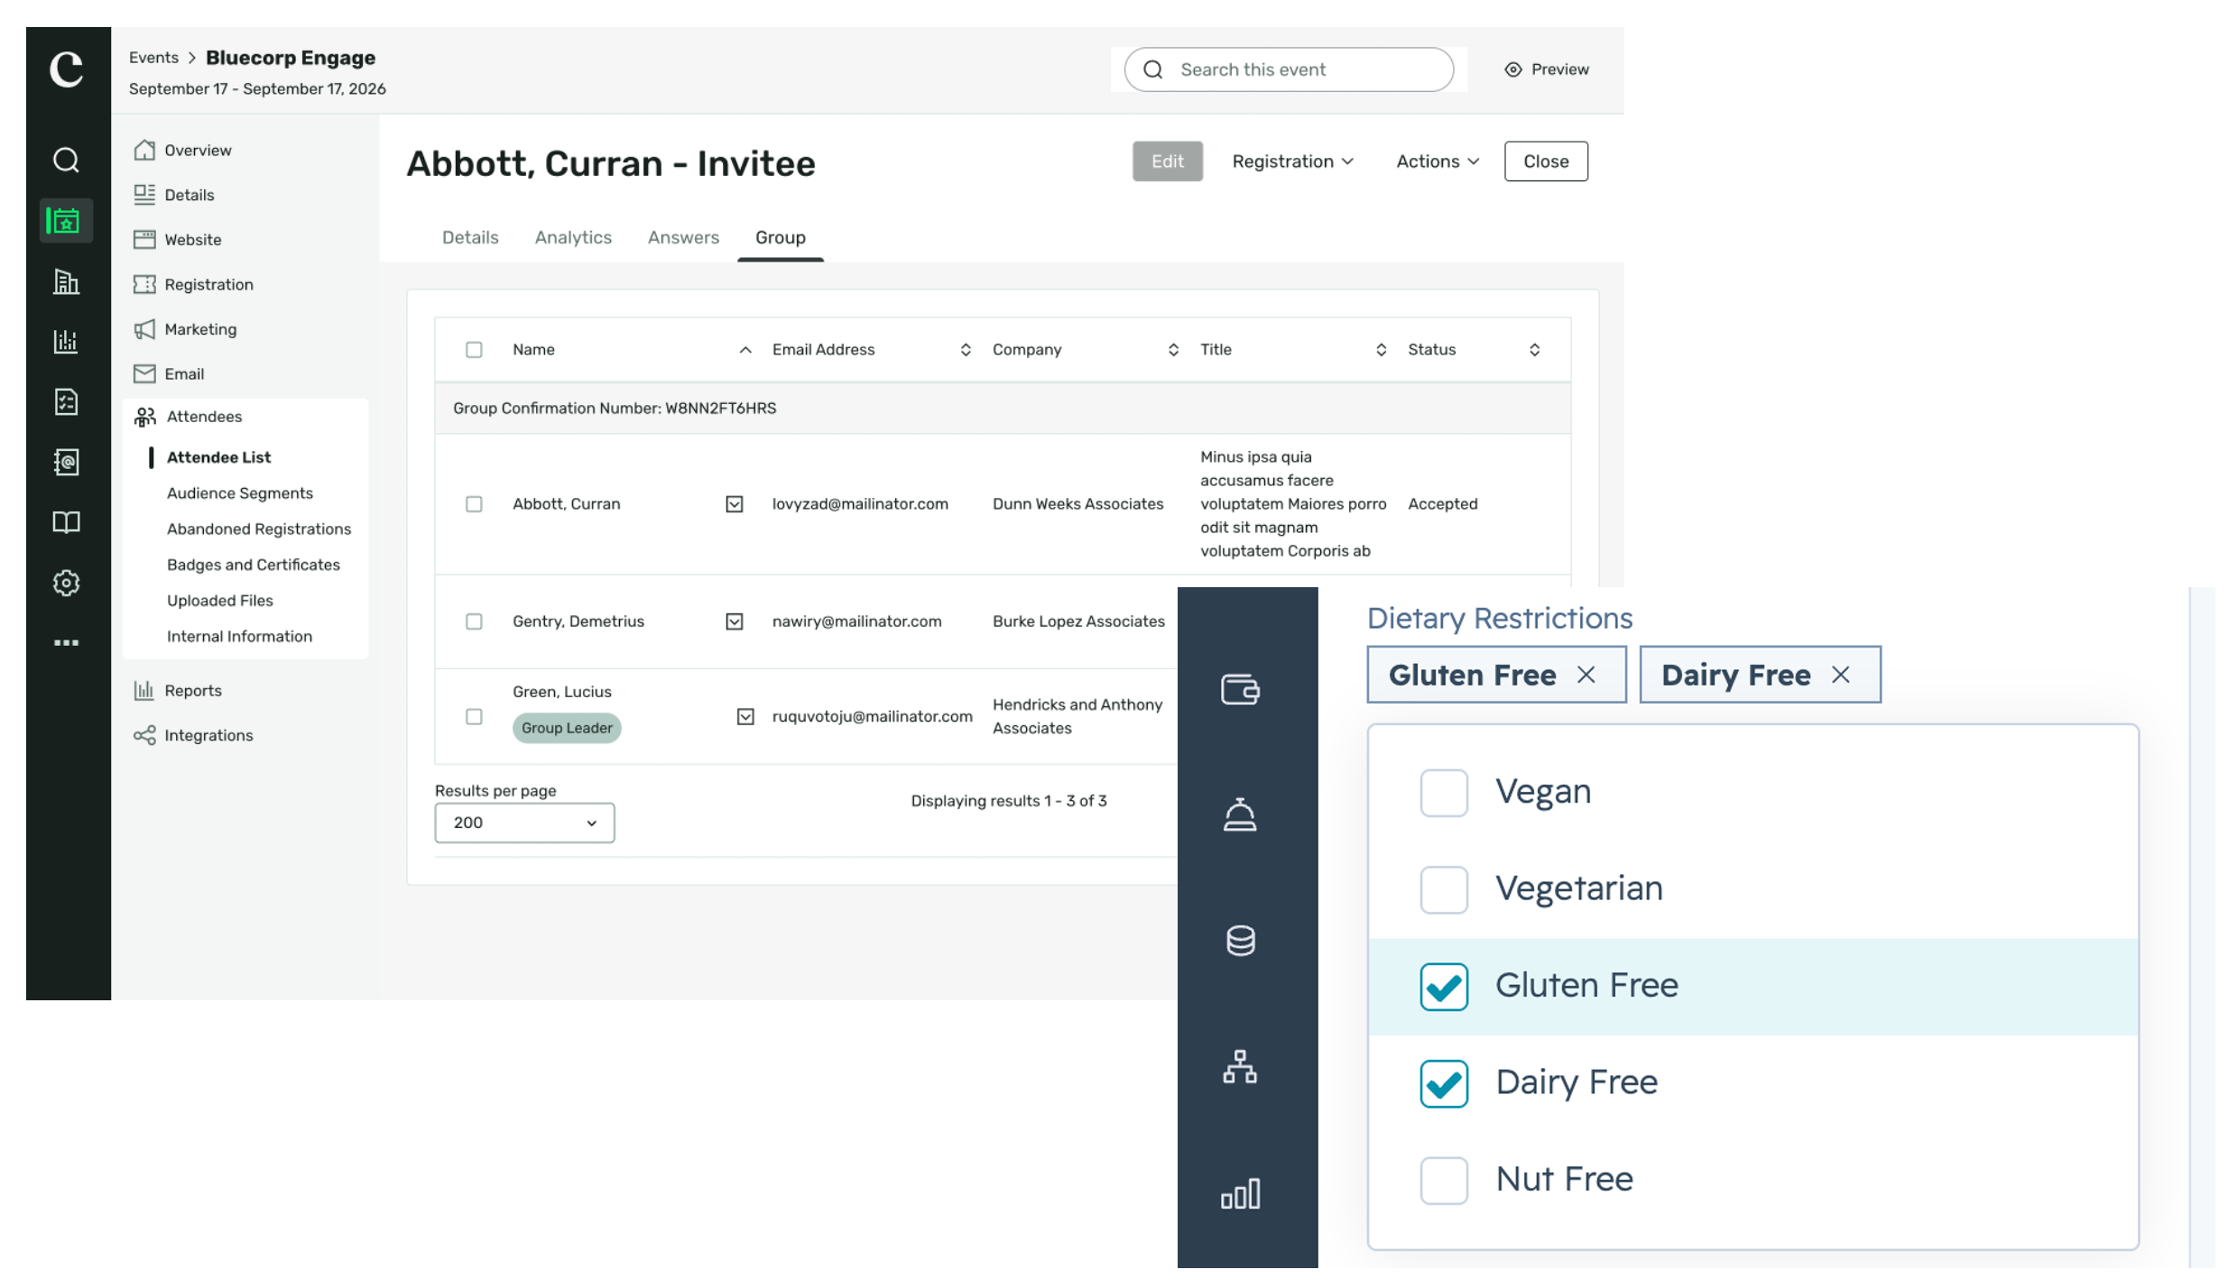
INTEGRATIONS
HubSpot Expanded Mappable Fields
What changed: Admins can now map Cvent fields to HubSpot Single Checkbox, Multiple Checkboxes, Dropdown, and Radio Select properties, plus new Group Leader, Group Member, and Group Confirmation Number fields.
Why it matters: Supports richer segmentation and scoring of group vs. individual registrants in HubSpot.
Use case: Map group registration context to HubSpot so marketers can segment group members differently.

Slide 22
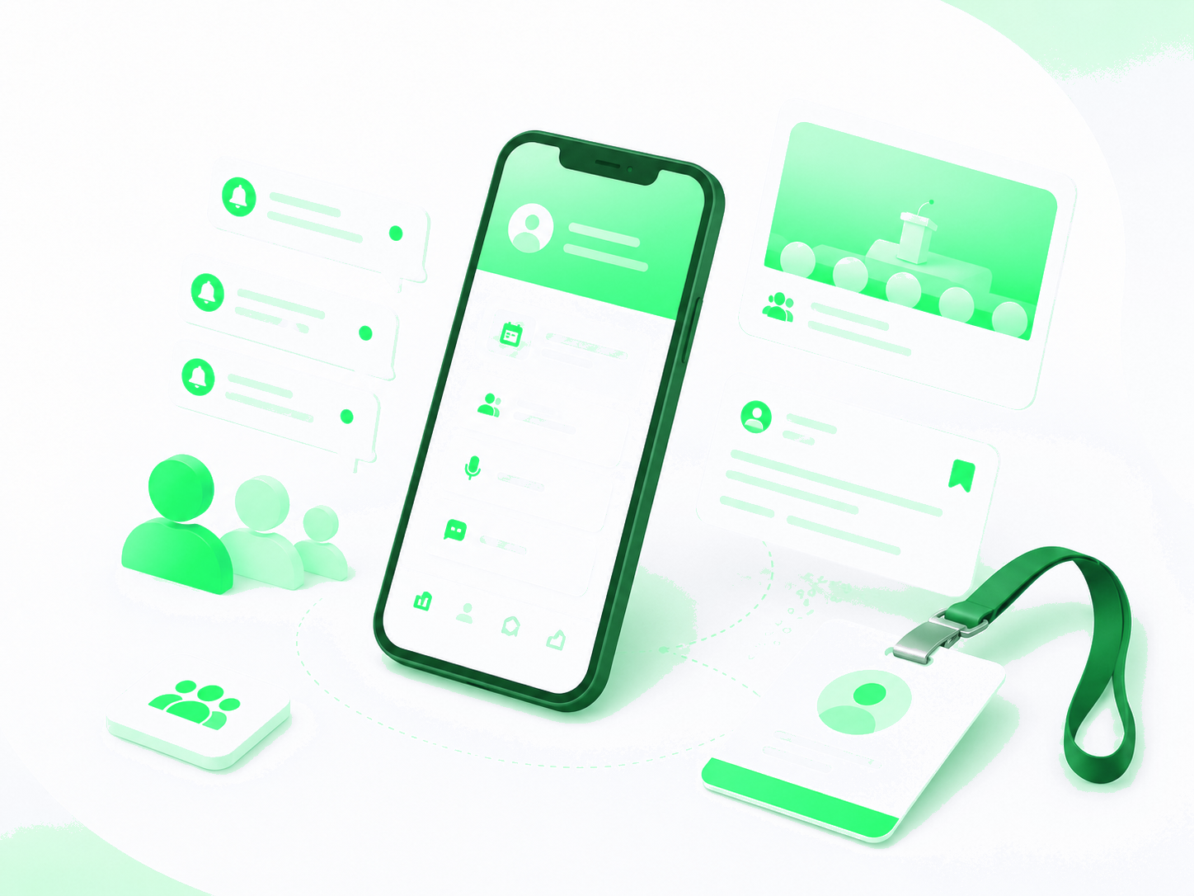
Attendee Engagement
Attendee Hub, Appointments, OnArrival, Essentials & Webinar

Slide 23
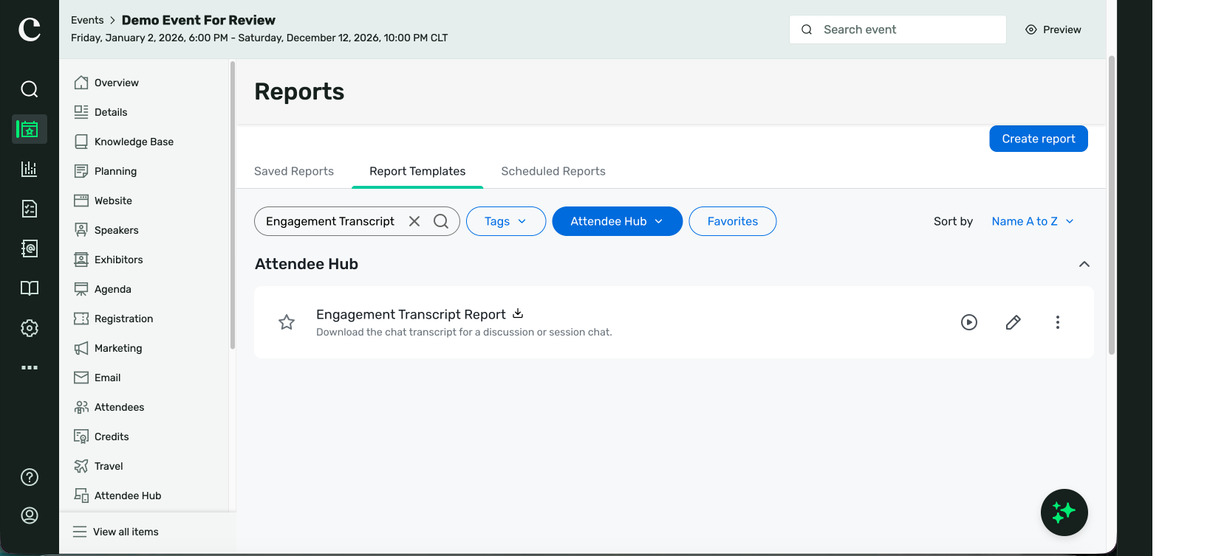
ATTENDEE HUB
Engagement Transcript Report
What changed: Export Discussion and Session Chat transcripts from Attendee Hub as CSV or Excel for review after the event.
Why it matters: Gives organizers a clearer view of attendee questions, reactions, and feedback without copying conversations manually.
Use case: Download a session's chat transcript to surface recurring themes and standout attendee quotes.

Slide 24
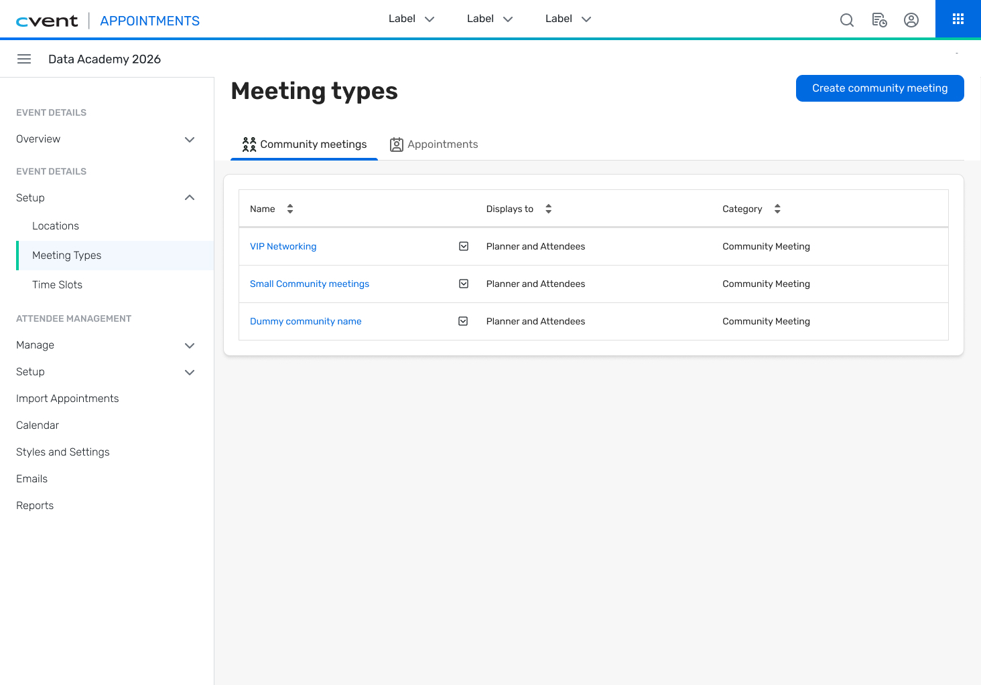
ATTENDEE HUB / APPOINTMENTS
Topic-Based Networking (Community Meetings) in Event App
What changed: Attendees can create, discover, join, and leave topic-based Community Meetings - with time, location, capacity, and AI-assisted descriptions - in the Attendee Hub Event App for Appointments Premium events.
Why it matters: Gives attendees more ways to connect around shared interests while planners coordinate less manually.
Use case: Let attendees self-organize interest-based meetups that appear in their My Schedule.

Slide 25
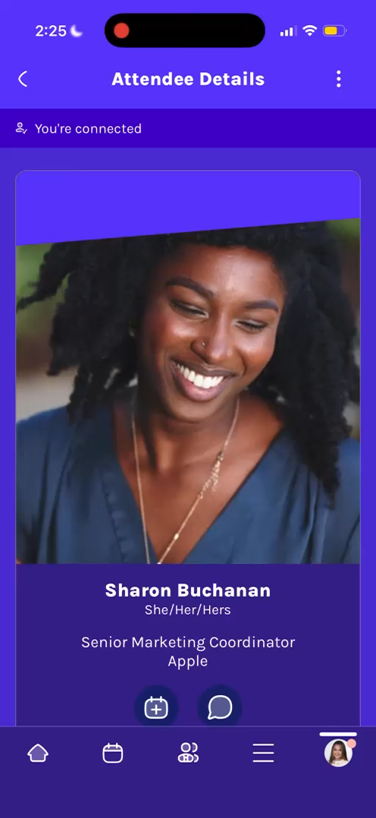
ATTENDEE HUB
Save Connections to Native Address Book
What changed: When attendees tap a connection's email in the Event App, a device-native modal lets them save the person as a contact with name, company, and email pre-populated.
Why it matters: Attendees can easily carry connection details onto their device and continue the conversation.
Use case: Save a new contact to your phone right after meeting them at the event, without manual re-entry.

Slide 26
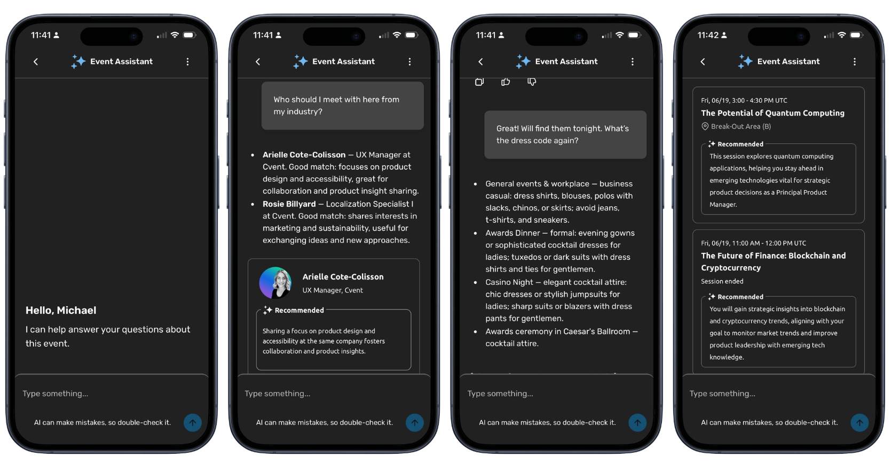
ATTENDEE HUB
Attendee Assistant and Event Knowledge Base (Open Beta)
What changed: An AI-powered companion in the Event App gives attendees personalized answers, links, and details, paired with an Event Knowledge Base for uploading event content that auto-generates FAQs.
Why it matters: Attendees get accurate, tailored answers while respecting your content-visibility and privacy rules.
Use case: Let attendees ask about sessions, speakers, venue guides, or travel policies and get instant answers.

Slide 27
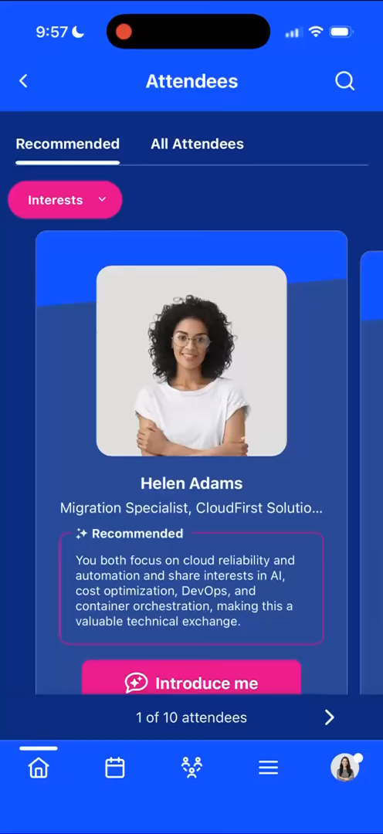
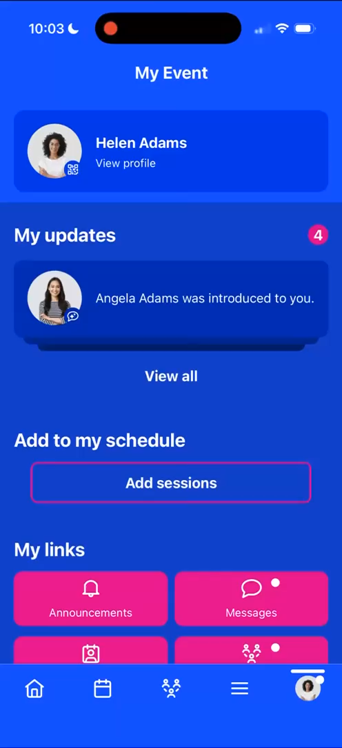
ATTENDEE HUB
Warm Introductions
What changed: When an attendee taps "Introduce me," Event Assistant drafts a personalized introduction from shared interests or goals, shows it for approval, and starts a shared conversation thread.
Why it matters: Gives attendees a lower-friction way to connect without cold outreach.
Use case: Turn a recommended match into a real conversation with an AI-drafted intro (up to 10 per attendee).

Slide 28
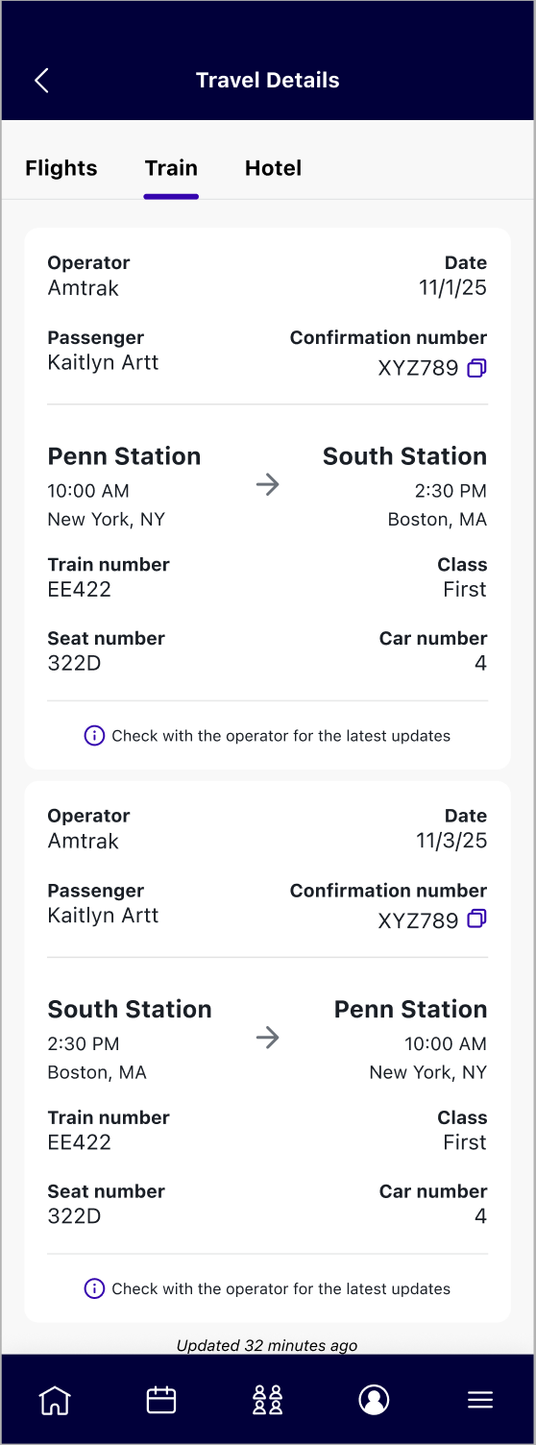
ATTENDEE HUB
Train Details in Attendee Hub Event App
What changed: When enabled and confirmed train bookings are imported, eligible attendees can view train operator, schedule, station, seat, and confirmation details in a new Train tab.
Why it matters: Puts confirmed train, flight, and hotel details in one place for attendees.
Use case: Let rail travelers find their train details alongside flights and hotels instead of searching emails.

Slide 29
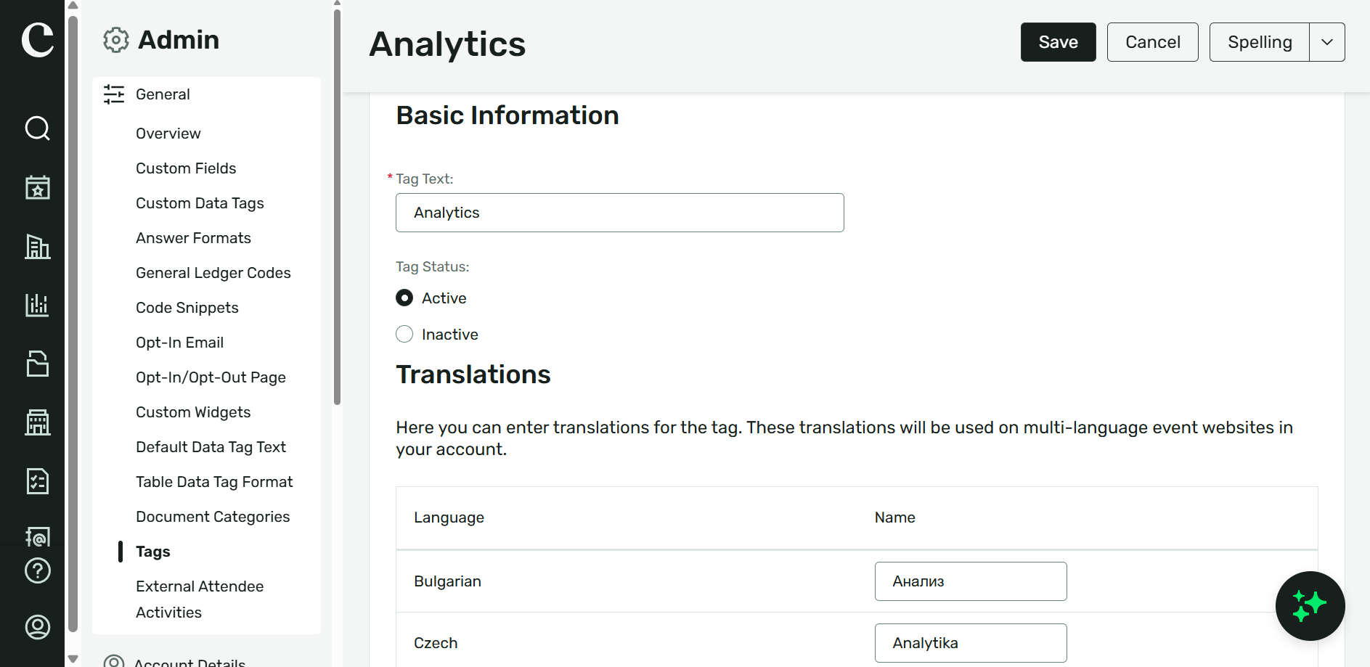
ATTENDEE HUB
Tag Translations
What changed: Admins can translate session, speaker, and interest tags, which then appear in Attendee Hub Web and the Event App based on each attendee's language preference.
Why it matters: Makes content and networking easier to navigate for multilingual attendees.
Use case: Let attendees select translated interest tags for more relevant session and connection recommendations.

Slide 30
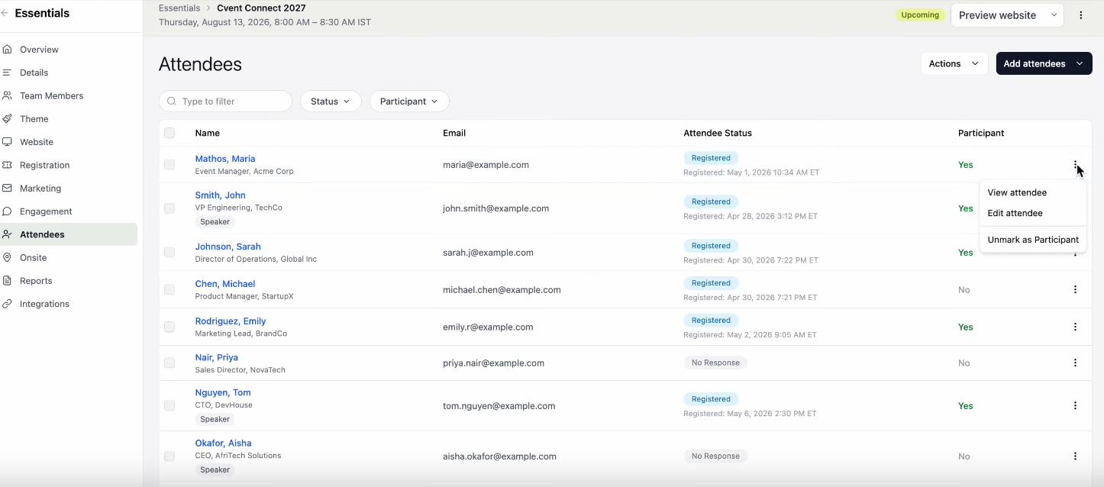
CVENT ESSENTIALS & WEBINAR
Manual Participation Tracking in Attendee List
What changed: Organizers can mark registered attendees as participants - one at a time or in bulk - directly in the Attendee List, with a new Participant column and full change history.
Why it matters: Lets teams correct or confirm participation without relying solely on check-in or webinar join data.
Use case: Confirm participation for attendees the system missed, and export the record in the Participation Report.

Slide 31
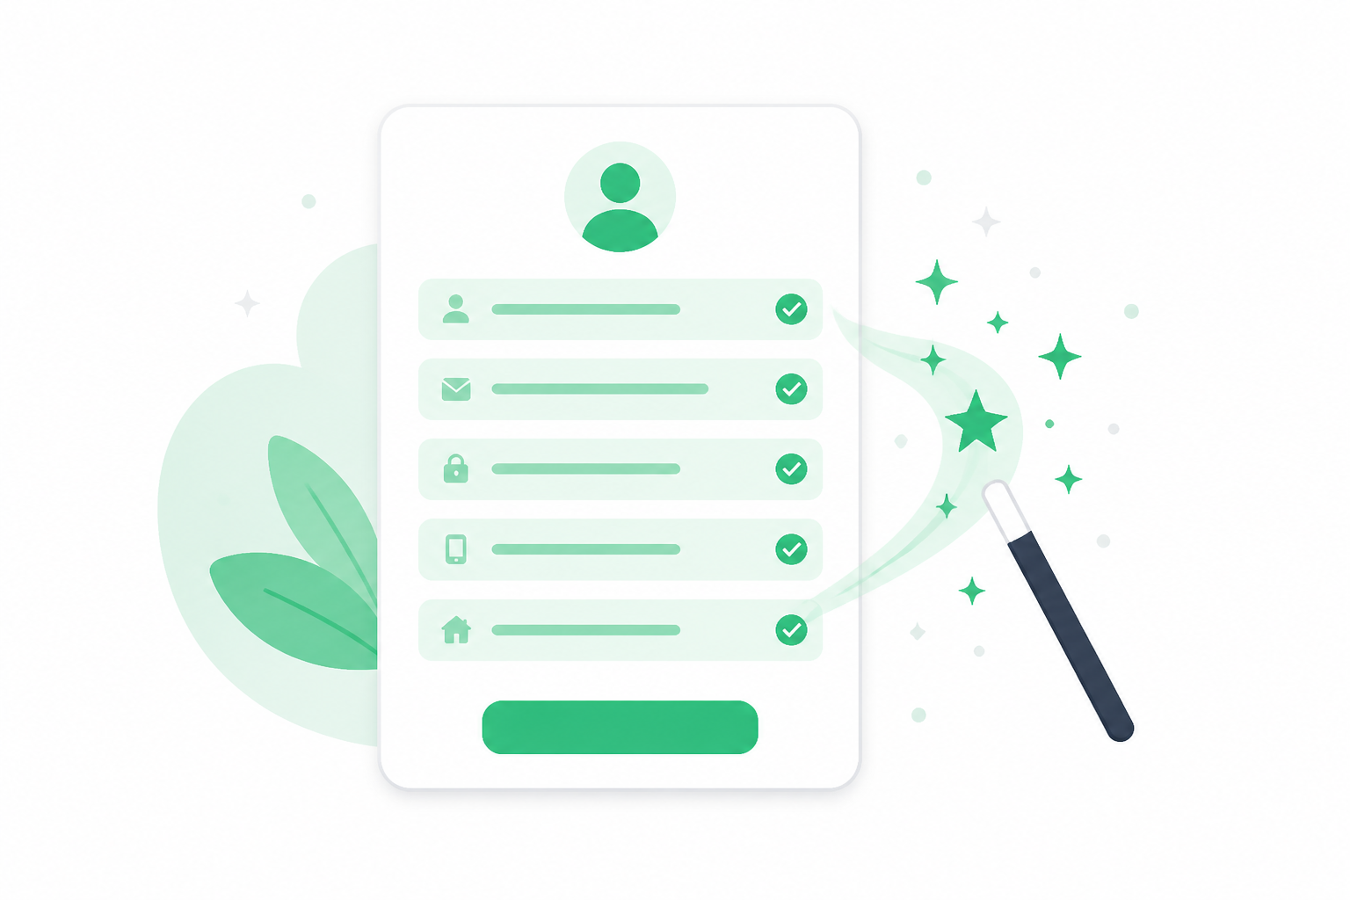
CVENT ESSENTIALS & WEBINAR
Pre-Fill Registration Form
What changed: Registration forms for Webinar and Essentials events pre-fill for invitees whose contact details are stored in the Address Book, with no extra setup.
Why it matters: Less typing makes it easier for known invitees to complete registration.
Use case: Speed registration for repeat invitees while still letting them edit their details before submitting.

Slide 32

CVENT ESSENTIALS & WEBINAR
Event Approval
What changed: Admins can create approval rules for Essentials and Webinar events (up to 10 rules, five conditions each) and assign approvers; events requiring approval can't publish until approved.
Why it matters: Brings the review process into Cvent to keep events on-brand and compliant.
Use case: Require a branding and compliance review before distributed organizers publish an event.

Slide 33

CVENT ESSENTIALS & WEBINAR
Role-Aware Event Website Preview
What changed: Admins and Organizers get role-aware website previews for events using the new website design experience, showing which widgets are Visible or Hidden.
Why it matters: Makes it easier to catch missing event details before a site goes live.
Use case: Preview a site as an Organizer to confirm all content widgets are complete before publishing.

Slide 34
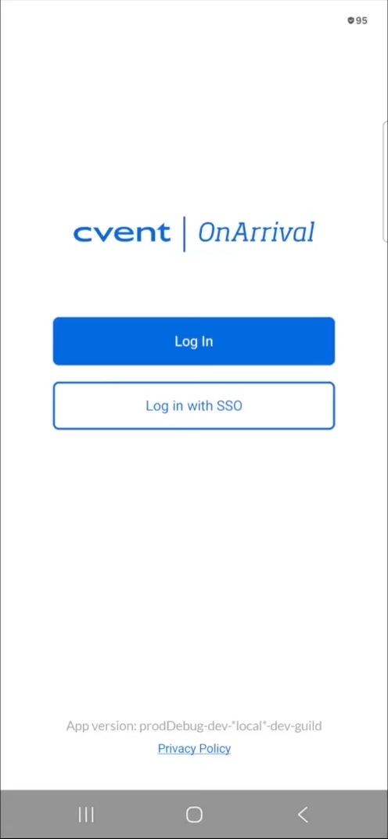
ONARRIVAL
New SSO Login Method for OnArrival | Android
What changed: OnArrival Android now supports SSO login using Organization ID, matching the existing app.cvent.com and OnArrival iOS experience.
Why it matters: Streamlines and standardizes the login experience across Cvent platforms.
Use case: Log in to OnArrival on Android with Organization ID the same way you do on the web.

Slide 35

Exchange Solutions
Cvent Supplier Network, Event Diagramming, Cvent Travel, Passkey

Slide 36
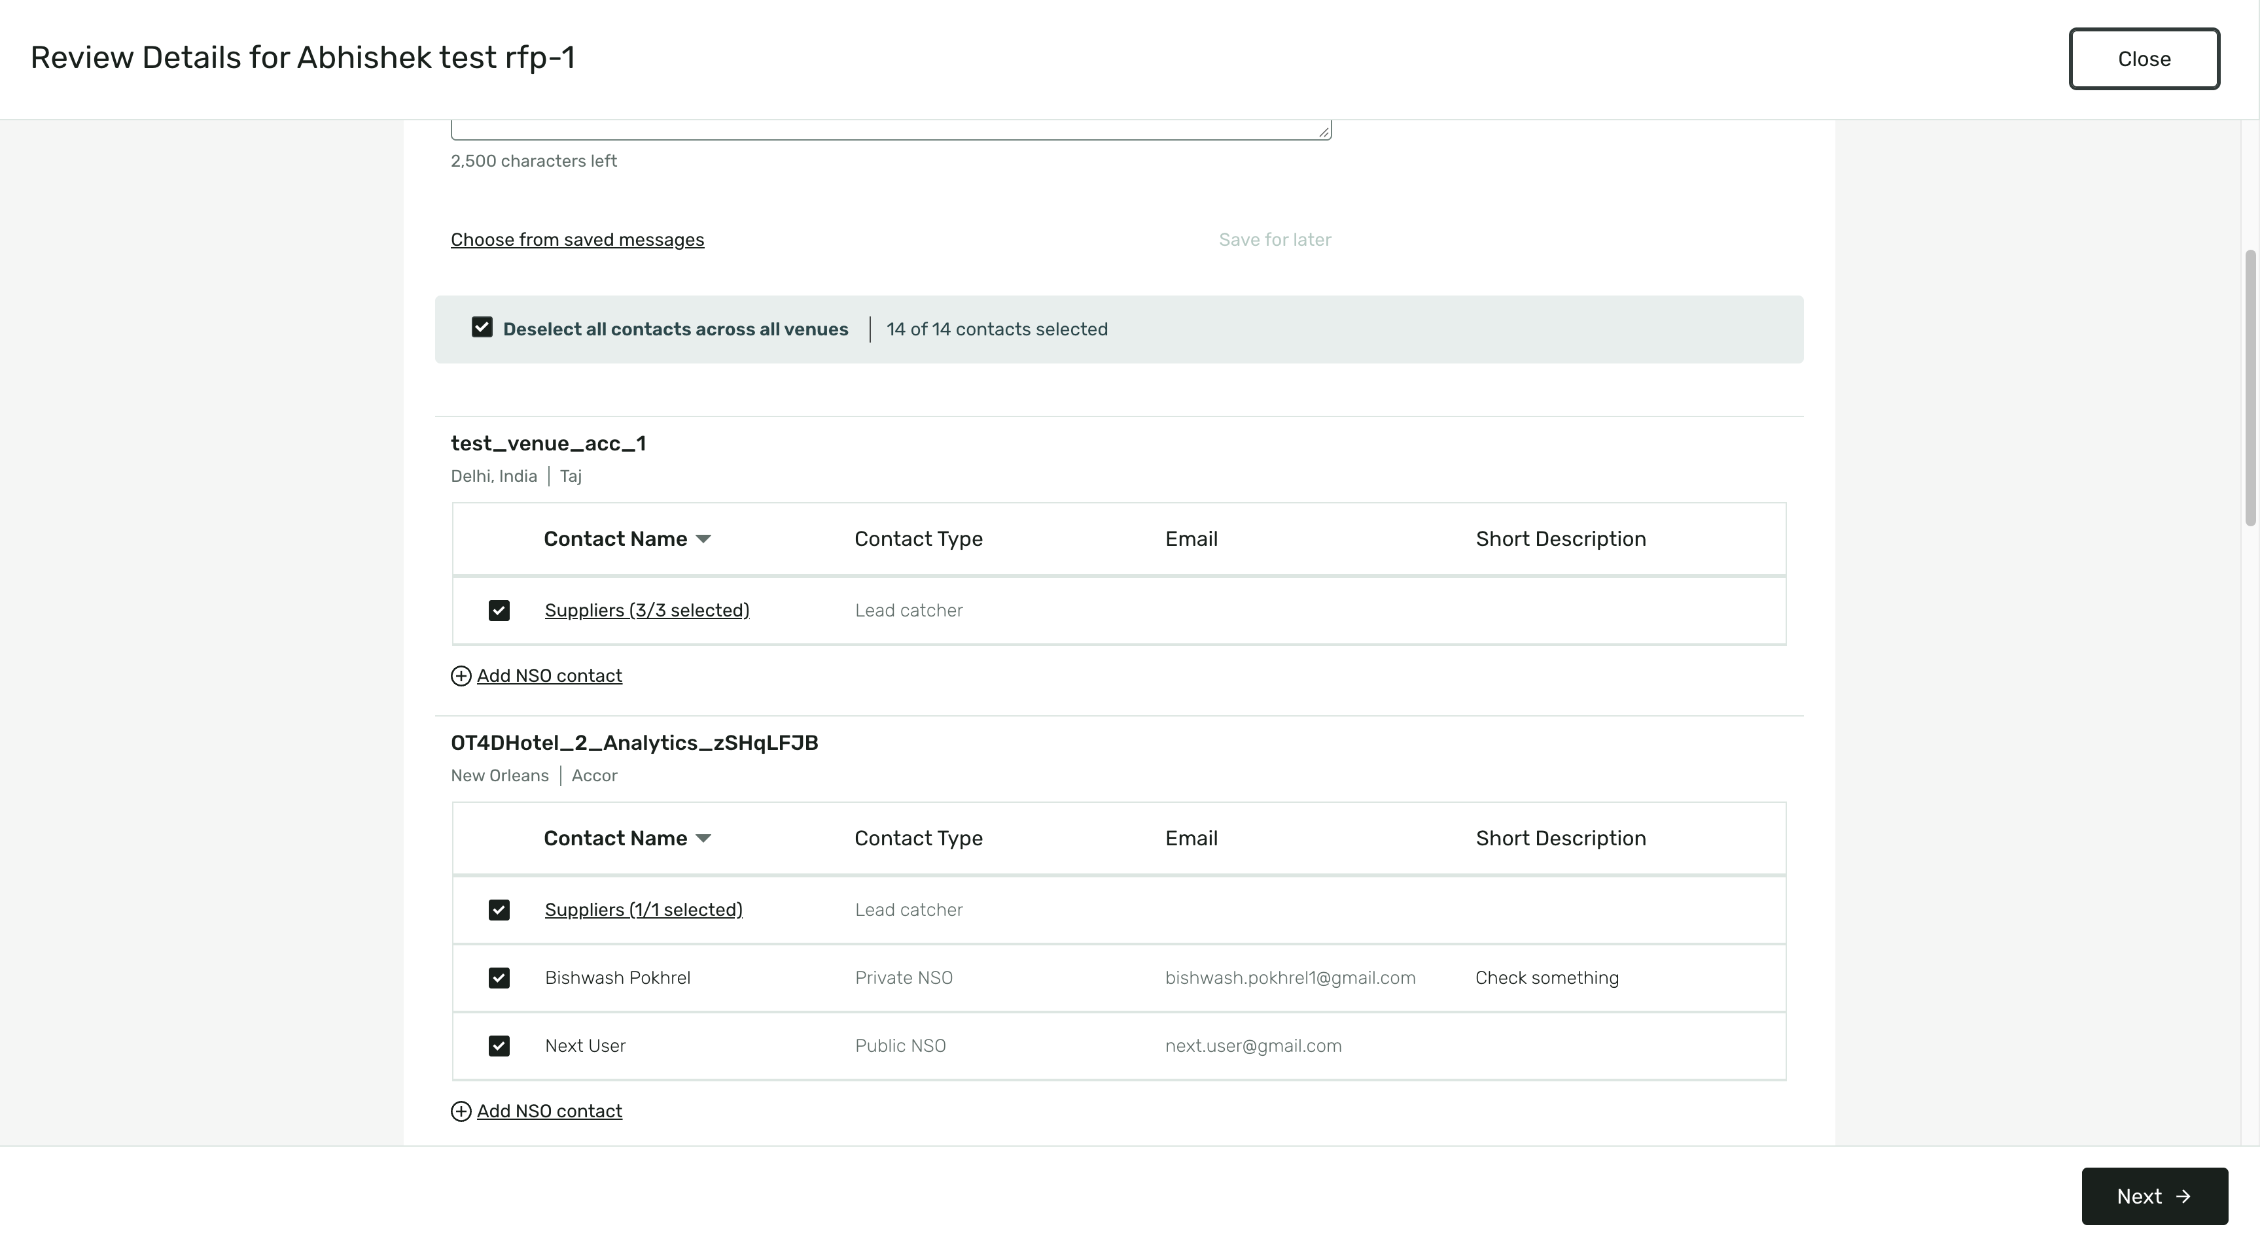
CVENT SUPPLIER NETWORK
Contact Select All and Manual RFP Archiving
What changed: Use a Select All checkbox to select eligible contacts across every venue in an RFP, and manually archive completed (Awarded) RFPs to keep active work in focus.
Why it matters: Saves time on multi-venue sends and keeps your workspace organized.
Use case: Archive an Awarded RFP so it drops out of Current RFPs while staying available in Archived RFPs.

Slide 37
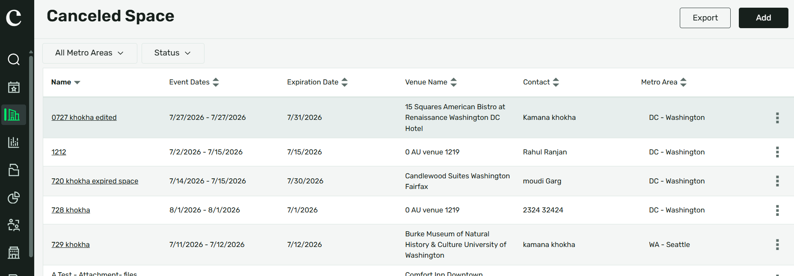
CVENT SUPPLIER NETWORK
Modernized Canceled Spaces and Organization Profiles
What changed: The Canceled Spaces and Organization Profiles pages have a modernized look and feel that aligns with the rest of RFP management, with no action required.
Why it matters: Provides a more consistent, easier-to-navigate experience while keeping your existing data.
Use case: Access your existing Canceled Spaces credits and Organization Profiles in the refreshed experience.

Slide 38
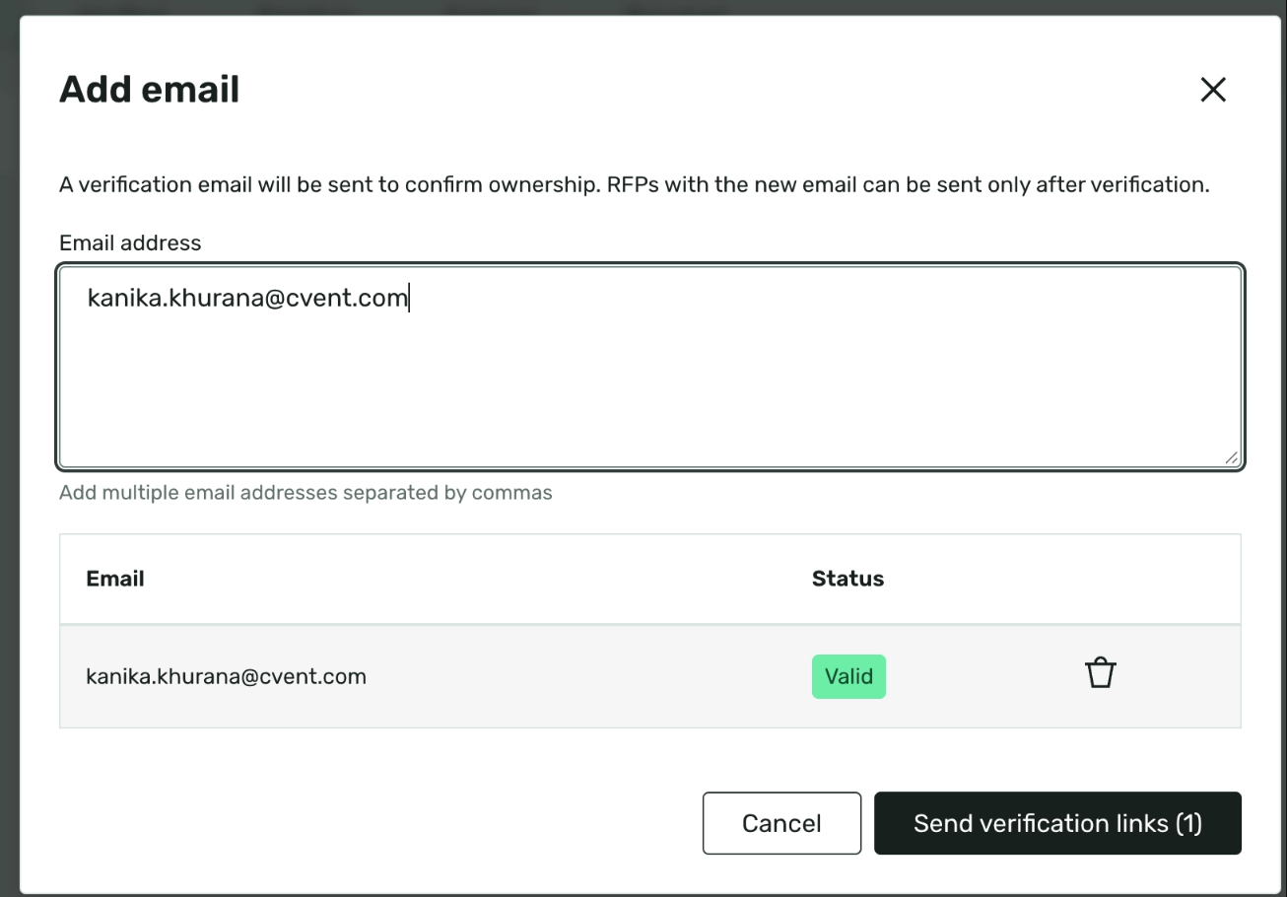
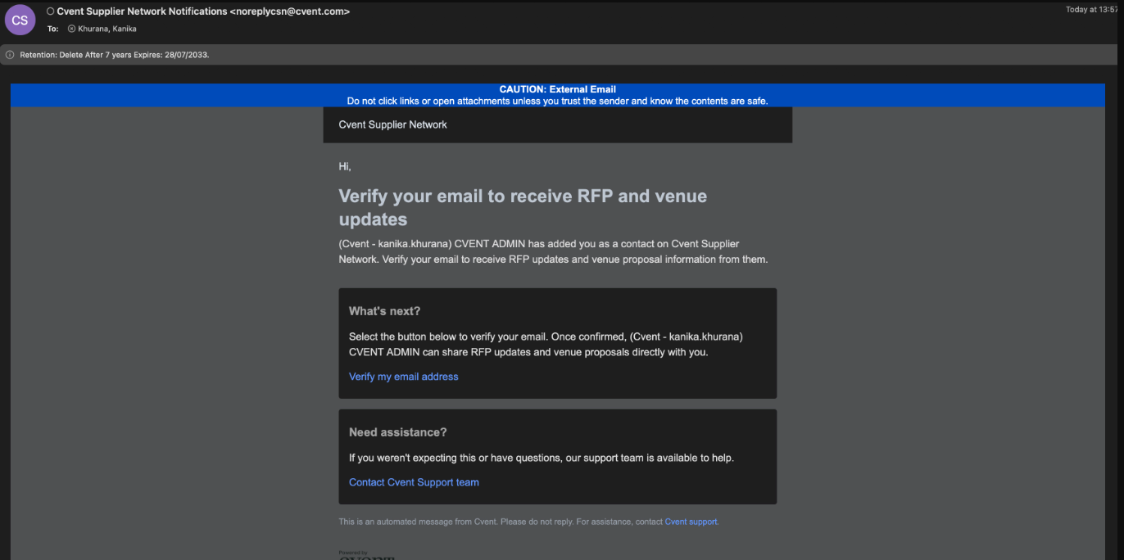
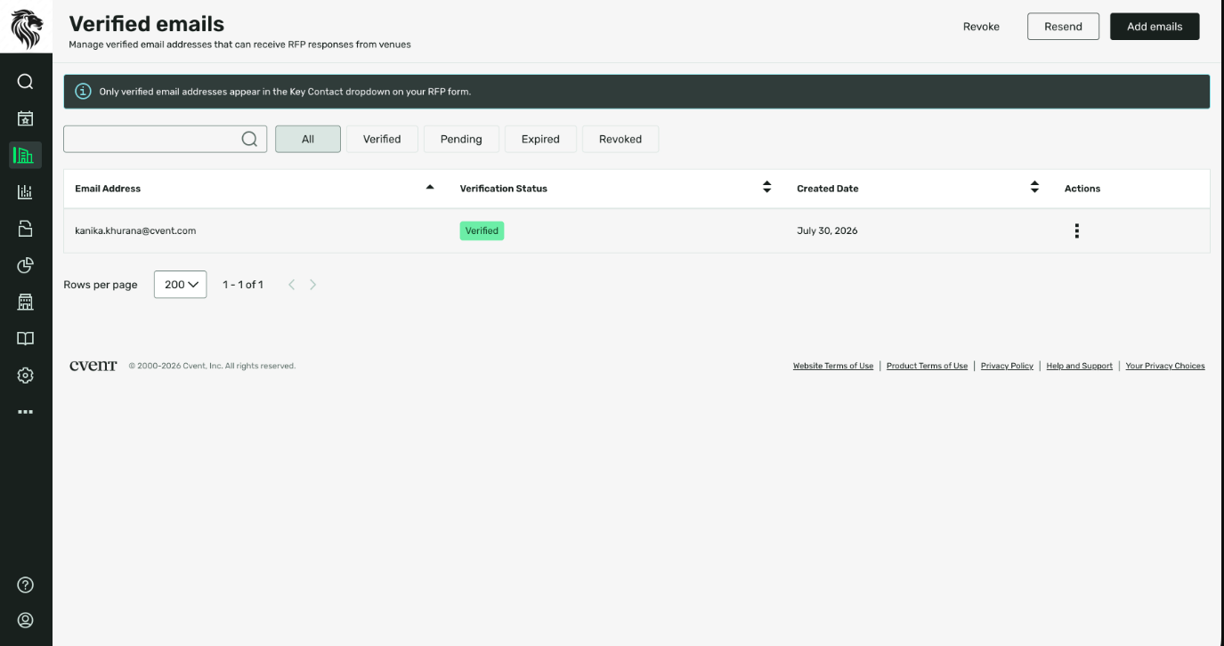
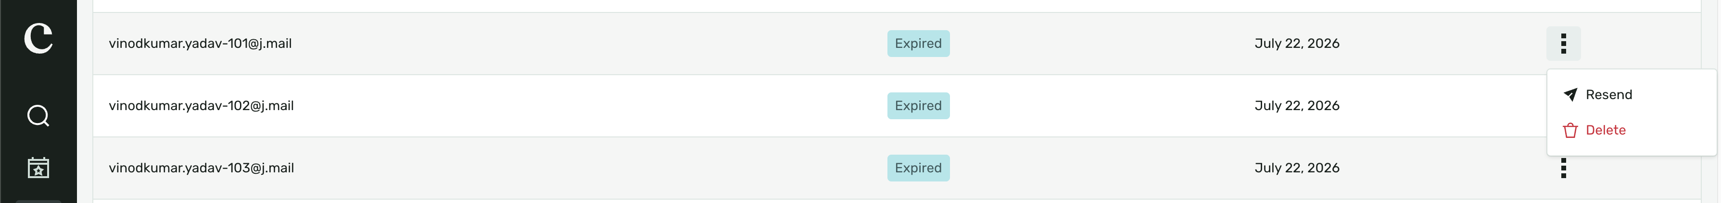
CVENT SUPPLIER NETWORK
Verify RFP Contact Emails
What changed: A new Verified Email section under Sourcing lets planners add, verify, track, resend, and revoke key contact email addresses (verification links last 7 days).
Why it matters: Helps protect the sourcing process and reduce email spoofing risk for key contacts.
Use case: Verify a third-party planner's key contact email before using it on an RFP.

Slide 39

CVENT SUPPLIER NETWORK
RFP Showcase Now Available in Europe
What changed: RFP Showcase is now available and enabled by default for customers in the European region, with no workflow changes required.
Why it matters: Expands sourcing reach by including eligible RFPs in Showcase across Europe.
Use case: Include eligible RFPs in Showcase as part of your existing European sourcing workflow.

Slide 40
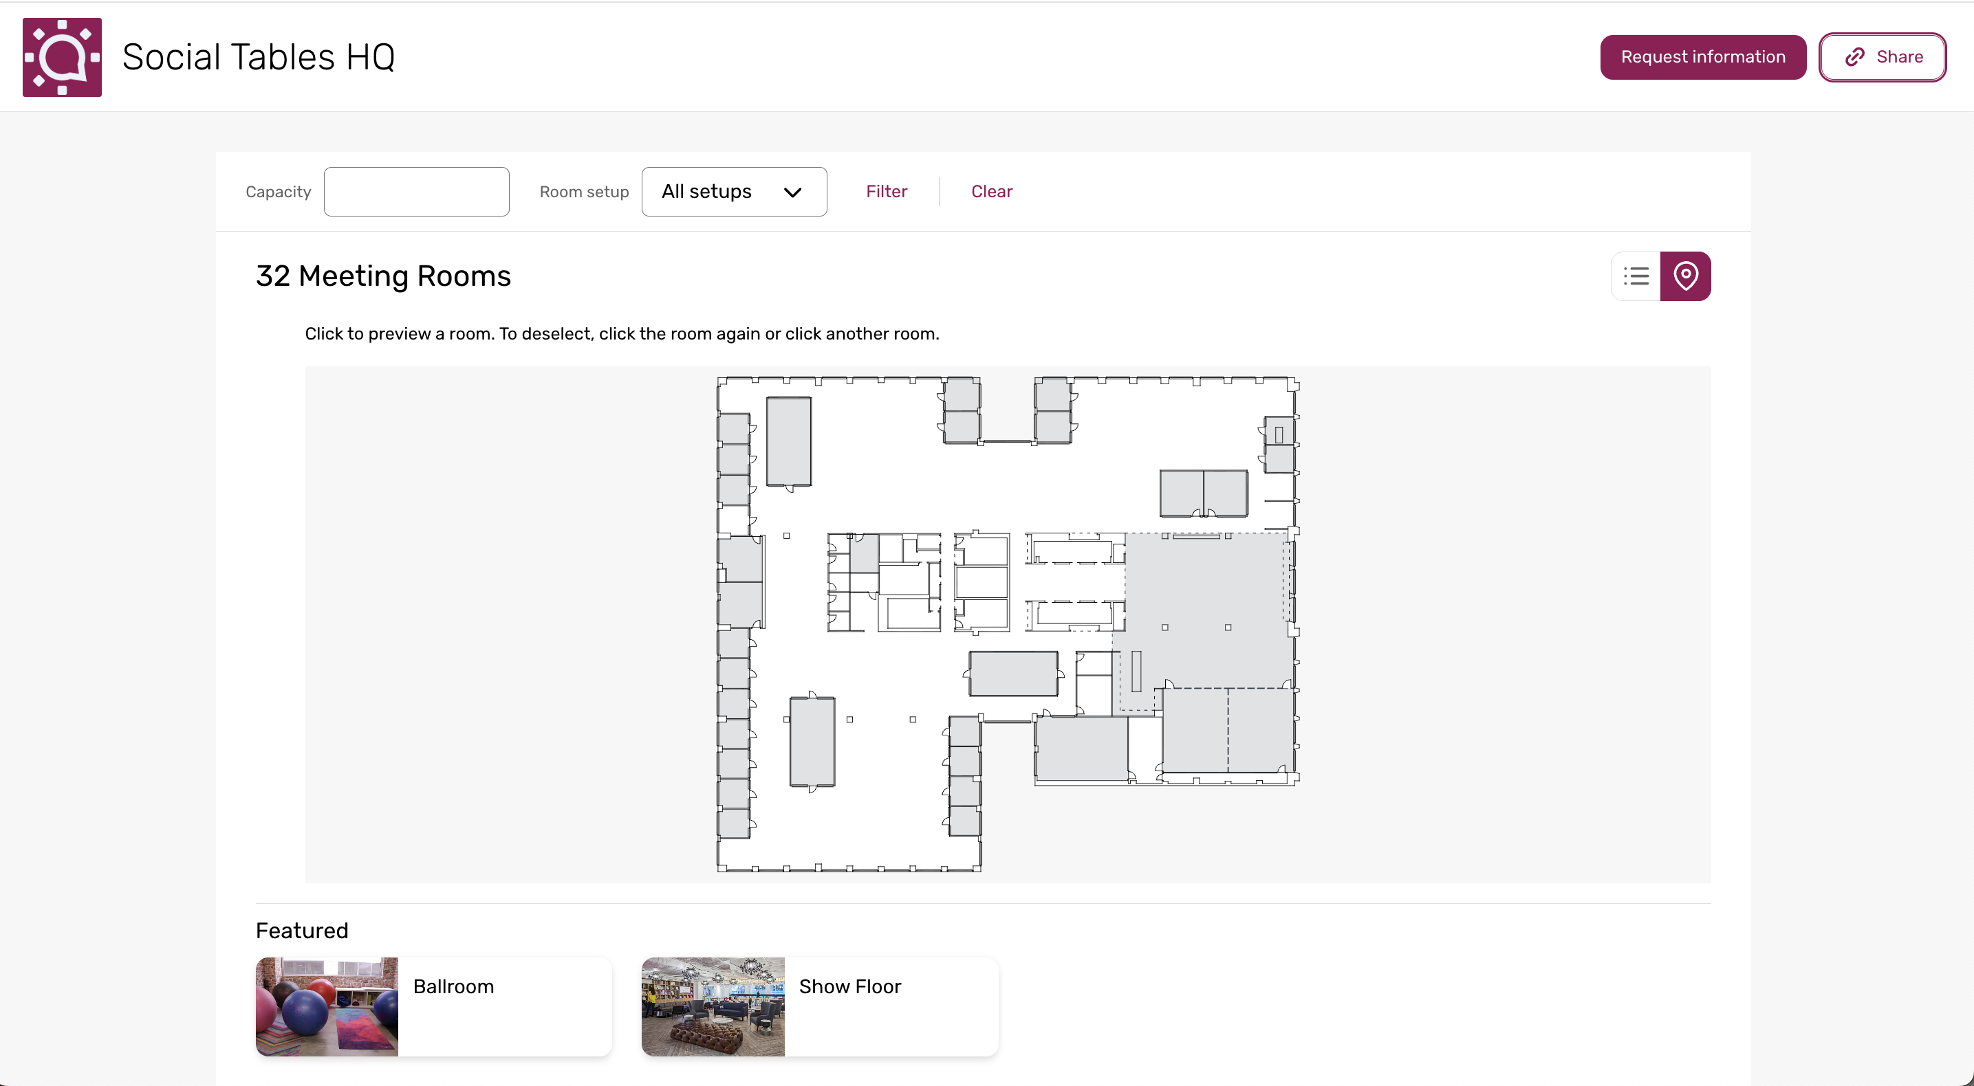
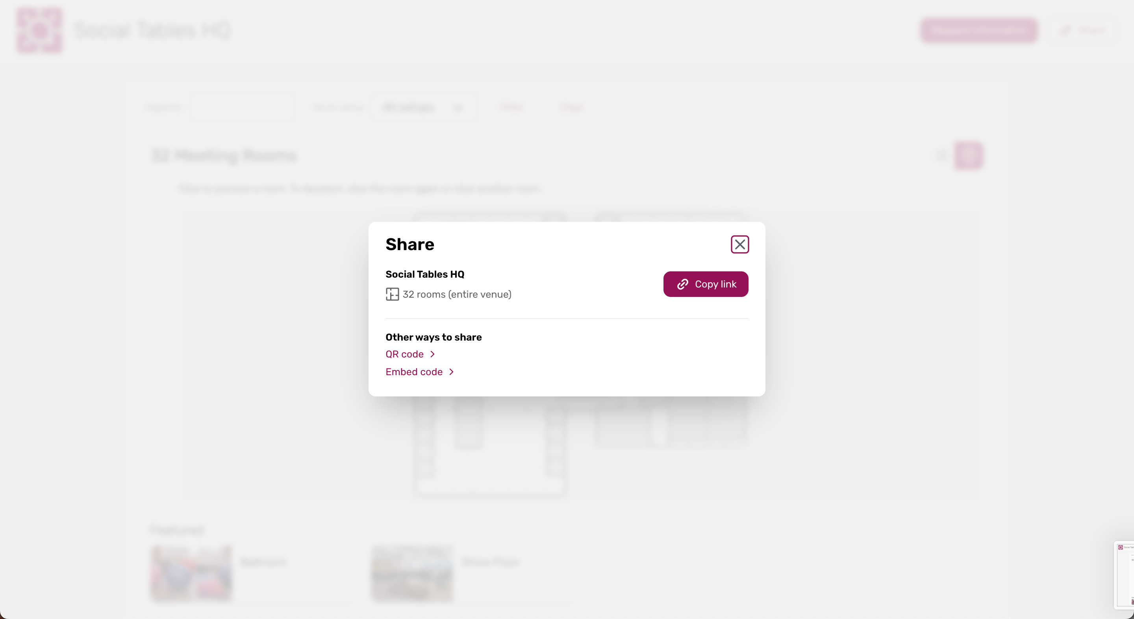
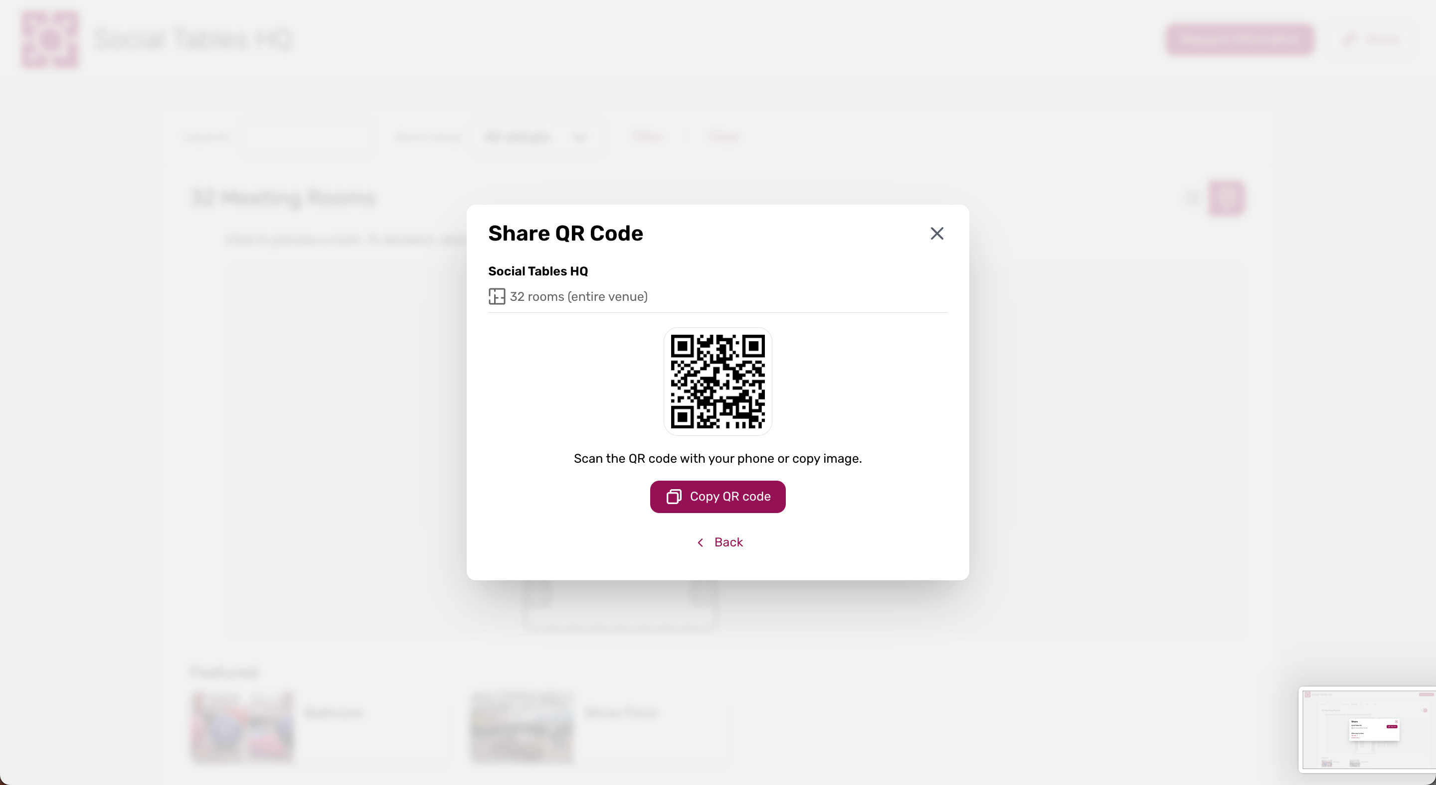

CVENT EVENT DIAGRAMMING
Sharing Interactive Floor Plans
What changed: Hotel and venue teams can share Interactive Floor Plans via a direct link, QR code, or embedded webpage, so planners can open them wherever they're shared.
Why it matters: Makes it easier to access venue and event information in fewer steps.
Use case: Scan a QR code from venue signage or open an IFP link shared by email to explore a layout.

Slide 41

CVENT TRAVEL
Booking Insights with Emburse: Stronger Negotiations
What changed: Customers with an Emburse Benchmarking license and the Booking Insights connector can add Room Nights, Total Spend, and Average Booked Rate to custom report templates and a new Negotiation side-panel tab.
Why it matters: Brings actual traveler booking data into reporting and hotel-rate negotiations.
Use case: Review a hotel's Room Nights and ABR trends while responding to proposed rates.

Slide 42

Spend & Workflow
Meeting Request Form, Access Portal

Slide 43

MEETING REQUEST FORM
Auto Event Creation in Workflows
What changed: Auto Event Creation is now a workflow action; admins can create a Standard, Essentials, or Webinar event using Advanced Rule Criteria based on meeting request or RFP status.
Why it matters: Reduces manual event setup and helps standardize workflows.
Use case: Automatically create the right event type when a meeting request reaches a specific status.

Slide 44

MEETING REQUEST FORM
Workflow Execution History
What changed: A new Workflow Execution History Report lets account admins review workflow executions - status, configuration, initiation details, and action type - and filter, save, schedule, and export it.
Why it matters: Gives visibility to investigate workflow outcomes without relying on Support for basic details.
Use case: Check whether a workflow execution succeeded, is pending, or failed.

Slide 45

Trade Show Solutions
iCapture, Jifflenow

Slide 46

ICAPTURE
Request a Jifflenow Meeting
What changed: iCapture Kiosk now includes a Request a Meeting option for Jifflenow customers, sending booth-visitor meeting requests directly into Jifflenow.
Why it matters: Turns in-the-moment booth interest into meeting requests with fewer manual handoffs.
Use case: Let a booth visitor request time with your team on the spot, flowing straight into Jifflenow.

Slide 47

ICAPTURE
Daily Lead Action Report
What changed: A new Daily Lead Action Report summarizes the previous day's lead activity so teams can see which leads need attention.
Why it matters: Gives teams a clear daily starting point instead of pulling lead data from multiple places.
Use case: Start each day with a prioritized view of recent leads to follow up faster.

Slide 48

JIFFLENOW
Location Assignment
What changed: Location Assignment (formerly Mappings) now keeps canceled meetings visible alongside active ones, connected to their assigned location.
Why it matters: Gives teams a clearer, more complete history of how each space was planned and used.
Use case: Review the full scheduling history for a room, including canceled meetings, in one place.

Slide 49

JIFFLENOW
Multi-Level Topic Support for Mapping Meetings on Mobile
What changed: Meeting Managers can select multi-level topics when creating or editing Mappings-based meetings in the Jifflenow Mobile App, which filters SMEs and locations to match the topic path.
Why it matters: Less searching and rework, with more confidently routed meetings from a phone.
Use case: Route a mobile meeting to the right expert and location using topic-based filtering.

Slide 50

Resources, Learning & Events
Highlights from the In Case You Missed It ~ August 2026 roundup.
Q3 Product News Live
Q3 Product News Live webinar September 30, noon ET - release recap and product Q&A.
On-Demand
Learning & Training
July 14 Product Roadmap Session, available to watch on demand.
Cvent Beginners Office Hours; Email Best Practices (Sept 22 US / Sept 24 EMEA).
Customer Success Groups: Tampa Bay Sept 2, San Diego Sept 3, Salt Lake City Sept 9, Raleigh Sept 16, Denver Sept 23, Toronto Sept 24.
Regional Training Workshops: Houston Sept 16-17, Atlanta Sept 22-23, Baltimore Sept 29-30 - use code UPSKILL50 for 50% off.
Spotlight
Turn common interests into meaningful connections with Community Meetings.
Sources
Get Involved
ICYMI August 2026
August 19 Digest
September 2 Digest
Join the UX Research Panel and the Beta Programs page for early access.

