Slide 1
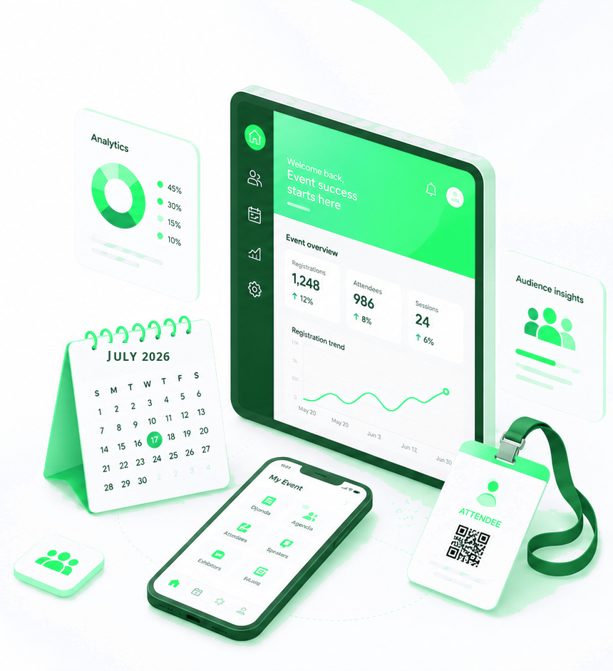

Monthly Product Update – July 2026

Slide 2

About the newsletter
The July updates are grouped into six product neighborhoods to make it easier to review what changed, why it matters, and where each update fits across the Cvent platform.
Plan & Promote
Exchange Solutions
Train Travel, Exhibitor Management Overview Page, Microsoft Dynamics 365 Integration
Photo-Realistic 3D UI Update, Hotel Guarantee Rules, Delete Policies & Taxes in Negotiation
Attendee Engagement
Spend & Workflow
Speaker Self-Joins the Stage, Waitlist for Essentials & Webinars, Improved Networking Discoverability
Tracking Awarded Reposite Vendors in Budget
Actionable Insights
Trade Show Solutions
Event Details in Access Portal Report List; Microsoft Dynamics 365 Integration
Managing Staff Activities on the Go, Mapping Enhancements, Post-Event Meeting Booking (Calendly & HubSpot)

Slide 3
July at a glance: features by neighborhood
32
feature releases
Note: “Event Details in Access Portal Report List” and “Microsoft Dynamics 365 Integration” also appear under Actionable Insights & Integrations.

Slide 4
Additional resources
Helpful links for product news, roadmap visibility, and subscription management.
Announcements
Subscribe to Product News
Browse all Event Marketing & Management product news on the Cvent Product News home page.
Get an email whenever a new product news update is published.
Roadmap
Manage Subscription
See what is currently planned on the Cvent release roadmap.
From the Product News home page, choose “Manage Subscription” to tailor which product interest areas you receive.
Open Forum
Ask questions about rolled-out updates in the Cvent Community.

Slide 5
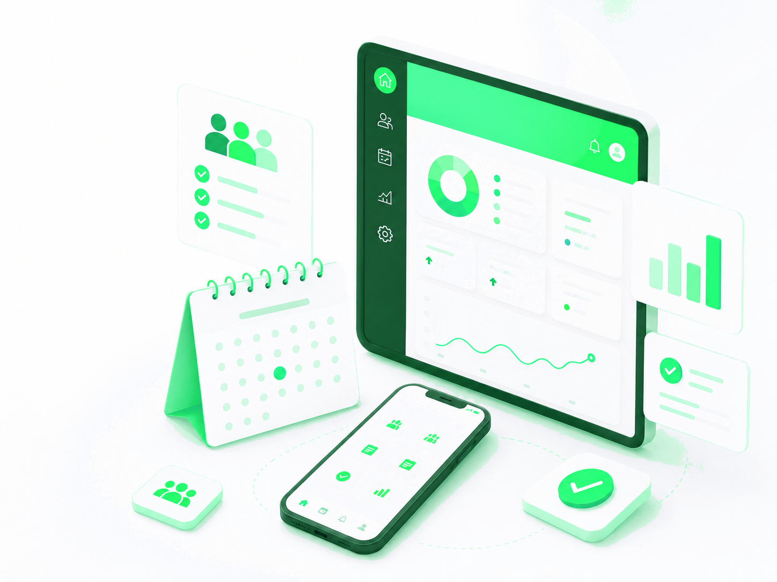
Plan & Promote
Registration, Payments, Exhibitor Management

Slide 6
REGISTRATION
Train Travel: More Flexibility for Event Journeys
What changed: Cvent now supports train travel, bringing train requests, actuals, reporting, and email visibility into the platform alongside existing travel options.
Why it matters: Gives attendees another way to share travel needs and gives planners fuller visibility into event journeys in one place.
Use case: Enable train requests for events where attendees travel by rail, and track requests and actuals without a separate process.

Slide 7
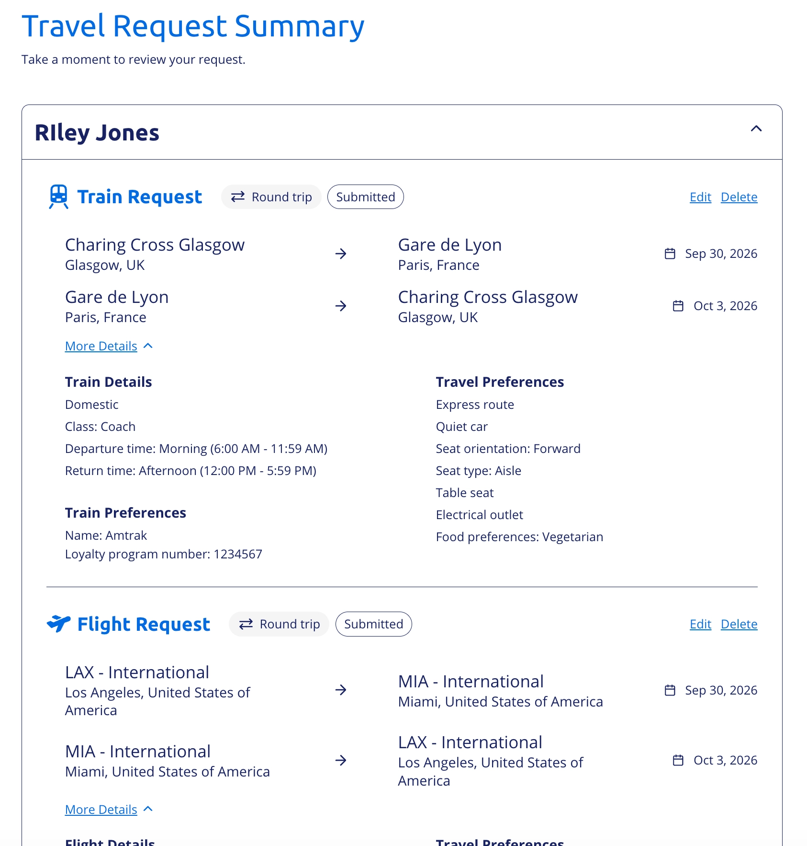
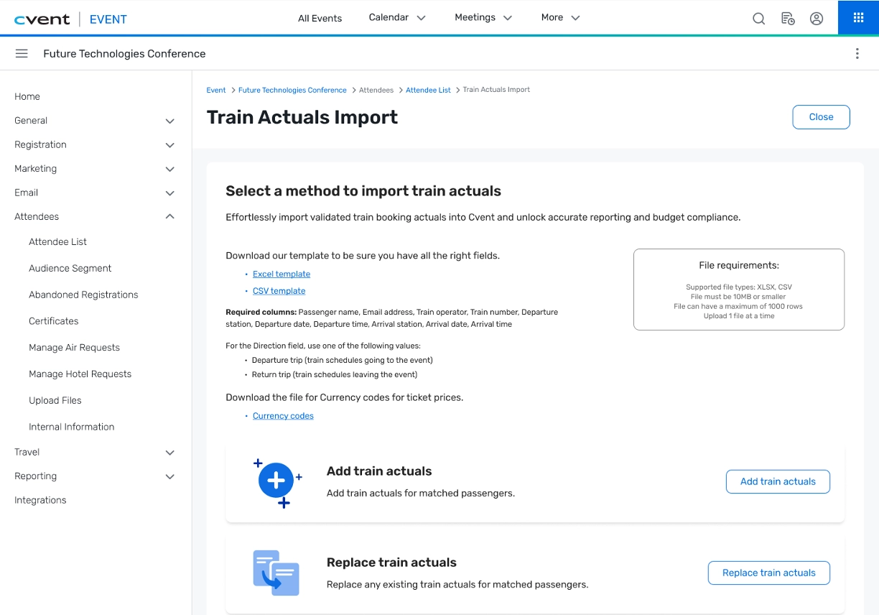

Slide 8
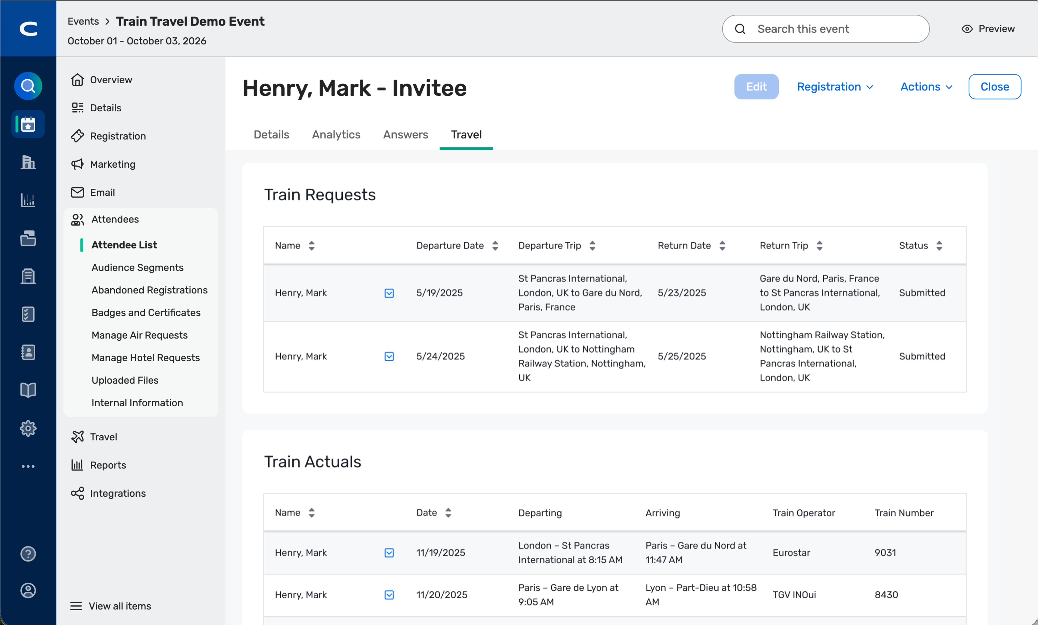
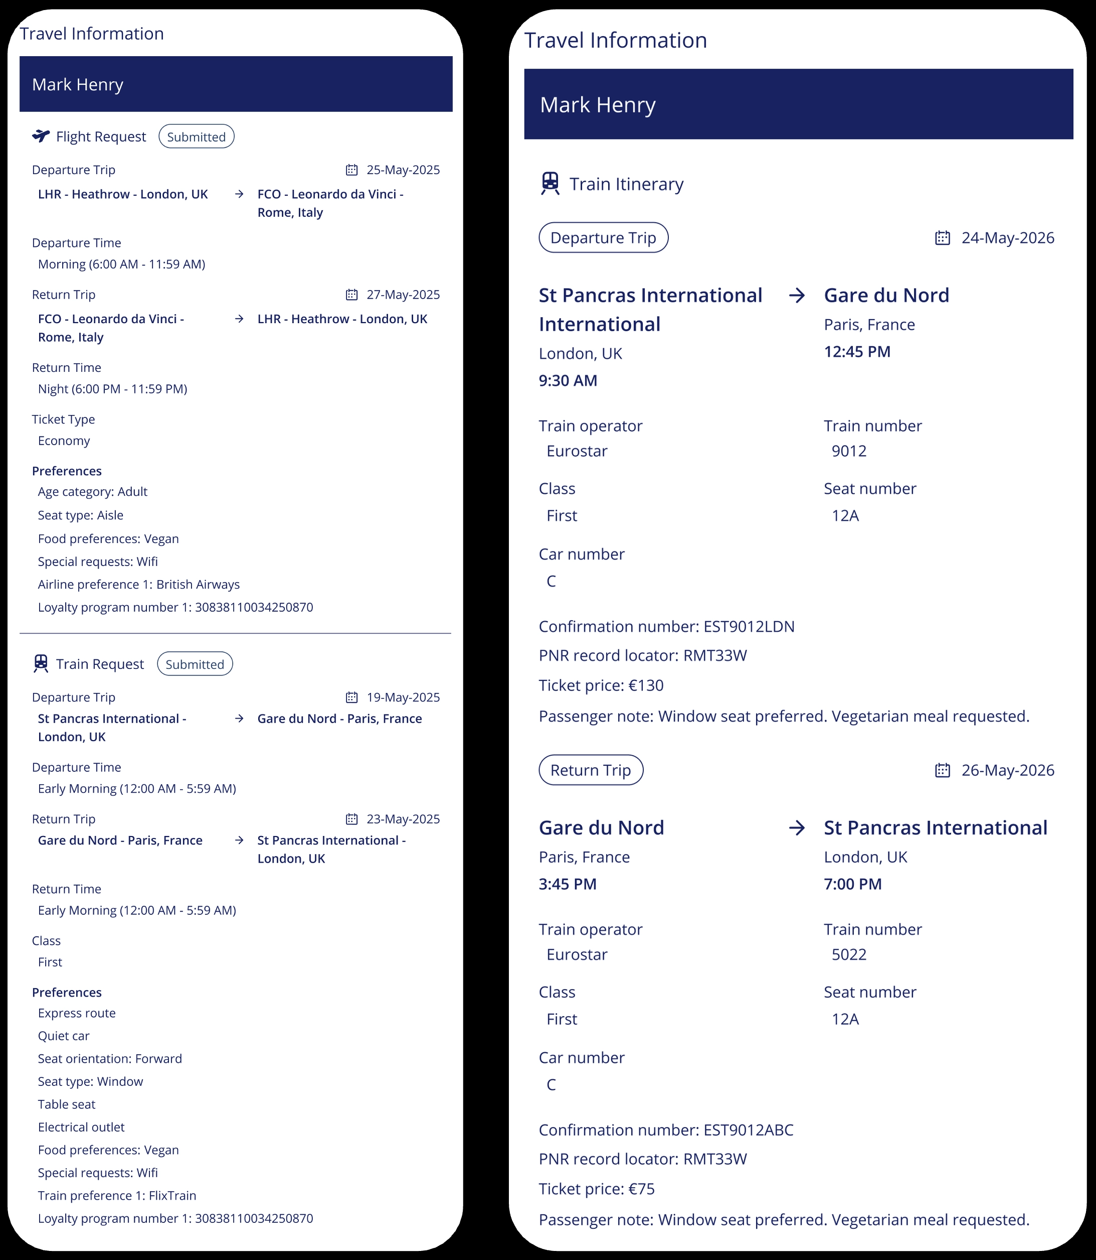

Slide 9
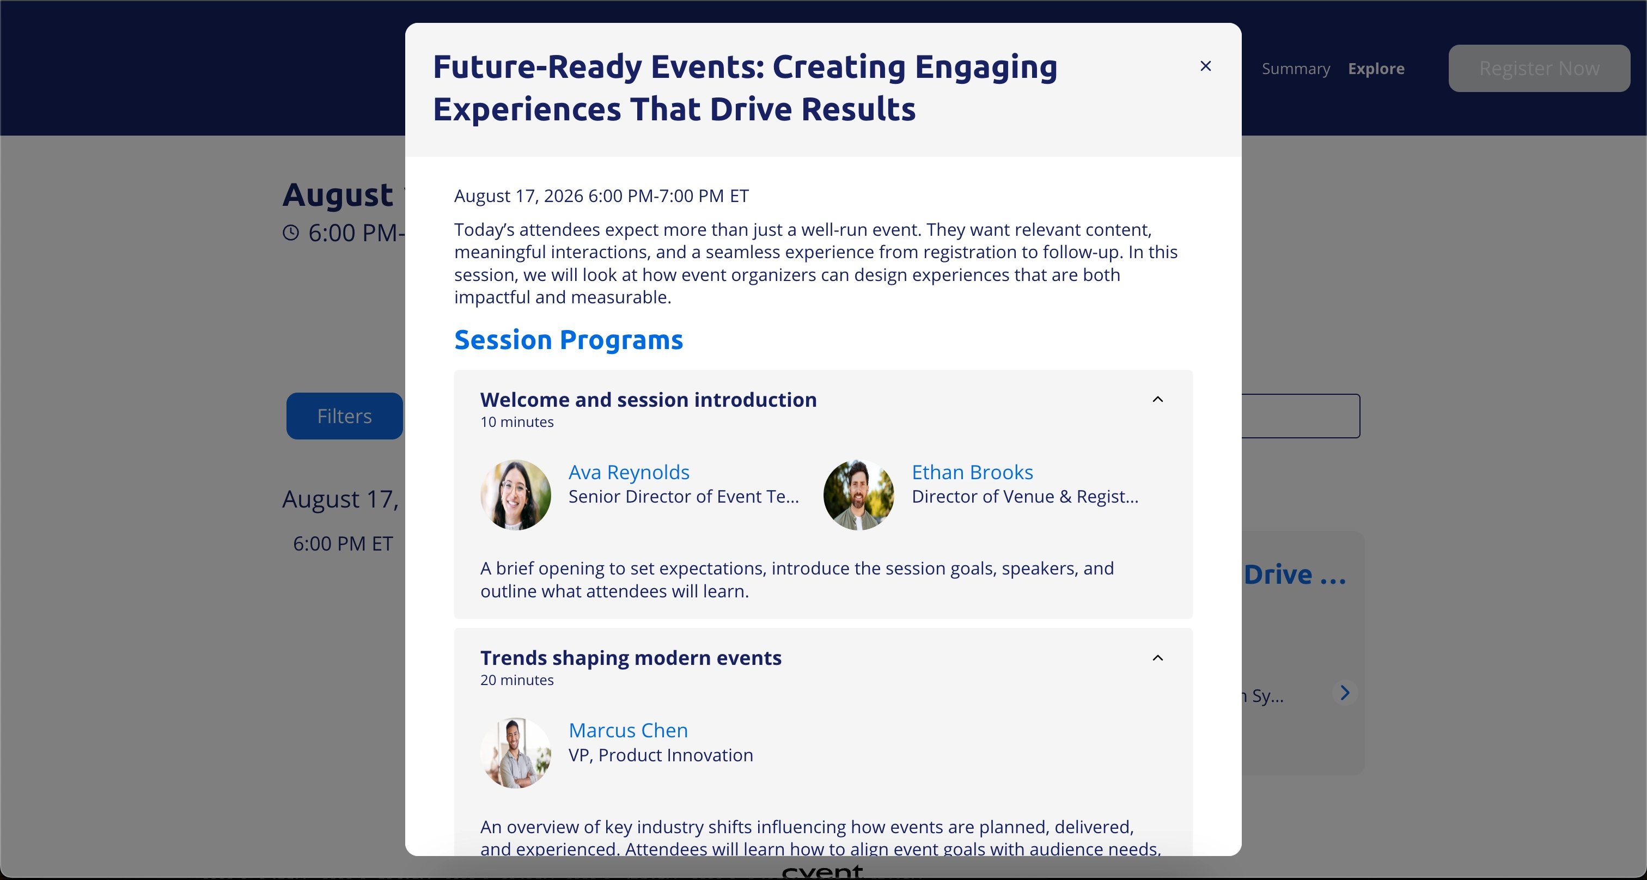
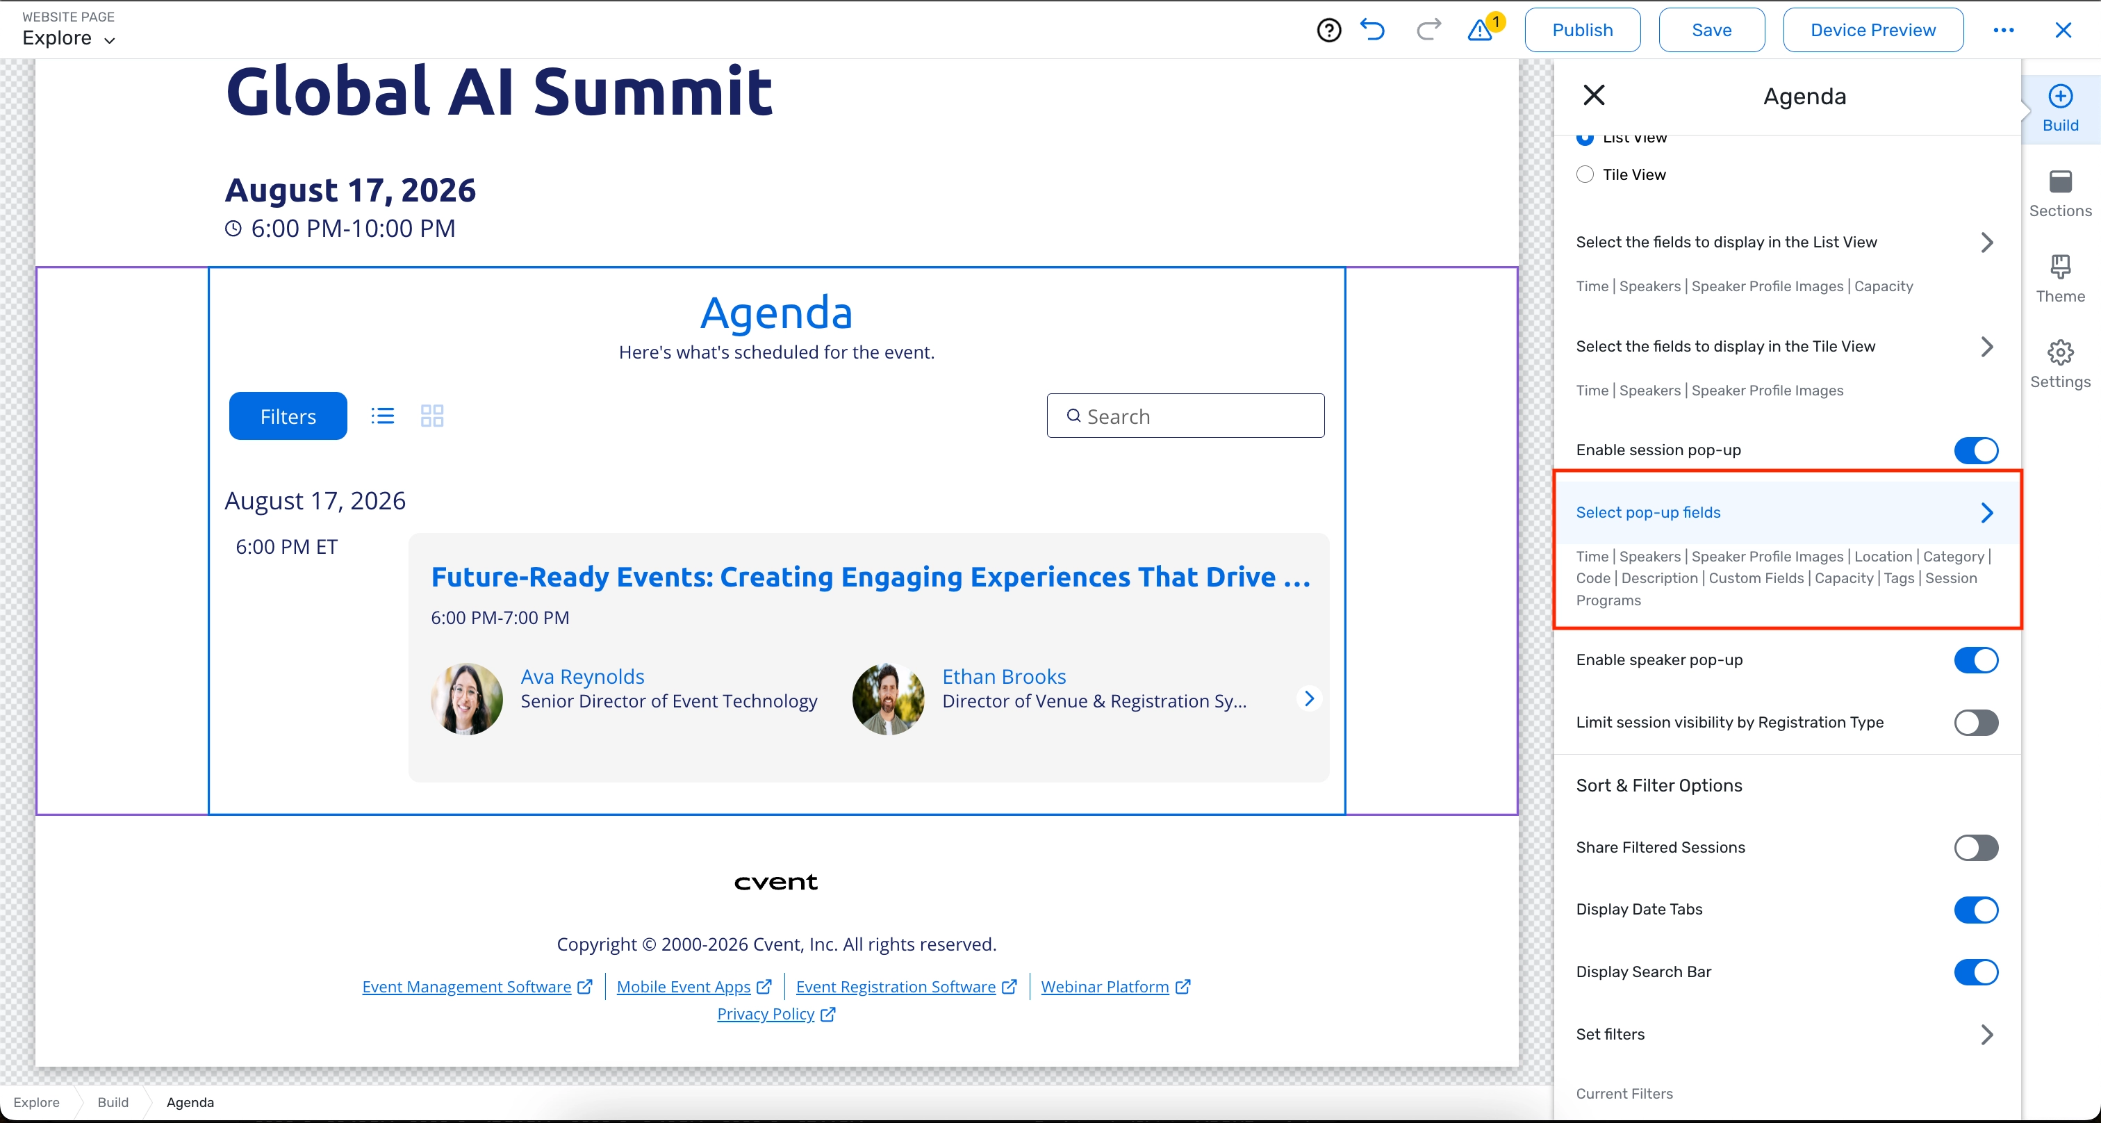
REGISTRATION
Session Programs in the Website Agenda Widget
What changed: The website agenda widget now surfaces richer session details so attendees can preview what a session includes before they register.
Why it matters: Clearer session context helps attendees choose the right sessions and commit with more confidence.
Use case: Use it on multi-track agendas where attendees need to understand what each session covers before they sign up.

Slide 10
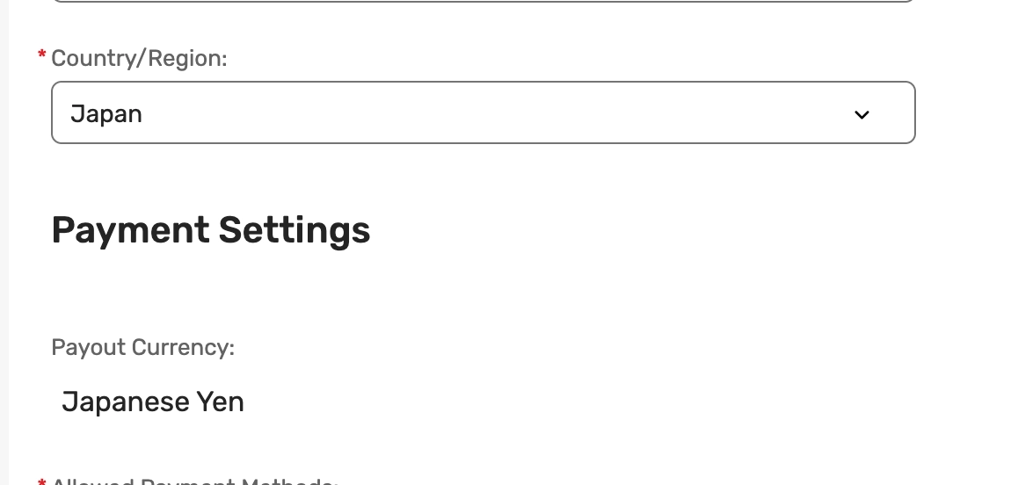
REGISTRATION / PAYMENTS
Additional Countries Supported for Payouts
What changed: Payout support has expanded into more priority regions and supported local currencies.
Why it matters: More customers can receive funds locally, reducing friction for globally distributed events.
Use case: Collect payments and receive payouts for events run in newly supported countries without workarounds.

Slide 11
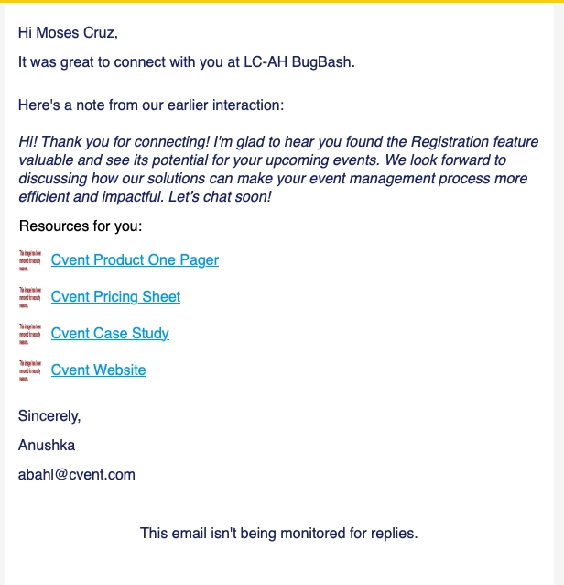
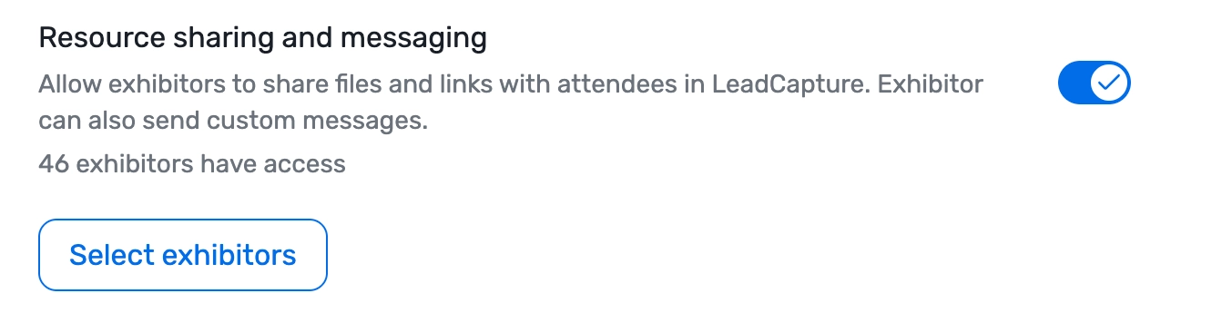
EXHIBITOR MANAGEMENT (ALSO ATTENDEE HUB)
Exhibitor Resources & Personalized Messaging from LeadCapture
What changed: Booth staff can send tailored messages and collateral from LeadCapture, and attendees can revisit shared resources in Attendee Hub.
Why it matters: Keeps exhibitor follow-up moving while interest is high and gives attendees an easy way to return to shared content.
Use case: Send a personalized message with a one-pager right after a booth conversation, then let the attendee find it later in Attendee Hub.

Slide 12
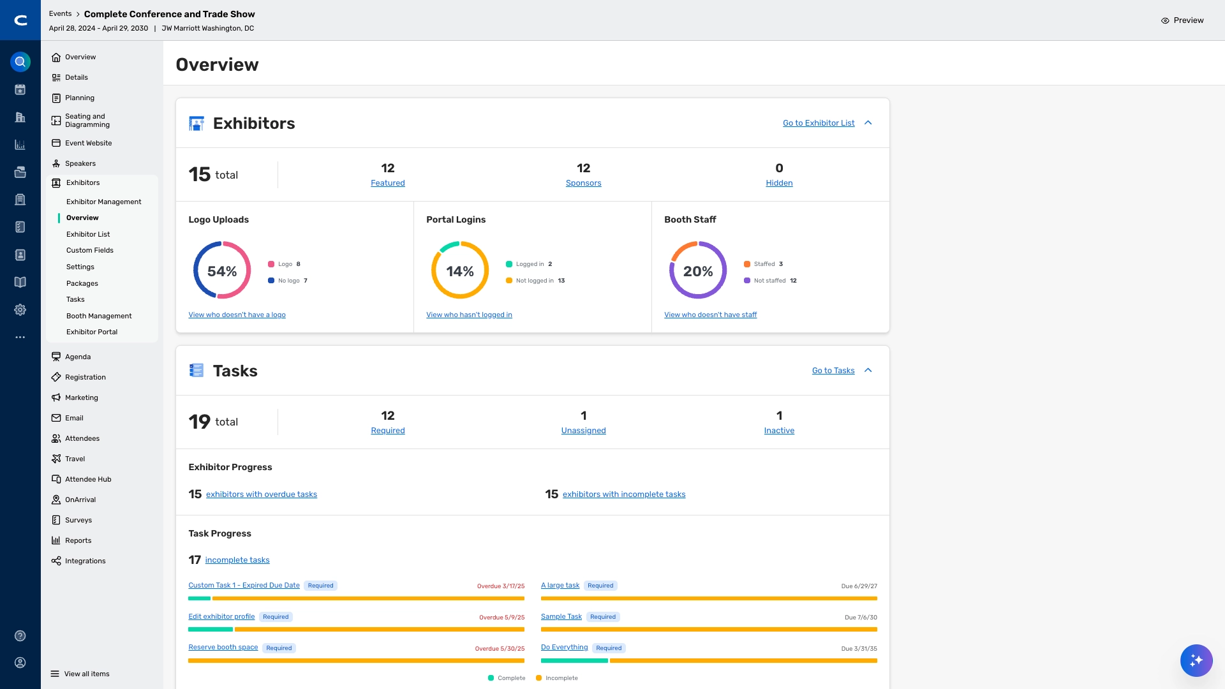
EXHIBITOR MANAGEMENT
Exhibitor Management Overview Page
What changed: A new overview page centralizes exhibitor readiness, lead activity, booth status, tasks, and engagement in one place.
Why it matters: Gives teams a single snapshot to manage exhibitor programs instead of checking multiple screens.
Use case: Review exhibitor readiness and outstanding tasks at a glance in the run-up to a trade show.

Slide 13
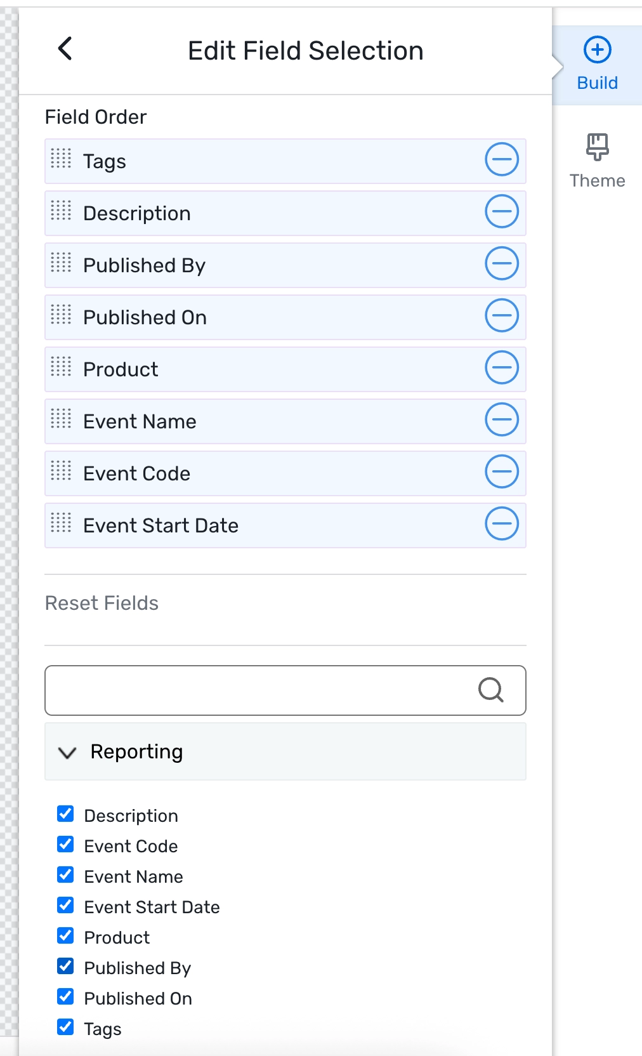
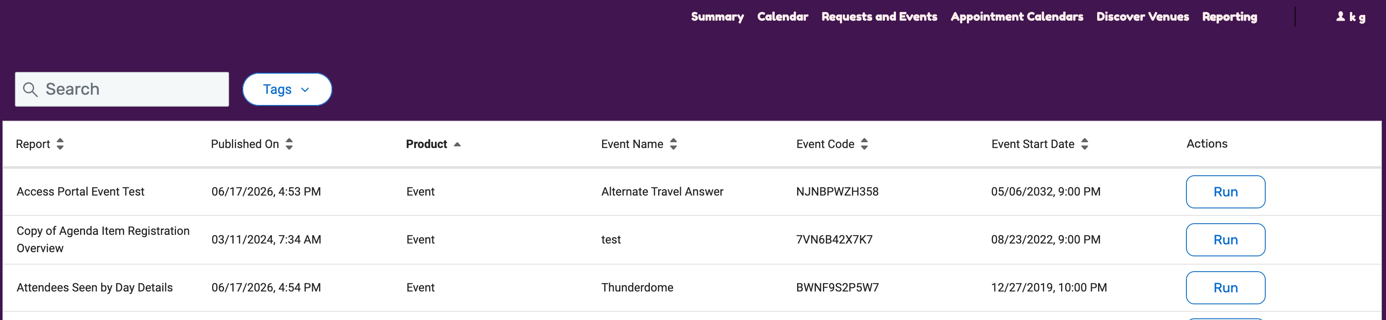
REGISTRATION (ALSO ACTIONABLE INSIGHTS / ACCESS PORTAL)
Event Details in Access Portal Report List
What changed: Report lists now include event name, code, and start date.
Why it matters: Added event context helps users spot and filter to the right report faster.
Use case: Quickly locate the correct report when working across many events in the Access Portal.

Slide 14
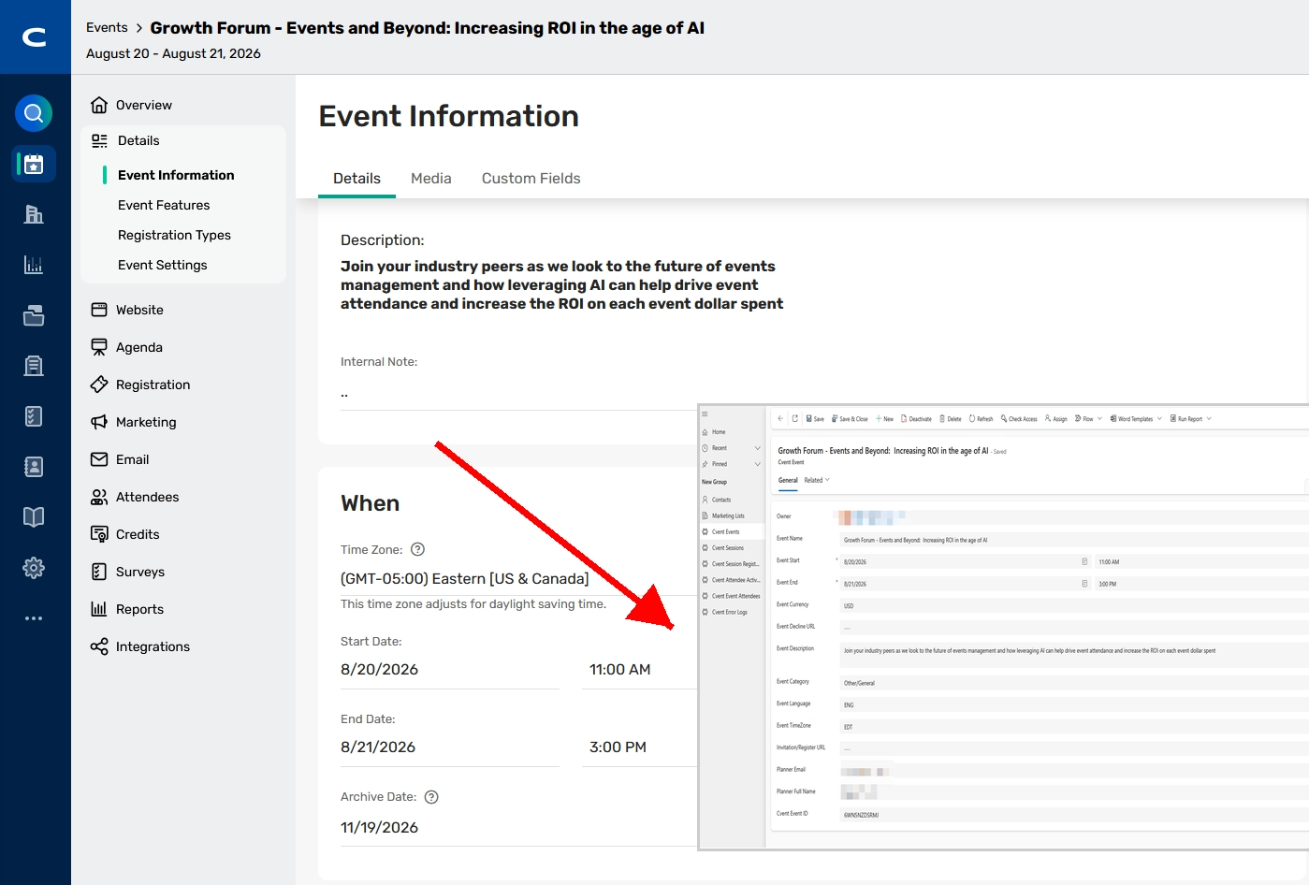
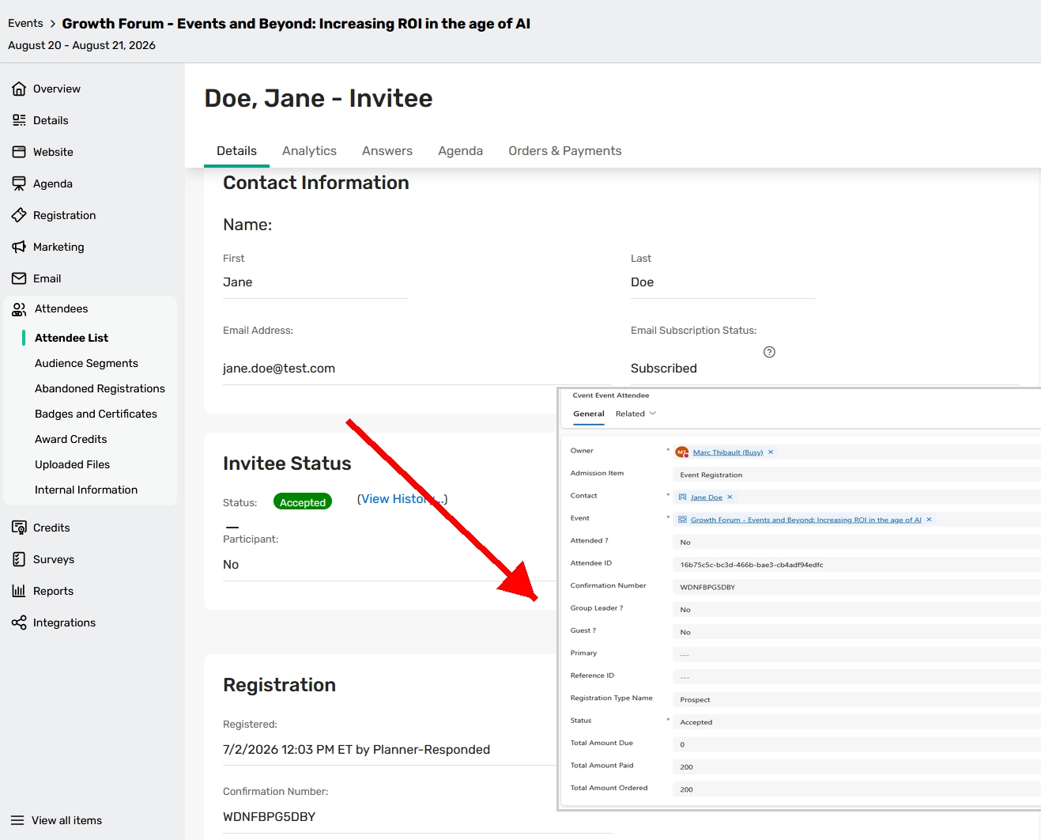
REGISTRATION (ALSO ACTIONABLE INSIGHTS / INTEGRATIONS)
Microsoft Dynamics 365 Integration
What changed: Event, session, and attendee activity now sync with Microsoft Dynamics 365 from one shared view of engagement.
Why it matters: Helps sales and marketing teams automate data sync, enrich contact records, speed follow-up, and measure event impact.
Use case: Push post-event engagement into Dynamics 365 so sellers can prioritize and follow up on the most engaged attendees.

Slide 15
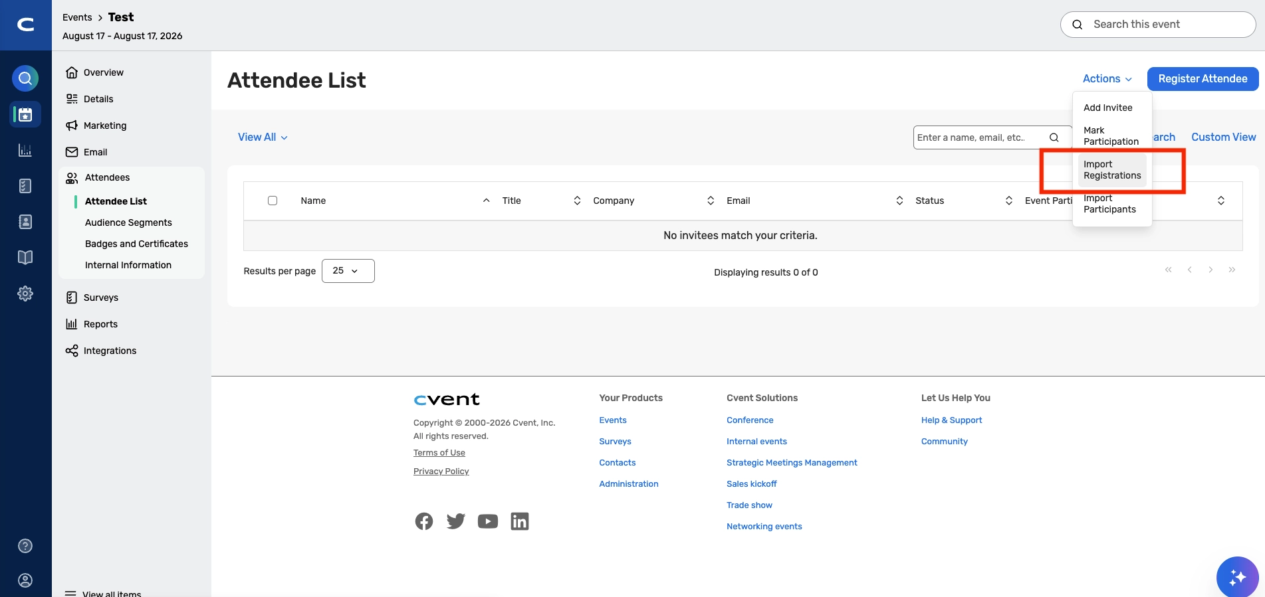
REGISTRATION
Registration Import for Pay-As-You-Go Registration Events
What changed: Known audiences can be bulk-registered for pay-as-you-go events via import.
Why it matters: Imported attendees are ready for check-in, badge printing, and Attendee Hub access without manual workarounds.
Use case: Load a prepared attendee list ahead of a pay-as-you-go event so everyone is set up before doors open.

Slide 16
PAYMENTS
Cvent Payments Transactions Summary Report
What changed: A new summary report aligns to billing statement periods and brings key transaction and payout details into one exportable view.
Why it matters: Simplifies reconciliation by consolidating financial detail that was previously harder to pull together.
Use case: Export the summary at month-end to reconcile payouts against billing statement periods.

Slide 17
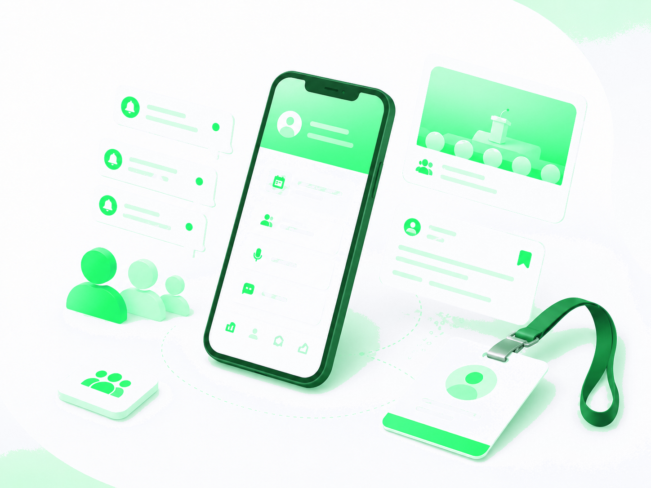
Attendee Engagement
Attendee Hub, Webinar, Essentials

Slide 18
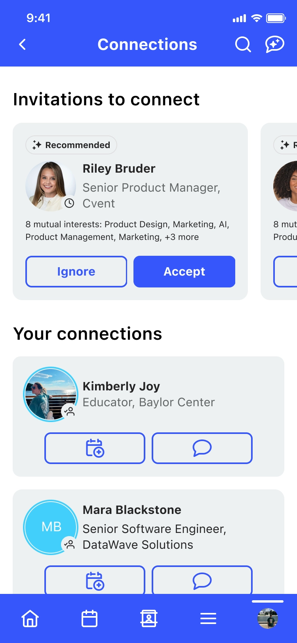
ATTENDEE HUB
Improved Discoverability of Networking Actions on Attendee List
What changed: The attendee list has been refreshed to surface profile context and networking actions more clearly.
Why it matters: Makes it easier for attendees to find and act on networking opportunities.
Use case: Help attendees quickly start a chat or meeting request from the attendee list at a networking-heavy event.

Slide 19

WEBINAR AND ATTENDEE HUB
The Speaker Self-Joins the Stage
What changed: Speakers can now join the stage independently while hosts retain overall session control.
Why it matters: Reduces host coordination overhead and smooths the transition when speakers go live.
Use case: Let a guest speaker bring themselves on stage at the right moment without waiting for a host to add them.

Slide 20

WEBINAR / ESSENTIALS
Waitlist for Cvent Essentials and Webinars
What changed: A built-in waitlist now captures overflow demand for Cvent Essentials and Webinars.
Why it matters: Makes it easier to fill open spots and manage interest when events reach capacity.
Use case: Turn on a waitlist for a capacity-limited webinar and backfill seats as registrants drop.

Slide 21

Exchange Solutions
Cvent Event Diagramming, Cvent Travel, Cvent Passkey

Slide 22
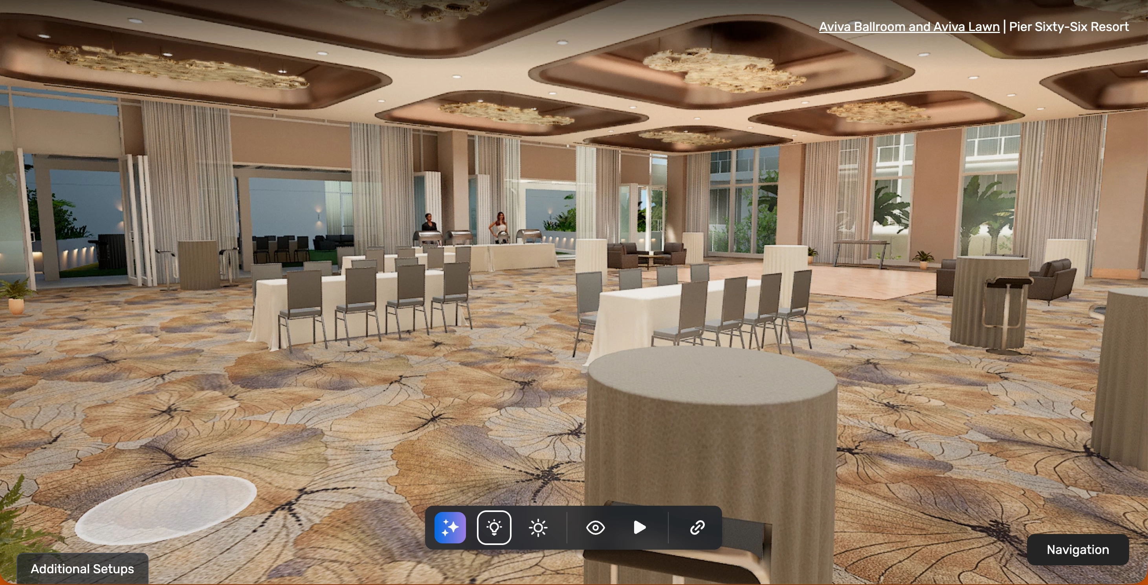
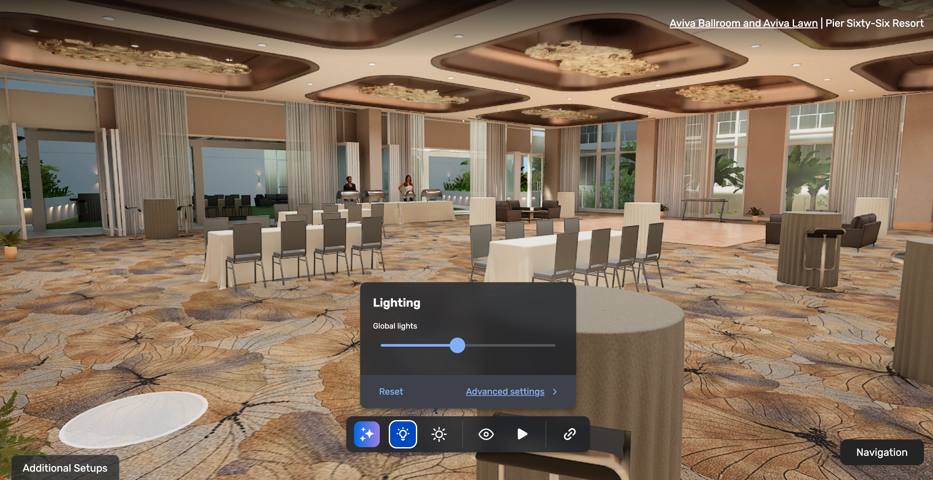
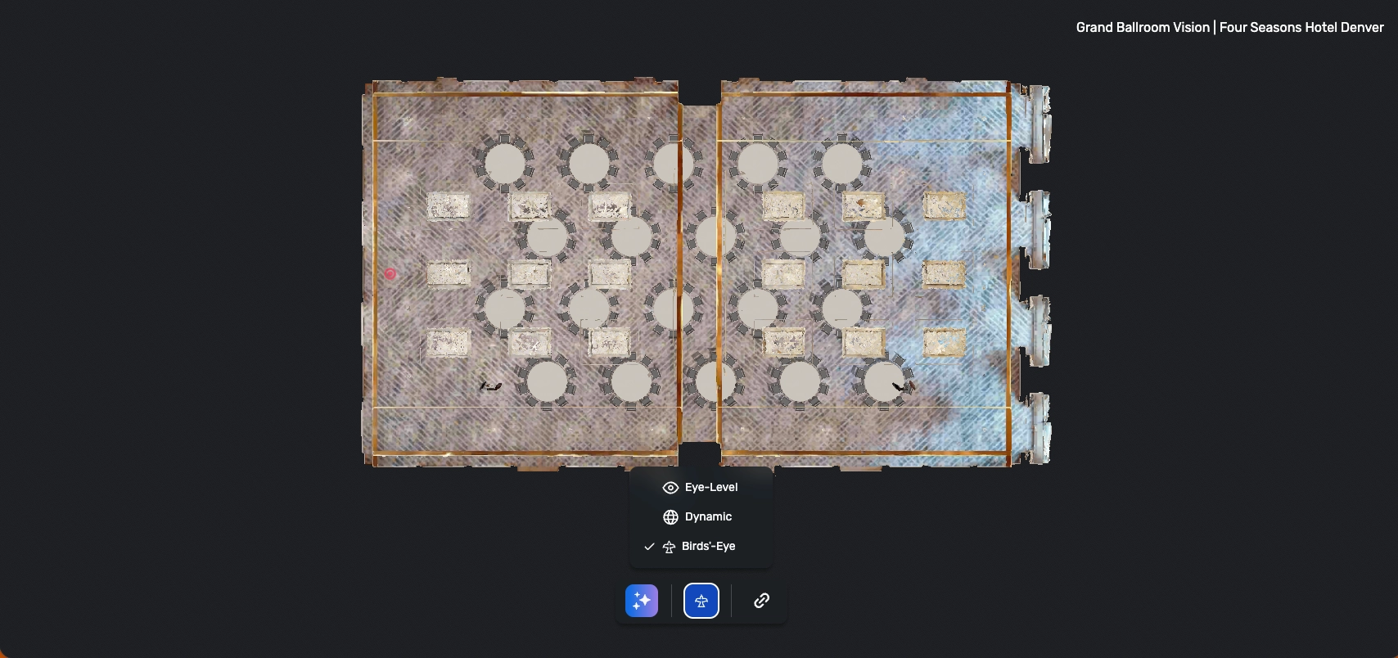
CVENT EVENT DIAGRAMMING
Photo-Realistic 3D: User Interface Update
What changed: 3D controls have been modernized across supported diagramming experiences.
Why it matters: Planners and suppliers can navigate 3D views more intuitively.
Use case: Walk a client through a photo-realistic 3D room layout with smoother, more intuitive controls.

Slide 23
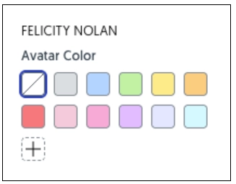
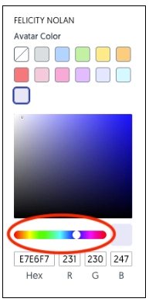
CVENT EVENT DIAGRAMMING
More Color Options for Attendee Attributes
What changed: Attendee avatars, tags, and meals now support broader color customization.
Why it matters: Delivers cleaner, easier-to-scan diagrams.
Use case: Color-code meal choices or attendee types to review a layout at a glance.

Slide 24
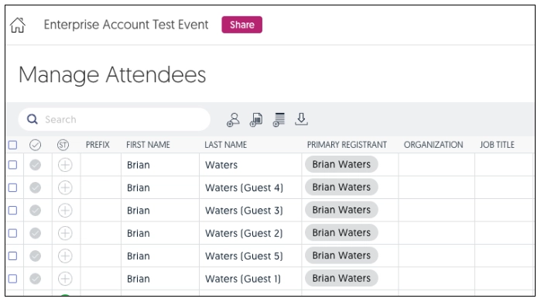
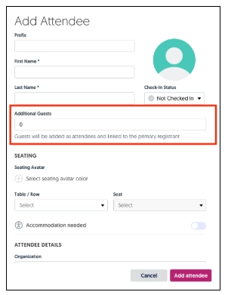
CVENT EVENT DIAGRAMMING
Primary Registrant and Associated Guests
What changed: Registrants and their guests are now linked more visibly across diagramming workflows.
Why it matters: Clarifies guest relationships and speeds setup.
Use case: Seat a primary registrant and their guests together without manually tracking who belongs to whom.

Slide 25

CVENT TRAVEL
Delete Policies and Taxes in Negotiation
What changed: Buyers can request removal of specific policies and taxes during negotiation without rejecting the entire bid.
Why it matters: Keeps negotiations moving instead of restarting over individual terms.
Use case: Ask a hotel to drop a specific mandatory fee mid-negotiation while keeping the rest of the bid intact.

Slide 26
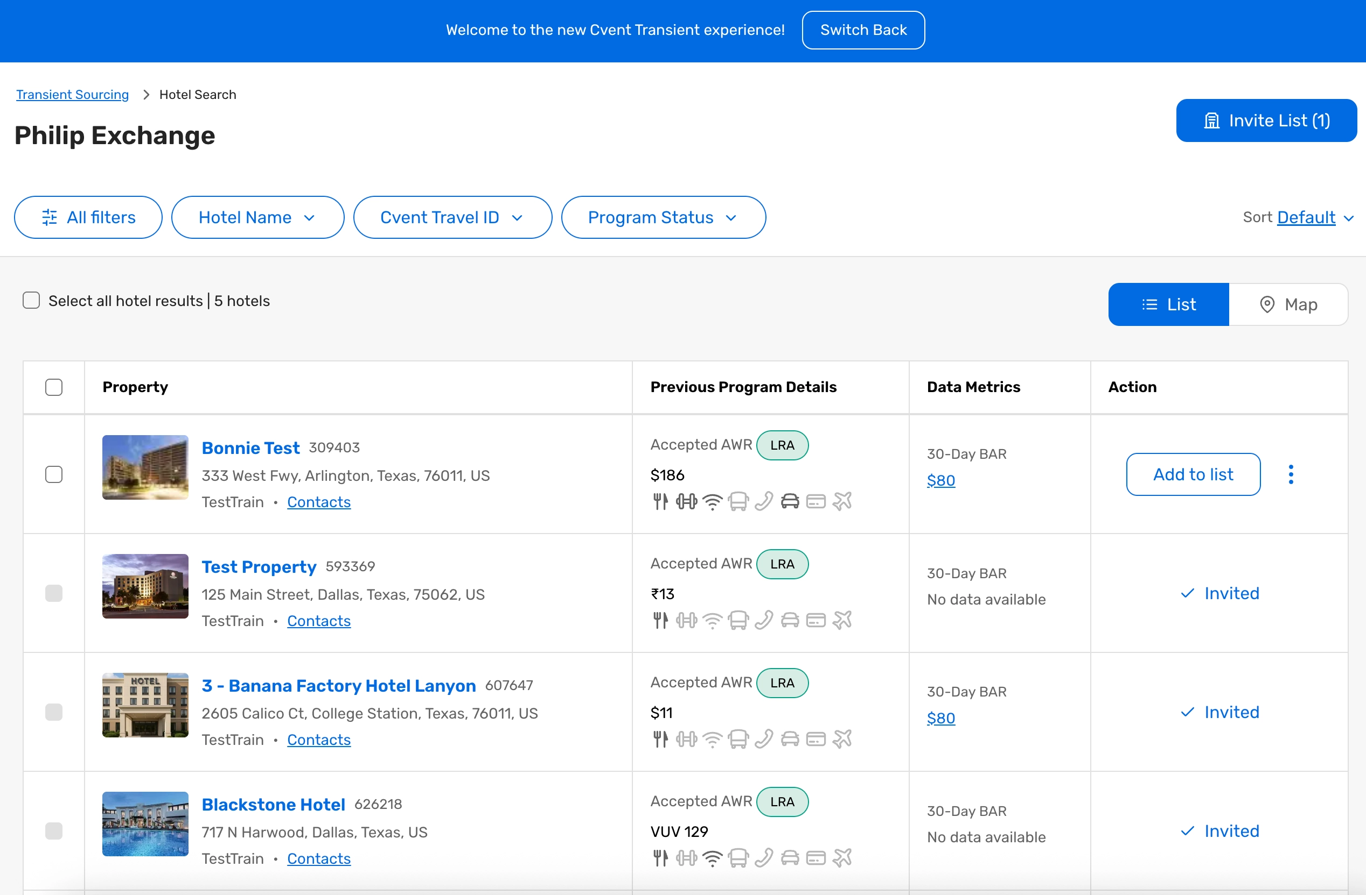
CVENT TRAVEL
Solicitation List Redesign
What changed: The solicitation list has been redesigned with faster search, simpler filters, and a clearer path from shortlist to invite.
Why it matters: Streamlines sourcing and reduces time to invite venues.
Use case: Filter a large venue list and move a shortlist to invite in fewer steps.

Slide 27

CVENT PASSKEY
Hotel Guarantee Rules
What changed: Guarantee requirements can now be aligned by individual hotel.
Why it matters: Organizers can match each property's policies, simplify multi-hotel setup, and reduce manual workarounds.
Use case: Configure different guarantee rules per hotel for a multi-property room block.

Slide 28

CVENT PASSKEY
Planner Portal: View as Planners or Contacts
What changed: Users can now view the Planner Portal from a planner or Sub-Block Group contact's point of view.
Why it matters: Confirms settings faster and supports users with less back-and-forth.
Use case: Preview exactly what a sub-block contact sees before sharing the portal with them.

Slide 29

CVENT PASSKEY
Communication Tracking for Smart Alerts and Updates
What changed: Smart Alerts and Updates can now be tracked alongside Email Campaigns.
Why it matters: Gives a fuller view of message engagement for smarter communication decisions.
Use case: Compare engagement on Smart Alerts versus email campaigns to refine attendee messaging.

Slide 30

CVENT TRAVEL
Save Bids as Negotiation Received
What changed: Qualifying bids can be saved directly as Negotiation Received after small buyer-side updates, with an audit trail across UI and import.
Why it matters: Moves qualifying bids forward faster while keeping a clear record.
Use case: Advance a nearly-final bid to Negotiation Received without a full re-submission.

Slide 31
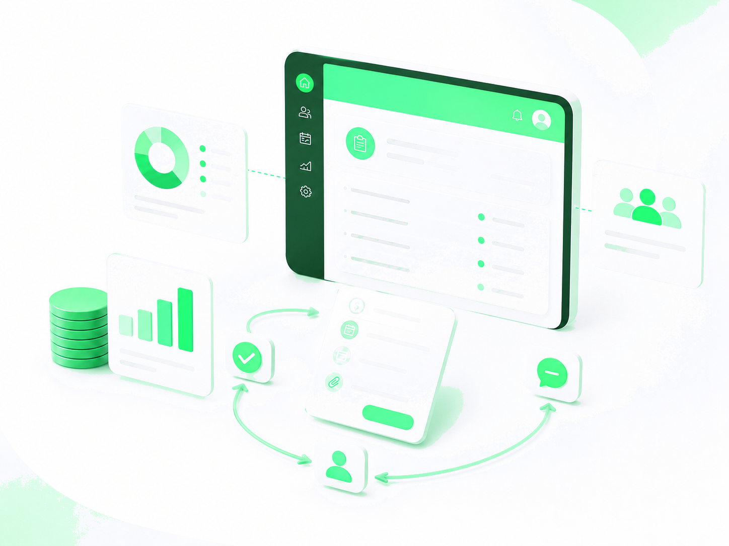
Spend & Workflow
Budget Management

Slide 32
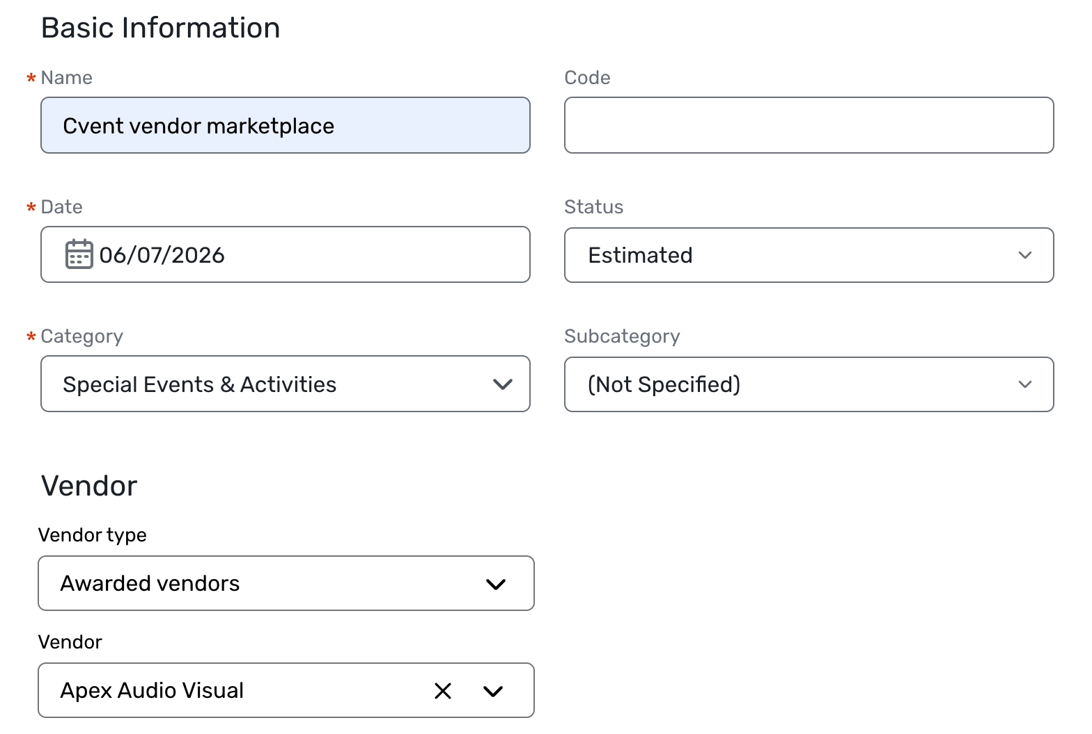
BUDGET MANAGEMENT
Tracking Awarded Reposite Vendors in Budget
What changed: Awarded vendors from Cvent Vendor Marketplace powered by Reposite can be pulled directly into budget items.
Why it matters: Saves time, reduces manual entry, and improves spend visibility across events.
Use case: Add an awarded vendor's cost to the event budget without re-keying the details.

Slide 33

Trade Show Solutions
Jifflenow, iCapture

Slide 34

JIFFLENOW
Persistent Column Selection on All List Pages
What changed: Each user's column preferences now save automatically across all list pages.
Why it matters: List views stay consistent from one session to the next.
Use case: Set your preferred columns once and keep them every time you return.

Slide 35

JIFFLENOW (MOBILE)
Managing Staff Activities on the Go
What changed: Staff can review assignments, respond to activities, and check in participants from the mobile app.
Why it matters: Keeps field teams productive without needing a desktop.
Use case: Have booth staff check in participants and update activities directly from their phones.

Slide 36

JIFFLENOW
Improved Manual PII Deletion for External Attendees
What changed: Inactivity-based controls have been added to manual PII deletion for external attendees.
Why it matters: Helps teams manage PII deletion with more confidence and control.
Use case: Remove PII for external attendees after a defined period of inactivity to support data-handling policies.

Slide 37

JIFFLENOW
Configurable Session Timeout
What changed: Eligible meeting managers can now update web session timeout settings directly.
Why it matters: Better aligns session behavior with internal security policies.
Use case: Set a shorter session timeout to match your organization's security requirements.

Slide 38

JIFFLENOW
Mapping Enhancements: Smarter Topic Routing & Visibility
What changed: Mapping now supports multi-level topic selection, more precise routing, and clearer assignment visibility.
Why it matters: Improves how meeting requests are routed and who can see assignments.
Use case: Route incoming meeting topics to the right team with multi-level topic mapping.

Slide 39

ICAPTURE
Predictive Email Suggestions
What changed: iCapture now suggests likely work email addresses at capture, with user confirmation before saving.
Why it matters: Helps teams complete lead records more accurately at the point of capture.
Use case: Confirm a suggested work email on the spot to reduce incomplete or incorrect lead data.

Slide 40

ICAPTURE
Firmographic Enrichment
What changed: Captured leads are now automatically enriched with company details.
Why it matters: Supports faster qualification, routing, and follow-up.
Use case: Auto-append firmographic data so leads can be routed to the right rep immediately.

Slide 41

ICAPTURE
Post-Event Meeting Booking with Calendly and HubSpot
What changed: Meeting scheduling can now be launched from iCapture via Calendly and HubSpot.
Why it matters: Teams can convert leads into follow-up meetings without leaving the workflow.
Use case: Book a follow-up meeting with a hot lead right after capturing their details.

Slide 42

JIFFLENOW
Auto-Decline Unregistered Attendees
What changed: Unregistered attendees are now automatically removed from associated meetings, sessions, and activities.
Why it matters: Keeps attendee data accurate and cuts down on manual cleanup.
Use case: Automatically clear no-longer-registered attendees from their scheduled meetings.

Slide 43

JIFFLENOW
Staff Activity Enhancements
What changed: Activities now support built-in comments, participant notifications, bulk upload, and cleaner reporting filters for meetings versus activities.
Why it matters: Adds more context and control to staff activity management and reporting.
Use case: Bulk-upload activities and notify participants, then report on meetings and activities separately.

Slide 44
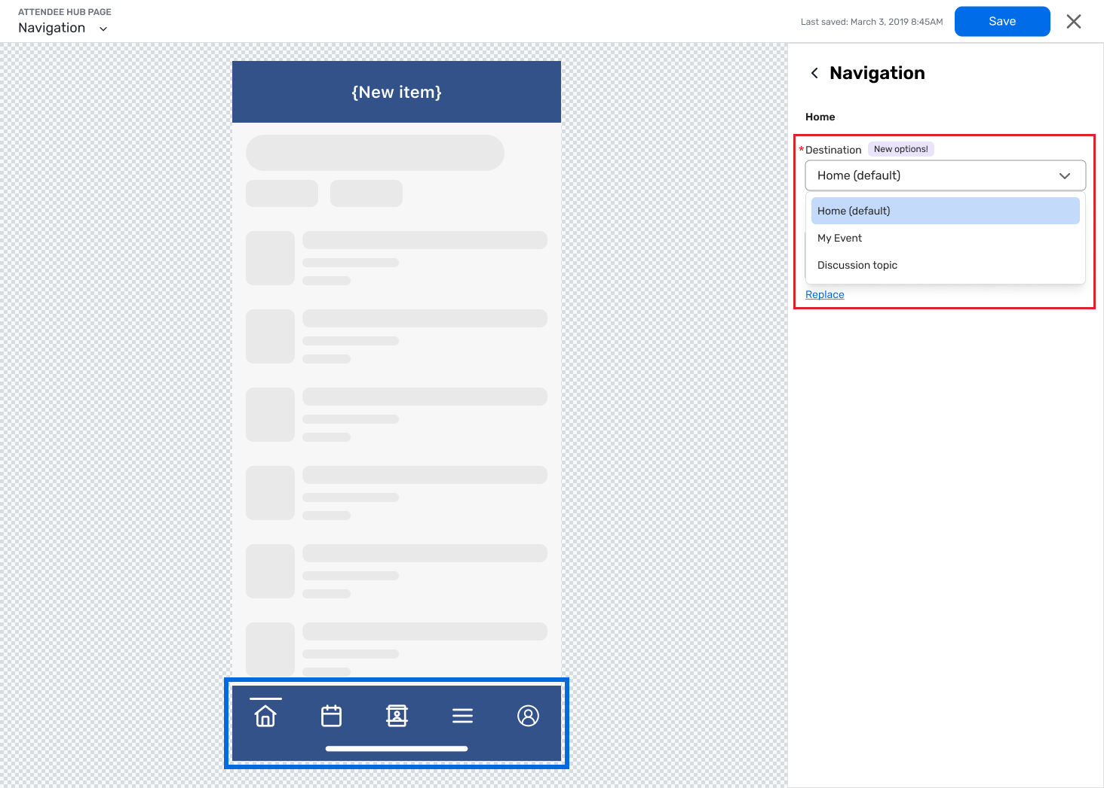
ATTENDEE HUB
Date Changes & Postponements
These items appeared in the July digests as schedule changes, not live launches:
Alternative Landing Pages for Event App (Attendee Hub):
introduced in the July 7 digest (choose which screen attendees see first in the Event App), then delayed until further notice per the July 22 digest.
Magic Link for Branded Apps (Attendee Hub):
postponed in the July 7 digest, with a new release date still being determined.

Slide 45

Resources, Learning & Events
Highlights from the In Case You Missed It ~ July 2026 roundup.
Q3 Product News Live
Webinar August 26, noon ET — recap of release news and product Q&A.
On-Demand
Learning & Training
July 14 Product Roadmap Session, available to watch on demand.
Cvent Beginners Office Hours; Email Best Practices (Aug 25 US / Aug 27 EMEA).
Customer Success Groups: Chicago Aug 19, Atlanta Aug 20, San Diego Aug 26, Philadelphia Aug 27.
Regional Training Workshops: Baltimore Aug 5-6, Denver Aug 12-13, Toronto Aug 19-20 — use code UPSKILL50 for 50% off.
Case Study
“The power of one consistent lead capture system.”
Sources
Get Involved
ICYMI July 2026
July 7 Digest
July 22 Digest
Join the UX Research Panel and the Beta Programs page for early access.

Slide 46
Thank You!

