Slide 1


Cvent Monthly Product News
June 2026

Slide 2
About the newsletter
The updates are labelled within six product neighborhoods that cover different products in each one of them. Below is the list of them with the products covered:
Plan & Promote
  Products covered: Registration, Abstract Management, Speaker Resource Centers, Exhibitor Management
Attendee Engagement
  Products covered: Attendee Hub, Event App, Events+, Appointments, OnArrival, LeadCapture, Webinar
Spend & Workflow
  Products covered: Budget Management, Meeting Request Form, Access Portal
Actionable Insights
  Products covered: Surveys, Reporting, Integrations, Engagement Scoring, App Marketplace
Exchange Solutions
  Products covered: Cvent Supplier Network, Cvent Event Diagramming, Passkey, Travel, Instant Book, Vendor Marketplace
Trade Show Solutions
  Products covered: Jifflenow, iCapture

Slide 3
Additional resources
You can go to the following link for all the Event Marketing & Management Product News: Announcements
To check what’s on the roadmap, click the following link: Roadmap
If you have questions about anything we’ve rolled out, get questions answered in the Community via the Open Forum
You can also subscribe to Product News and get emails every time there is a new update. To know how to subscribe, click on the following link: Subscribe to Product News
If you’re already subscribed to Product News and don’t need news on ALL Cvent products, you can customize your subscription. From the Product News home page, select “Manage Subscription” and select your product interest areas-- which could reduce the number of email news bundles you receive.

Slide 4

Join Upcoming Beta Programs
Be among the first to try our new features and products! Sign up for our beta program and get early access and share feedback on upcoming features before they launch.
Your feedback is invaluable, and you can help us shape the tools that drive your success. Sign up today and help build a better future together!
New Beta Programs
    Cvent Assistant
    Attendee Assistant
    Email Templates
    New Cvent Platform Navigation
    Out-of-the-box Website Templates
    Event Approvals
Ongoing
    Cross-Platform
    Attendee Hub
    Registration
    Cvent Supplier Network
    Reporting & Insights
    Workflow Management
Bookmark this page and check back monthly for new Beta Program Opportunities!
We're always looking for customers to join our UX research panel, which helps shape the vision for future products and feature development. Sign up for our user research panel today.

Slide 5
SPOTLIGHT: A New Way to Move Through Cvent
What’s the new experience like?
The first thing you’ll notice is a clean, left-hand navigation that stays with you as you move through Cvent.
Your navigation lives on the side, not across the top, giving you more vertical space for the work that matters—event details, RFP lists, dashboards, and more.
The layout will feel familiar if you use other modern SaaS tools, so it’s easier for both new and existing users to get oriented quickly.
As you click into different areas, the navigation remains consistent, so you don’t feel like you’re “switching products” every time you change tasks.
Before:
You start in one part of Cvent, then use an app switcher or multiple menus to find what you need.
Reports, events, and RFPs sit under different labels, so you pause to remember where each thing lives.
Search is one place, your recent work is another, and getting back into an in-progress event or report can take more clicks than it should.
After:
  A single, left-hand global navigation guides you wherever you need to go.
  Top-level sections are grouped around your workflows, not product names, so the path from “log in” to “doing” is much shorter.
  Search and Recent Items come together in one place, making it easy to jump back into that event, RFP, or report you were working on.
Moving to the new navigation

Slide 6
Plan & Promote
Products covered:
Registration
Abstract Management
Speaker Resource Centers
Exhibitor Management

Slide 7
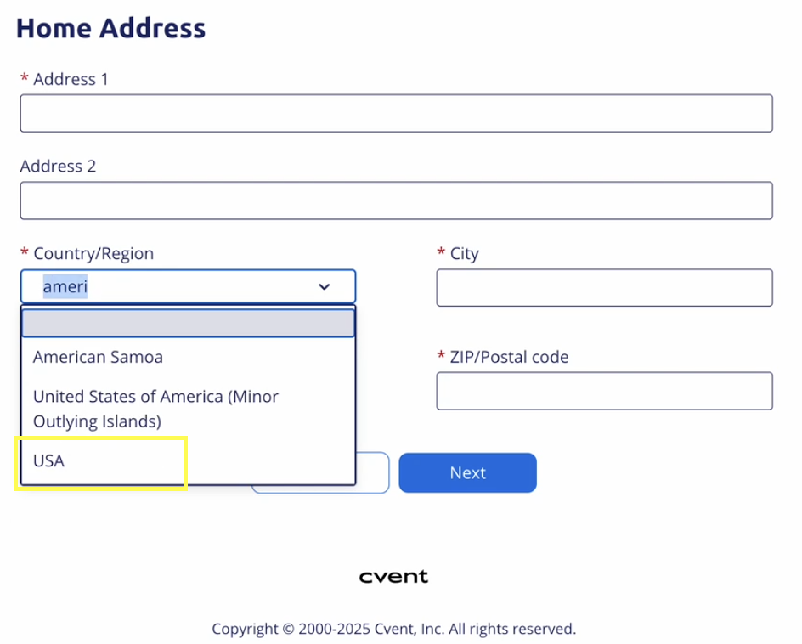
Easier Discovery of “USA” in Country Dropdowns
Registration
To reduce friction in forms and align with how attendees naturally search for countries, the country dropdown now makes “USA” significantly easier to find when “United States”–style terms are entered in searchable country fields.
Why It Matters
Attendees who type “United States” or similar phrases now immediately see “USA” in the filtered results instead of scrolling through the full list.
Reduces the risk of incorrect country selection, supporting cleaner location data without requiring configuration changes.
Read more about the update here
What's new:
Typing phrases and partials such as “United States”, “United”, “USA”, “America”, or “States” returns “USA” in the filtered list of options.
Existing behavior for all other countries (labels, ordering, and search results) remains unchanged.

Slide 8
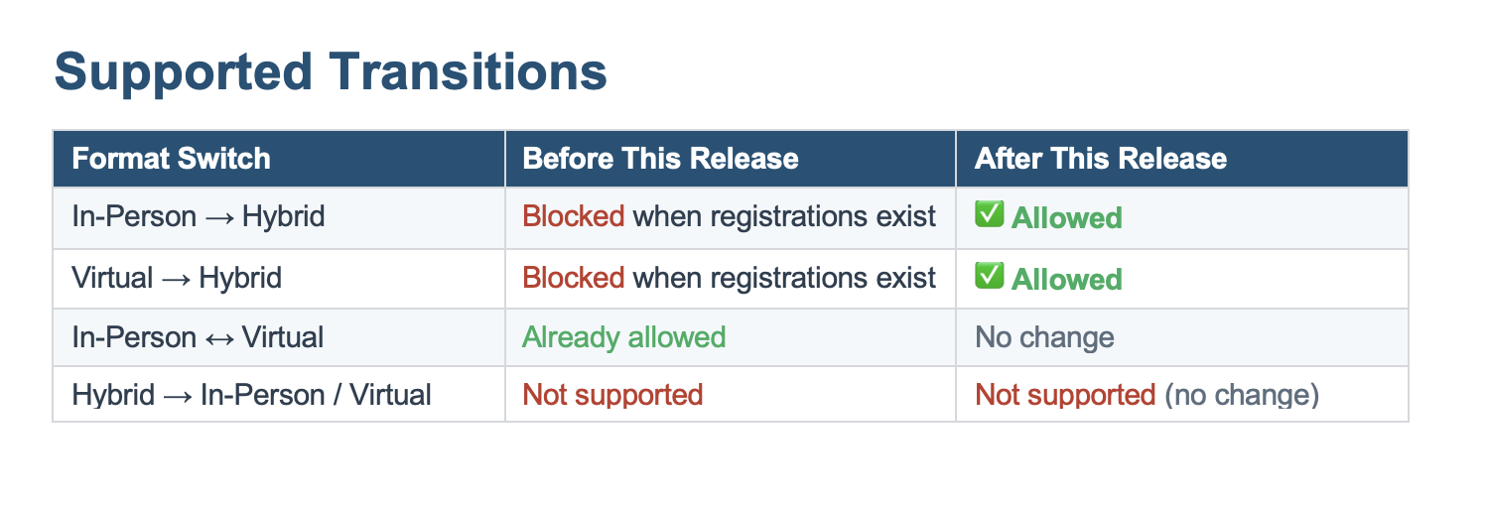
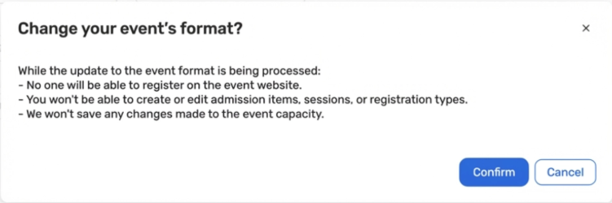
Switch Event Format to Hybrid After Live Registrations
Registration
You can now switch an event’s format from In‑Person or Virtual to Hybrid even after registrations have started. This removes the need to copy events and re‑import registrations, while keeping existing registration data and reporting intact.
What's new:
Post‑registration format switch to Hybrid
Hybrid‑ready structure behind the scenes
Light safeguards during the switch
Key Benefits:
Respond faster to changing event strategy
Eliminate manual event copy + import workflows
Better attendee continuity
Read more about the update here

Slide 9
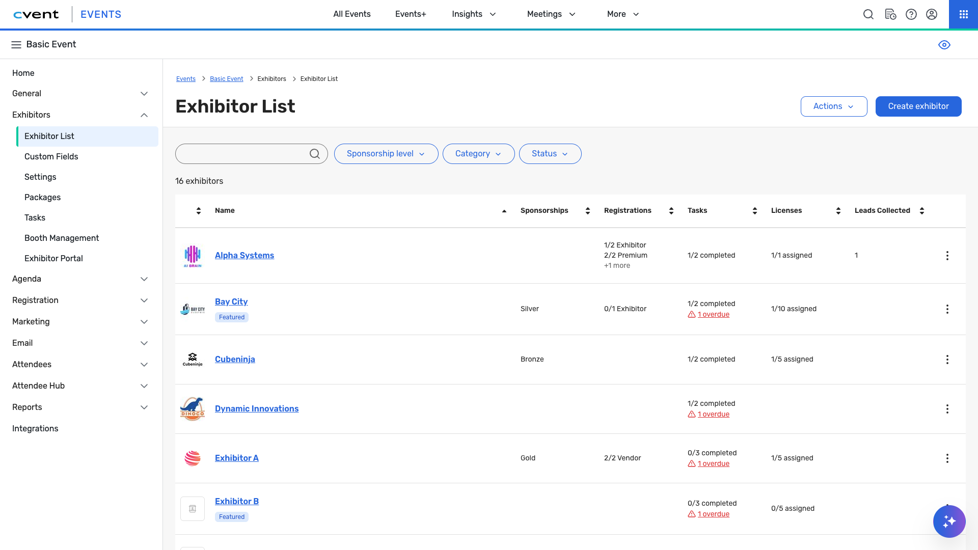
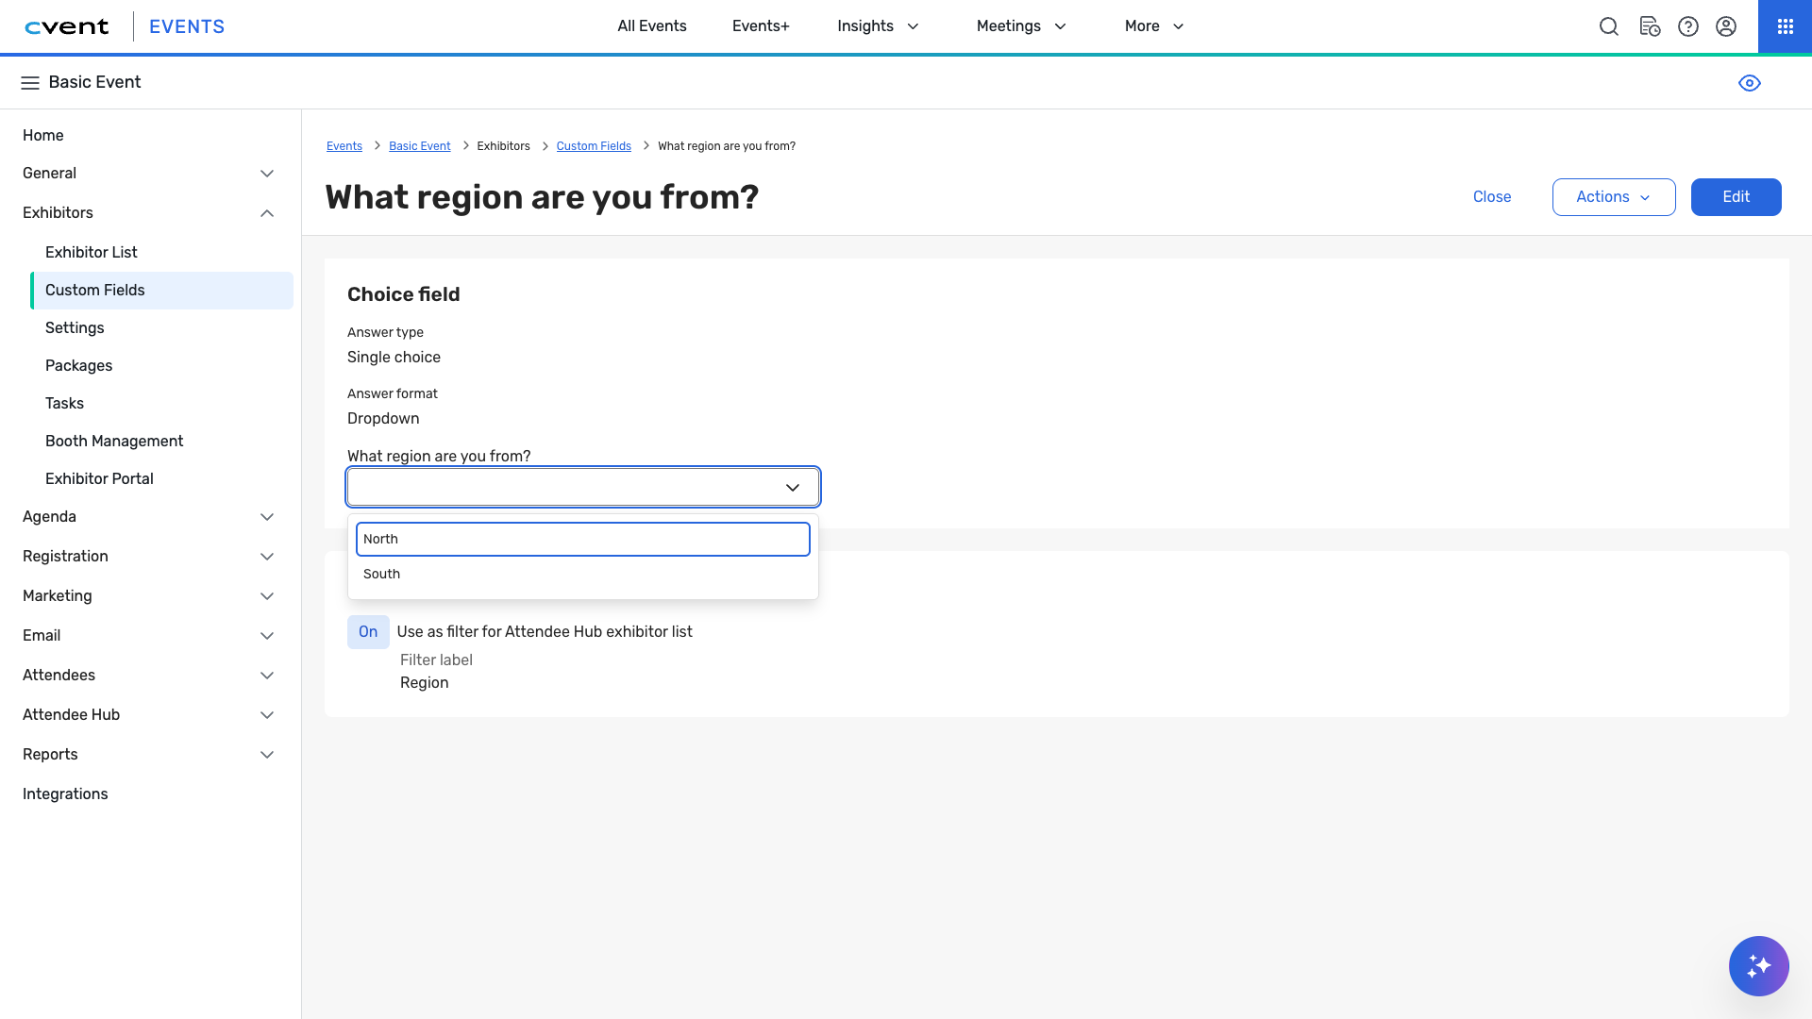
Introducing New Exhibitor Management Experience
Exhibitor management
What's new
Exhibitor List
The Exhibitor List page now features a new layout that provides valuable data points on exhibitors and sponsors at an event. Revamped filters, sort options, and search capabilities will make it easier for customers to quickly find exhibitors with missing data.
Exhibitor Custom Fields Editor
Our refreshed editor improves efficiency by integrating the layout, interface, and accessibility. Question types have been designed with a streamlined approach, including a new question-duplication feature to speed up editing.
Read more about the update here

Slide 10
Attendee Engagement
Products covered:
Attendee Hub
Event App
Events+
Appointments
OnArrival
LeadCapture
Webinar

Slide 11
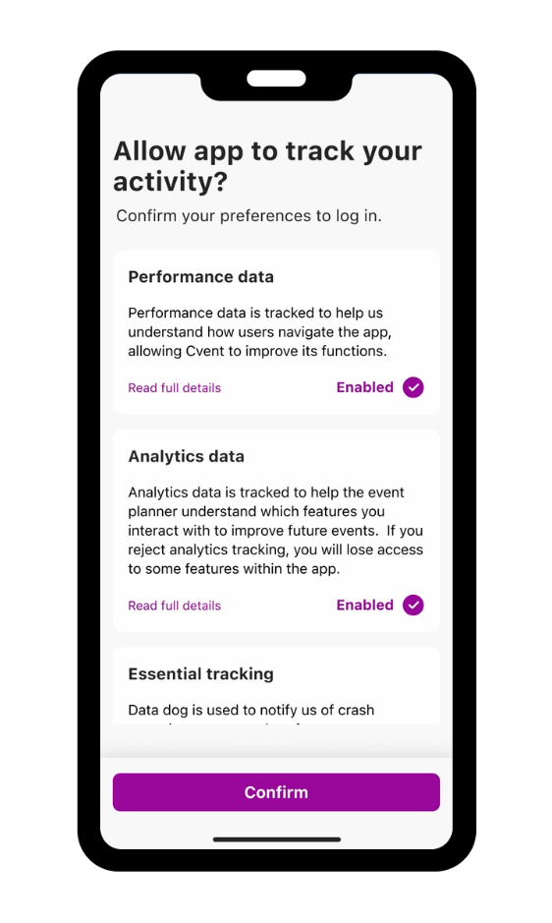
Analytics Consent for Branded Apps
Attendee hub
What's Changed: You can now turn on an Analytics Consent prompt at the app level in Branded App Builder. When enabled, attendees see a clear consent screen the first time they open the app that explains how their data may be used, and they can revisit and update their choices at any time from a new settings area in the app. This experience is available only for Branded Apps and requires a new app build to take effect.
Benefit: This release gives your privacy and compliance teams greater confidence in using Branded Apps, especially for events with significant EU participation or stricter internal data‑governance standards. By prompting attendees to make an informed choice—with no default selected—you can align more closely with the ePrivacy Directive and GDPR
Read more about the update here
The Attendee Hub Event App is updated twice a month to include our newest features! Click to check the Event App Version History

Slide 12
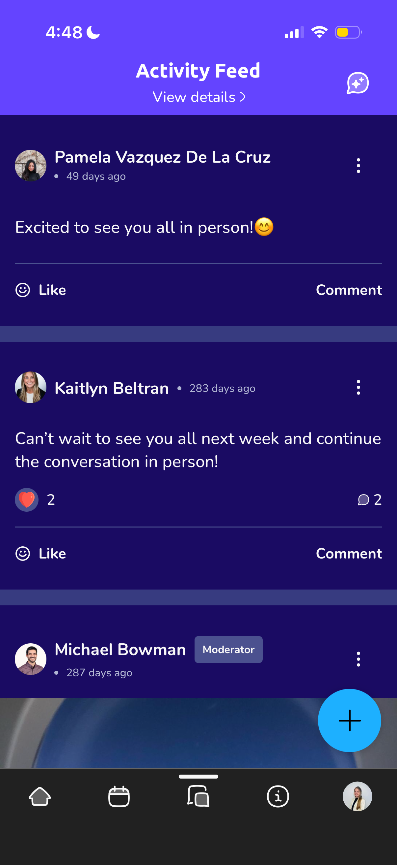
Discussion Topics in Event App Bottom Navigation
Attendee hub
What's Changed:
Discussion Topics can now be added to the Event App's bottom navigation.
Benefit:
Promote high-value conversations in the event app by putting a specific Discussion topic directly into the bottom navigation bar, turning it into a highly visible item to be clicked on by attendees
Read more about the update here
The Attendee Hub Event App is updated twice a month to include our newest features! Click to check the Event App Version History

Slide 13
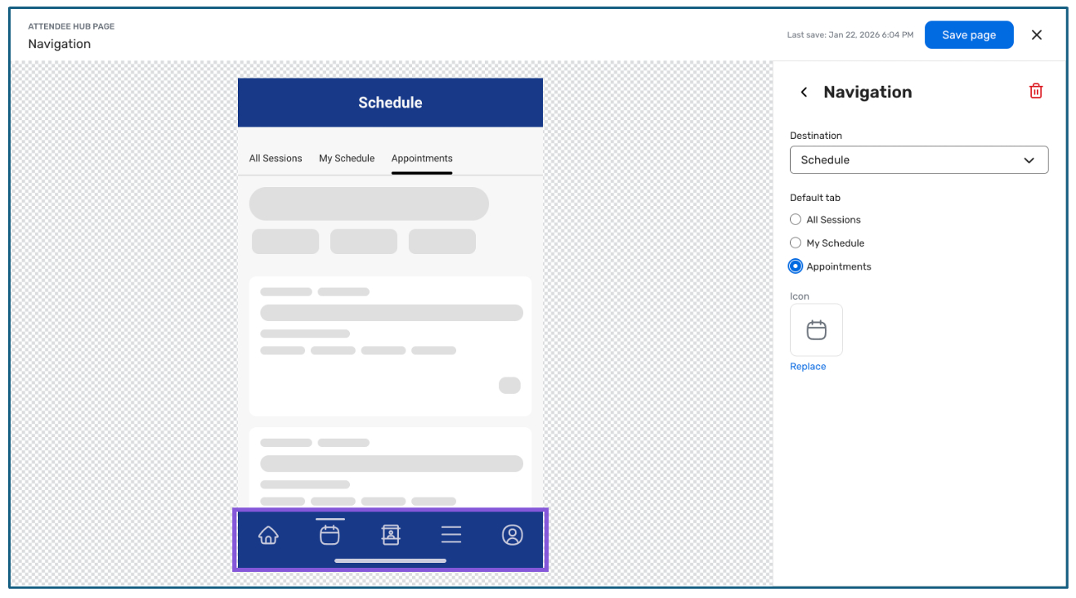
Set Appointments as the Default Schedule Tab in Attendee Hub App
Attendee hub
What's Changed:
For appointment‑focused events, you can now set Appointments as the default landing tab under Schedule in the Attendee Hub app navigation, for both built‑in Appointments and Appointments Premium.
Benefit:
This gives you tighter control over the attendee journey, so the app immediately reflects what matters most at your event—your meetings. Attendees get instant clarity on where they need to be, with fewer taps and less hunting around the app.
Read more about the update here
The Attendee Hub Event App is updated twice a month to include our newest features! Click to check the Event App Version History

Slide 14
Contact Snapshot for Contact Data Isolation Across Events
Webinar & essentials
What's Changed:
Keep attendee updates limited to a single event, instead of updating your Global Address Book
Protect the integrity of contact data synced to external systems like Salesforce and Workday
Enforce cross-event data separation using Data/Privacy templates, so governance rules are consistent and not reliant on per-event setup
Benefit:
For teams with strict data governance or division-level data walls, this release makes it easier to confidently prevent accidental overwrites of shared contact records, standardize data separation rules across all new events and webinars through a single Data/Privacy template, and maintain a seamless attendee experience because everything runs in the background with no visible change to registration or event flow.
Read more about the update here
The Attendee Hub Event App is updated twice a month to include our newest features! Click to check the Event App Version History

Slide 15
Removing iOS 17 & Socket Mobile Support
onarrival
What's Changed:
The OnArrival iOS app will support iOS 18 and newer operating systems only, and iOS users will need to be on App version 4.16 or higher. OnArrival will continue to support the current iOS version and one version prior to help deliver faster, safer, and more reliable performance when managing your event.
Benefit:
Our systems indicate low usage of this feature. To simplify our supported hardware stack and pass these cost savings back to our customers. If you rely on Socket Mobile today and need help planning an alternative, please contact your Cvent account team or Customer Support.
Read more about the update here
The Attendee Hub Event App is updated twice a month to include our newest features! Click to check the Event App Version History

Slide 16
Spend & Workflow
Products covered:
Budget Management
Meeting Request Form
Access Portal

Slide 17
Event Languages
Meeting request form
What's Changed:
Meeting requesters can now set an Event Language directly on the meeting request form, and that language is automatically applied to the event website, registration, and emails when the event is auto-created (including Essentials and webinar events).
Benefit:
This prevents events from defaulting to the account or requester language, helping multilingual organizations launch events in the correct language from the start and reducing manual rework to fix event, registration, and email language after creation.
Read more about the update here

Slide 18
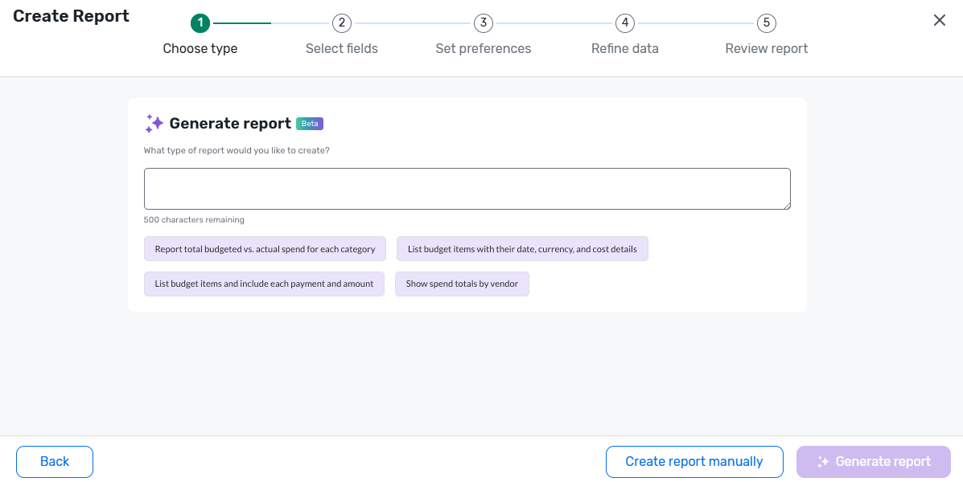
Create Budget Reports in Build Your Own Reports
Budget management
What's Changed: You can now create fully customizable Event Budget reports in Build Your Own Reports (BYOR), using the same trusted budget fields and filters from the existing Budget Overview report while choosing your own layout, groupings, and prompts.
Benefit: Planners get flexible, self-serve visibility into budget and spend performance, so they can quickly answer specific budget questions without relying on a single canned report or manual exports.
Read more about the update here

Slide 19
Actionable Insights
Products covered:
Surveys
Reporting
Integrations
Engagement Scoring
App Marketplace

Slide 20
Cvent Salesforce App - 8.7.0 Release
integrations
We’re excited to announce the release of Cvent Salesforce App v8.7.0.
External Client App configuration: Due to recent changes in the Salesforce platform, Connected Apps are no longer supported. The App Configuration page now uses External Client Apps instead.
Resolved an issue where a rare migration of older Cvent connection object data to the newer connection registry could fail because of an incorrect migration path.
See Cvent Salesforce App Release Notes for more information.
Read more about the update here

Slide 21
Exchange Solutions
Products covered:
Cvent Supplier Network
Event Diagramming
Passkey
Cvent Travel
Instant Book
Vendor Marketplace

Slide 22
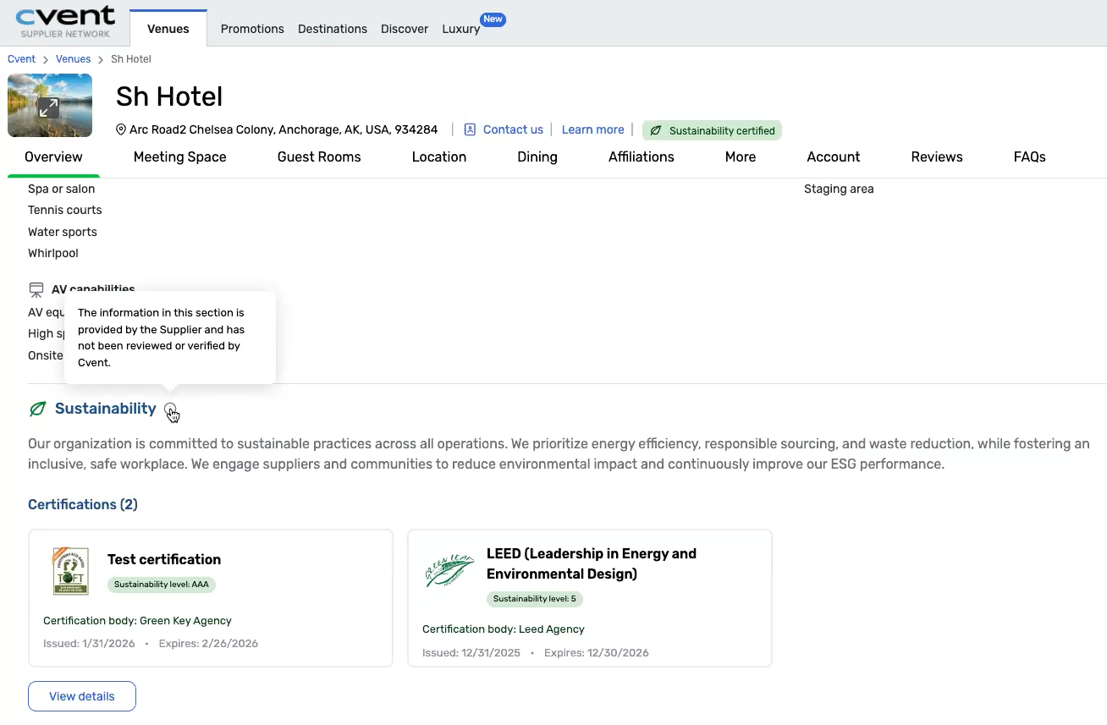
Expanding Sustainability Across More Venues
Cvent supplier network
What’s new:
On the venue profile page, you’ll now see a Sustainability section for eligible venues that are not integrated with BeCause. This section includes a plain-language sustainability description provided by the venue, Certification details, including the certifying agency name/logo and certificate expiry date
Why this matters
Gives you a more consistent and transparent view of sustainability information, so you can evaluate venues with greater confidence, Expands visibility across more venues, allowing you to see sustainability credentials beyond those enrolled in BeCause
Read more about the update here

Slide 23
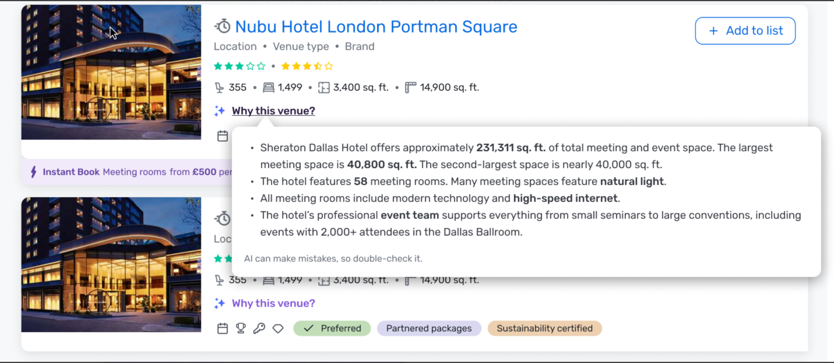
'Why This Venue' on CSN AI Search
Cvent supplier network
What it is:
The "Why this venue" feature in CSN Search helps you understand why a specific venue is being recommended based on your unique search query. This enhancement adds a concise, contextual, AI-generated summary directly on each venue card within the Search Results Page (SRP).
By combining your search prompt with detailed venue profile data, the feature gives you a clear, plain-language explanation of a venue’s relevance. This boosts transparency, builds trust in your search results, and helps you evaluate options more efficiently.
Read more about the update here

Slide 24
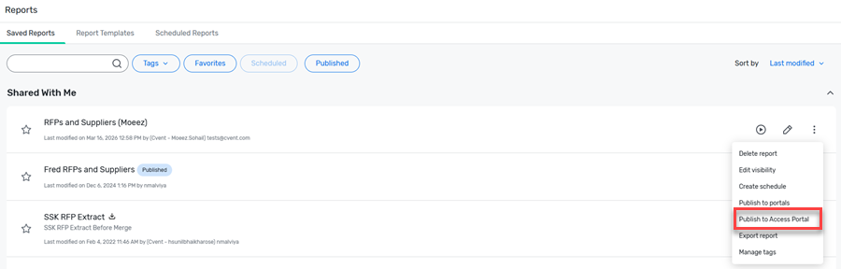
Publish RFP Reports to Access Portals
Cvent supplier network
What’s new:
Publish any saved RFP report to your Access Portal for easy external sharing
Give non-Cvent users direct access to sourcing data without relying on the legacy client portal
Keep stakeholders aligned with up-to-date reporting in a centralized, accessible experience
How it works:
Publishing a report follows the same steps as sharing other content to the Access Portal
Read more about the update here

Slide 25
No new releases in this window under following product bundles:
Trade Show Solutions (Jifflenow and iCapture)

