Slide 1


Cvent Monthly Product News
May 2026

Slide 2
About the newsletter
The updates are labelled within six product neighborhoods that covers different products in each one of them. Below is the list of them with the products covered:
Plan & Promote
  Products covered: Registration, Abstract Management, Speaker Resource Centers, Exhibitor Management
Attendee Engagement
  Products covered: Attendee Hub, Event App, Events+, Appointments, OnArrival, LeadCapture, Webinar
Spend & Workflow
  Products covered: Budget Management, Meeting Request Form, Access Portal
Actionable Insights
  Products covered: Surveys, Reporting, Integrations, Engagement Scoring, App Marketplace
Exchange Solutions
  Products covered: Cvent Supplier Network, Cvent Event Diagramming, Passkey, Travel, Instant Book, Vendor Marketplace
Trade Show Solutions
  Products covered: Jifflenow, iCapture

Slide 3
Additional resources
You can go to the following link for all the Event Marketing & Management Product News: Announcements
To check what’s on the roadmap, click the following link: Roadmap
If you have questions about anything we’ve rolled out, get questions answered in the Community via the Open Forum
You can also subscribe to Product News and get emails every time there is a new update. To know how to subscribe, click on the following link: Subscribe to Product News
If you’re already subscribed to Product News and don’t need news on ALL Cvent products, you can customize your subscription. From the Product News home page, select “Manage Subscription” and select your product interest areas-- which could reduce the number of email news bundles you receive.

Slide 4

Join Upcoming Beta Programs
Be among the first to try our new features and products! Sign up for our beta program and get early access and share feedback on upcoming features before they launch.
Your feedback is invaluable, and you can help us shape the tools that drive your success. Sign up today and help build a better future together!
New Beta Programs
    Cvent Assistant
    Attendee Assistant
    Email Templates
    New Cvent Platform Navigation
    Out-of-the-box Website Templates
    Event Approvals
Ongoing
    Cross-Platform
    Attendee Hub
    Registration
    Cvent Supplier Network
    Reporting & Insights
    Workflow Management
Bookmark this page and check back monthly for new Beta Program Opportunities!
We're always looking for customers to join our UX research panel, which helps shape the vision for future products and feature development. Sign up for our user research panel today.

Slide 5
Helpful Product Learning Opportunities
Community Conversations: Cvent Beginners Office Hours.
Cvent Beginners Office Hours. New to Cvent? Learn more about resources and best practices from a dedicated Onboarding Specialist. Resources for Cvent Beginners here.
  Next up: Cross Event Reporting and Access Portal, June 23, 12 to 1 ET; register here, or on June 25, 12 to 1 CET for EMEA, register here.
Customer Success Groups. Hear tips and tricks from Cvent experts, see our technology in action, network with like-minded Cvent customers, and exchange your unique customer stories.
  June sessions: Denver, CO, June 17. Secure your spot.
Regional Training Workshops. Our in-person, hands-on product training sessions continue to spread across the country. Use UPSKILL50 for 50% the cost.
  June topics: Arrivals and Check-In, Cvent Registration for New Users, Reimagining Event Check-In with OnArrival Premium, and Reporting Valuable Event Insights.
  June workshops: The Adolphus, Autograph Collection, Dallas. Register now.

Slide 6
SPOTLIGHT: Top 5 Product-Focused Sessions at Cvent CONNECT 2026
In addition to watching the Cvent CONNECT welcome keynote on Tuesday, July 14, from 9 – 10 AM CT, where you’ll hear Cvent Founder & CEO Reggie Aggarwal share his take on the future of meetings and events, and how technology and AI are reshaping our industry, we’ve got another top 5 product-focused sessions you don’t want to miss. Check out the full Agenda HERE.
General Session: Event Marketing & Management Product Roadmap
  Tuesday, July 14 | 10:15–11:15 AM CT In-Person & Streamed Virtually
The Power of the Cvent Platform — AI-Powered Event Success, Start to Finish
  Tuesday, July 14 | 2–2:45 PM CT In-Person & Streamed Virtually
The Future of Event Tech: The Next Act
  Wednesday, July 15 | 1:00 – 1:45 PM CT In-Person & Streamed Virtually
How We Market Cvent CONNECT
  Tuesday, July 14 | 2–2:45 PM CT In-Person & Streamed Virtually
Cvent on Cvent: How our events team uses AI to rethink their entire event program
  Tuesday, July 14 | 3:15 – 4 PM CT In-Person & Streamed Virtually
Register here to attend Cvent CONNECT virtually if you can't join us in person in Nashville, July 13 - 16.

Slide 7
SPOTLIGHT: Experience Cvent Assistant's Support Capability
Cvent Assistant is not just a support tool, it is the beginning of something much bigger. The vision is a single AI Assistant that helps customers with everything across their events: getting answers, pulling insights from their data, managing attendees, building events, and more — all without leaving Cvent. This is just the fist piece, more is coming quickly.
A better way to explore, learn, and keep moving
The best event professionals are often the ones willing to explore. They try new approaches. They test new workflows. They stay open to better ways of getting things done.
Cvent Assistant support capability is built for that mindset.
It gives you a faster, more intuitive way to find answers in the moment. So whether you are trying something new, validating a process, or working through an unexpected question, help feels closer, simpler, and easier to trust.
For event professionals who are curious, proactive, and always looking for better ways to work, Cvent Assistant support capability offers something powerful: help that meets you where you are.
Not later. Not somewhere else. Right when you need it.
Read More about it

Slide 8
Plan & Promote
Products covered:
Registration
Abstract Management
Speaker Resource Centers
Exhibitor Management

Slide 9
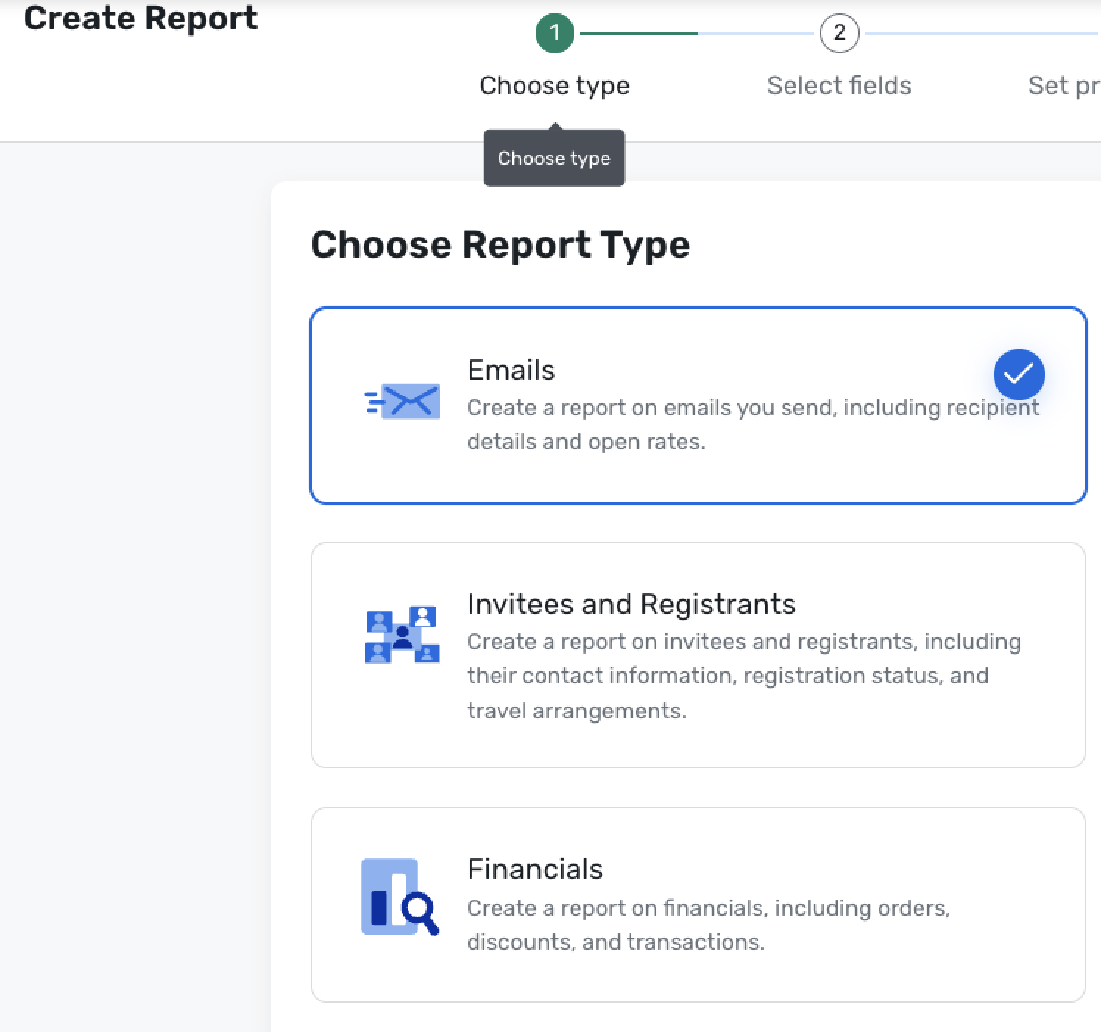
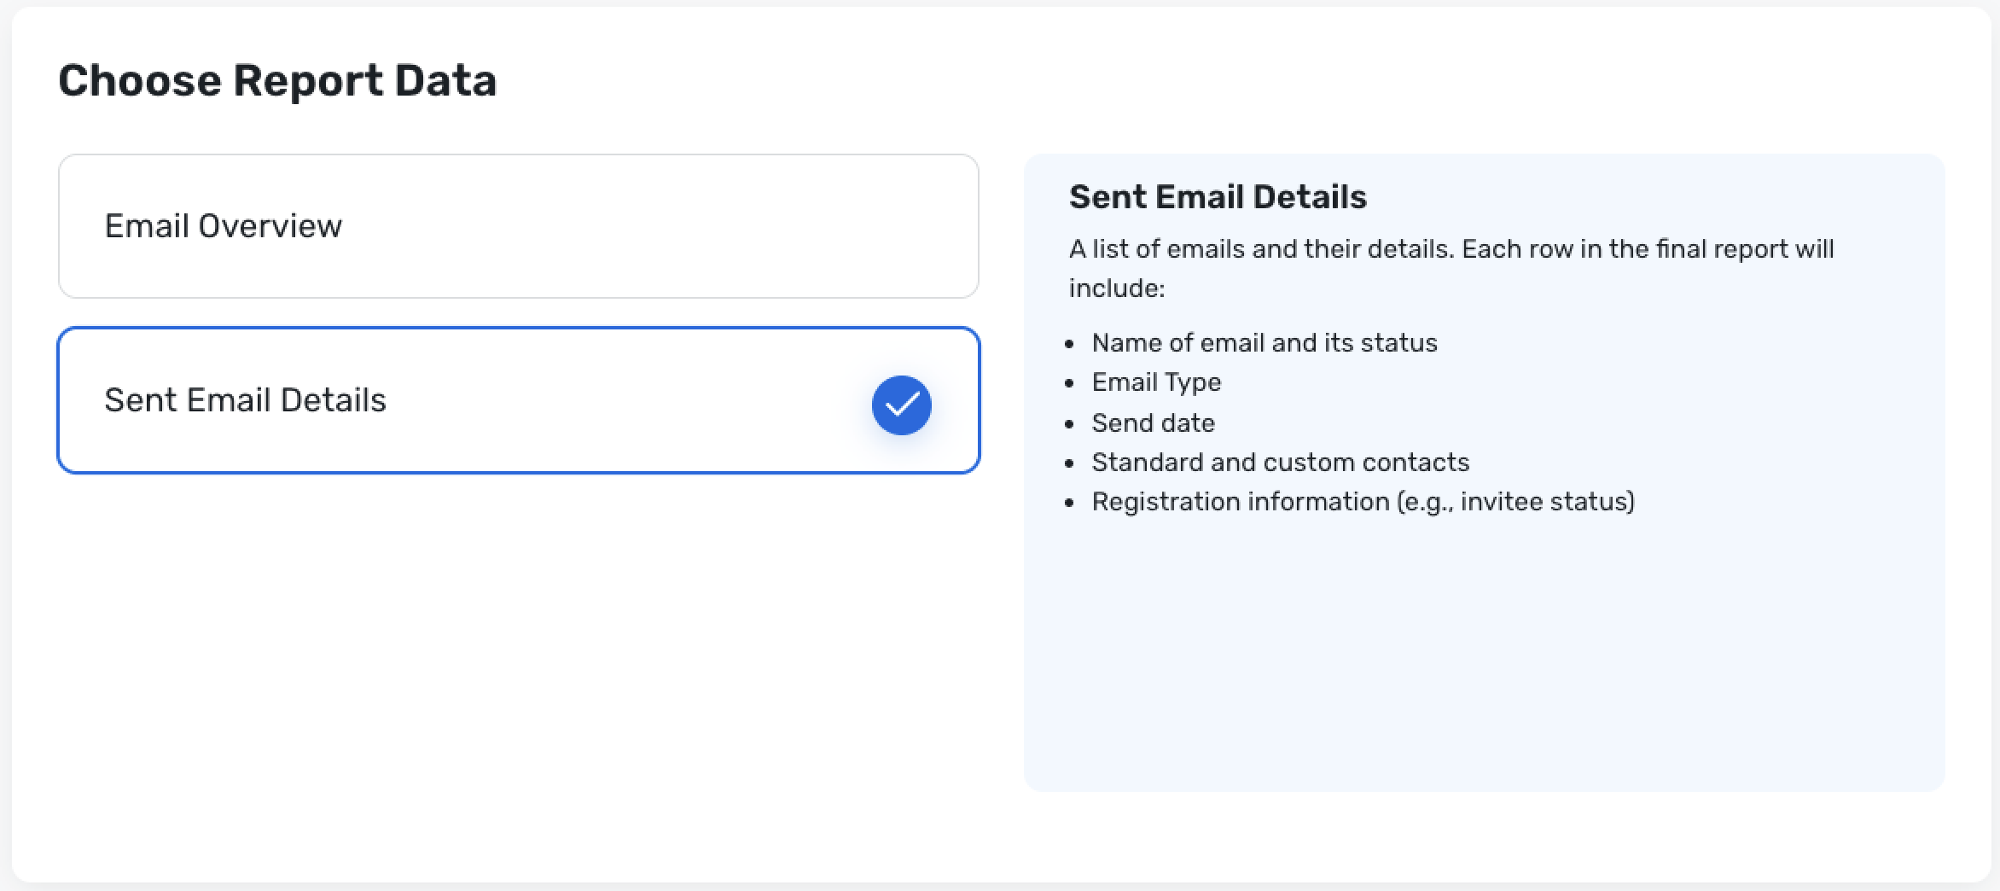
Introducing Build Your Own Reports in Email Reports
Registration
What’s new:
The new BYOR – Email category introduces a set of sub-reports designed to answer common questions about email effectiveness across your events. You can mix and match fields, apply filters, and save tailored views to track performance over time, just like other BYOR report types.
Access to the Email category follows your existing event reporting and email permissions, ensuring only authorized users can view and build these reports.
Read more about the update here

Slide 10
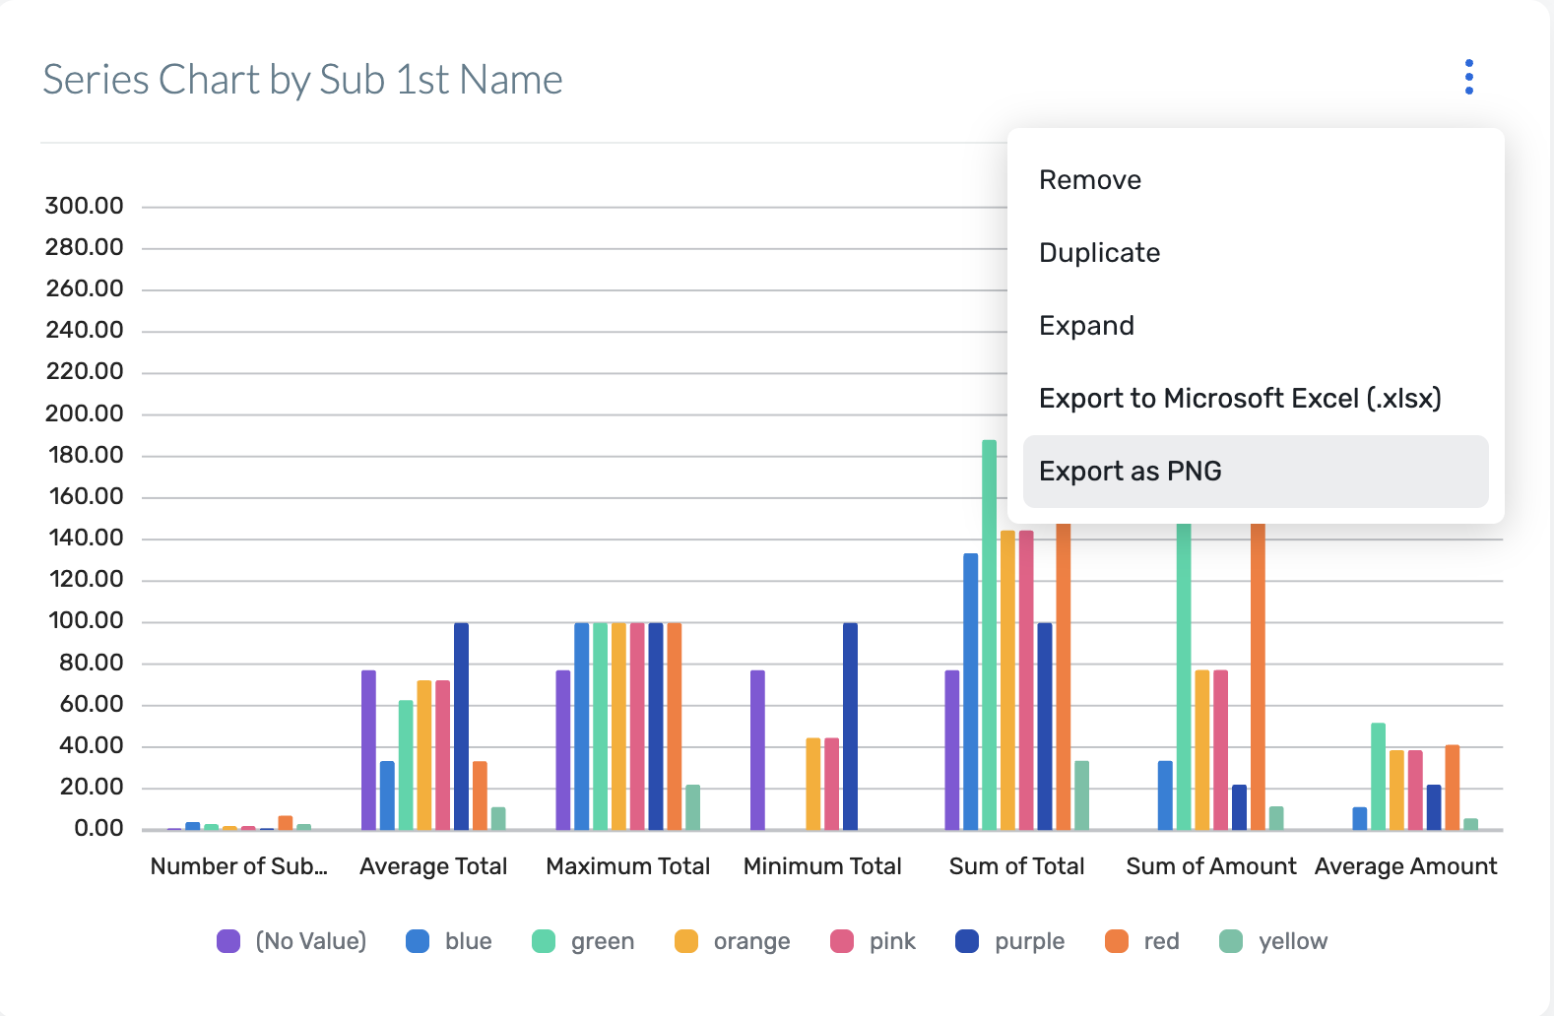
Download Report Charts as Images
Registration
What’s changed
Each chart in Reporting now includes an “Export as PNG” option in the chart controls.
Clicking this option generates a high-resolution PNG that preserves labels, legends, and colors as seen in the report.
Read more about the update here
The exported images are optimized for common uses like slide decks, status docs, and email updates, so you don’t need extra editing or cleanup.

Slide 11
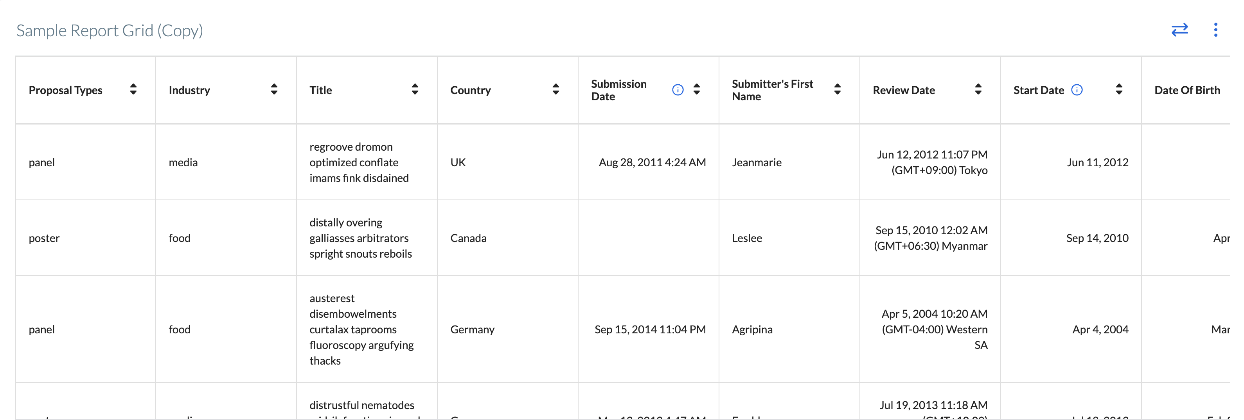
Enhanced Table Widgets in Reports
Registration
What’s changed
Clearer layout and alignment: Each value now sits in a dedicated cell with consistent spacing and alignment
Better readability and usability: Header styling and row structure are more defined
New capabilities
Reorder columns with drag-and-drop
Resize columns
The new grid layout will be available for all reports.
This layout works alongside existing reporting capabilities.
Read more about the update here

Slide 12
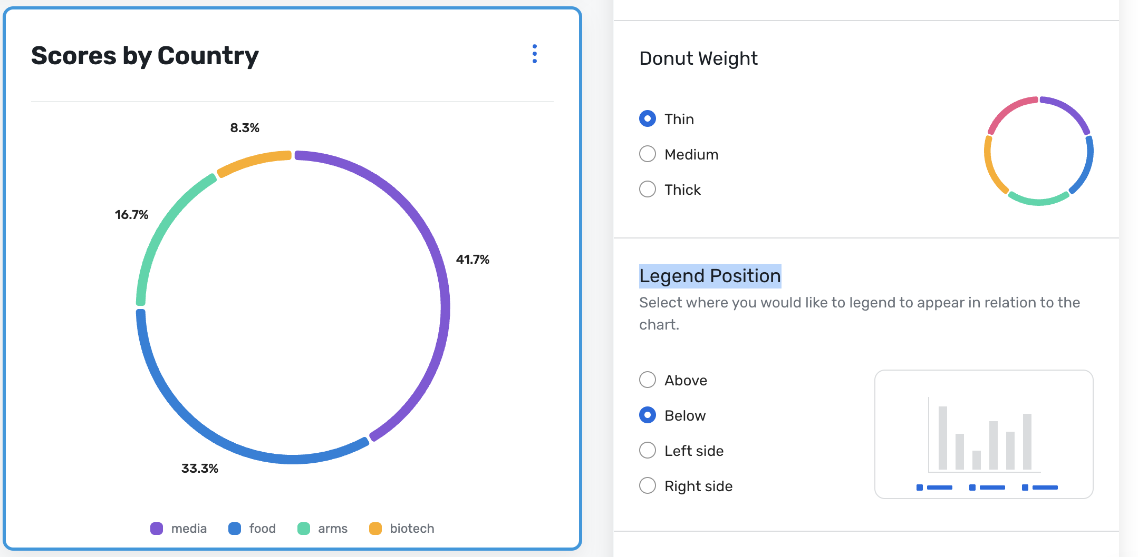
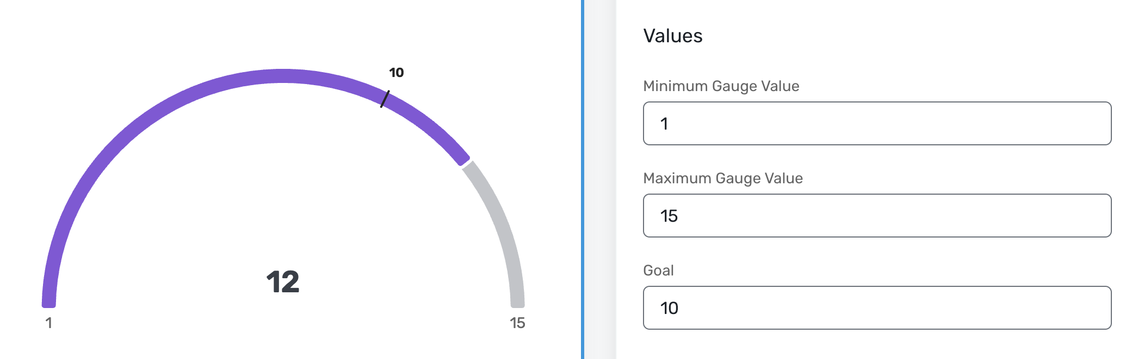
Expanded Chart Options in Reports
Registration
We’re expanding how you can visualize performance in reports with new chart types and display controls. These updates make it easier to highlight goals, simplify dense views, and fine-tune how charts appear in presentations and stakeholder summaries.
Read more about the update here
What’s new
Gauge charts for tracking against goals
Donut charts for clearer category breakdowns
Flexible legend positioning across key chart types

Slide 13
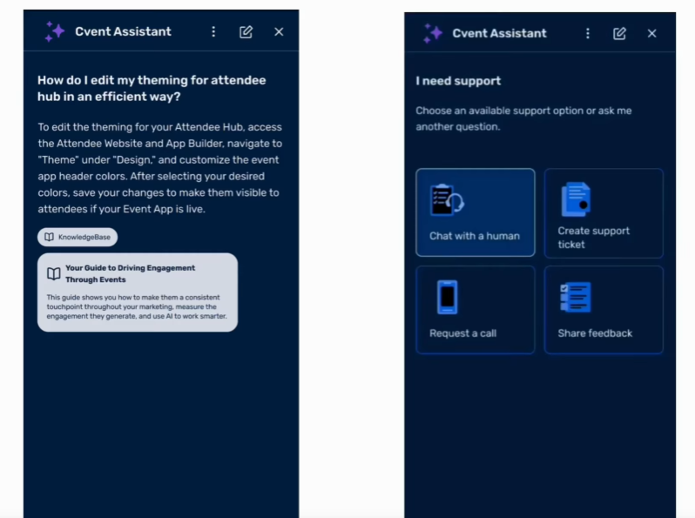
Introducing Cvent Assistant Knowledge & Support Capability
Registration
The Cvent Assistant Knowledge and Support Capability helps you get answers faster by bringing support directly into the product. Instead of leaving your workflow to find answers, you can ask questions where they arise, in natural language, get answers with cited sources from the Cvent Community, and move to the right support path when you need more help.
Read more about the update here
Open Beta note: This feature is currently in beta. You may experience some issues or incomplete functionality. We welcome you to send us feedback at betafeedback@cvent.com

Slide 14
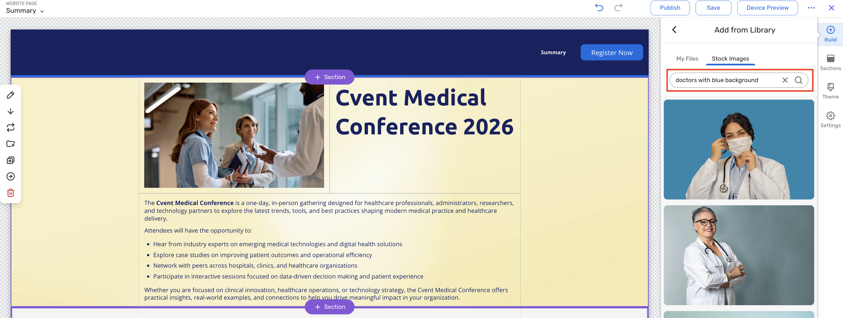
Enhanced Stock Image Library
Registration
The Cvent Stock Image Library, powered by Getty, provides a curated collection of licensed stock images directly in the Cvent website editor, enabling you to discover, preview, and apply high‑quality visuals without leaving the platform.
What’s New:
Find the perfect visual just by describing it
Choose great images without leaving your build flow
See it first, then drop it in with one click
Editing with existing tools
Read more about the update here

Slide 15
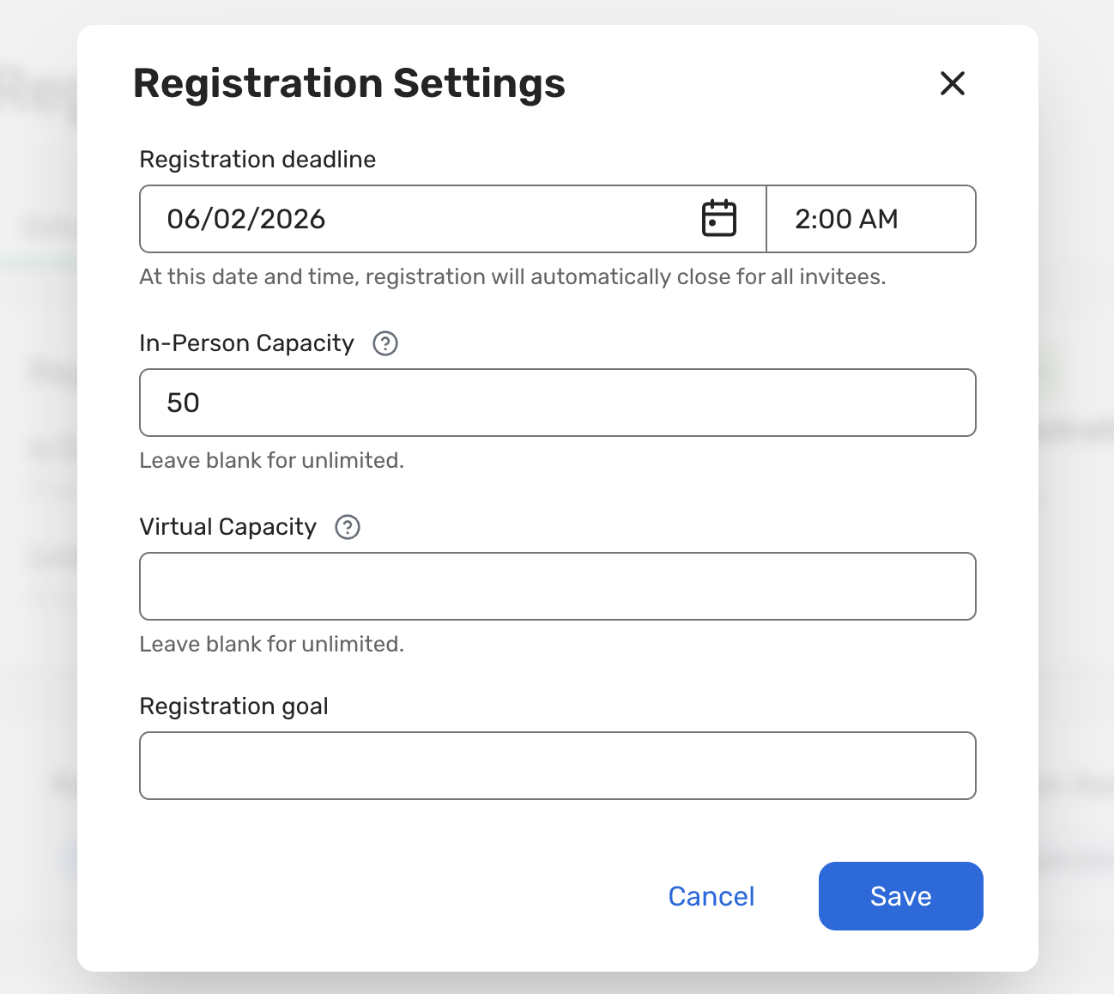
Registration Settings on Registration Overview Page
Registration
This update has simplified Registration Settings setup by moving controls and advanced options into the Registration Overview page, reducing navigation and making it easier to keep registration aligned with event goals.
What's new?
Registration Settings in one place: Manage the registration deadline, capacity (including in-person and virtual for hybrid), and attendee goal from a settings modal on the Registration Overview page
Registration Settings page removed: The old Registration → Registration Settings page is retired, and you can directly manage settings from Registration Overview
Read more about the update here

Slide 16
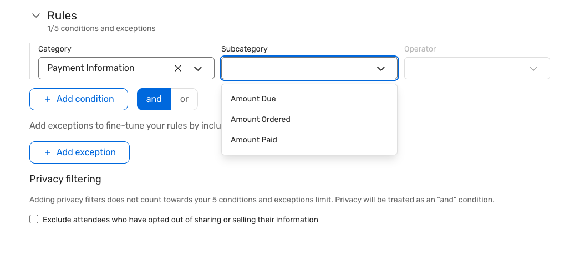
Audience Segments - Segment by Attendee Pricing Fields
Registration
We're excited to announce that you can now build rule-based audience segments using Payment Information fields.
With Payment Information added as a rule category, you can instantly target attendees based on Amount Ordered, Amount Paid and Amount Due - making it easy to identify who's paid in full, who's partially paid, and who still has an outstanding balance.
Read more about the update here

Slide 17
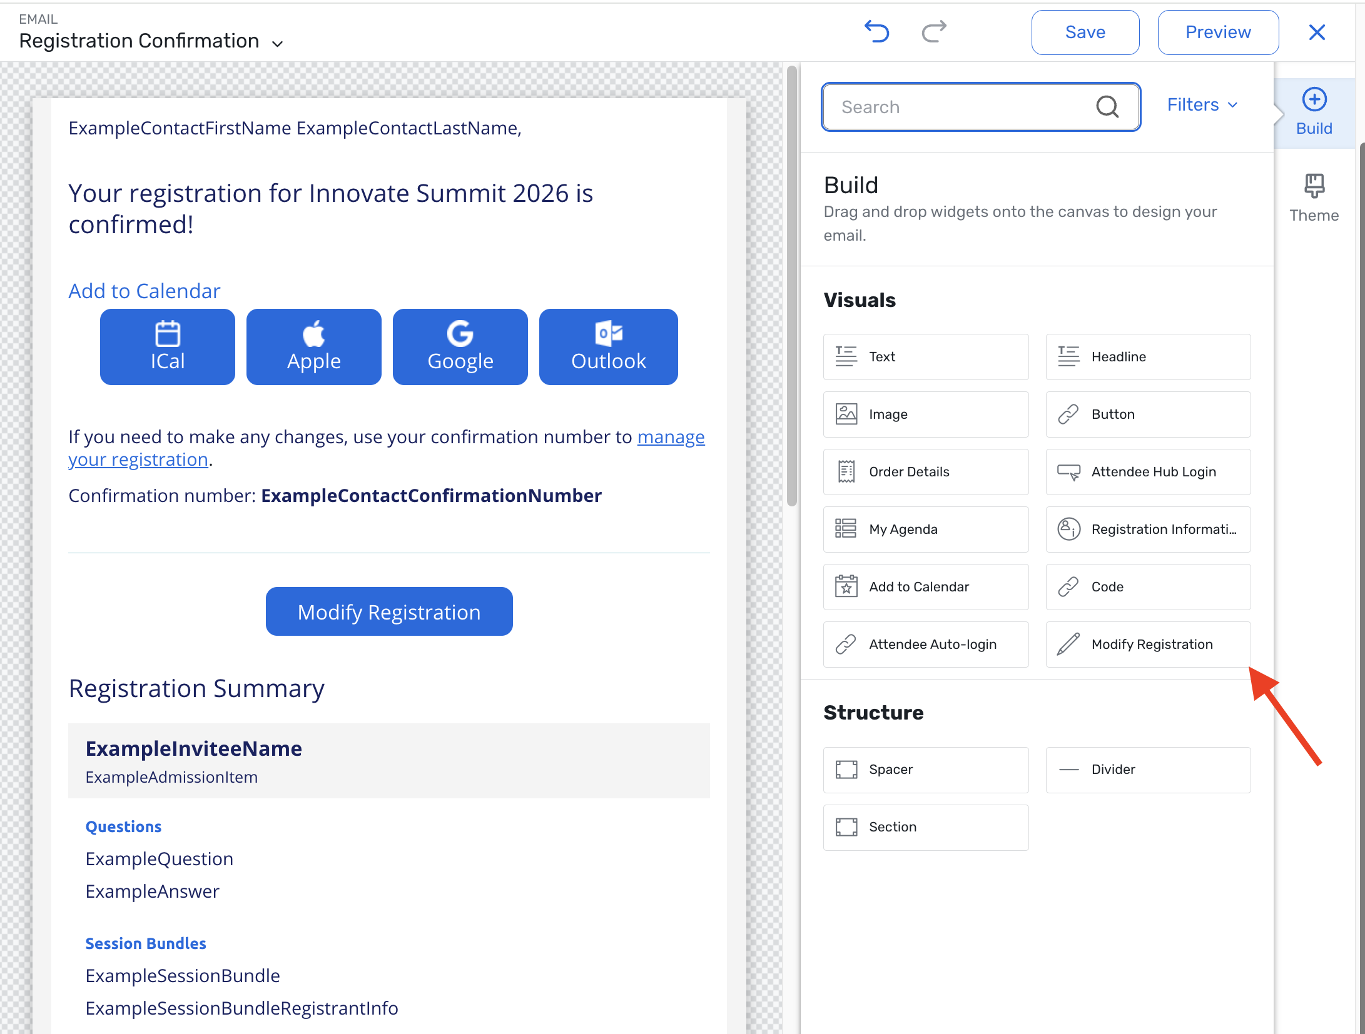
Modify Registration Shortcuts in Emails
Registration
You can now add modification shortcuts directly into post-registration emails, routing attendees straight to the specific widget they need to update — no re-entering the full registration flow required. This builds on the existing Modify Registration shortcuts available on post-registration pages and extends them to email communications so you can proactively prompt attendees to take action right from their inboxes.
Configure the widget with:
Display text — customize the button label
Button destination — choose a specific
widget to route attendees to:
  Sessions, Admission Items, Quantity Items
  Donation Items, Hotel Requests
  Air Actual, Group Flight, Flight Requests
Read more about the update here

Slide 18
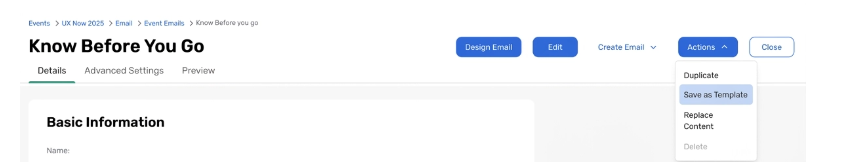
Reusable Email Asset Library
Registration
With this release, you can:
Save any event email into Admin → Email Assets
Create new emails in an event using a saved Email Asset
Replace content from an Email Asset (or another event email) into an existing email while keeping event-specific settings like audience and schedule intact
Email Assets are stored at the account level, making them reusable across all events in your account.
Read more about the update here

Slide 19
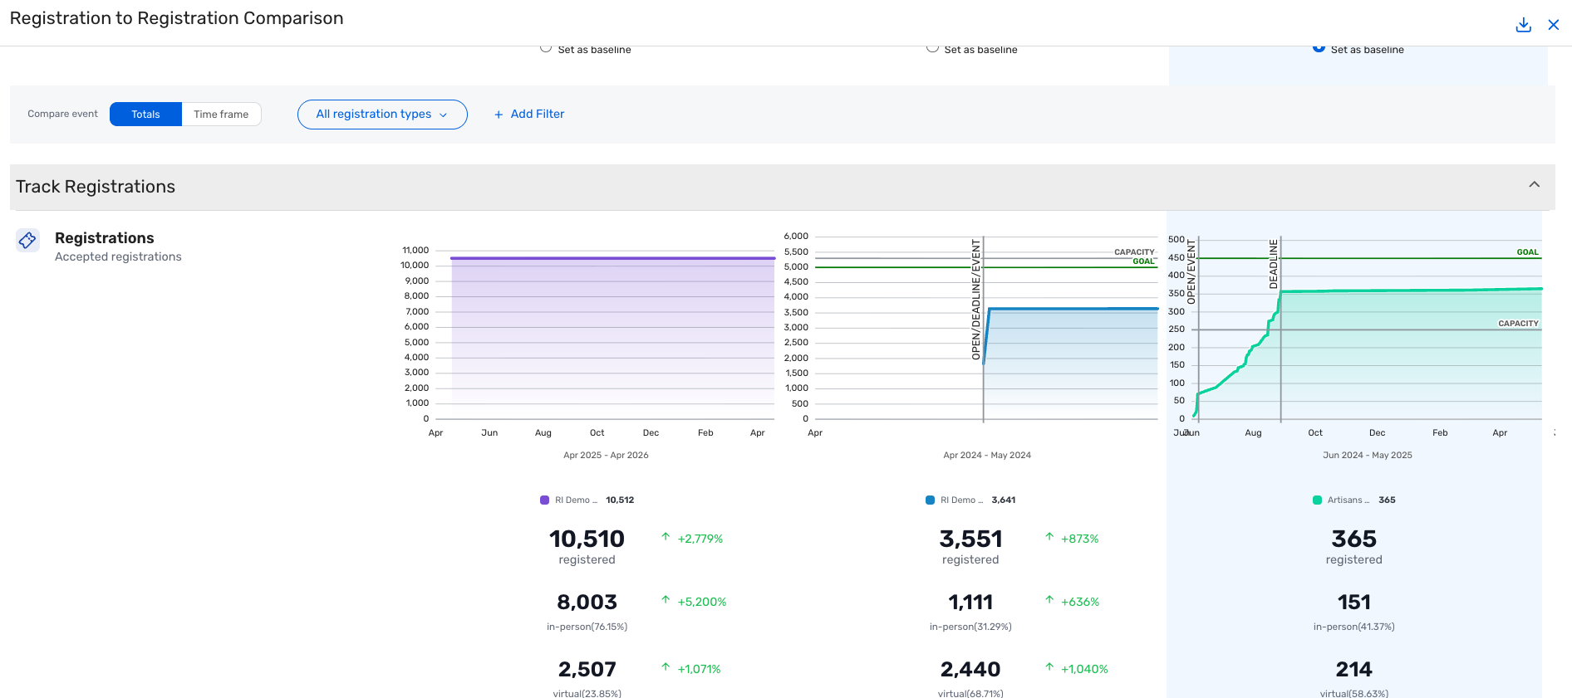
Registration Insights: Compare Registration Over Time
Registration
We are expanding the Registration Comparison feature to support time-relative event comparisons, giving you a more meaningful way to benchmark registration performance across events.
With this release, you can now compare where registration stood at the same relative point in time across multiple events, rather than only by calendar date.
Read more about the update here

Slide 20
Attendee Engagement
Products covered:
Attendee Hub
Event App
Events+
Appointments
OnArrival
LeadCapture
Webinar

Slide 21
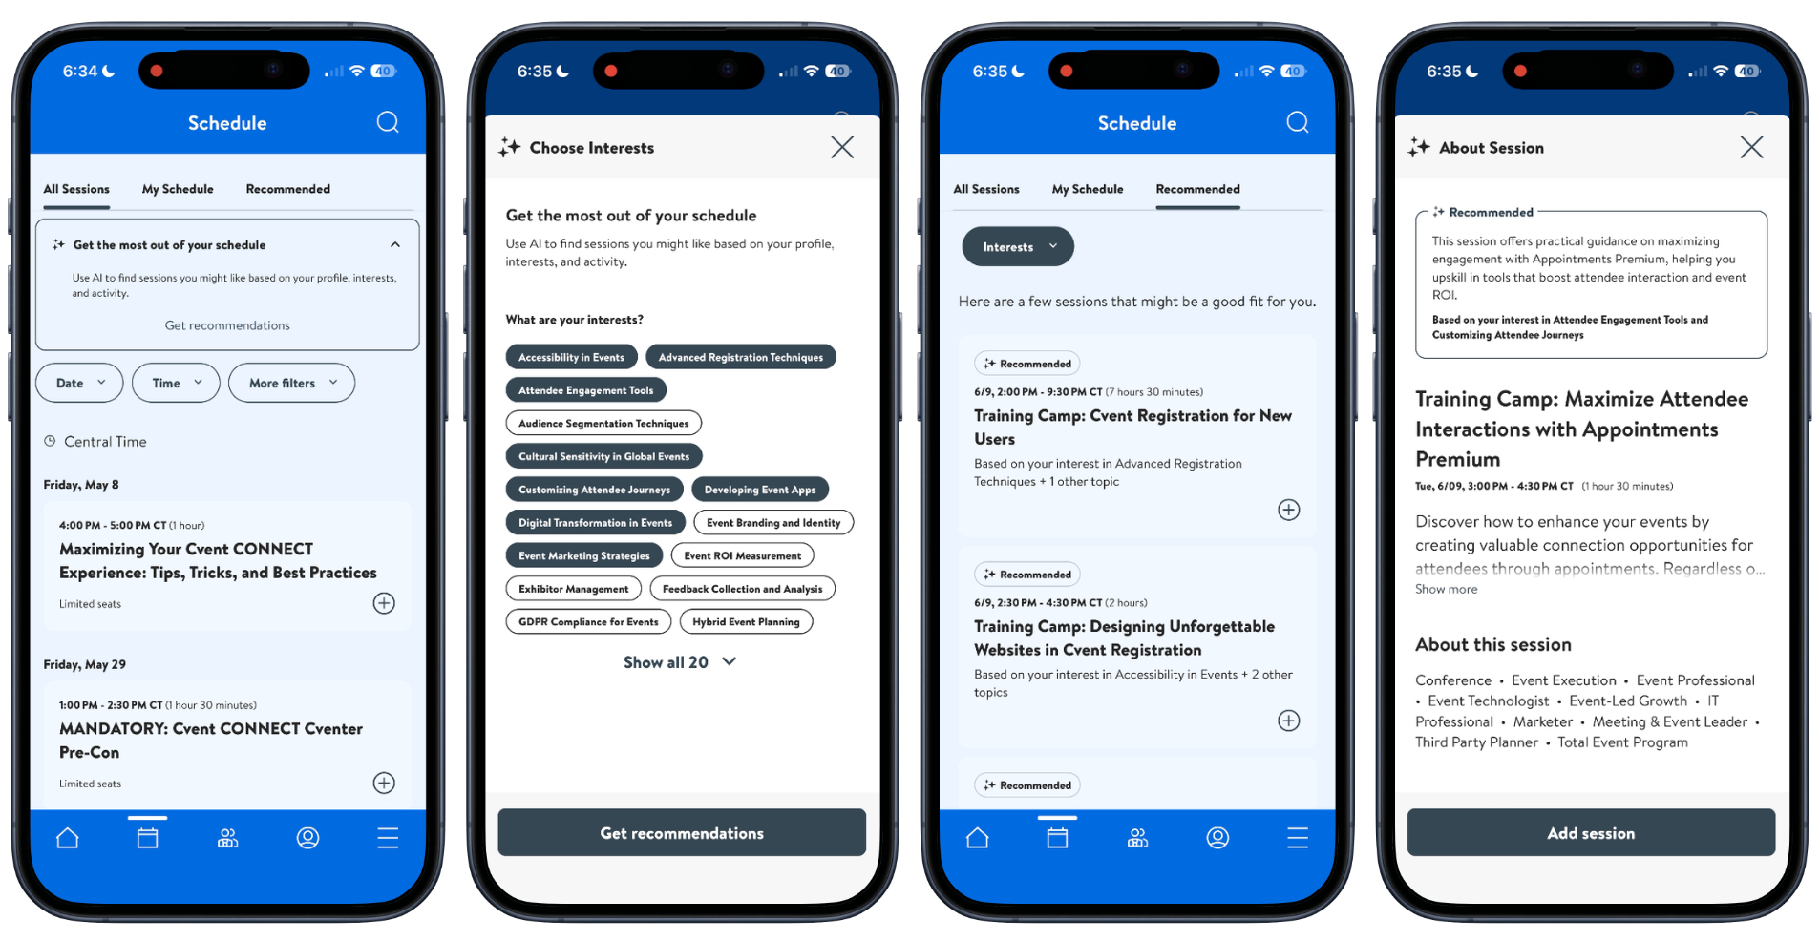
Agenda Builder (AI-Powered Session Recommendations)
Attendee hub
What's Changed: Agenda Builder will start offering AI-powered, personalized session recommendations that help each attendee quickly build and refine a high‑value agenda, based on what they say they’re interested in and what they actually engage with during your event.
Read more about the update here
The Attendee Hub Event App is updated twice a month to include our newest features! Click to check the Event App Version History

Slide 22
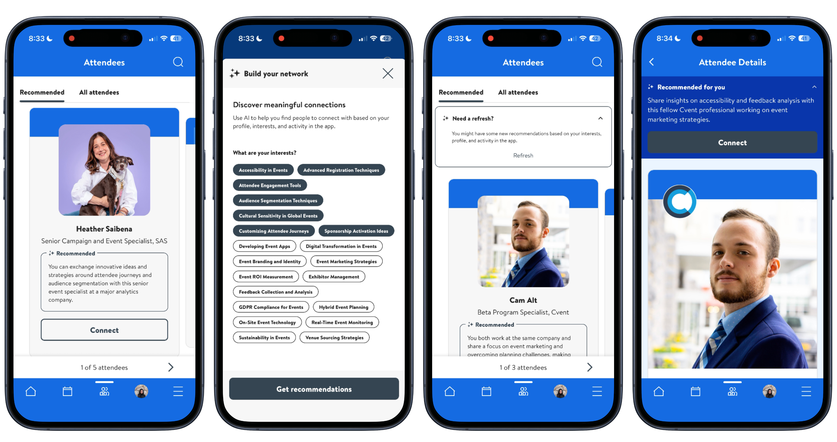
Network Builder (AI-Powered Attendee Recommendations)
Attendee hub
What's Changed: Network Builder introduces a new Recommended tab on the Attendees page that surfaces up to 20 suggested people each attendee may want to meet, based on their interests, profile, and real in‑event activity.
Read more about the update here
The Attendee Hub Event App is updated twice a month to include our newest features! Click to check the Event App Version History

Slide 23
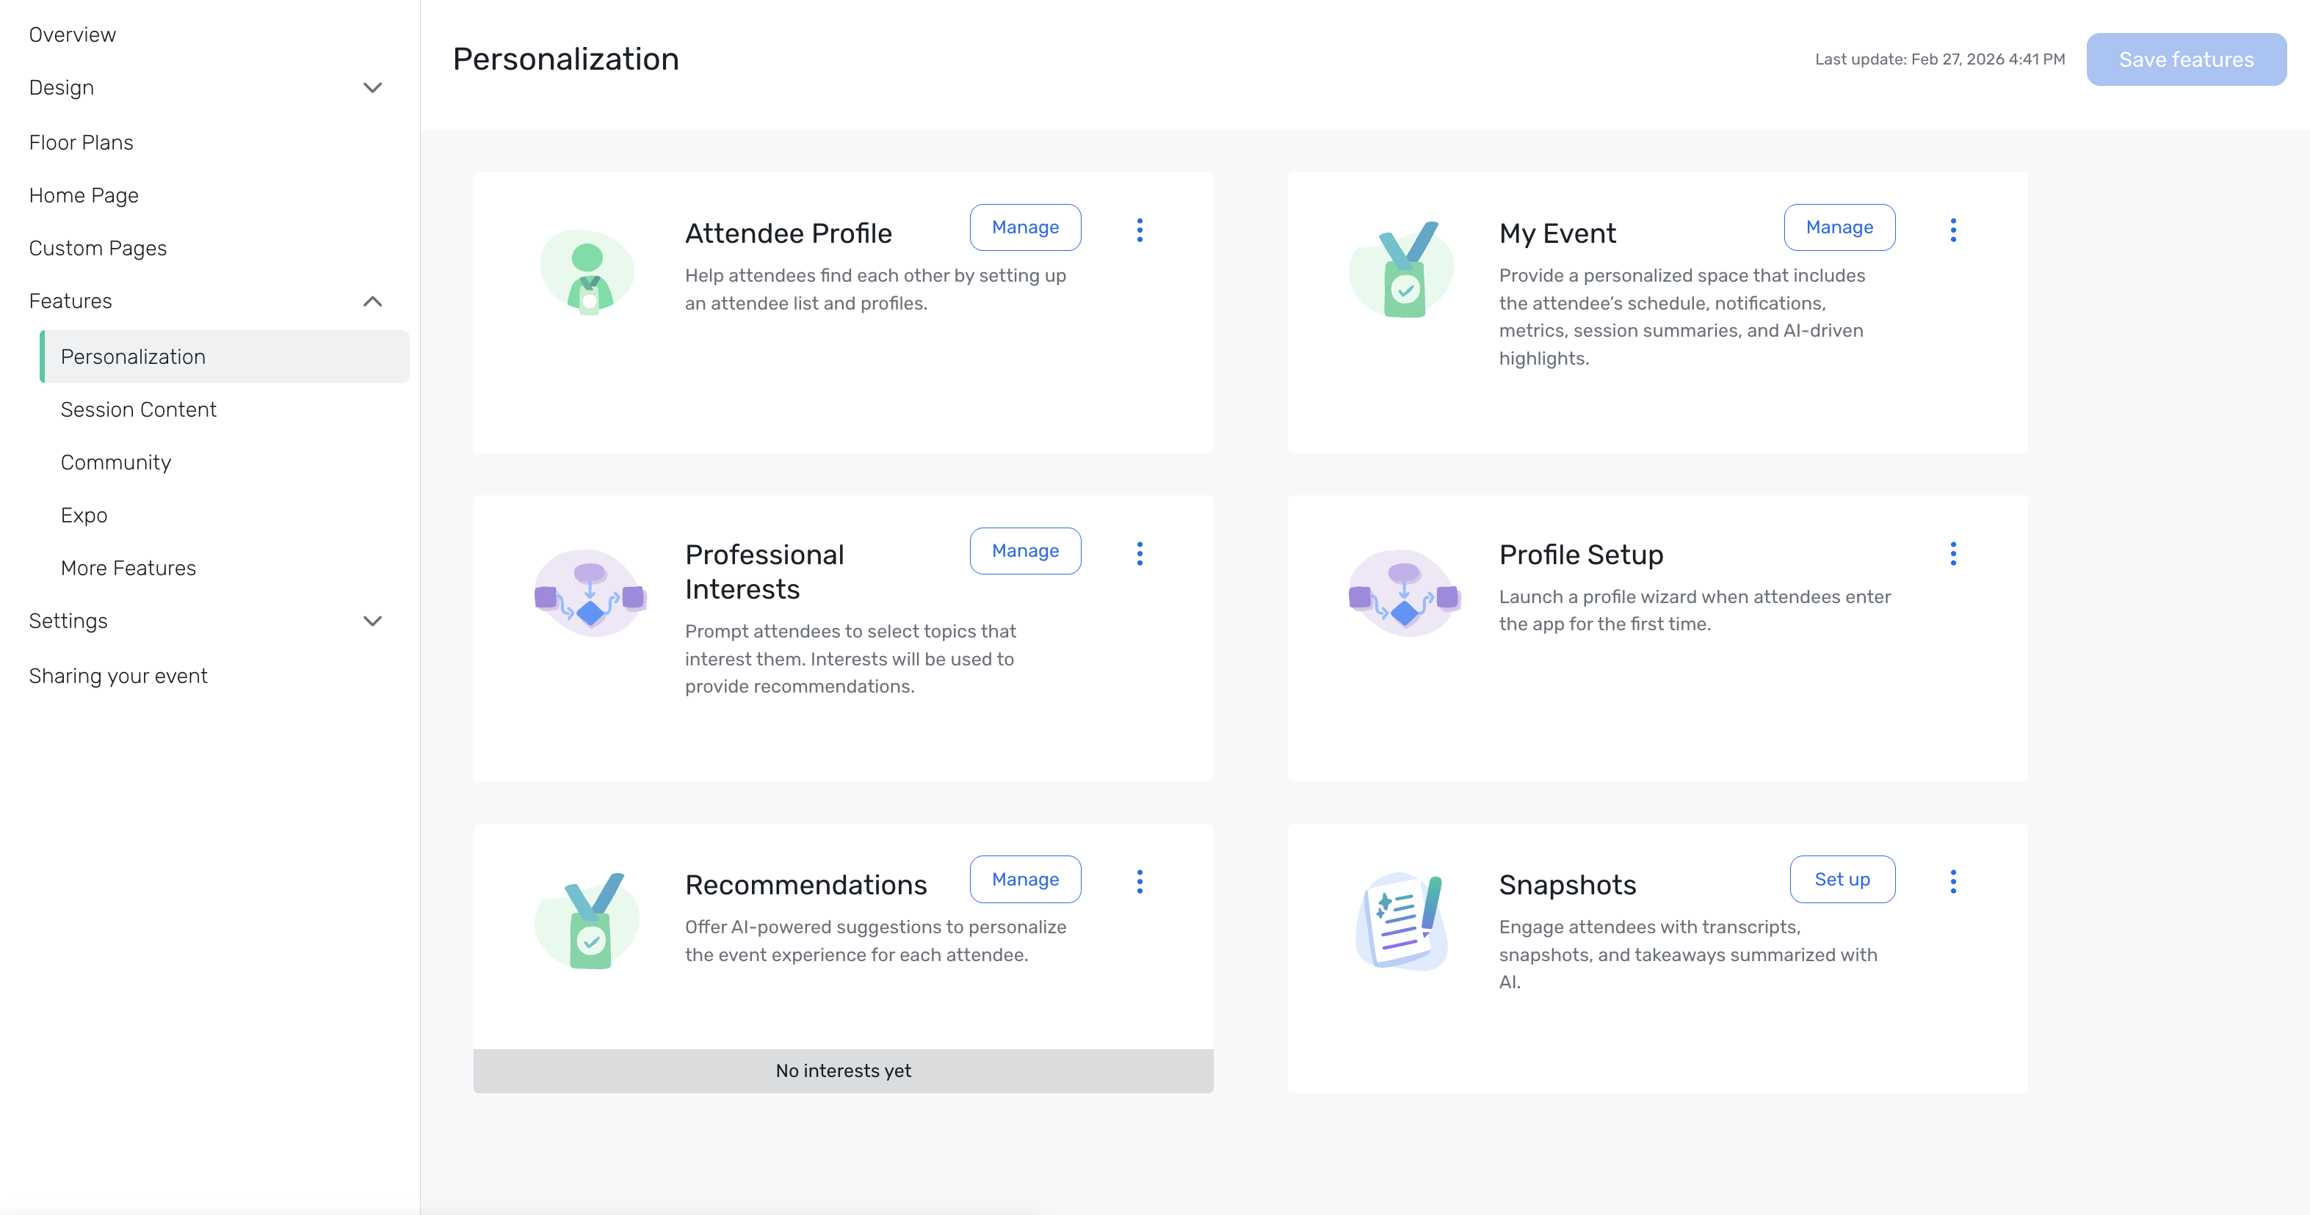
Attendee Hub Builder: Personalization Features
Attendee hub
What's Changed: Within Attendee Hub Builder, there will be a new Personalization section that brings together key tools like Attendee Profile, My Event, Professional Interests, Profile Setup, Agenda Builder, Network Builder, and Session Snapshots & Takeaways in one place.
Read more about the update here
The Attendee Hub Event App is updated twice a month to include our newest features! Click to check the Event App Version History

Slide 24
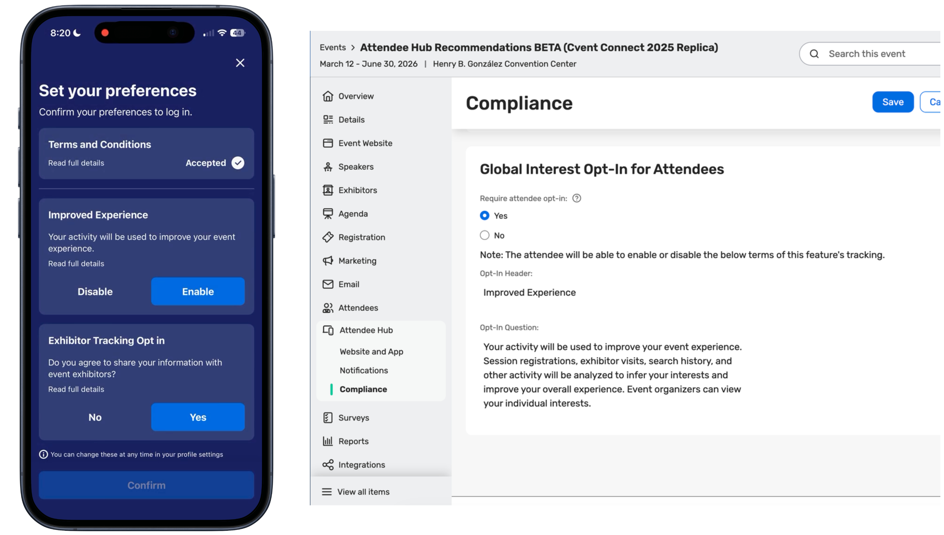
Discovered Interests & Tracking Consent in Event App
Attendee hub
What's Changed: The Event App will begin using Discovered Interests—AI‑inferred topics based on what attendees actually browse, watch, and interact with—to power richer recommendations alongside the interests they explicitly select.
Read more about the update here
The Attendee Hub Event App is updated twice a month to include our newest features! Click to check the Event App Version History

Slide 25
Exchange Solutions
Products covered:
Cvent Supplier Network
Event Diagramming
Passkey
Cvent Travel
Instant Book
Vendor Marketplace

Slide 26
Total Guest Room Pricing Updates
Cvent supplier network
What's Changed:
We’ve updated total guest room pricing in CSN, so required resort and housekeeping fees are captured and rolled into the totals you see when evaluating proposals. This helps remove hidden costs and makes it easier to understand the true price of each option before you award.
For new guest room RFPs created after May 6, 2026, CSN will now:
Require resort and housekeeping fees on supplier proposals whenever guest rooms are requested.
Automatically include room rate, resort fees, housekeeping fees, and applicable service charges in the total guest room cost.
Calculate fees based on total room nights to reflect the full stay, ot just a single night.
Show clear minimum and maximum total guest room costs when multiple date options are included, in both proposal views and bid comparison reports.
Benefit: This update gives you clearer, all‑in guest room pricing with fewer surprises, so it’s easier to compare options across hotels and dates and stay aligned with evolving fee transparency rules. With totals calculated for you, you can quickly see the real cost of each option and make faster, more confident sourcing decisions.
Read more about the update here

Slide 27
Fine-Tune RFP Showcase Preferences
Cvent supplier network
What's Changed:
We’ve added new Additional Preferences in RFP Showcase so you can fine-tune your venue requirements before you post an RFP. This gives you more control over which venues see your request and helps reduce declines caused by location or property mismatches.
When you add an RFP to Showcase, you’ll still see the Edit Preferences option. From there, you can now:
Set the distance from the city center for each preferred city so properties align with your attendees’ accessibility needs.
Set a distance from the airport to keep options convenient for groups arriving by air.
Use miles or kilometers for both distance filters, giving you precise control across all preferred cities.
Automatically include preferred venues and brands you’ve already identified for your account, so those partners are prioritized in matching.
These preference controls work alongside your existing RFP details to ensure only the most relevant venues see your request.
Read more about the update here

Slide 28
Save and Revisit Favourite Venues in Cvent Supplier Network Search
Cvent supplier network
What's Changed:
Finding the right venue often means comparing multiple options. Until now, when you used Cvent Supplier Network search, you had to rely on browser bookmarks, spreadsheets, or memory to keep track of preferred venues during your search. While supplier tags were available, they were visible to other planners within the same account and were not designed for personal use.
Benefits:
Save top venue choices for easy access later without relying on browser bookmarks, spreadsheets, or memory.
Quickly narrow results to preferred options by filtering to only your favourited venues in a selected location.
Refine searches more efficiently by combining favourite venues with other available filters, such as 3D or Instant Book.
Read more about the update here

Slide 29
No new releases in this window under following product bundles:
Trade Show Solutions (Jifflenow and iCapture)
Spend and Workflow (Budget Management, Meeting Request Form, and Access Portal)
Actionable Insights (Surveys, Reporting, Integrations, Engagement Scoring, and App Marketplace)
Thank You!

