Slide 1
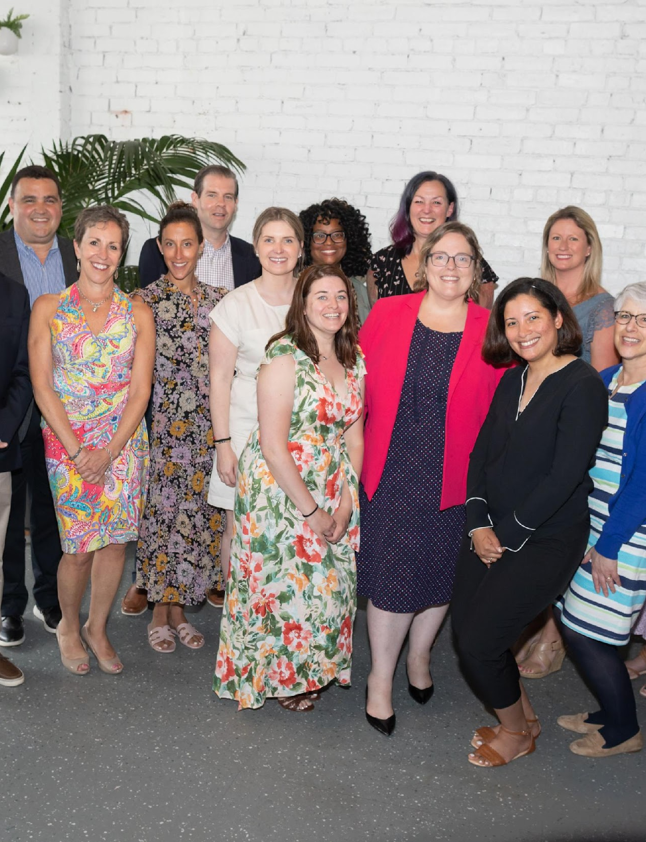
2023 - 2024
Sponsorship Prospectus

Slide 2
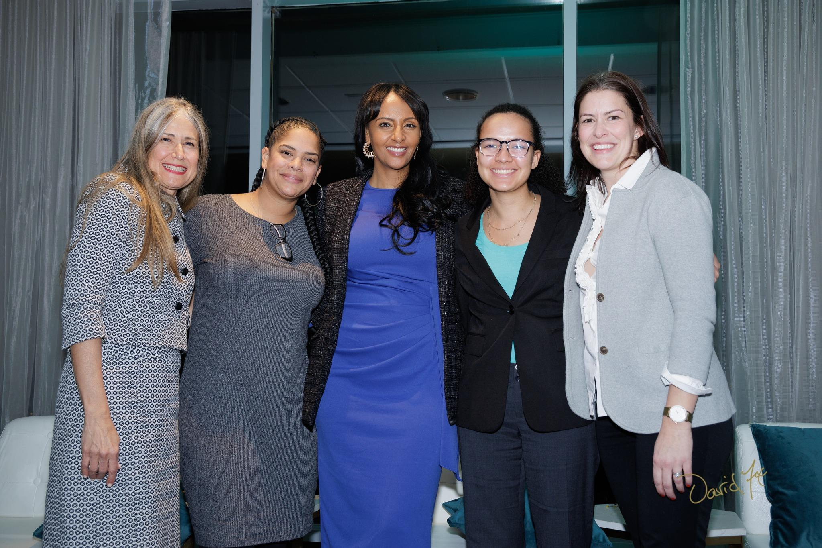
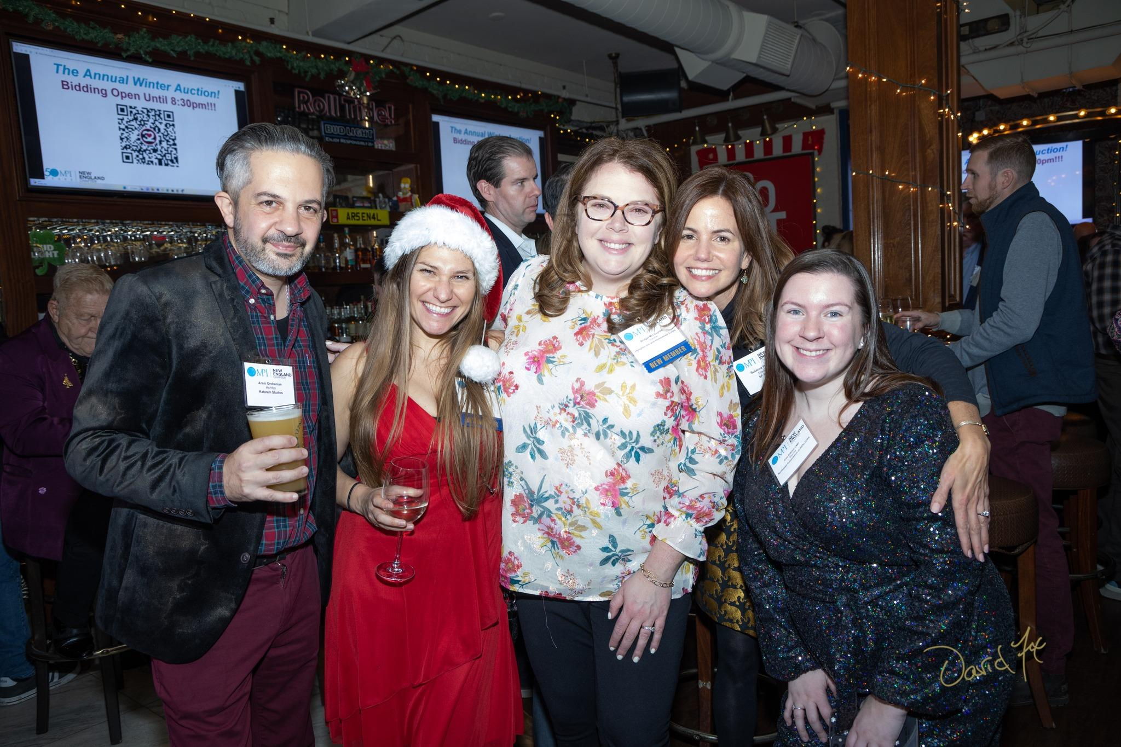
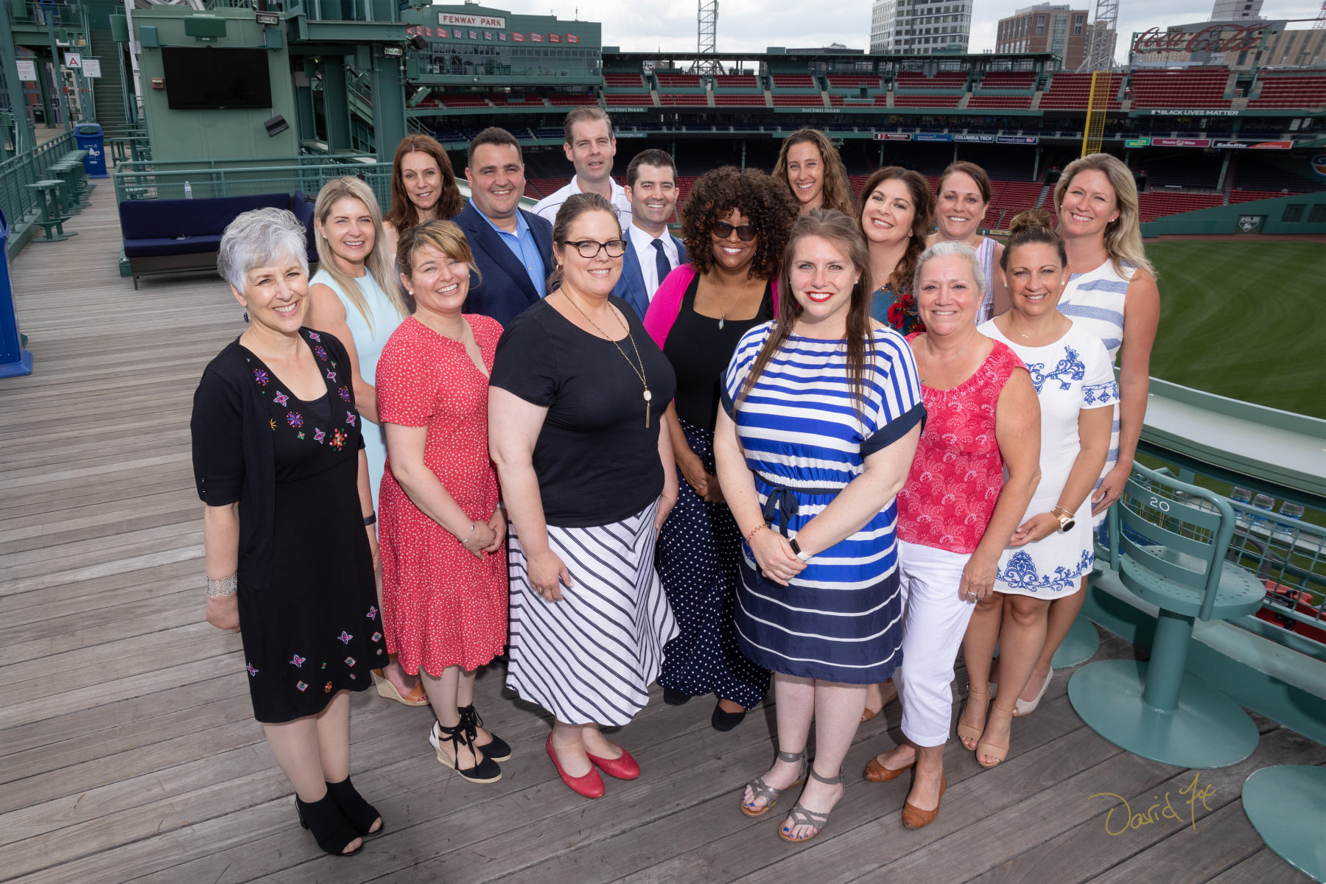

Slide 3
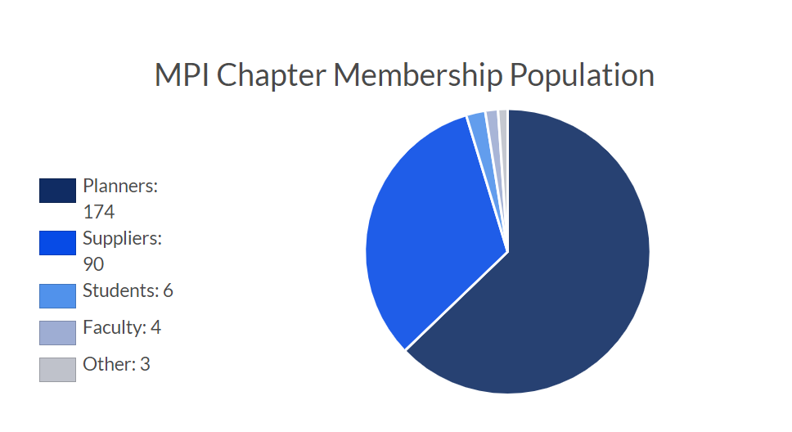
ABOUT MPI NEW ENGLAND
Established in 1979, MPI New England has been awarded a “Top Performing Chapter” designation by MPI Global since 2019. As one of the largest chapters internationally, MPI New England brings approximately 290+ planner and supplier members to the MPI global community with a combined buying power of over $265M.
When you partner with MPI New England, you become part of an organization dedicated to the personal and career success of Meeting and Events Professional across New England. You and you brand will connect with passionate people with big ideas that will empower you to become an agent of change.

Slide 4
EVENTS CALENDAR
MONTH | EVENT TYPE
February | Educational Institute
July | Networking & Education Event
September, November | Education Events
March, May, October | Networking Events
April | Global Meeting Industry Day Event
June | Board Induction & Awards
December | Holiday Party
We recognize that budget and marketing objectives vary, and we are happy to work with you on customizing a sponsorship package.

Slide 5
Platinum Sponsorship
Four (4) complimentary registrations at (4) MPINE events
Logo recognition - chapter website, program announcements, e-newsletter, walk-in slides, signage
One (1) table to display materials at each MPINE event (excluding Global Meetings Industry Day and Educational Institute)
A five (5) minute video at two (2) MPINE events (excluding Global Meetings Industry Day and Educational Institute)
One (1) Blog Post Feature in the quarterly newsletter (content generated through sponsor)
One (1) social media “takeover”
Two (2) dedicated emails to the chapter membership
$7,500
*Offer is valid for 1 Year from contract sign date

Slide 6
Gold Sponsorship
Three (3) complimentary registrations at (3) MPINE events
Logo recognition - chapter website, program announcements, e-newsletter, walk-in slides, signage
One (1) table to display materials at two (2) MPINE events (excluding Global Meetings Industry Day and Educational Institute)
A three (3) minute video at one (1) MPINE event (excluding Global Meetings Industry Day and Educational Institute)
One (1) featured article in the e-newsletter
One (1) social media “takeover”
One (1) dedicated email to the chapter membership
$5,000
*Offer is valid for 1 Year from contract sign date

Slide 7
Silver Sponsorship
Two (2) complimentary registrations at two (2) MPINE events (excluding Global Meetings Industry Day)
Logo recognition - chapter website, program announcements, e-newsletter, walk-in slides, signage
One (1) table to display materials at one (1) MPINE event (excluding Global Meetings Industry Day)
A three (3) minute video at one (1) MPINE event (excluding Global Meetings Industry Day and Educational Institute)
$3,500
*Offer is valid for 1 Year from contract sign date

Slide 8
Bronze Sponsorship
One (1) complimentary registrations at two (2) MPINE events (excluding Global Meetings Industry Day)
Logo recognition - chapter website, program announcements, e-newsletter, walk-in slides, signage
One (1) table to display materials at one (1) MPINE event (excluding Global Meetings Industry Day)
$2,500
*Offer is valid for 1 Year from contract sign date

Slide 9
Monthly Speaker Partner
One (1) complimentary registrations at associated MPINE event
Logo recognition - event reg website, program announcements, walk-in slides
One (1) table to display materials at associated MPINE event
$1,500
*Offer is valid for 1 Year from contract sign date

Slide 10
ADDITIONAL OPPORTUNITIES:
Dedicated Email Blast - $1,000
Full Social Media Take Over (3-5 Sponsored promotions over the course of 3-5 days) - $1,200
Social Media Take Over (1 post, 3 platforms) - $600
Social Media Take Over (1 post, 1 platform) - $250
Home page Advert Box - $650

Slide 11
TESTIMONIALS
“Thank you for the superb service you provided with my MPI New England Sponsorship. You were always there, even for the stupid questions, and you provided a level of comfort rarely demonstrated in sponsorship sales. Additionally, I secured several sponsorships in the northeast market as part of my duties for Visit Salt Lake, and you’ve provided a benchmark for others to reach. Thank you for your steadfast guidance and kindness. We were thrilled with the sponsorship and the way it was presented.
Additionally, I felt that you were always looking out to ensure MPI provided us the BEST value for our sponsorship. ROI is hard to measure in marketing efforts like these, but the value of a good impression is priceless! You are a true pro! Thanks also to the event partners Studio AVFX who were terrific to work with.”
Karen Staples, CMP, CASE (Visit Salt Lake)
“Even though I have been an MPINE-involved member for five years, being a sponsor increased my exposure to potential planners. Moreover, supporting the education efforts aligned with our company’s goals. The Board made sure to customize the sponsorship package to my needs and was always flexible to changes. The best part was the touchpoints from the Board, making sure my goals were being met along the process. Thank you, MPI New England, for your partnership! “
Yolanda Gonzalez, DMCP (Discover Puerto Rico)

Slide 12
PREVIOUS PARTNERS

Slide 13
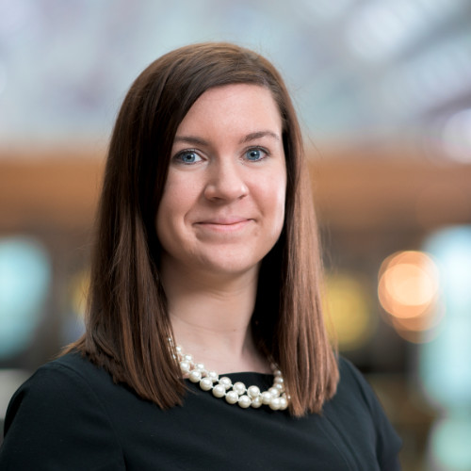
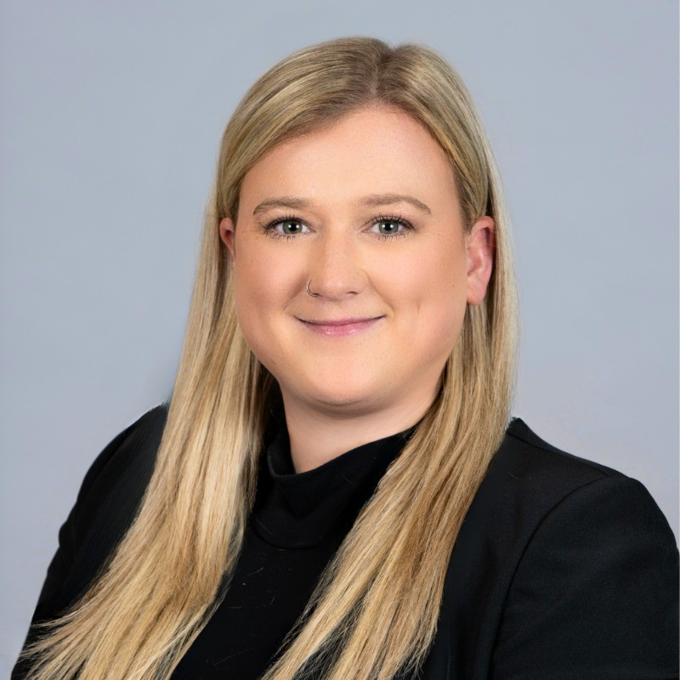
Meet Our Partnership Team
Building and supporting meaningful partnerships!
Johnice Veals
VP of Finance & Administration
Erin O’Brien
Director of In-Kind Sponsorship
Jackie Tattersall
Director of Chapter Advancement
We recognize that budget and marketing objectives vary, and we are happy to work with you on customizing a sponsorship package.

Slide 14
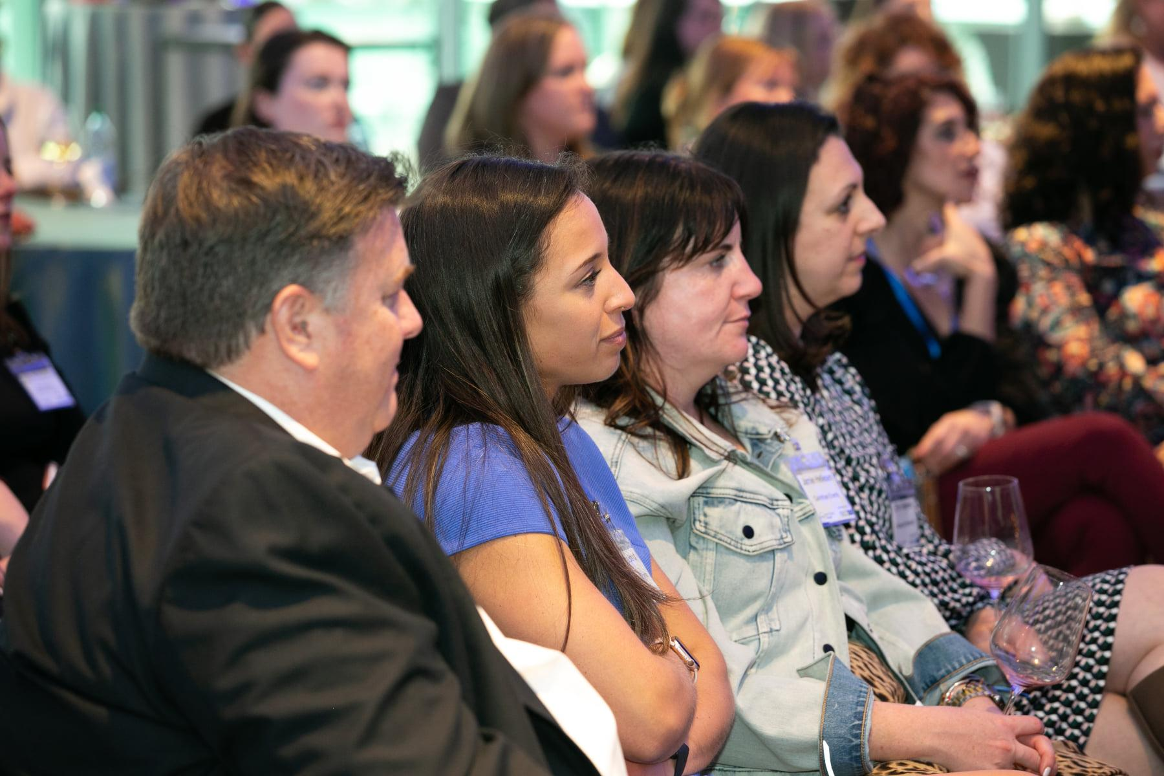
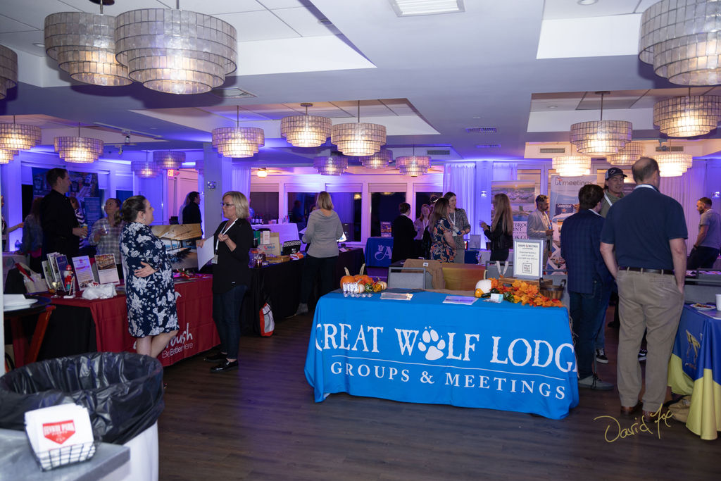
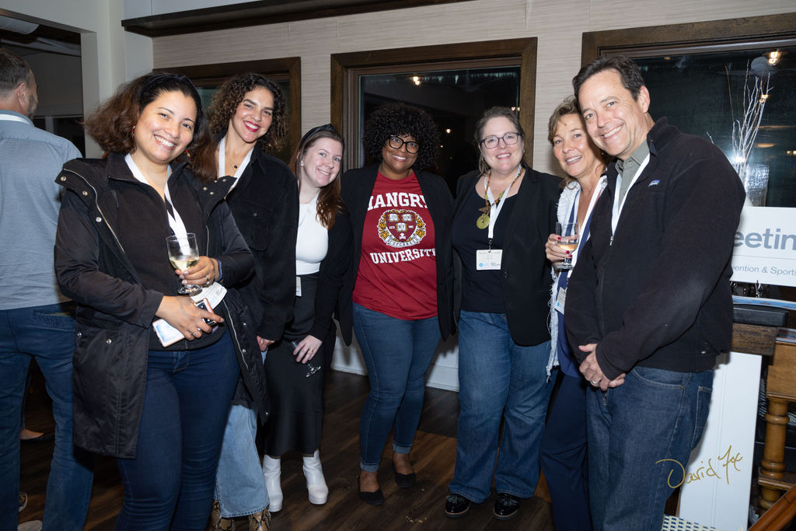
Have Questions?
Director of Chapter Advancement
finance@mpine.org

